Slide 1
Monday 3rd September - morning
08:35 Intervention on PLC for vacuum in PM76 is finished
sector 78 tripped cause by a vacuum reading on the QRL
PLC - has been exchanged
09:10 3 persons enter in PM85/UJ83 for an urgent cryogenic intervention (with RP)
Leak in seal of DFBXG.L8
10:15 access in PM15 for inner triplet R1 finished.
10:25 access in US25 for cryogenics check
10:40 access in point 8 for cryogenics finished
11:10 Start pre-cycle

Slide 2
Monday 3rd September - afternoon
MCOX and skew sextupole tests in shadow of 18 kV cable tests in SPS
Global PMA, Powering, IQC and XPOC analysis servers and GUIs redeployed by Roman.
12:25 Injecting probes for MCOX tests
14:30 skew sextupoles polarity checks
17:30 Filling for physics
18:30 Injecting physics beam
20:30 Stable beams fill 3025
Initial luminosity 6.2e33 cm-2s-1
Average bunch current going into collisions: 1.56e11 ppb
B1 Vertical instability during collision BP..
Tweaked Q’, octupoles

Slide 3
4th September – early morning
06:08 lost 3205 to lost the sector 23 due to the trip of RQD/F.
MPE piquet called, reason of the trip not clear but green light to restart
133 pb-1 in 9 hours 40 minutes
07:35 The switches of the RQF and RQD of sector 23 have cooled down and we go for the precycle

Slide 4
Triplet octupoles
The RCOX at full current generate a tune spread equivalent to 500A in the MO at beta*=60 cm, but of course 4 times less at 1.2 m, etc.
successfully tested the RCOX3 in point 1 and 5 (RCOX3.L1/R1/L5/R5). They are therefore released for powering during the day or in the following days. (Mirko)
Polarity checks
power the RCOX and try to look for tune shifts.
Trimming on the k of the RCOX.
Stephane Fartoukh, Rogelio Tomas et al

Slide 5
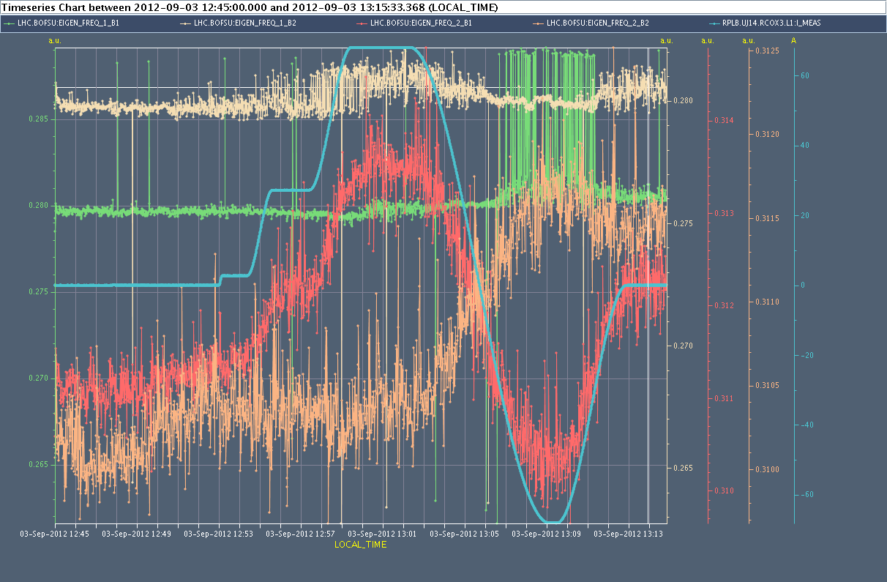
MCOX tests

Slide 6
Skew sextupoles
OMC measurements summary: KSS polarity We performed ac-dipole measurements of the coupling with individual Beam2 RSS families powered to k=+0.5, for RF trims of +-80Hz. We took data for REFERENCE, A23, A34, A45, A56, A67. Coupling shifts with the dp/p were seen clearly well outside of the error bar.
Determination of the polarities will be performed offline.

Slide 7
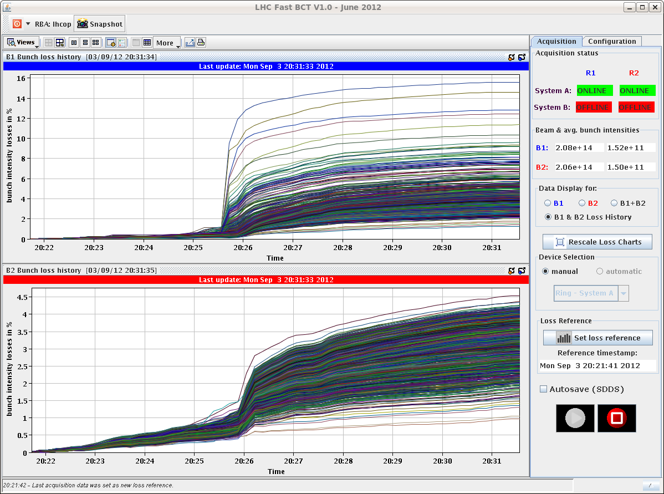
Losses going into collision 3205
CMS off a bit again – lumi scan knobs incorporated

Slide 8
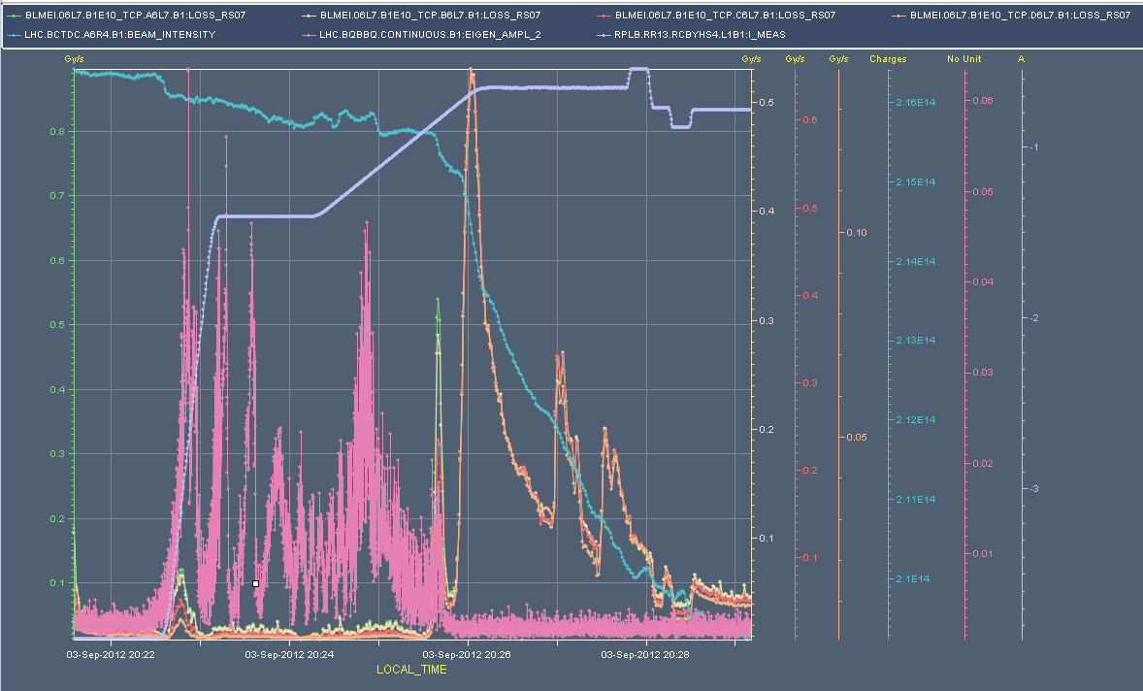
3205 – instability VB1

Slide 9
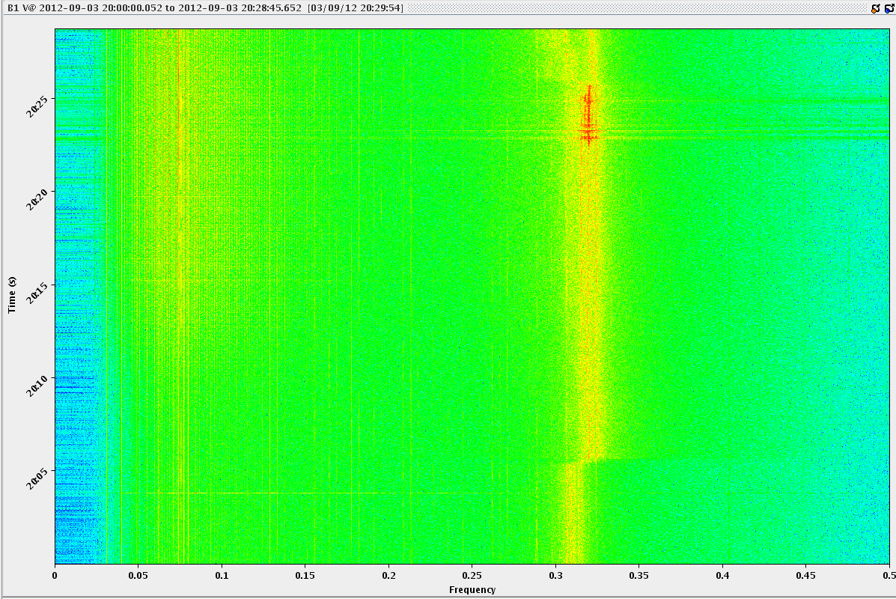
3205 – instability VB1

Slide 10
MISC
QRL gauge problem – sector 76
Fixing the gauge problem would require an access in UJ76. The Cryo team decided to continue since the probability that the back-up gauge also breaks is very little and there is anyway no safety concern for the machine.
Updated the temperature limits for MKIs according to instructions from M. Barnes (JW)
OFC bug found – deploy fix next TS (Ralph Steinhagen)

