Slide 1
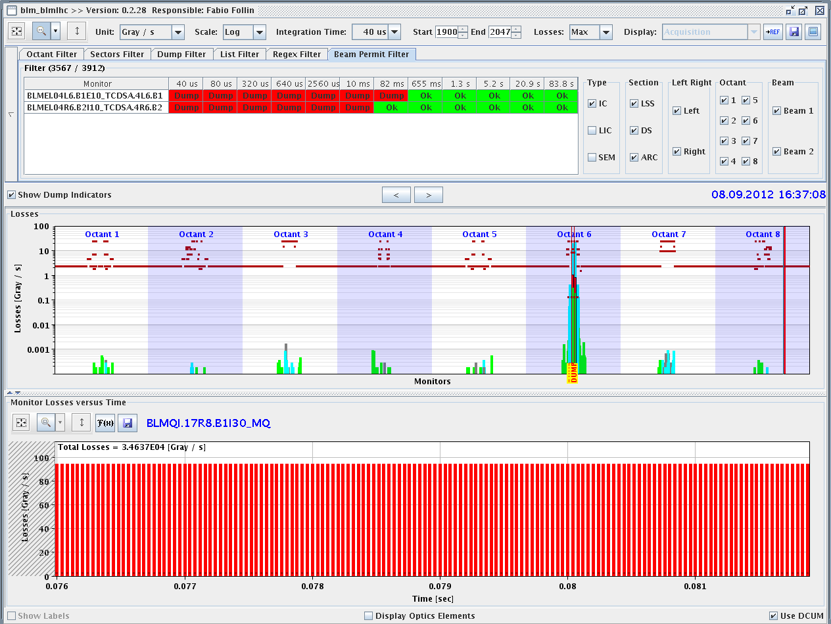
LHC Status Sun Morning 9-Sep
Bernhard Holzer, Mike Lamont
Sat Morning
since 5:00h repair /exchange of water cooling motor
13:20h precycle the machine
nb: * BLM sanity check had to be repeated 7 times before passing,
* installed monitoring electronics on Line 2LB1
15:37h injection physics beam
16:37h injection beam 1 done, inj. collimators out
& beam dump
PC Interlock triggered dump at injection,
reason unclear

Slide 2
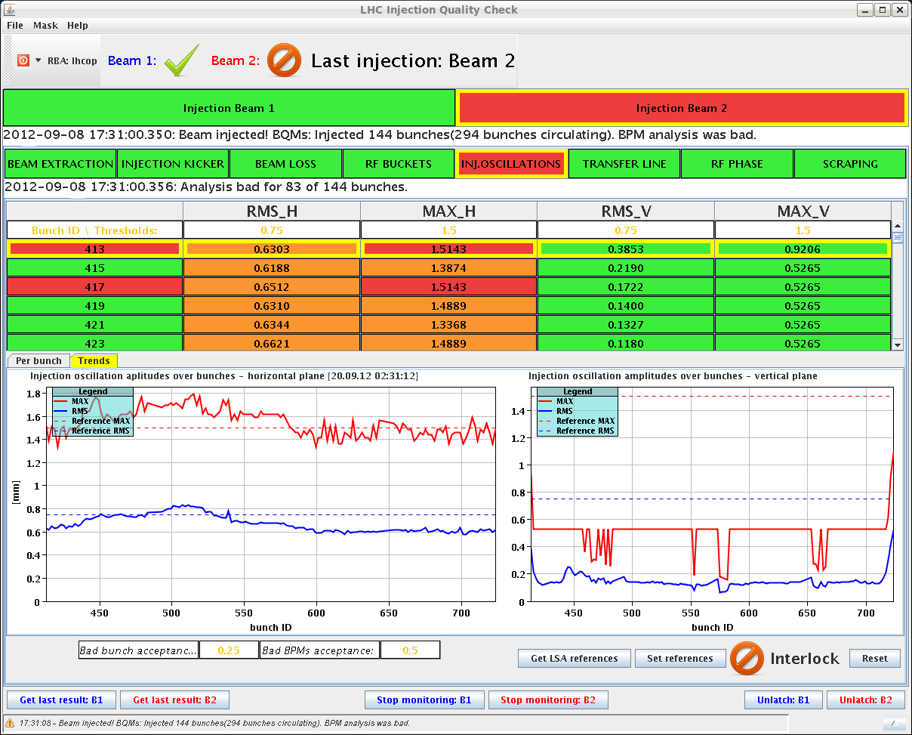
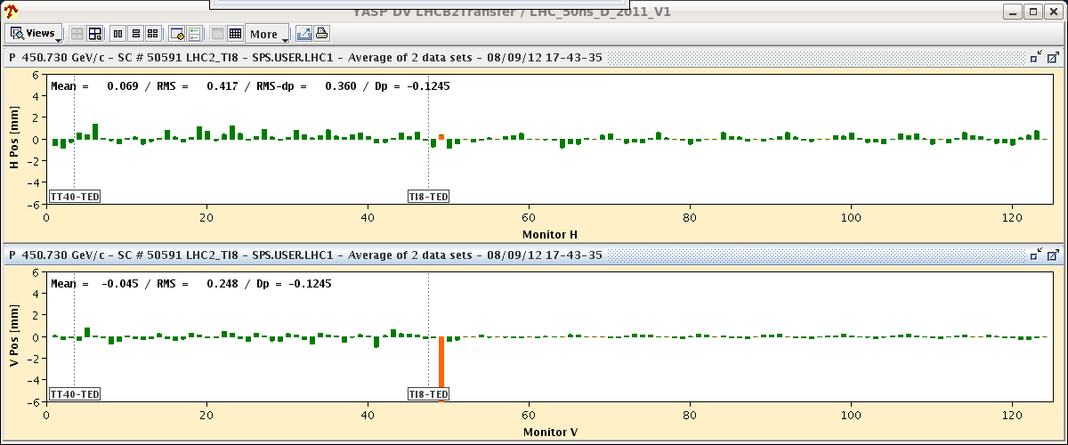
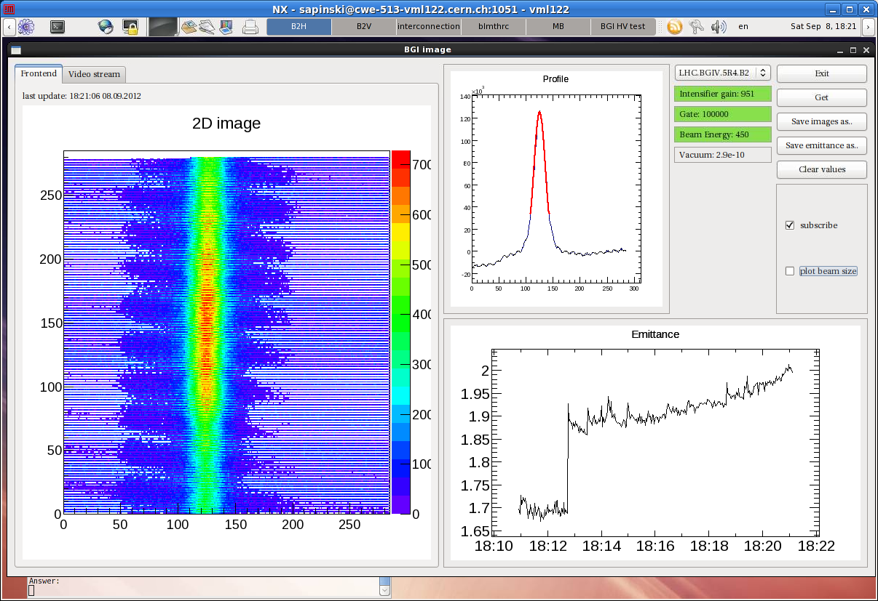
Sat Late
17:17h new injection
delayed by TI8 injection oscillations
and delayed again by
“IQC latches for TI2 missing injection oscillation data on 72 b trains.”
18:19h injection finished
bgi emittance measurement !!
... to be calibrated
18:23h ramp

Slide 3
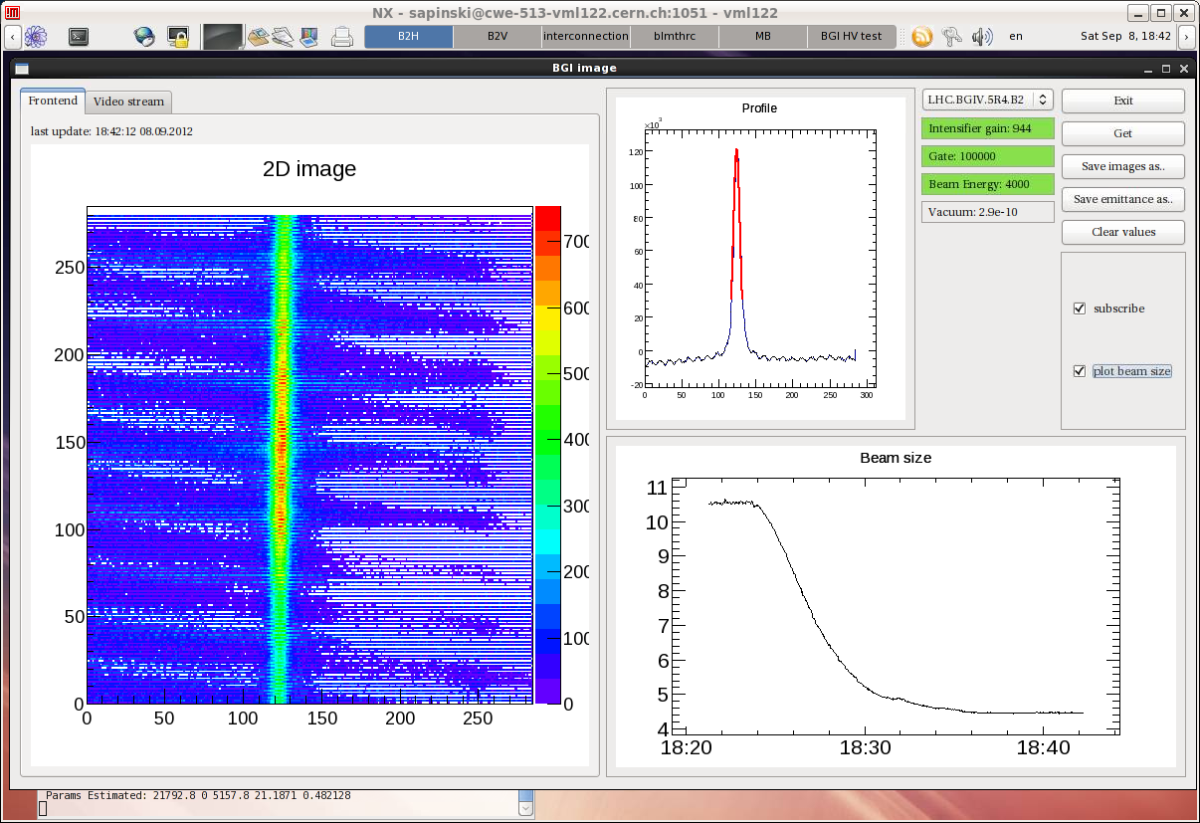
Sat Late
18:36h flat top, bgi data qualitatively ok
... at 2.3 TeV MKI2 went faulty, vacuum spike?
checked by expert
18:50h squeeze
19:06h adjust & beam dump: instability
“Instability and losses in collision beam
process, mostly beam 1 “
21:00h new injection

Slide 4
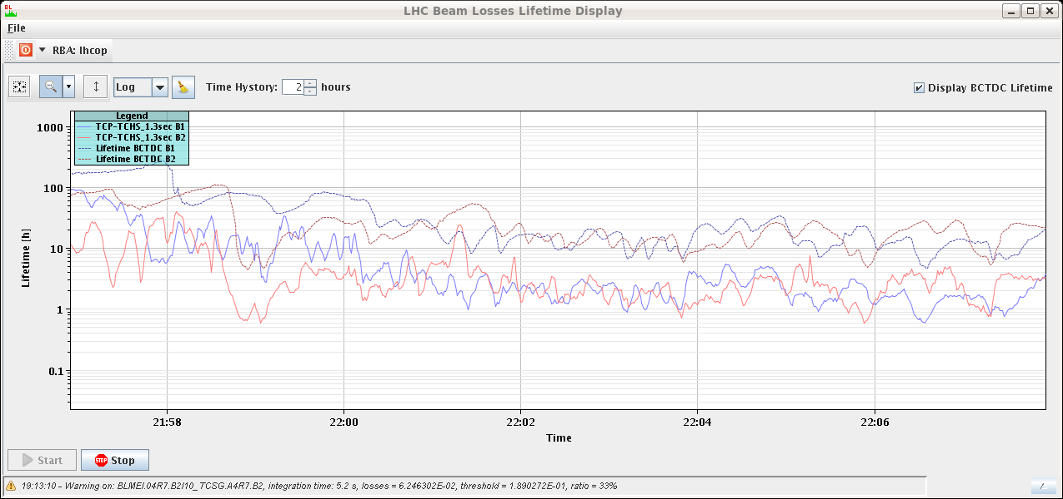
Sat Late
lifetime
21:31h ramp, squeeze ...
22:14h adjust
22:21h stable beams, L₀ = 7.3 E33
10h
lifetime
10h

Slide 5
Sat Night
stable beams ... and rising
repair water pump
instability adjust
BLM beam 1
??
stable beams

