Slide 1
Monday 27th August & night
03:40 Beam dumped by OP due to cryo problem in Pt4, integrated L ~ 56 pb-1. Cryo compressor off in Pt4. Accesses ongoing.
08:00 Start accesses
All experiments, point 7 for vacuum interlock re-configuration on spiky gauge, point 6 for orbit corrector, point 4 for BSRT beam 2, point 1 for QPS controller of RQ4.L1, ALICE power converter cooling monitoring
16:00 Cryo conditions back – earlier than announced
Get people out of the machine
17:00 Cycling the magnets
18:30 Injecting batches of 6 for steering TI2, seems ok.
19:18 Inject for physics
19:30 No beam anymore from SPS – dump half way filling
Extraction septum problem – call specialist
21:47 Injecting for physics again
23:00 Stable beams fill #3009, initial lumi 7.3e33 cm-2s-1
23:27 Beam dump – UFO……
02:09 Stable beams fill #3011, initial lumi 7.4e33 cm-2s-1
CMS always bit lower than ATLAS

Slide 2
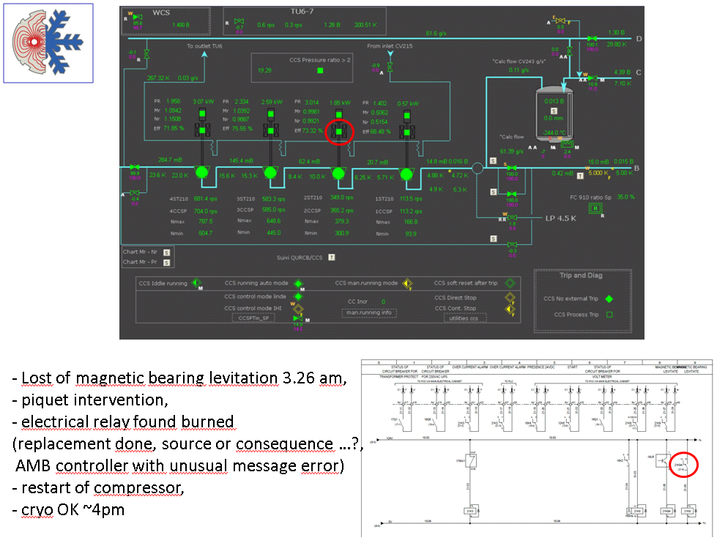
Cryo Point 4 - Krzysztof Brodzinski

Slide 3
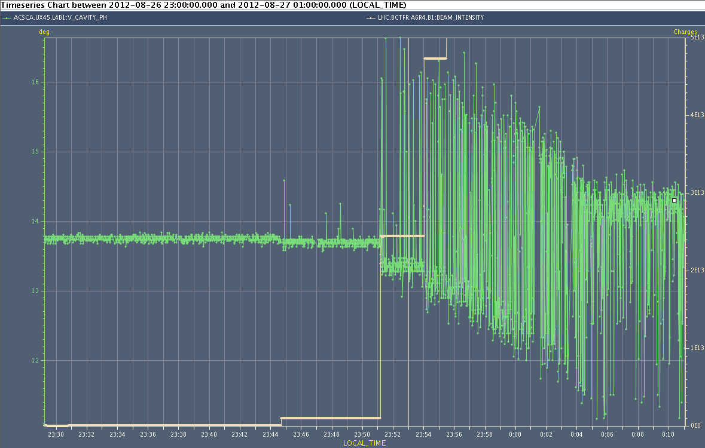
RF investigations
Over last weeks RF phase noise warning through ramp
Phase noise present on Cav4B1
1 turn feedback on this cavity was off
probably following the running of a Matlab script that indeed opens the switch
Problem present since at least one week, no older logging data
The 1 turn feedback generally improves RF phase noise due to beam loading by a factor of 6. This noise gets worse with increased beam intensity…
Switched back on the 1 turn feedback and observe on later fills
Philippe Baudrenghien, Gregoire Hagmann

Slide 4
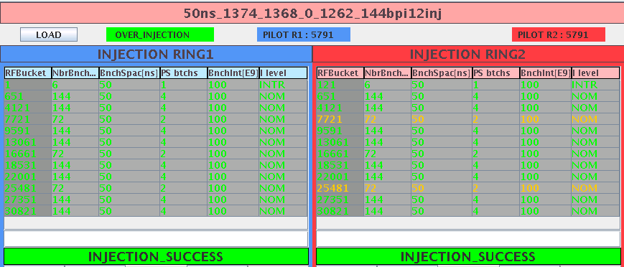
Injection steering TI2

Slide 5
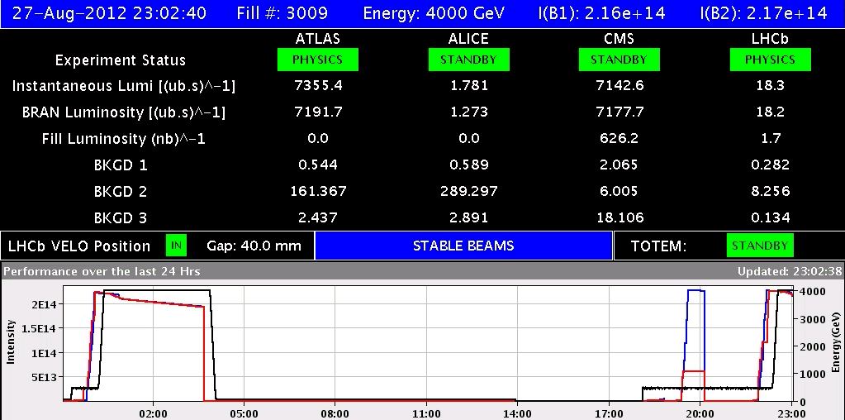
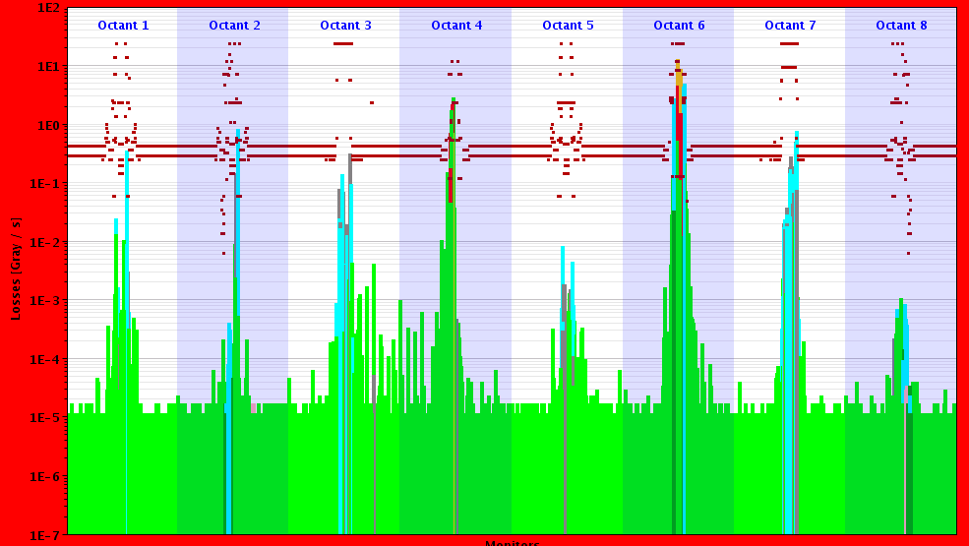
Fill #3009
UFO 5L4 losses were at 200% of threshold and were spread over RS 3,4, and 5.

Slide 6
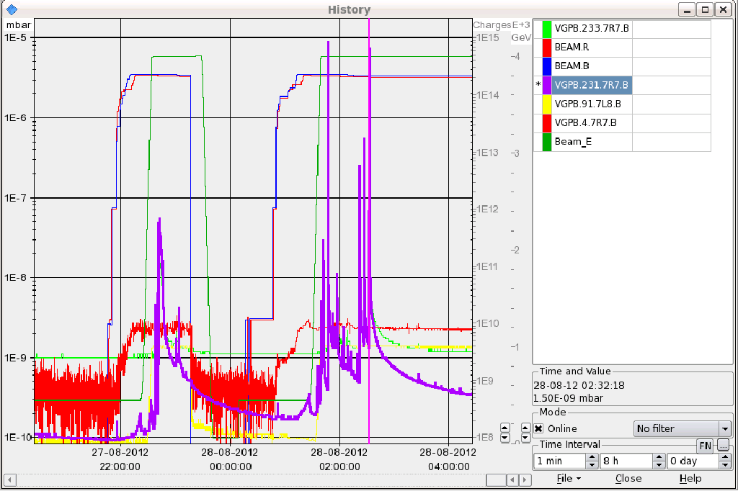
RF fingers 7R7
.... would have dumped if threshold not raised / interlock of valve reconfigured

Slide 7
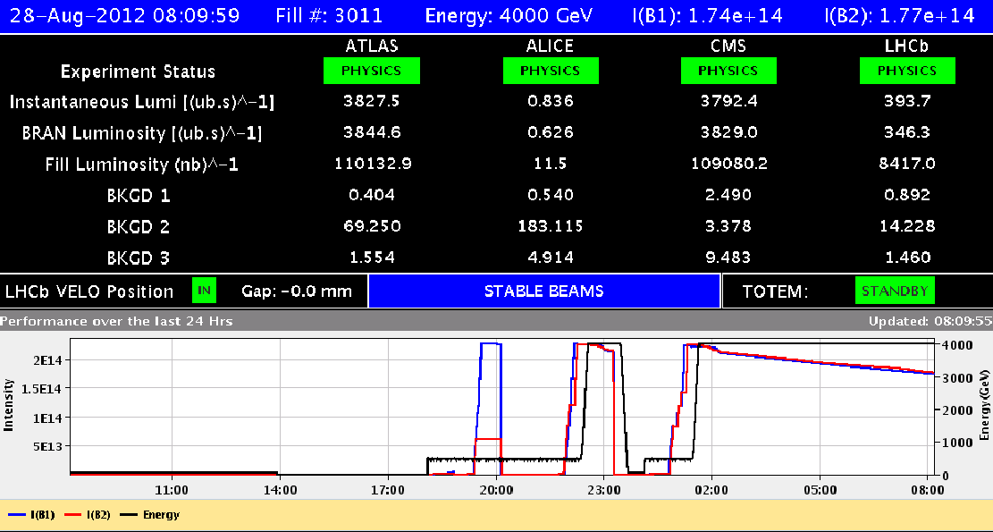
Present situation
LHCb polarity flip at the end of this fill

Slide 8
The Plan
Physics
LHCb polarity change
After this fill ....
15 minutes intervention on LHCb dipole power converter when current at zero for polarity change. Monitoring values of the cooling system of the power converter to be changed.
If no beam for 1 – 2 hours, also intervention from LHCb side, but this is presently not foreseen.
Followed by fill 2 x 6 bunches to check head-on collisions on all IPs
RF batch-by-batch blow-up
Long outstanding,1-2 hours at injection
Some time later this week

