Slide 1
Friday 17/08
09:00 Filling #2981. Still very good emittances
09:52 Beam dump during the ramp. SIS interlock on RB energy check. Data update too slow (CMW) ➔ Being investigated
While ramping down start PS access for RF cavity then access for ALICE, ATLAS, CMS + other 2 pending accesses for the machine.
Problem of the 40 MHz RF cavity more serious than expected. Could not be repaired. More news next week. For the moment running without hot spare.
13:20 PS/SPS ready but still CMS access.
13:45 CMS out.
14:13 injecting (2983): 1.6x10¹¹ p/b. Increased damper gain (V) during the squeeze.
15:41 Stable beams #2983: Initial luminosities close to 7x10³³ cm⁻²s^{-1 .} Losses on some bunches (B2 mostly) after end of squeeze.

Slide 2
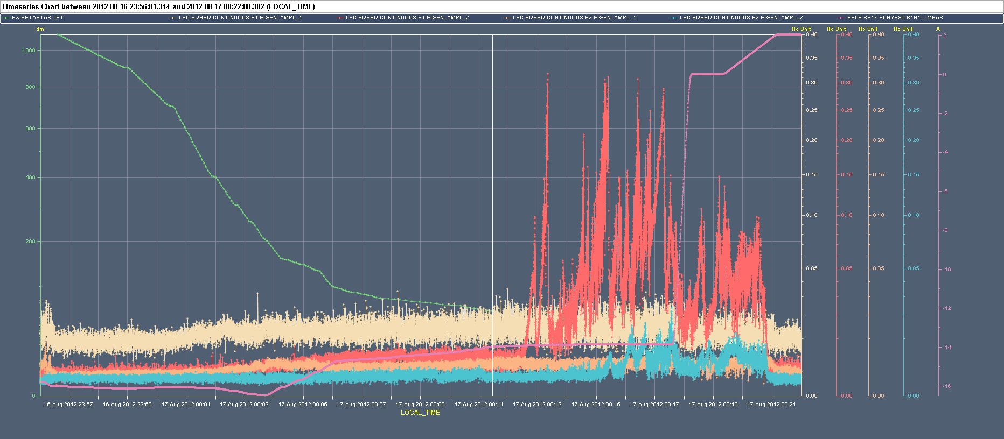
Fill #2980
Instability (vertical) observed at the end of the squeeze in Fill 2980.
BBQ-B1H
BBQ-B2H
BBQ-B1V
BBQ-B2V

Slide 3
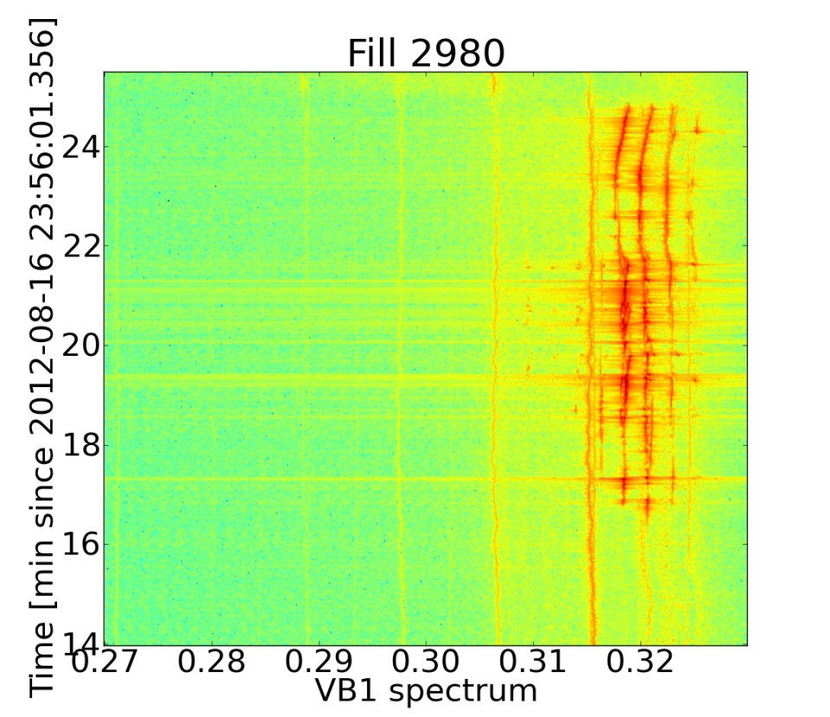
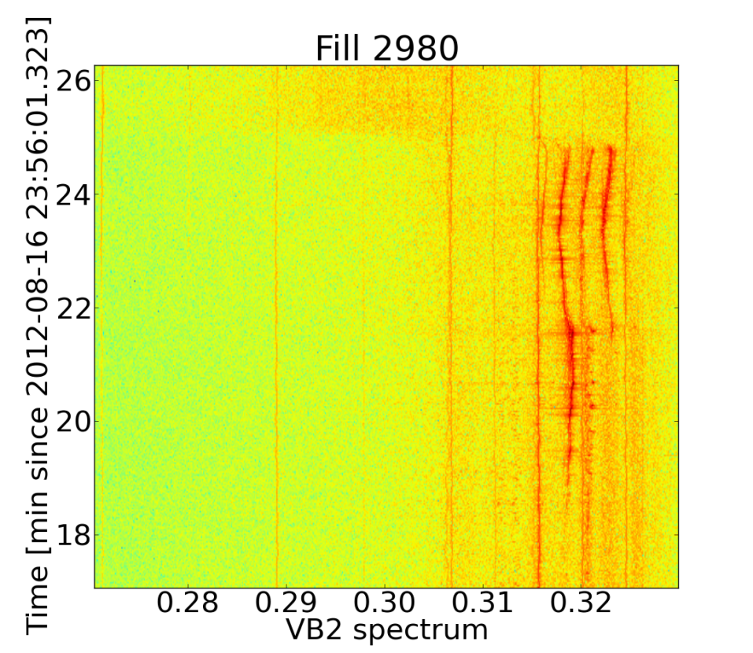
Fill #2980
Collision
Collision
End of squeeze
End of squeeze
X. Buffat
Following recommendation from impedance team further increased damper gain in the V-plane (factor 2) now equal to H-plane

Slide 4
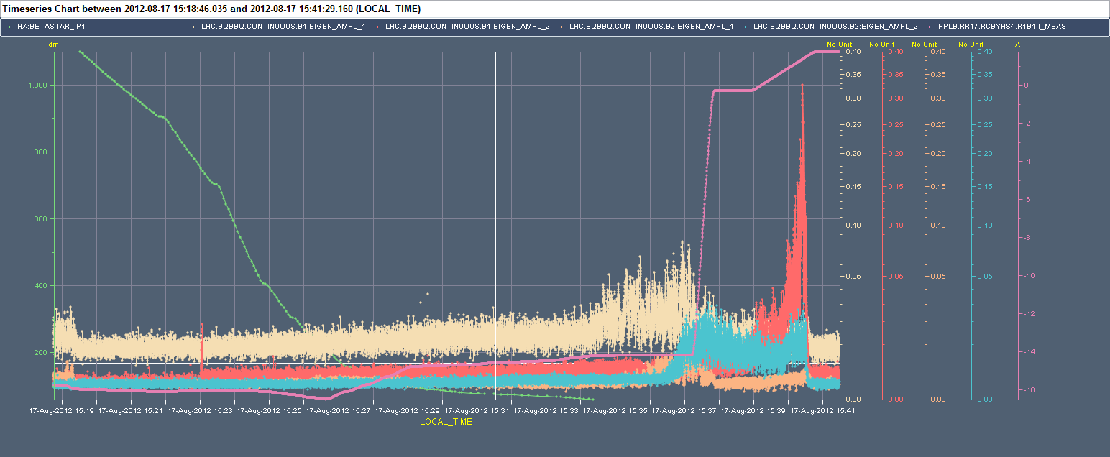
Fill 2983
Still some instabilities already appearing at the end of the squeeze and later although better than fill 2980.
Further increase damper gain (now at maximum in both planes) and chromaticity (13 units)
BBQ-B1H
BBQ-B2H
BBQ-B1V
BBQ-B2V

Slide 5
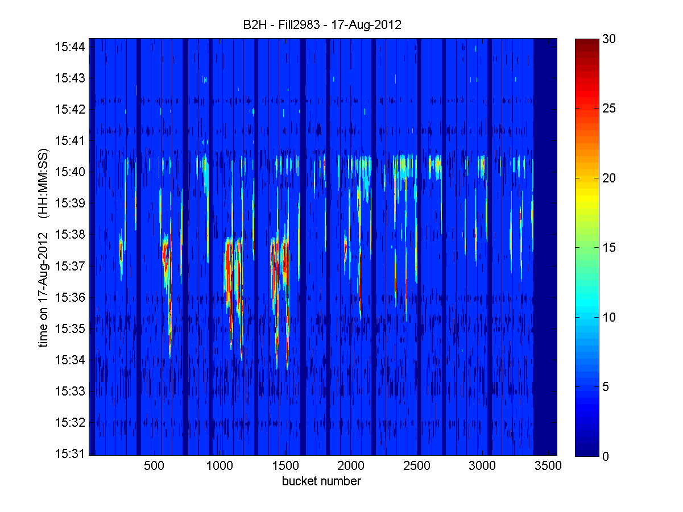
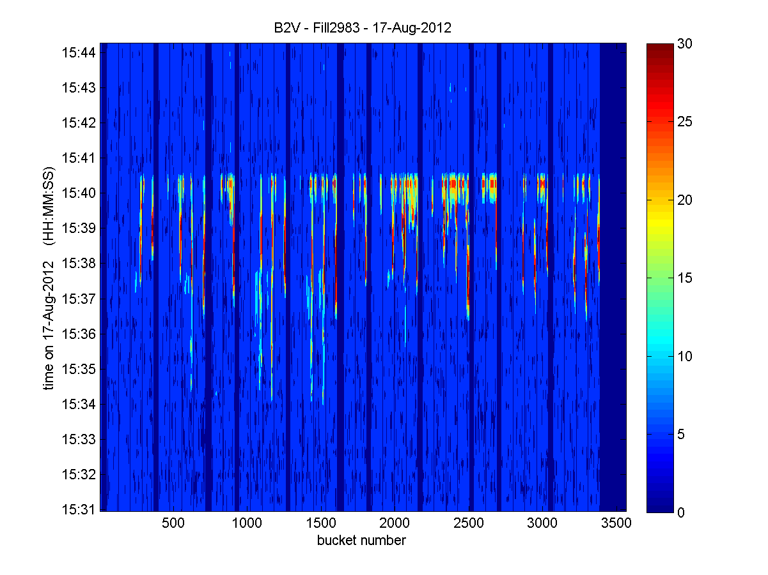
Fill 2893
Damper pick-up data
Consistency with BBQ data being verified
B. Salvant

Slide 6
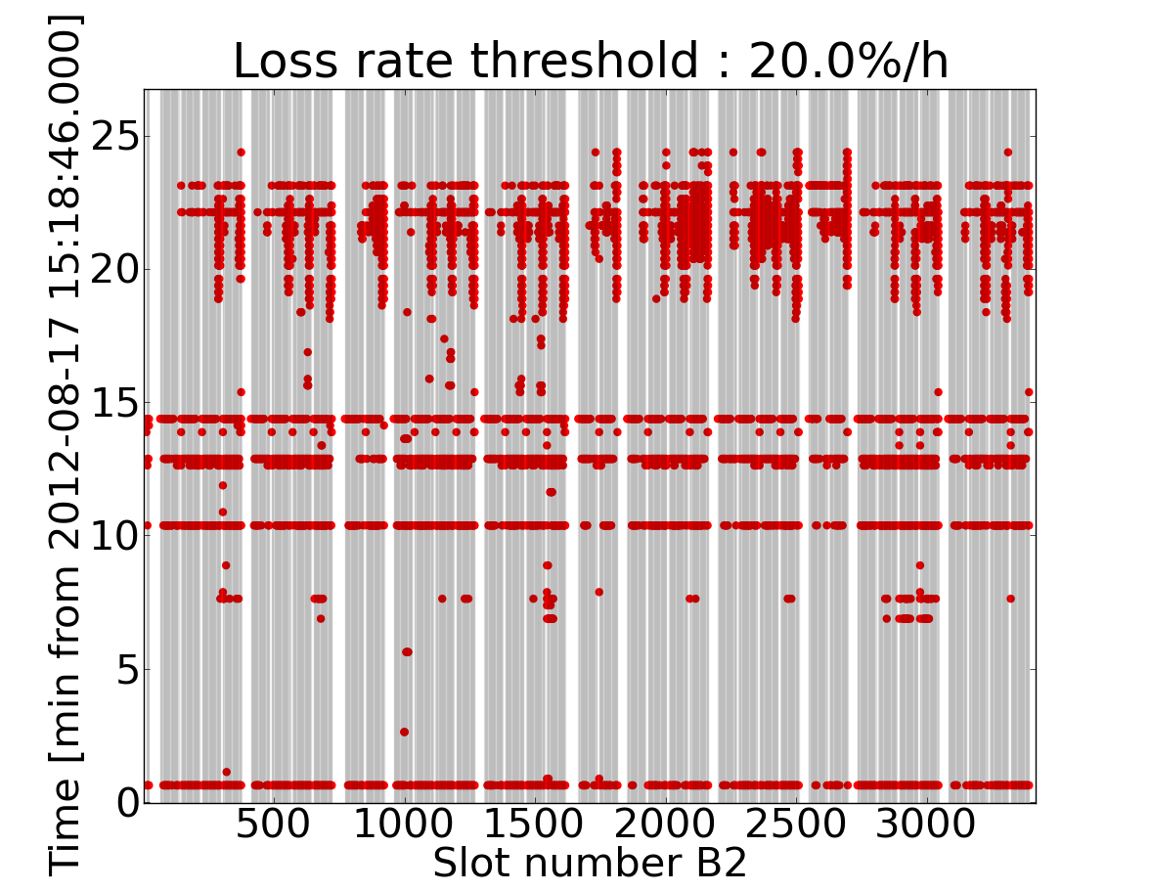
Fill 2893
Loss data
Adjust
End of squeeze
X. Buffat

Slide 7
Kicker temperature
Dump delayed due to injection kicker temperature (MKI2) to minimize waiting time at injection. Thresholds to be verified.
07:30 Beams dumped (end of fill #2893 – 195 pb⁻¹ in 16 h). Filling for physics

