Slide 1
Thu 02/08
12:09 dump by OP: 12.5 hours in stable beams; Integrated lumi: ~149 pb⁻¹.
13:38-17:00 series of problems in sequence:
SPS B2 extraction (BPM interlock)
Vacuum interlock on LHC transverse damper (VB1 and HB2). Vacuum spike.
PS main power supply down
17:00 Problem with QPS controller on RQD.A23 (33.L3). Access required.
19:36 End of access: power supply of the QPS detection unit replaced. In the shadow verification of the RQF.A12 energy extraction (following spurious opening on sunday night)

Slide 2
Thu 02/08
19:44 Lost patrol in PM18 (door YCPS01=PM18). Already happened last friday. Piquet intervention to replace relay on the door
21:20 Patrol completed and machine closed - Precycling
22:30 injection finally.
Fill with equal settings for B1 and B2 ➔ reduction of damper gain by 25% for B1 H and reduction of the octupoles for B2 (~10 %)
00:22 Stable beams #2905 Initial luminosity 5.9x10³³ cm⁻²s⁻¹

Slide 3
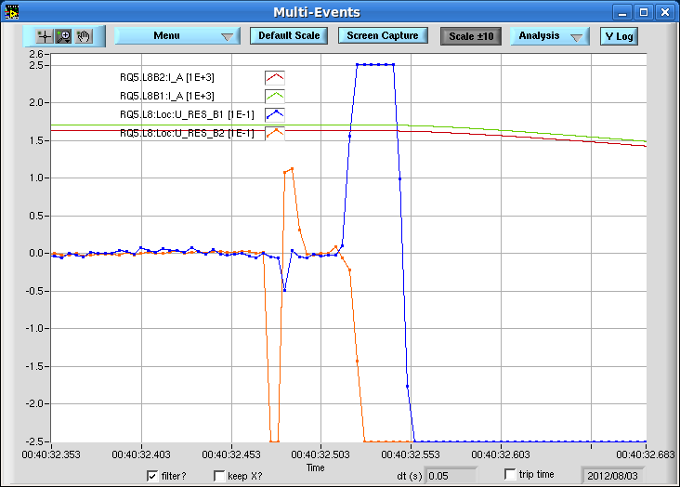
00:40 Beam dump due to trip of RQ5.L8 ~6 pb⁻¹ in 20 mins. SEU ?

Slide 4
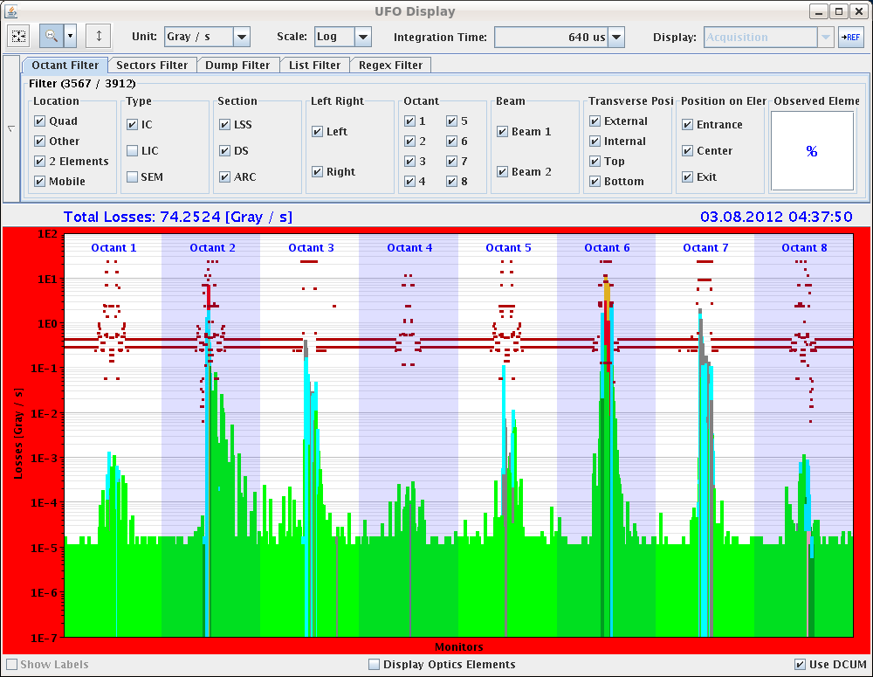
03:43 Stable beams #2906. Initial luminosities 6x10³³ cm⁻²s⁻¹
04:38 beam dump due to UFO @ MKI2 (156% of dump threshold). 18 pb⁻¹ in 55 mins

Slide 5
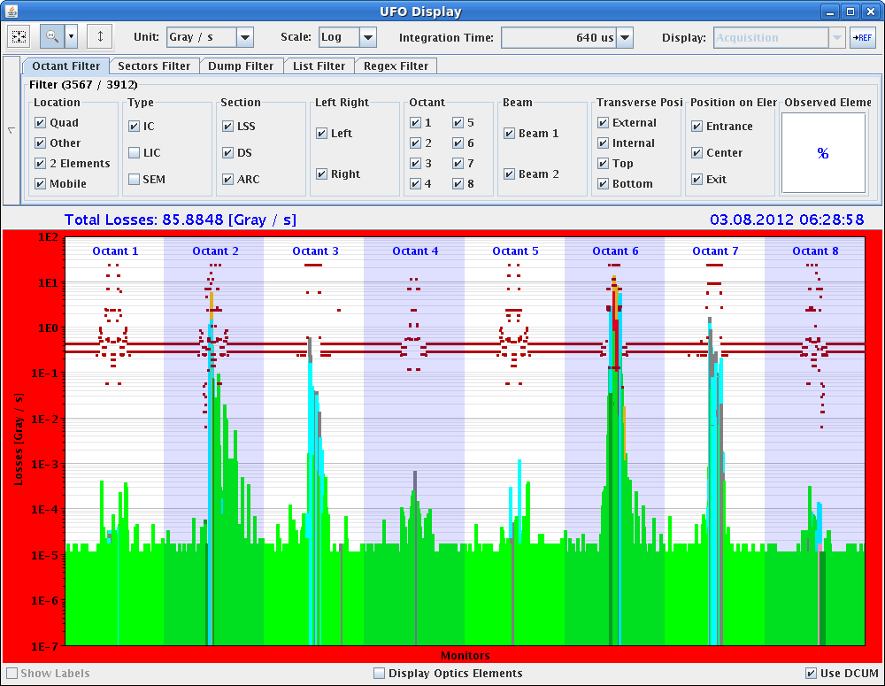
06:28 Fill #2907. Dumped once more by UFO during the first part of the squeeze (100 %!!!)
Filling rather rocky with frequent IQC vetos.

Slide 6
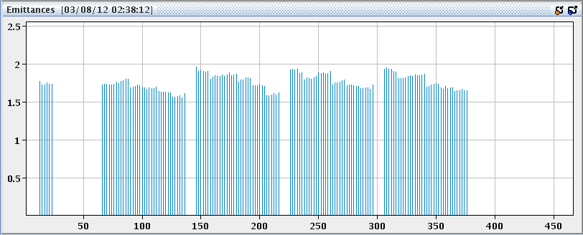
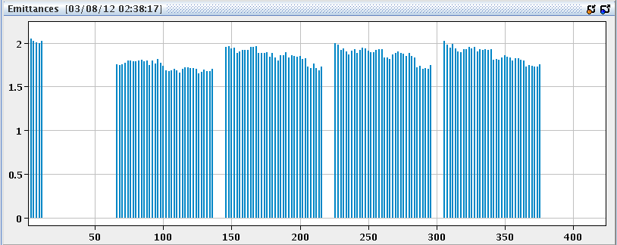
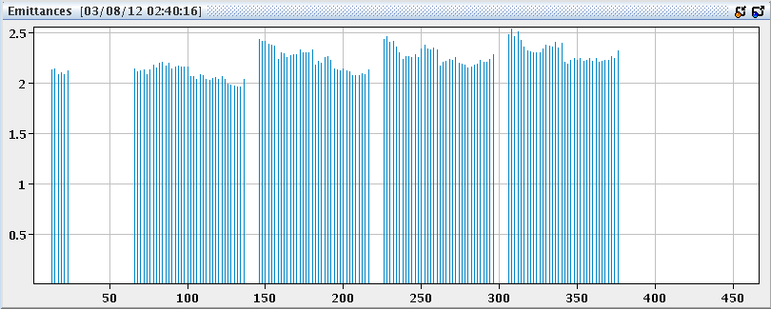
Beam quality
Still rather large emittances particularly B2V
Emittance increasing along the SPS trains

Slide 7
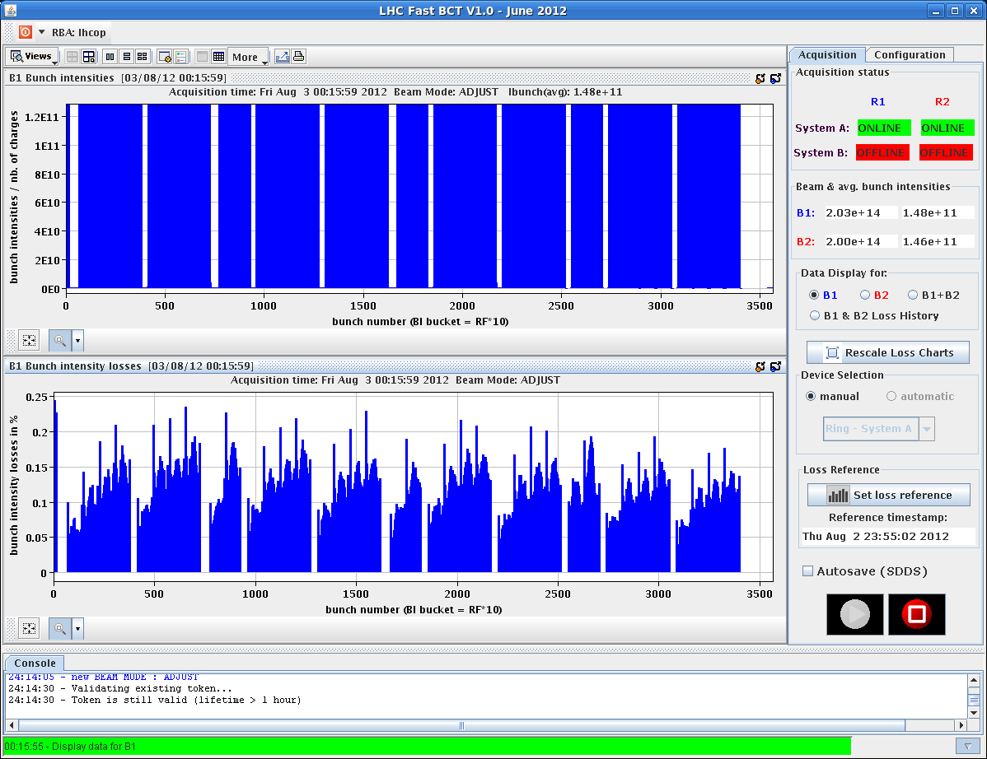
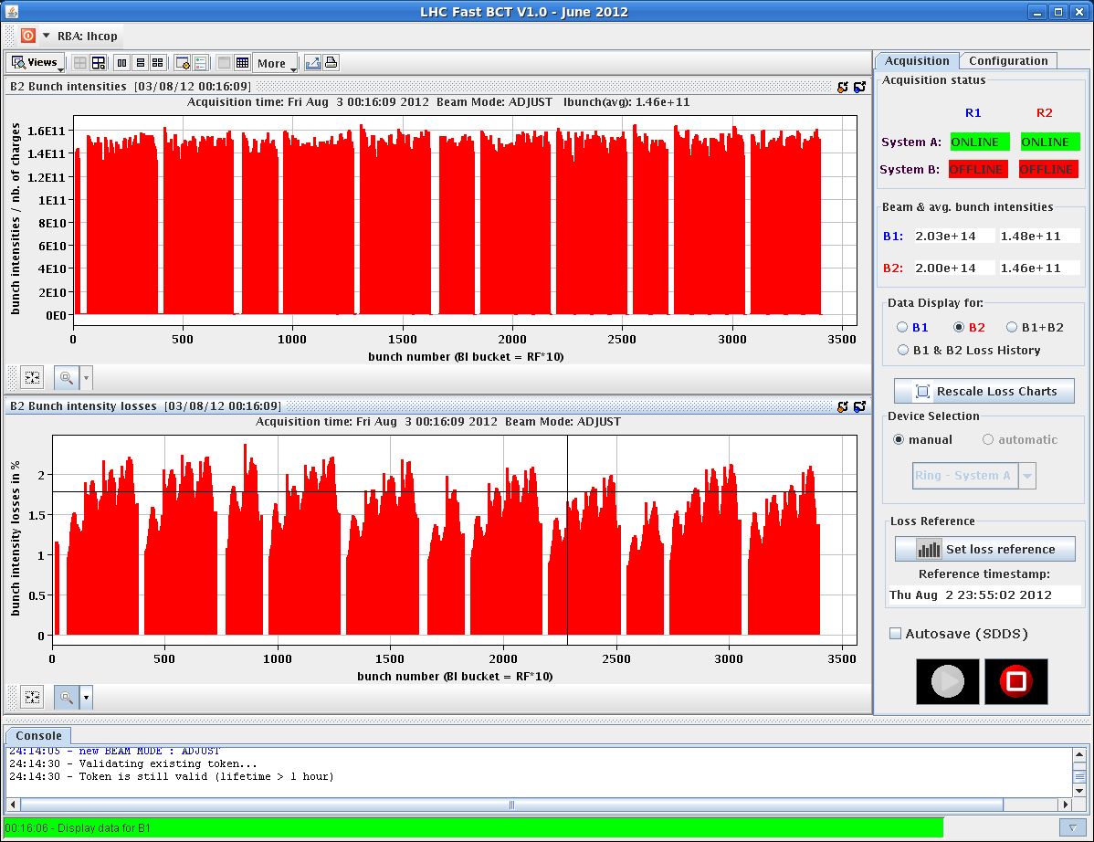
Losses during the squeeze

Slide 8
Plans
Fill for physics
Still pending: scraping of tails

Slide 9
Pending
Change CTRV cards on TSU FECs for LBDS ➔ N. Magnin (2 h)
Moving of the spare MKD generator from gallery to the surface

