Slide 1
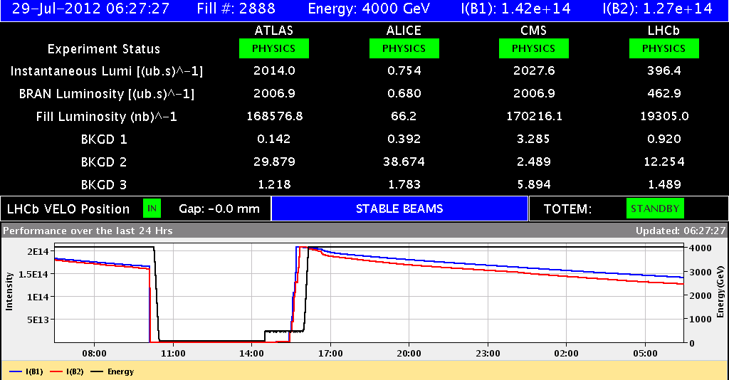
LHC Status Sun Morning 29-July
Bernhard Holzer, Mike Lamont

Slide 2
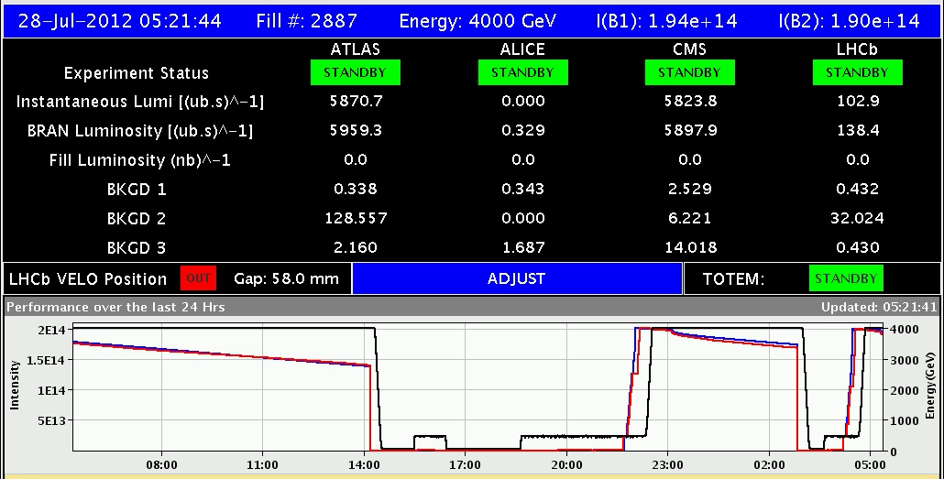
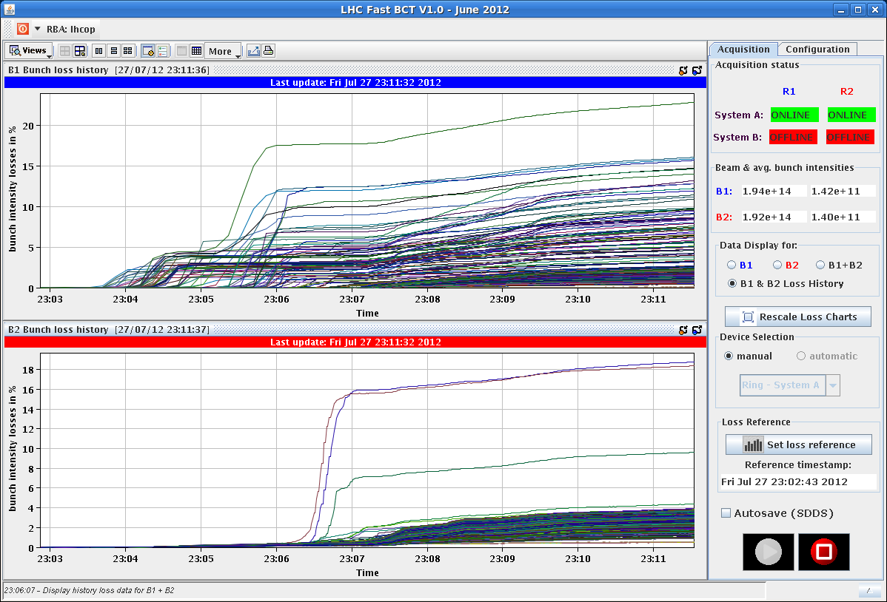
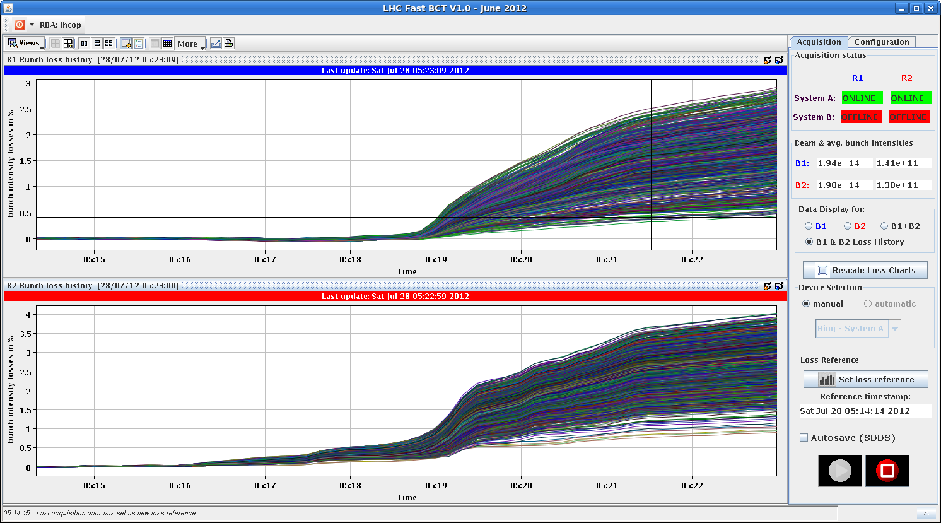
Sat Morning
since 05:21 h ... stable beams ...
using special filling scheme for Alice
bunch losses during squeeze / adjust
fill 2884
20%
3%
fill 2886

Slide 3
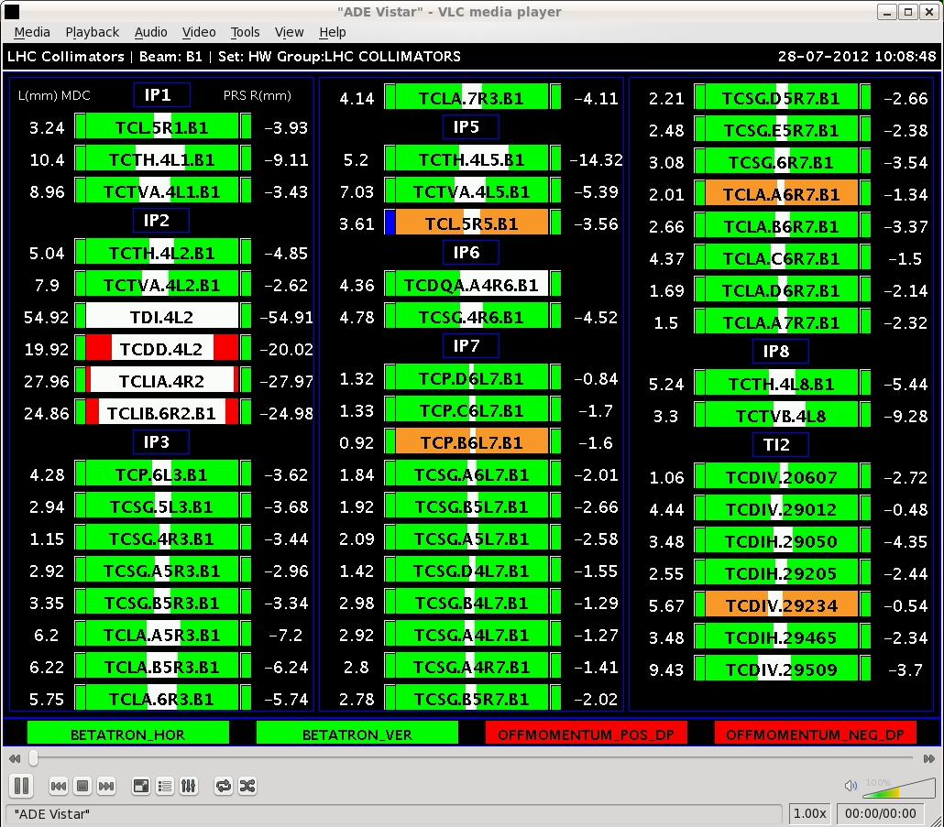
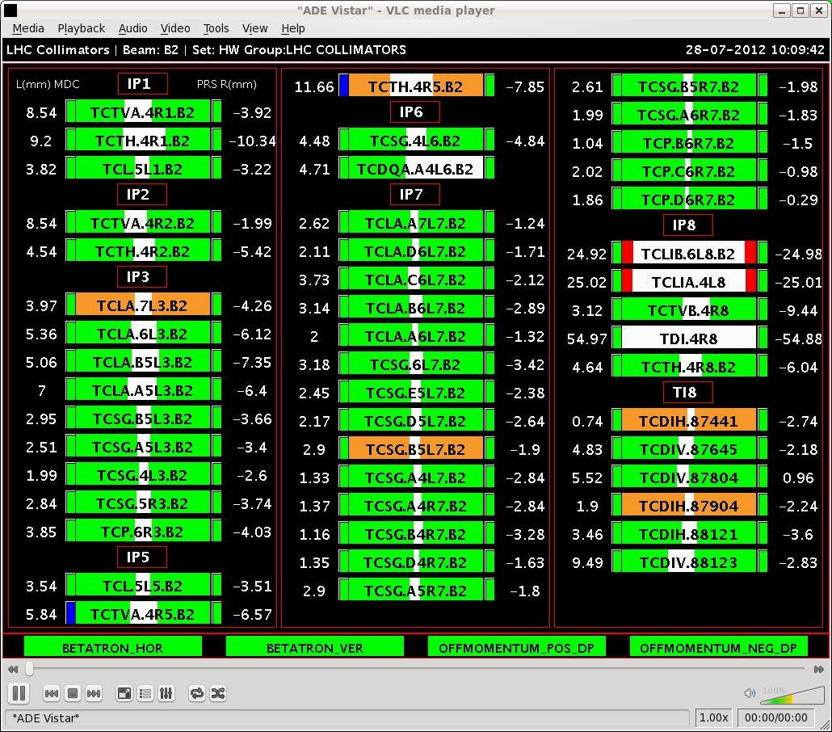
Sat Morning
10:06h beam dump: loss of network communication in UJ56
collimator TCL5.R5 beam 1,
... an old friend !! TCTVA.4R5,TCTH.4R5 beam2

Slide 4
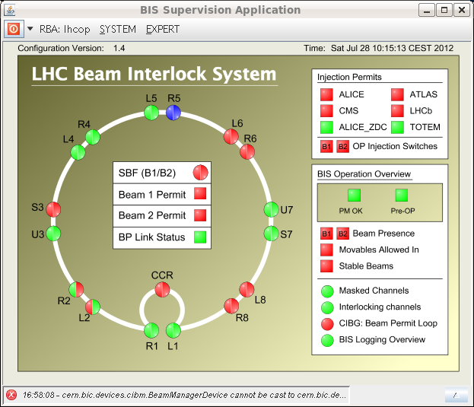
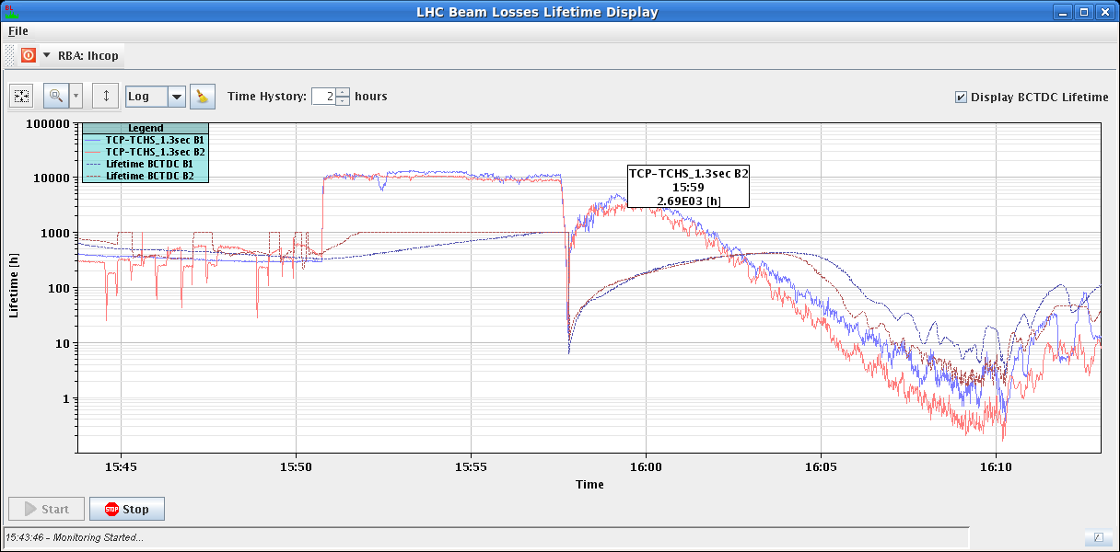
Sat Morning
10:15h communication lost for BIC
... piquet: might be a dead network switch in UJ56.
Access: but door to the first level of UJ56
cannot be opened
(door access control is inside ;-)
15:18h injection for physics
B1H = 1.8 B2H = 1.58
B1V = 1.81 B2V = 1.8
15:53h ramp
3.5 TeV

Slide 5
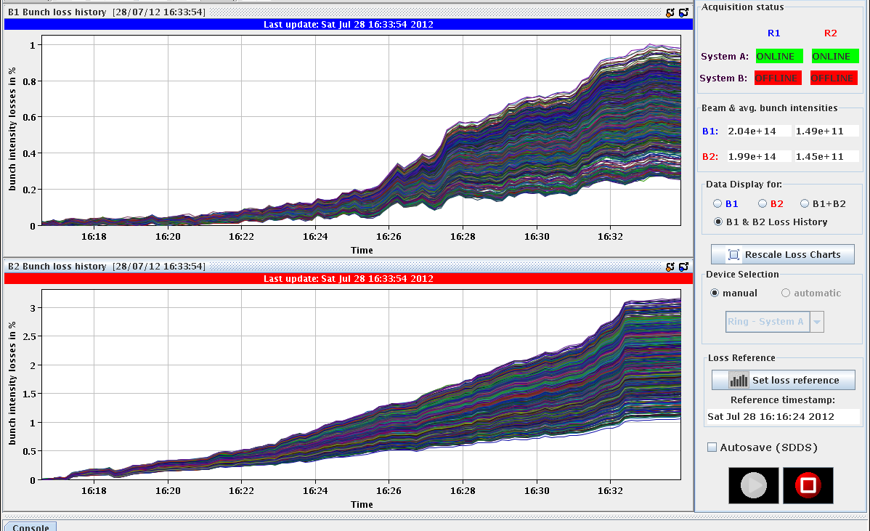
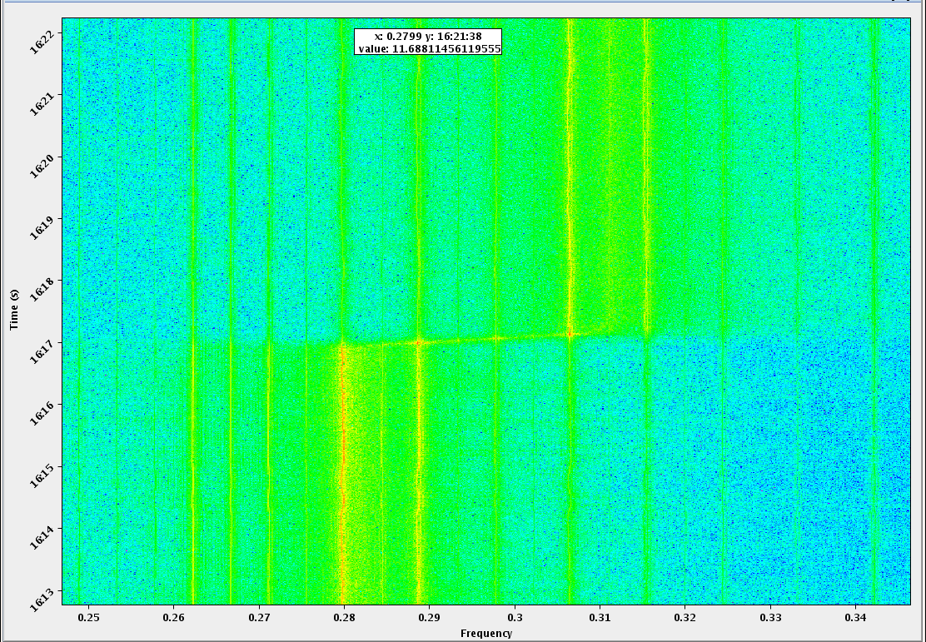
Sat Late
16:16h squeeze
no warning level losses until collisions.”
very small bunch intensity losses
during squeeze / adjust
carefully following the tune
& re-optimise optimi
3%
3%

Slide 6
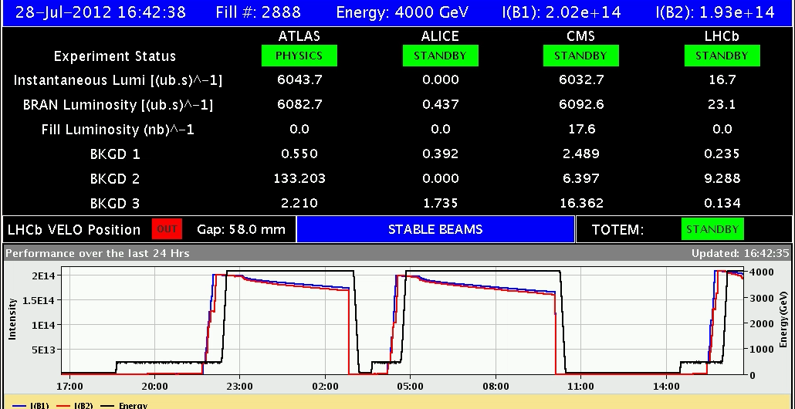
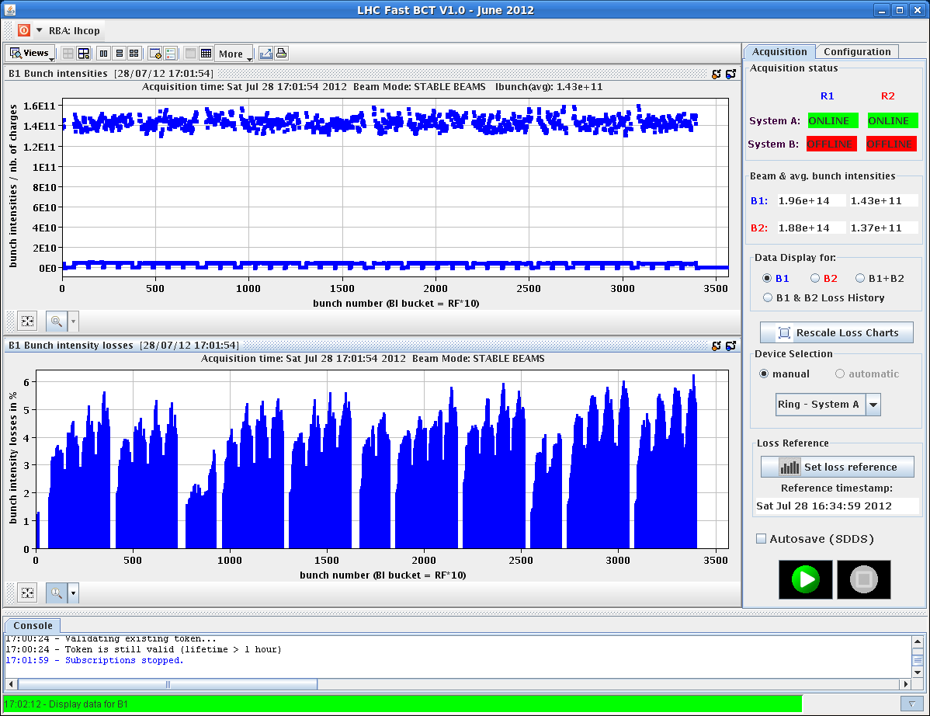
Sat Late
16:42h stable beams
bunch losses in adjust:
3...5% b1
4...7% b2

Slide 7
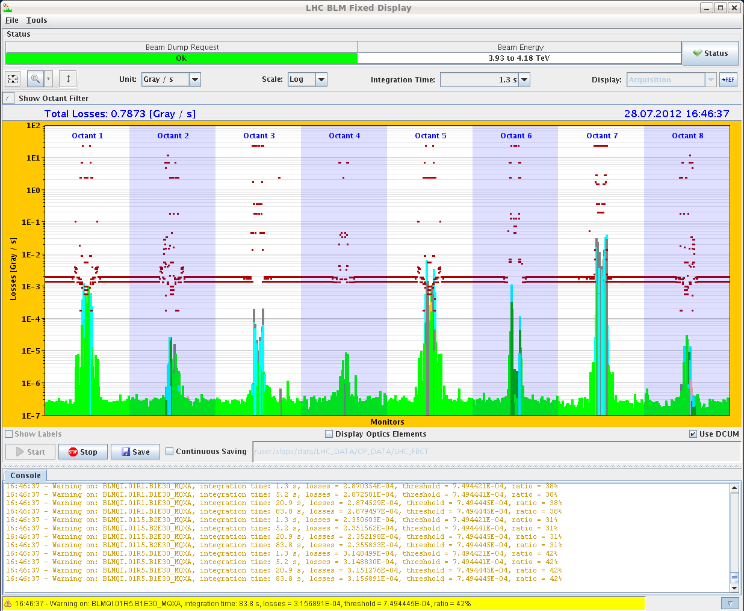
Sat Late / Night
16:42h for completeness:
losses during collisions
30 ... 40 %
18:00h ... 08:30h Stable beams

Slide 8
Sun Morning
ATLAS request: access for cooling problem (30 min)

