Slide 1
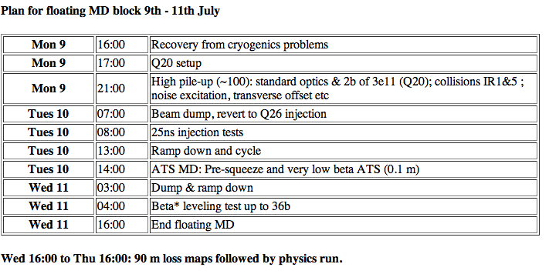
LHC Status Tue Morning 10-July
Bernhard Holzer, Jan Uythoven

Slide 2
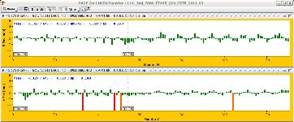
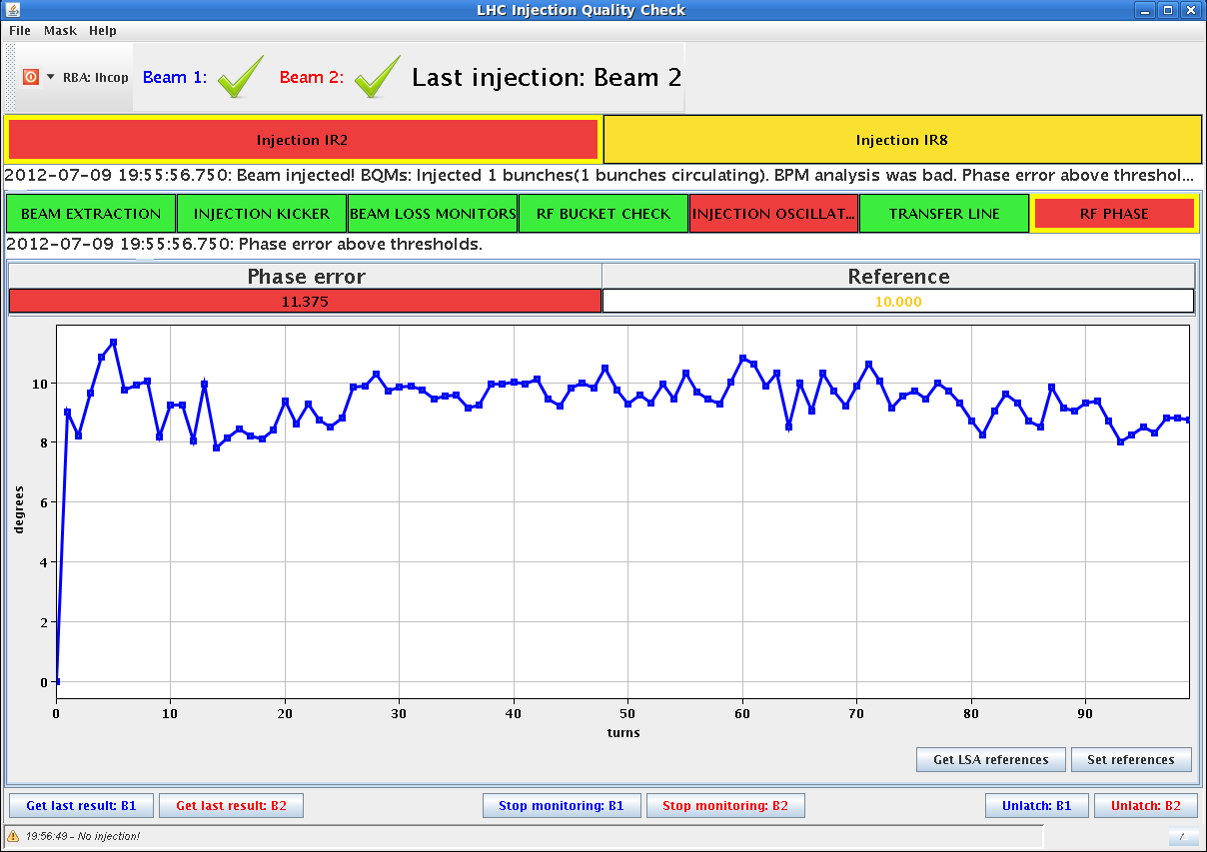
Mon Late
16:00h cryo back
17:00h LHC “on”, no QPS hick ups, start precycle
17:40h injection probe beam
17:40h Q20 pilot in ... RF phase error ...

Slide 3
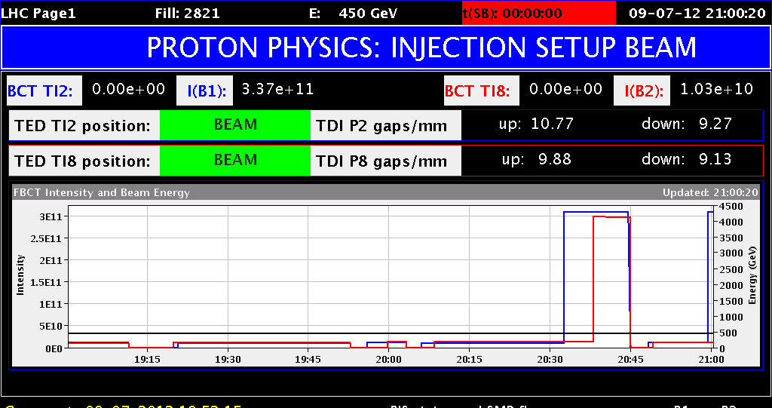
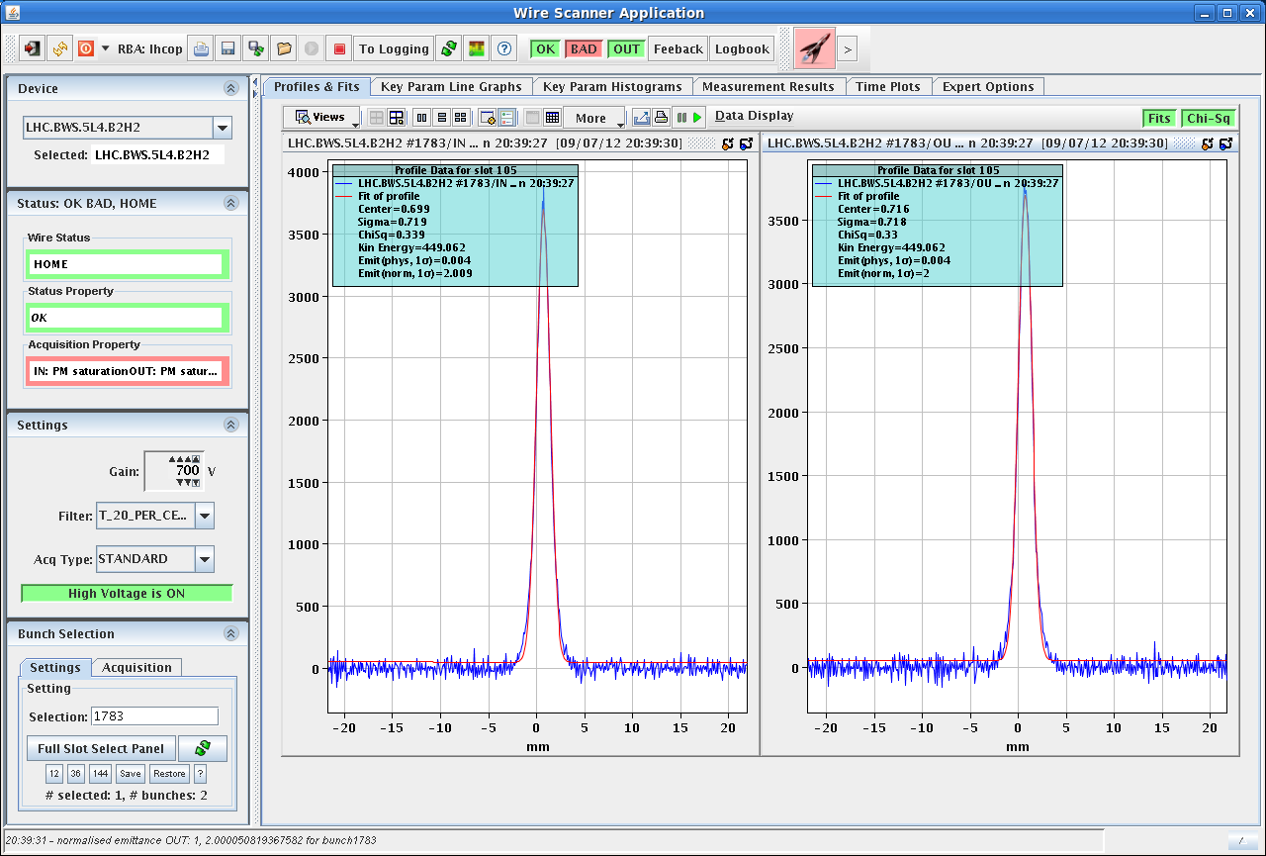
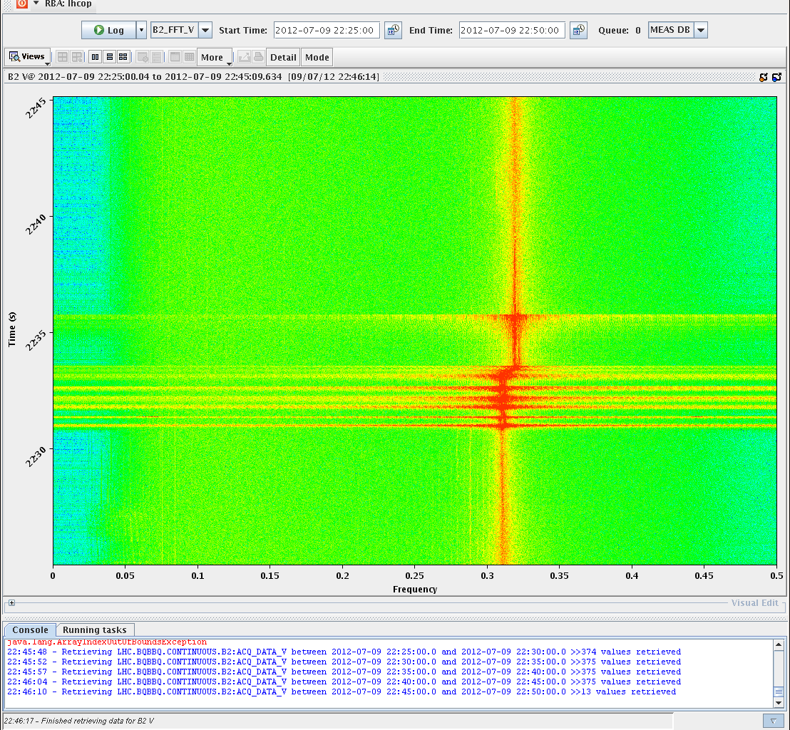
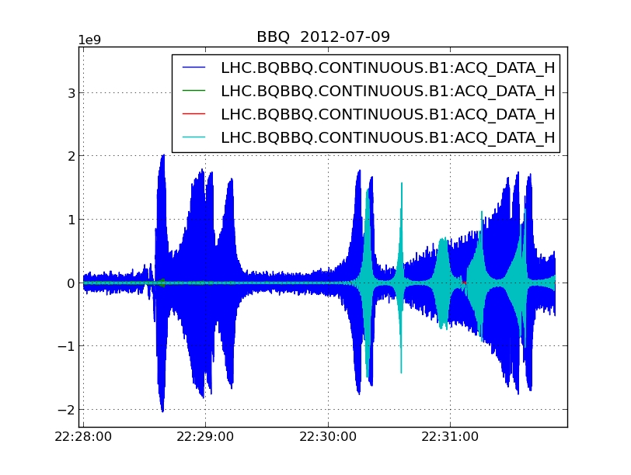
Mon Late
20:34h
First high intensity Q20 bunch in. 3.26e+11
ε_{n} ≈ 2.0
22:14h ramp ... with problems ...
emittances after Squeeze: B1H = 4.2
B1V = 1.5
B2H = 2.8
B2V = 4.2

Slide 4
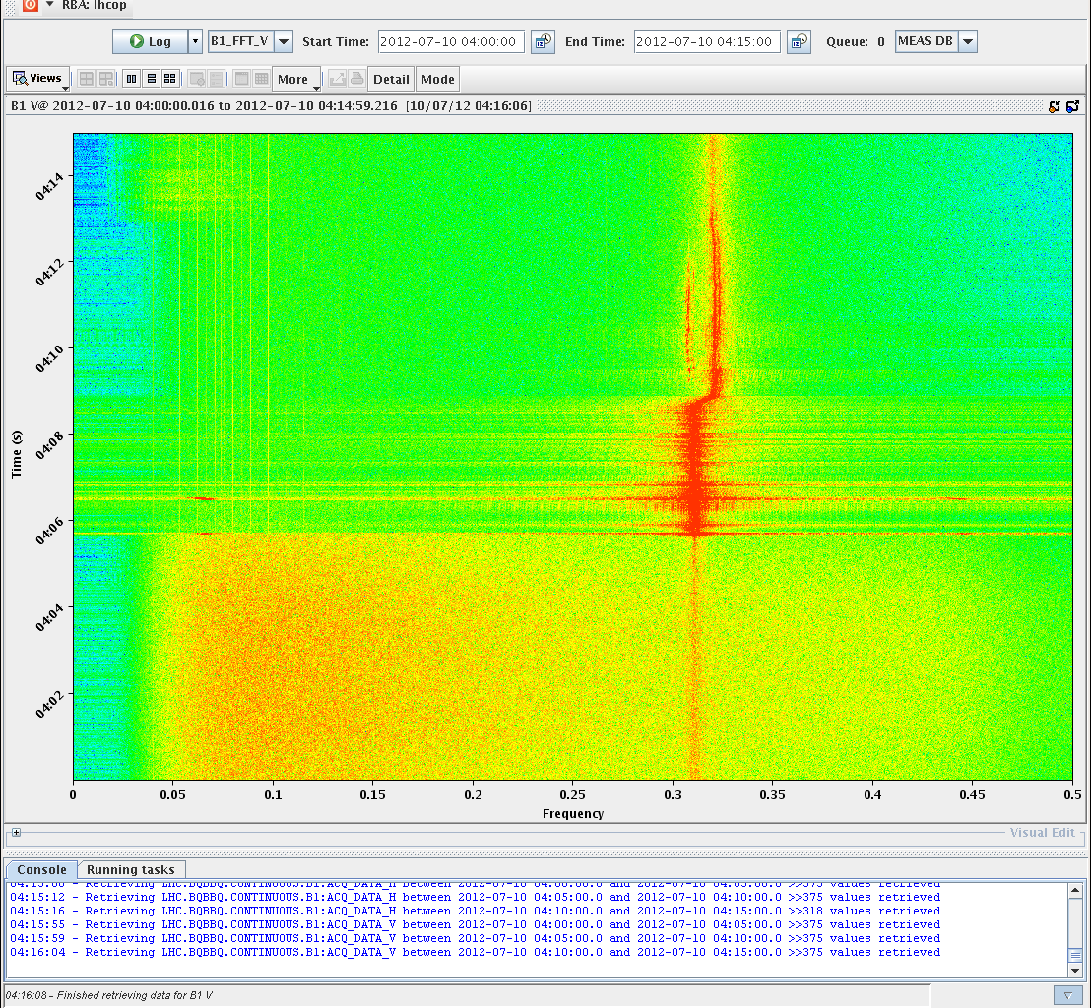
Mon Late / Night
23:00h stable beams
preliminary pile-up number from CMS at start of SB: 45
from ATLAS at start of SB: 30
23:58h beam dump & cycle
01:25h new injection, ramp, squeeze ...
02:15h beam dump: High losses on B1,
we decided to dump since the pile-up wouldn't be better than before.
03:19h new injection
B1 heavily unstable during the squeeze
→ dumped by operator
05:35h new injection

Slide 5
Tue Morning
07:00h ... finally stable beams

