Slide 1
Monday
14:00 beam dump
End fill 2797 after 7h 2m of stable beams 480 bunches, ATLAS toroid OFF.
Access:
ATLAS
change of the PC of RCVBV24.L4B1,
repair of QPS/EE on RCS.A23B1
intervention on the crates of the BPMD in P6.
ATLAS toroid ramped up
The collimator vistar display was fixed and the DIP processes are being restarted (timestamp problem).
The sequence for setting the XRP thresholds for TOTEM was fixed by Stefano.
The vacuum solenoids around the injection kickers have been switched back ON; they had been left OFF after the technical stop.
unmasked all three masks in RF monitoring in Big Sister. They were all dating back from 2011.

Slide 2
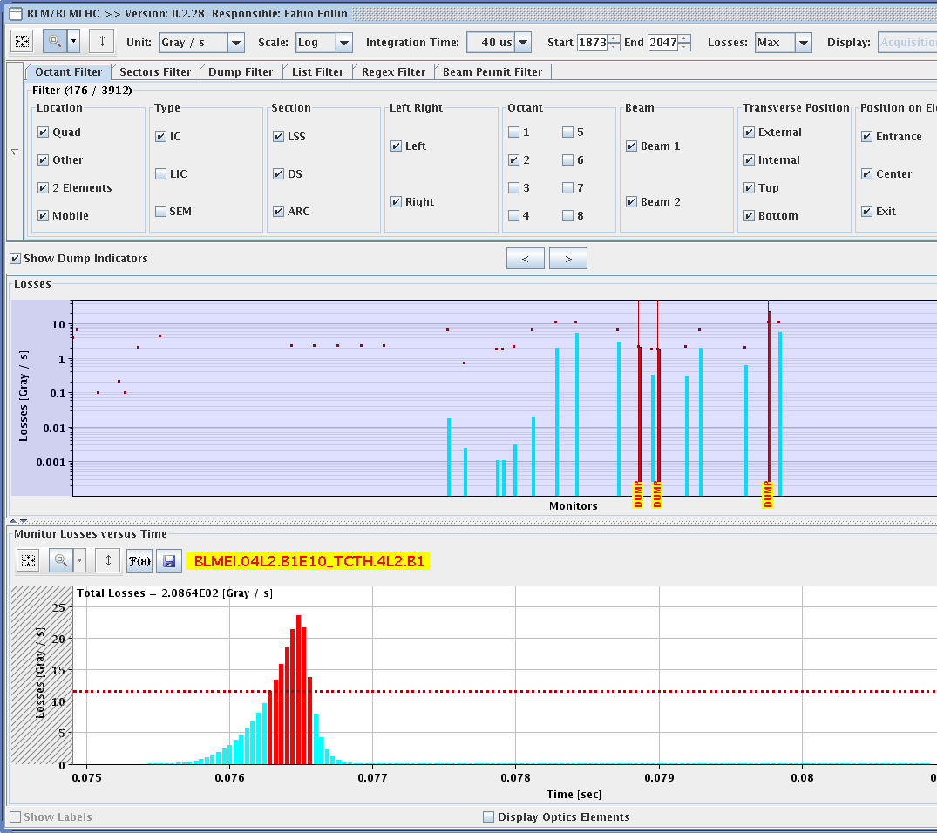
Monday afternoon
17:30 Injecting
19:24 Stable beams
Fill 2798 - 852 bunches
20:01 Beams dumped – big UFO MKI2

Slide 3
Monday evening
Access prepared for LHCb.
22:00 Access finished ready for injection
Beam quality problems from the SPS.
The vertical emittances were measured to be 2 um (instead of 1.5).
00:53 lose 2799 in the squeeze
trip of RQ7.L7B1 – QPS trigger
02:00 Back around at injection
03:38 Fill 2800 - beam dumped by high losses on Q4.L6 on RS 5.2s after 1 minute into the collisions BP.
Tune signal for beam 1 show instabilities in H

Slide 4
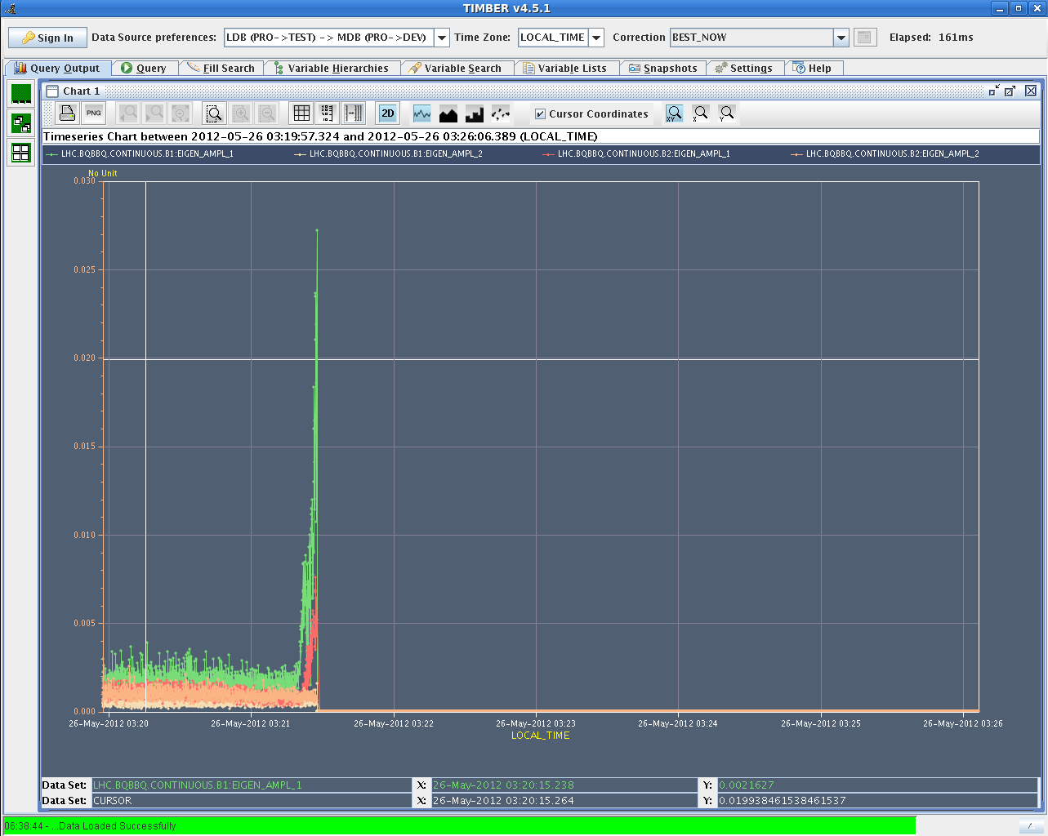
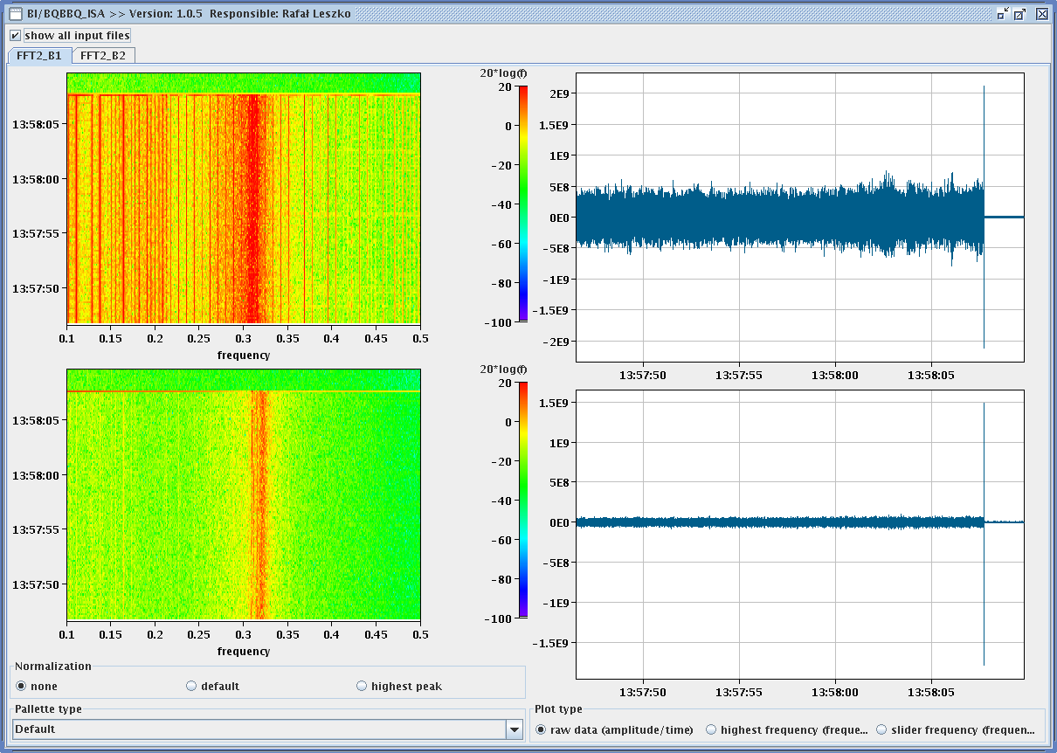
Familiar picutres

Slide 5
Tuesday morning
05:30 Access start for Atlas
Compressor – Torroid
07:10 Atlas finished
08:10 – lose test ramp to un-masked interlocks
Try test ramp again – chromaticity and then another shot at 854 bunches
SPS working on beam quality in the meantime

