Slide 1
Tuesday
In the morning test cycle with probe for Q’ measurement.
Difficult to get good Q’ measurements, fall back to manual RF frequency trims.
Q’ close to negative in H, a bit high in V (~5) at end of squeeze.
Dumped on too large RF frequency trim (forgot to mask).
Refilling with 852b. Hor Q’ trimmed up to ~2 based on measurements.
14:30 Lost beam when going into collision, B2 losses (similar to early morning loss).
Trying again, but drop bunch intensity to 1.4E11.
18:45 Once more beam lost when going into collisions, on B2 losses.

Slide 2
Tuesday evening / night
Decided to fall back to 840b, rollback back Q’ trims… Keep the bunch intensity lower.
20:55 Stable beam fill #2805, 840b, 1.4E11 ppb. Luminosity ~3.5E33 cm-2s-1.
06:00 Dump by OP, 70 pb-1 integrated.
Moving to 1380 (in fact 1374), keeping lower bunch charge.
During the squeeze losses starting on selected groups of bunches of B2, partner bunches on B1 (wrt IR1/5) blown up in H plane.
Strange QH trim on B2 by QFB, compensated manually at end of squeeze.

Slide 3
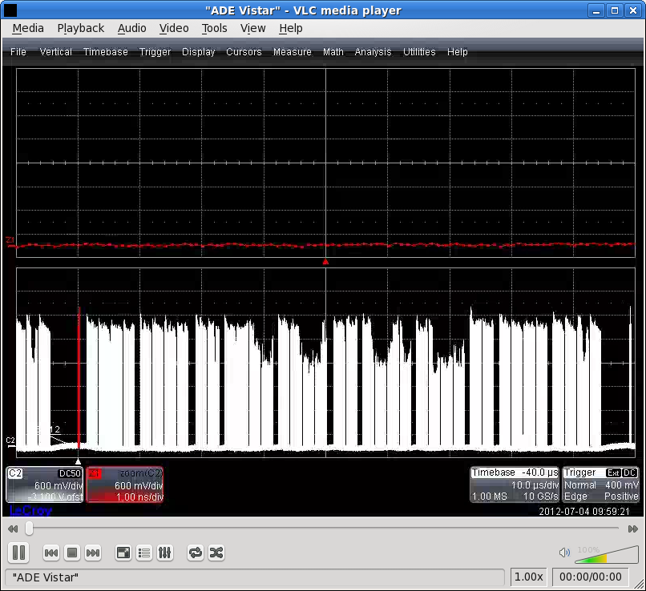
Pattern of losses of B2 in collision fill 2806
Developed in the squeeze, getting worse and worse…
Stabilized finally when colliding…

Slide 4
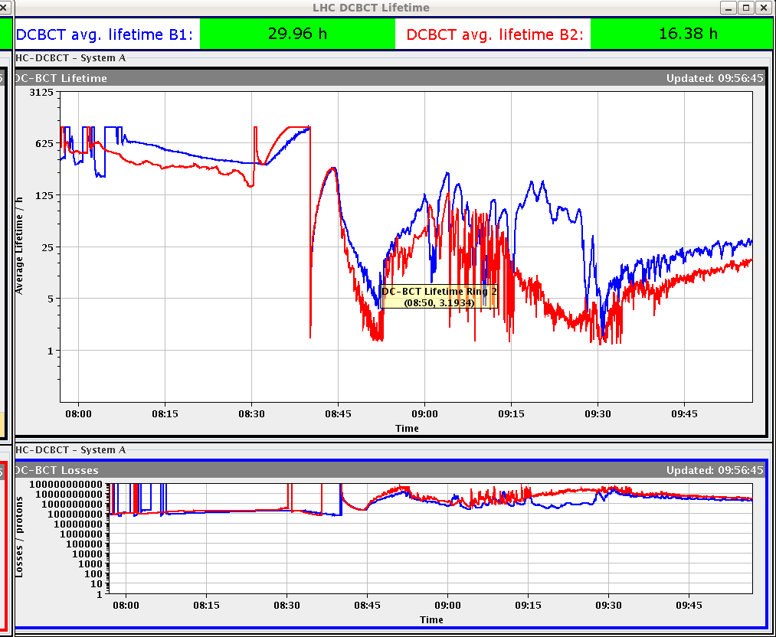
Lifetimes
End of Squeeze
Collide

Slide 5
Emittances on B1
All OK on flat top, blown-up after the squeeze in H.
Mirrors the losses on B2 bunches (wrt IR/5 collisions)
B1
B2

Slide 6
Wednesday
09:30 Stable beam fill #2806, 1374b, 1.4E11 ppb. Luminosity ~4.6E33 cm-2s-1
18:50 OP dump. Integrated L 103 pb-1.
20:10 B1: 6 bunches lost at injection, large losses in injection area, ALICE trigger.
21:20 Ditto.
In both cases it seems the beam was dumped on the TDI. No trajectory recorded in the PM.
Beam arrives some 50 us too early.
Traced to the fact that the SPS RF was on local clock and not locked to LHC – is normally be caught by SPS BQM. To be checked.

Slide 7
Last night
23:00 Injection, ~1.45-1.5E11 ppb.
00:09 Stable beam fill #2807, 1374b. Luminosity ~6.2E33 cm-2s-1
03:40 Cryo compressor in Pt2 stopped due to increased oil leakage.

Slide 8
Today
Morning: intervention on cryo compressor in Pt2 – oil leak.
Weld with a crack.
Cryo team hopes to minimize impact with no or little downtime for cryo-maintain.
In the shadow of stable beams if all goes well.
Then stable beams again.
And we would like to insert yet another Q’ measurement cycle (until Monday).

Slide 9
90 m
90m setup starts Friday in the morning (> 09:00).
Un-squeeze 3 bunches of ~8E10 (< Very Relaxed SBF)
Commission/test collision BP,
Find collisions,
Align TCTs in IR1 /5 (collisions only, end of squeeze settings will be calculated from collision settings),
Align all RPs,
RP data taking with minimal retraction.
Then loss maps and asynch. dump tests (full set).
To be completed next week if needed, as it is not very likely that we finish all in the 24 h slot.

