Slide 1
LHC Status Sat Morning 9-June
Bernhard Holzer, Joerg Wenninger
Status Friday Morning:
09:00h end of fill “studies”
rf coupler fine tuning
ADT gain reduced

Slide 2
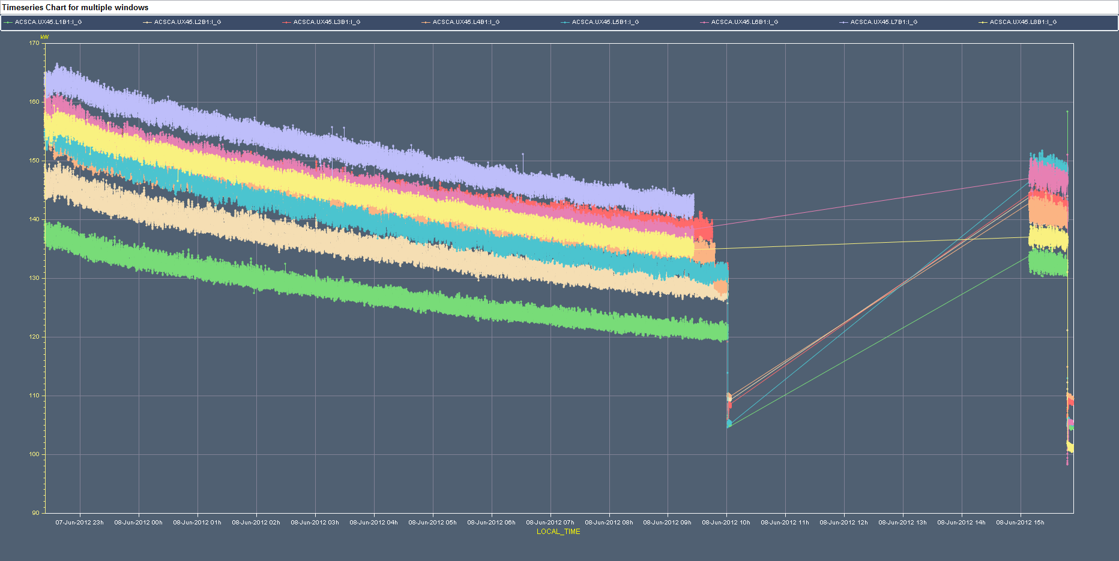
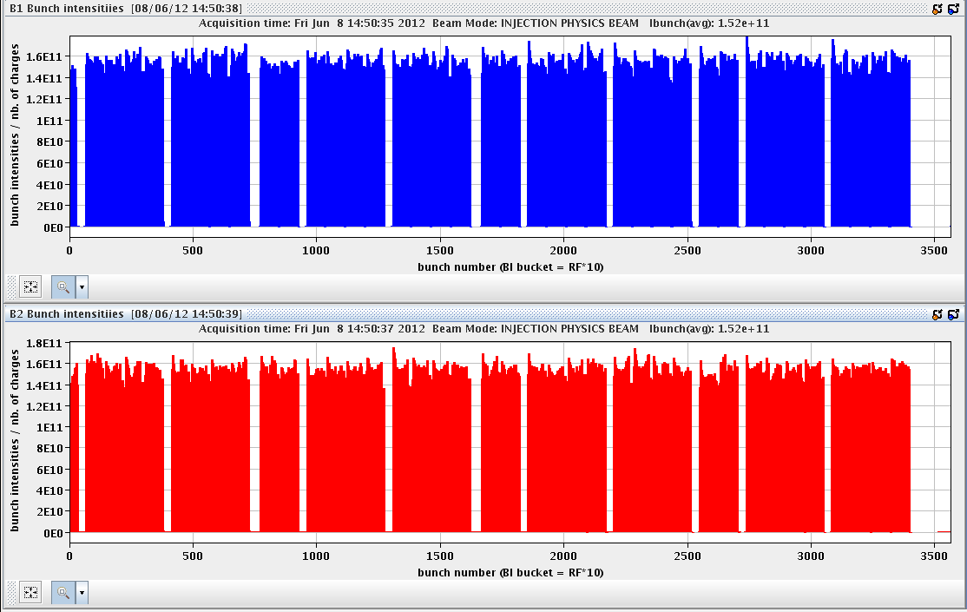
Fri Morning
09:00h end of fill “studies”
rf coupler fine tuning
10:01h ADT gain reduced & beam separation ...
beam dump: Mains disturbance (EDF)
precycle ... but
12:35h problem on RCO.A12B1 (spoolpiece octupole)
access needed -> postponed
13:36h injection probe beam
14:06h injection for physics

Slide 3
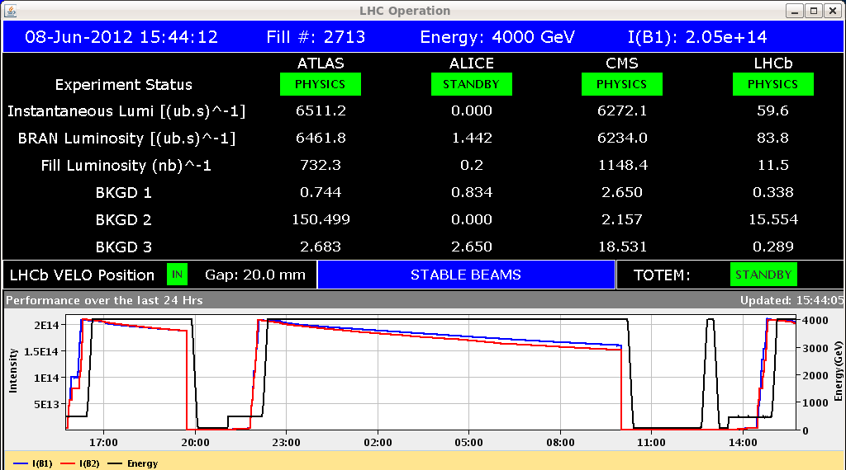
Fri Late
15:41h ramp, squeeze, stable beams
15:47h beam dump:
SIS lost subscription to CODs and after the timeout (40s)
dumped the beam.
Experts Explanation:
We analysed the logs of the FGC gateways, for which delayed subscriptions (>1min.) were
observed:In all cases, the blocking on the FGC side occured at the same time when LHC Luminosity
Scan application was subscribed to several properties and it got disconnected from the front-end server.
It is not fully understood why FGC gateway experiences such behaviour (temporary blocking while
pushing new notifications), while another application disconnects. CMW team will introduce additional
logging in RDA server part in order the gather more diagnostics, necessary to understand this behaviour.

Slide 4
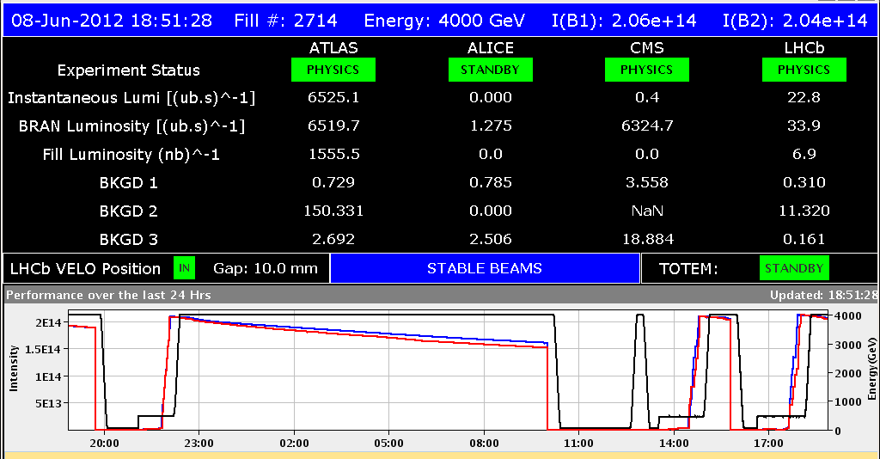
Fri Late
Explanation based on my complete ignorance:
stable beams
in parallel: work on a new version of the lumi-leveling application (which reads data form the coil settings)
in parallel experts working on the CMW
-> coil readings not available (overflow of server ?) and after 45 s the SIS
dumped the beam
17:33h back in business: injection for physics
18:08h ramp, squeeze , adjust
18:24h Lumi

Slide 5
Fri Late / Night
18:24h Serious issues discovered with LBDS.
systematic checks of possible failure scenarios -> there is a possibility to
get into a situation where a dump (on full steam) would not be possible.
(12 V supply at LBDS system)
Considered as critical for machine safety
-> dump
-> development of a survey system (12V check) that would dump
(a-synchroneously) in case of trouble.
20:34h Beam Dump due to LBDS problem
00:41h injection probe beam, check the new electronics
Pilot dumped to check LBDS synchronisation.
Everything looks good.
01:58h OFSU crashed at prepare ramp.
02:21h test ramp with some problems ...
QFB in V does not hold in both rings...
ramp, squeeze, adjust for checks
& chroma measurements

Slide 6
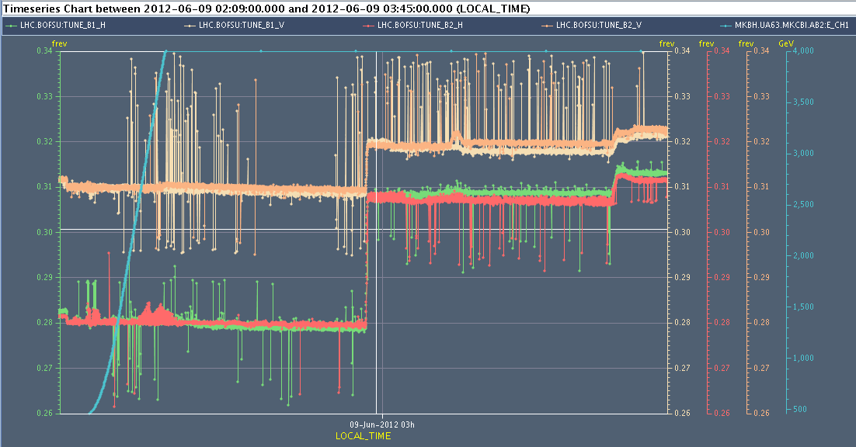
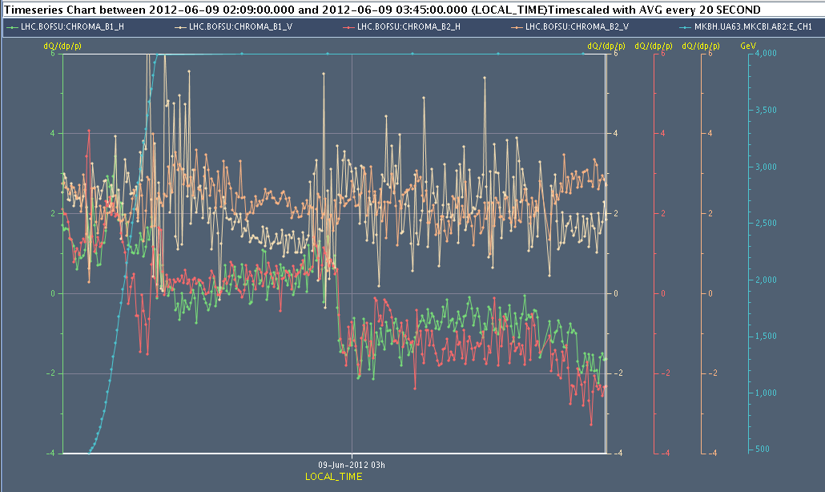
Fri Night
tune measurement
at ramp ... squeeze ... adjust
chroma measurement
at ramp ... squeeze ... adjust
05:35h beam dump, Power converter fault, RTQX2.R5
Piquet could reset the fuse fault.
07:34h injection probe beam

