Slide 1
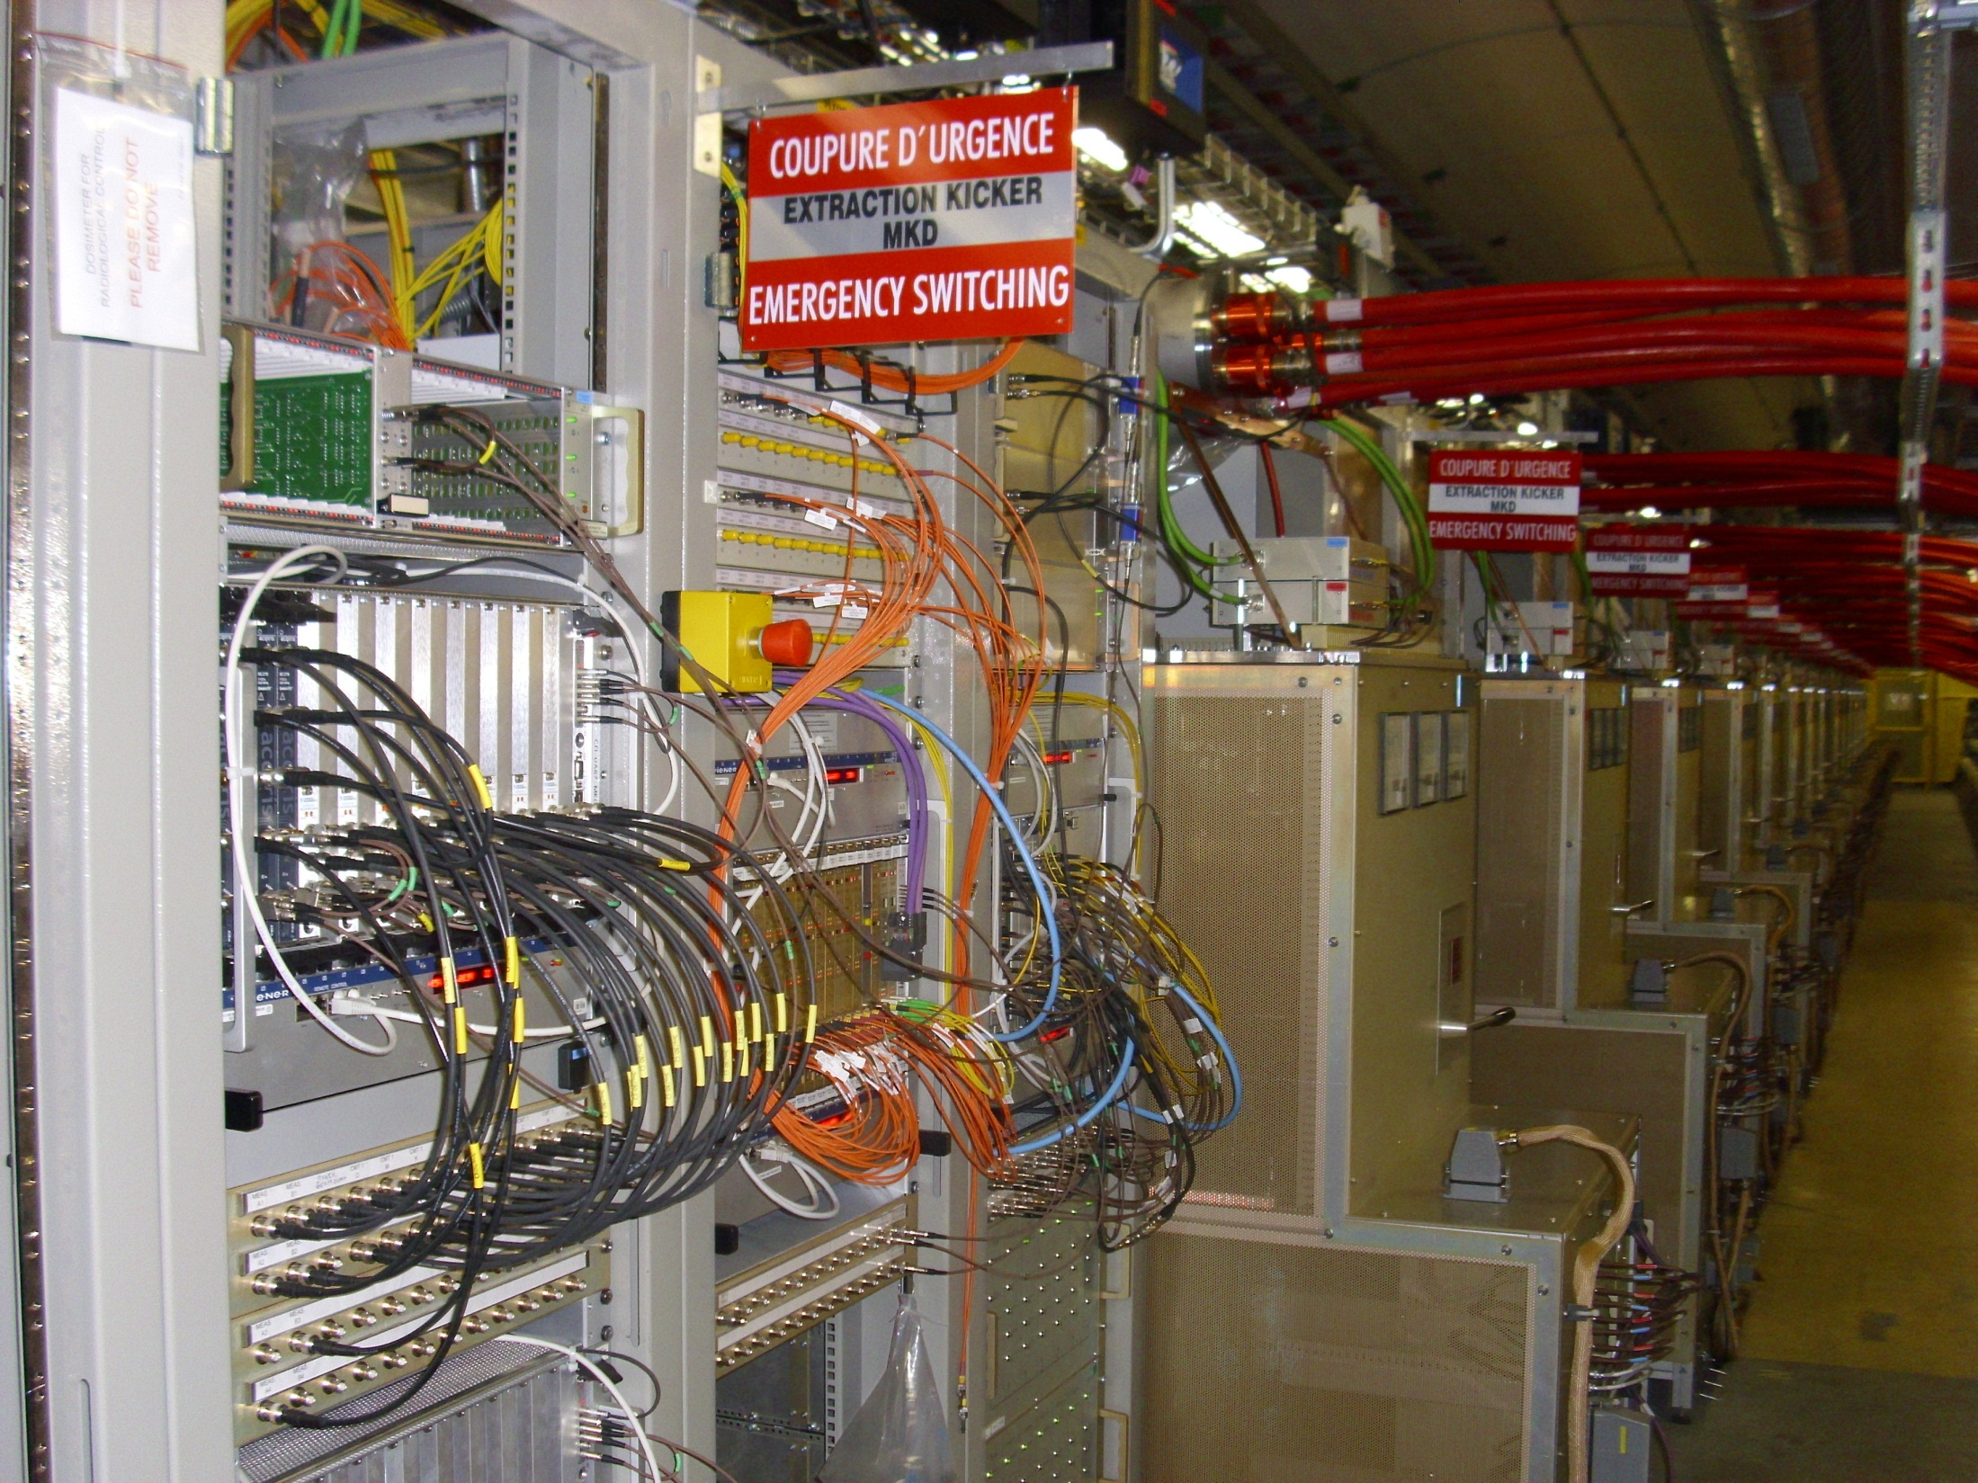
trigger and other general LBDS electronics
LBDS Beam 2 (UA67)
15 + 1 pulse generators
TSU
Fixing a (potentially fatal) safety problem
V.Mertens for E.Carlier, N.Magnin, A.Patsouli

Slide 2
Findings and actions
Preparing for a review on “LBDS powering” on 20 June … (triggered by asynch. dump)
Identified an error source on the test bed which would (if this error would occur) render the LBDS inoperable (→ NO dump when requested)
Trigger Synchronization Units (redundant TSUs, powered by redundant PS) in one crate
Loss of +12 V, e.g. by short circuit on a card, would make all output stages unusable
Power failure will be detected but, due to the loss of 12 V, not be transmitted further down into the LBDS (power triggers/pulse generators)
Informed straight away people in charge, who carried the message forward
Decision to dump and fix/solve this safety hole immediately
Simple (yet functional) fix got worked out, and was applied by midnight
Detects 12 V loss and injects trigger into re-triggering system (i.e. behind TSUs)
If 12 V loss in TSU crate → asynchronous dump (synchronization units not working)

Slide 3
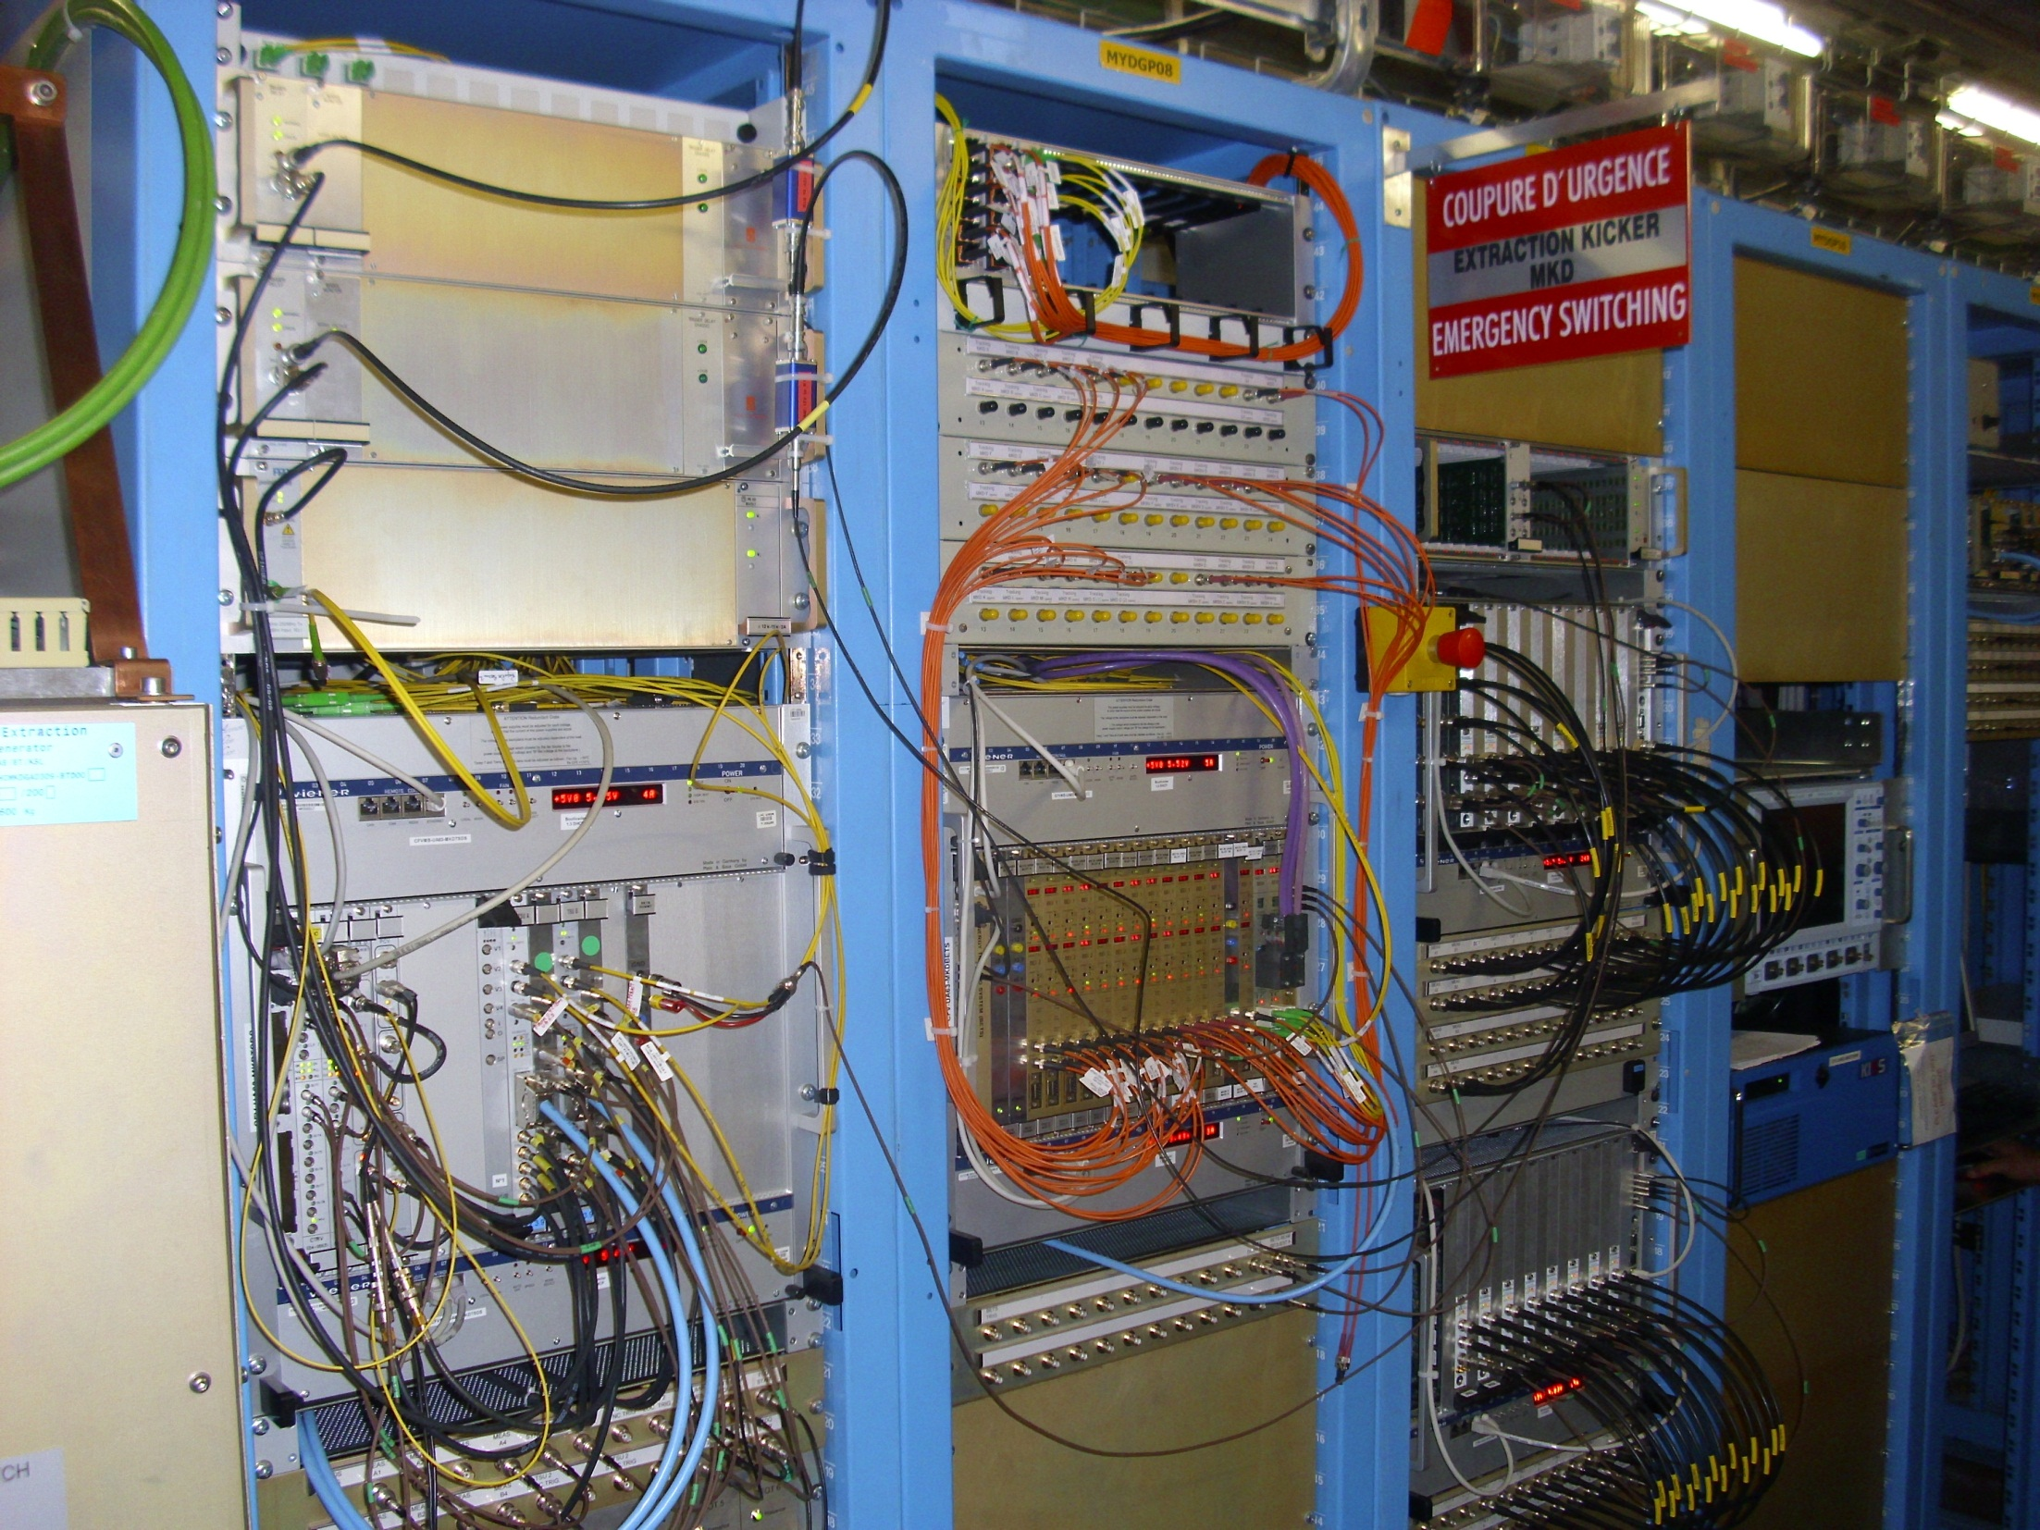
LBDS Beam 1 (UA63)
trigger injection into re-triggering system
pulse generation on detection of 12 V loss
TSU
BETS
Fix will be improved in TS2 (surveillance of 12 V surveillance, …)
Splitting of TSUs probably too involved for short stops
New TSU layout/design in preparation, to be implemented in LS1
(taking latest information into account)

Slide 4
Remarks
Potential error source existed since beginning
Would have been – and will be – eliminated by new layout/design of TSU system in LS1
Review of LBDS powering (June 2012)
Review of first years of operational experience (October/November 2012)

