Slide 1
Tuesday
08:30 Fill 2700 dumped by QPS on RCBXH2.L1
SUE candidate.
Integrated luminosity 33 pb-1 in 1:40.
Delaying refill for ATLAS solenoid (in case access would have been needed).
10:00 Injecting. Back to filling scheme with 3 non-colliding bunches.
11:00 ALTAS solenoid tripped again during ramp up.
11:30 Stable beam fill 2701, L ~ 6.2E33 cm-2s-1.
ATLAS solenoid ramping up…
CMS VdM cancelled.
23:20 Dump by OP.
Integrated luminosity 160 pb-1 in 11:50.

Slide 2
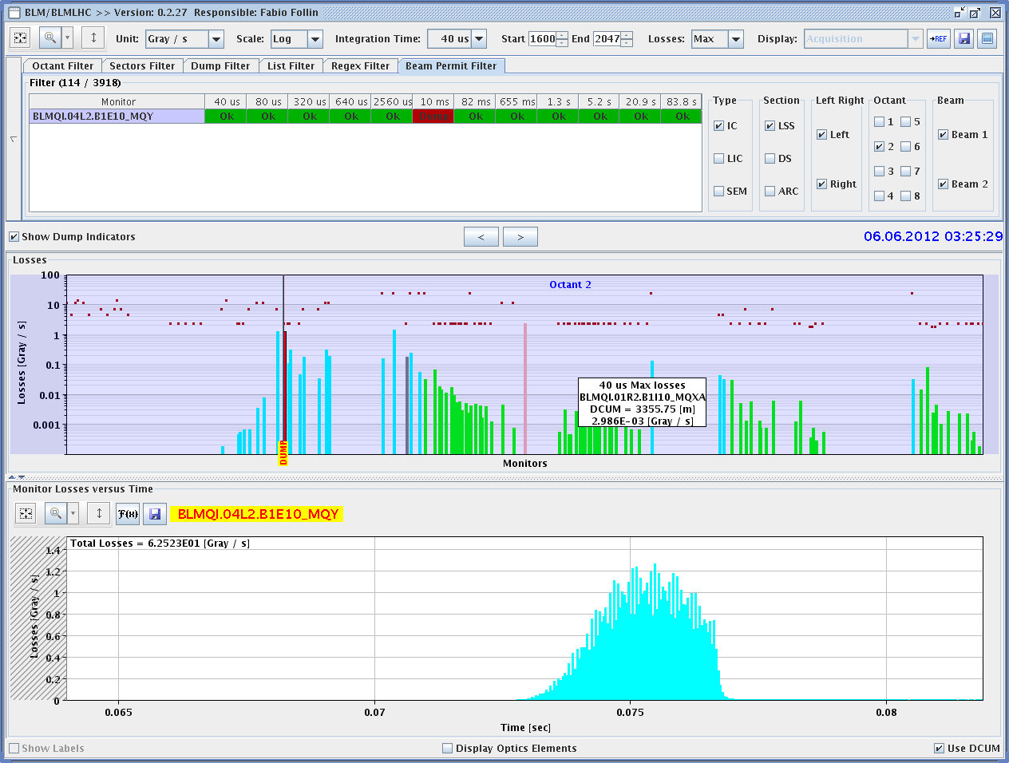
Night
00:00 Access for CMS, ATLAS and ALICE.
01:20 Machine closed.
03:30 Dump at 450 GeV.
UFO candidate around MKI2. ~300 ms after injection.
BCT

Slide 3
Night
04:00 Dump beam – some poor injections.
05:00 Ramp started. Beam not ideal…
Beam dumped in ramp.
Water flow fault on converter RQ10.R1.
Access for EPC.
Pressure increased from 1.9 to 2.2 bar.

Slide 4
Today
XPOC error investigations.
Test dump when we are ready again.
Then refill for physics. Expected around 10:00

Slide 5
Pending
CMS VdM and ADT gain reduction at end of fill.
RF: 1 hour end of fill for fine adjustment of tuners.
Impact of TETRA on hump / beam.
30 mins at injection with probe bunches.
Accesses:
TCLIB.6R2.B1 electronics and LVDT sensor
MAD PM15: motors of inner doors not working
RQTL11.R7B2 temp DFBAN spikes affecting cryo start but not CM (~3 to 5 hours).
BI in Pt4 (3-4 hours, working hours).
MKA test in Pt4 (1-2 hours).

