Slide 1
Loss of fill 2734
Global Post Mortem Event
Event Timestamp: 15/06/12 15:54:55.343
Fill Number: 2733
Accelerator / beam mode: PROTON PHYSICS / STABLE BEAMS
Energy: 3999960 [MeV]
Intensity B1/B2: 15691 / 15005 [e^10 charges]
Event Category / Classification: PROTECTION_DUMP /
MULTIPLE_SYSTEM_DUMP
First BIC input Triggered: First USR_PERMIT change: Ch 11-BLM_MSK: A T -> F on CIB.SR7.S7.B1

Slide 2
Loss of fill 2734
[ms]
[ms]

Slide 3
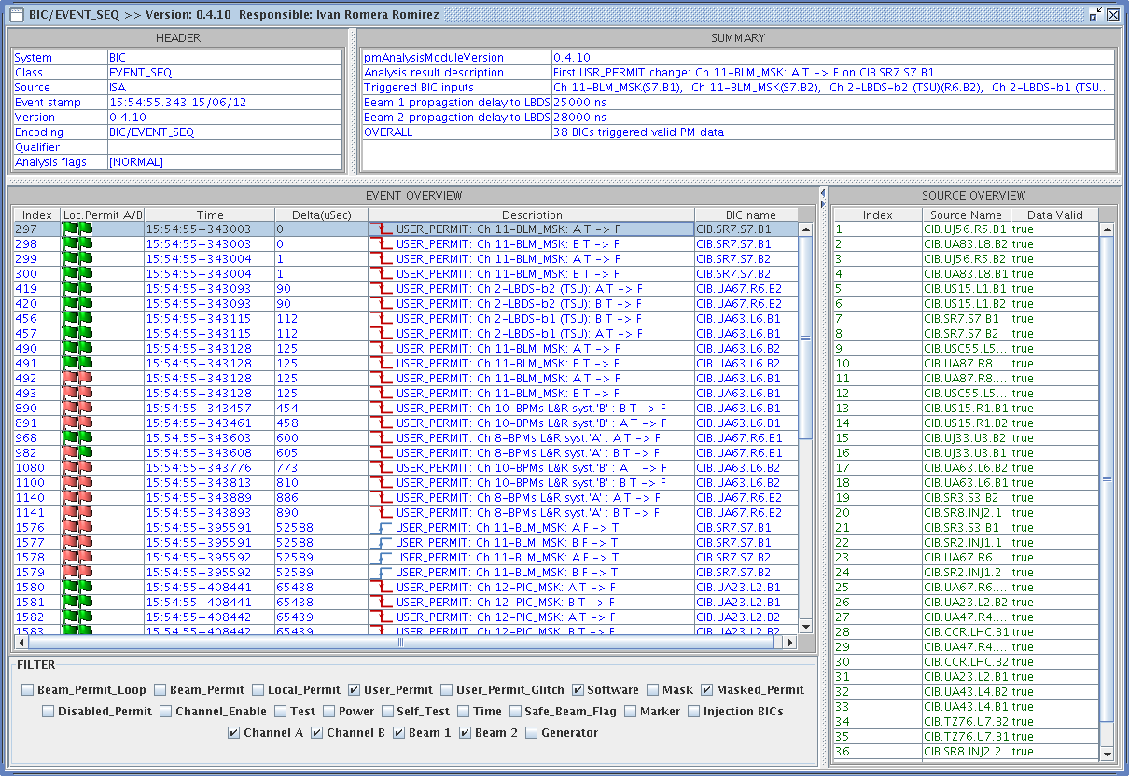
From BIS logs
BLM triggered Beam dump request
PIC only sees the Powering problem after ~60ms

Slide 4
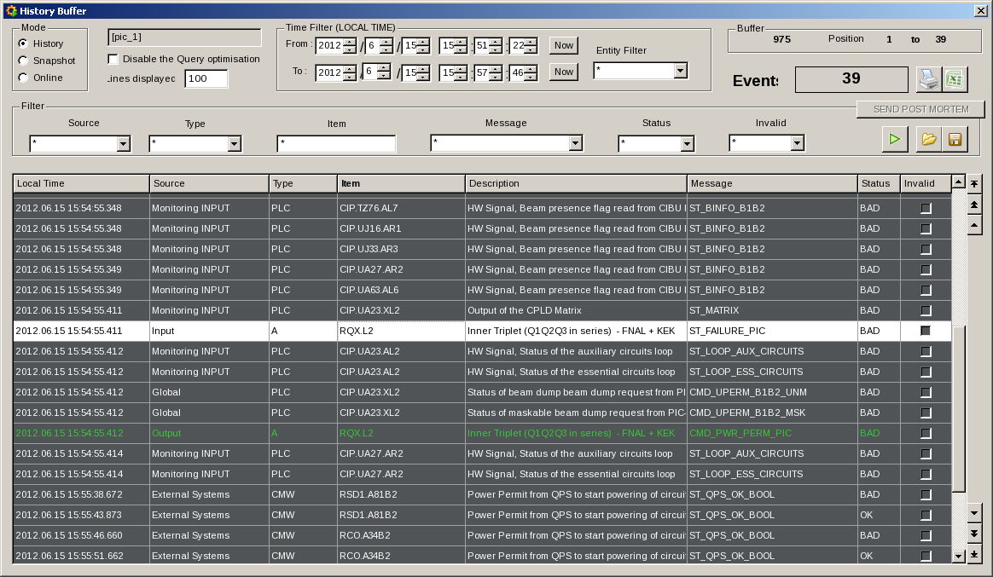
From PIC

Slide 5
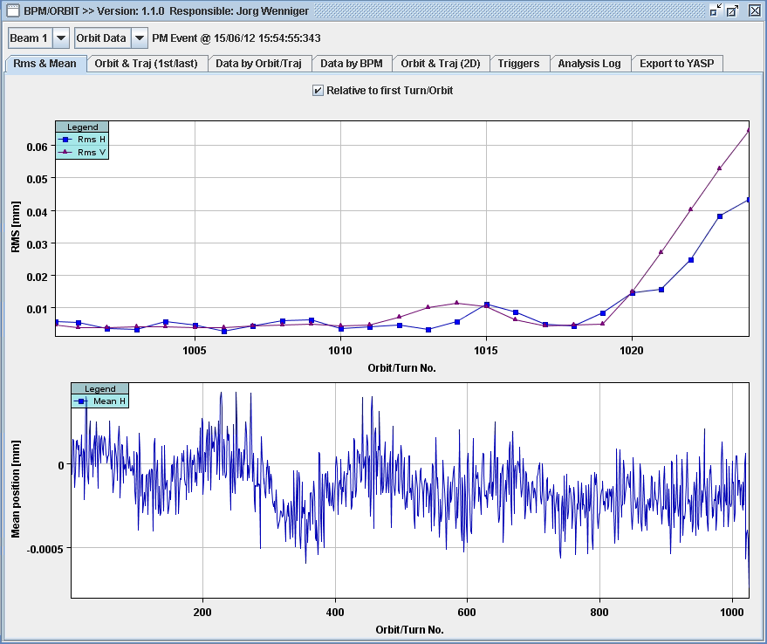
Loss of fill 2734 – change of orbit B1

Slide 6
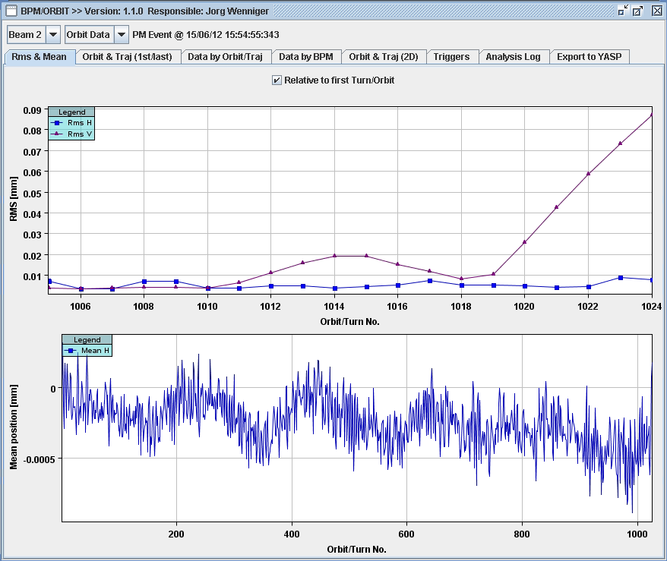
Loss of fill 2734 – change of orbit B2

Slide 7
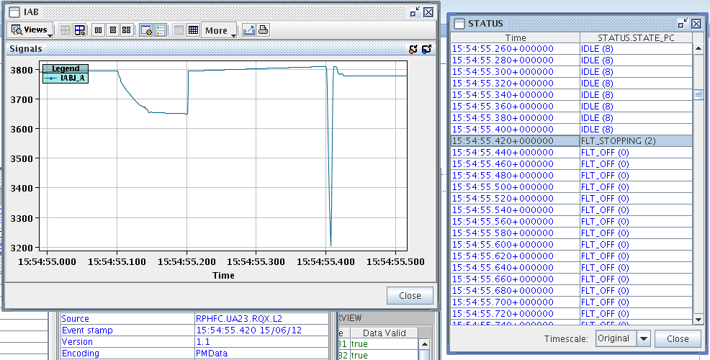
From FGC
Power converter only sends Powering Failure at 15:54:55.420
-One can see strange jump in current some ms before…

Slide 8
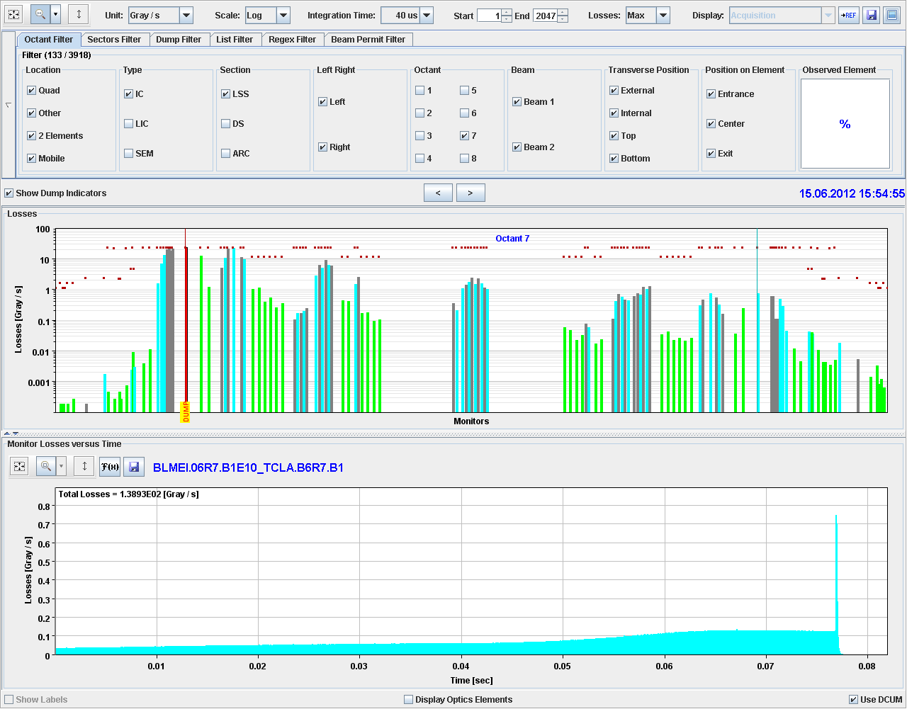
Beam losses beam 1 for fill 2734

Slide 9
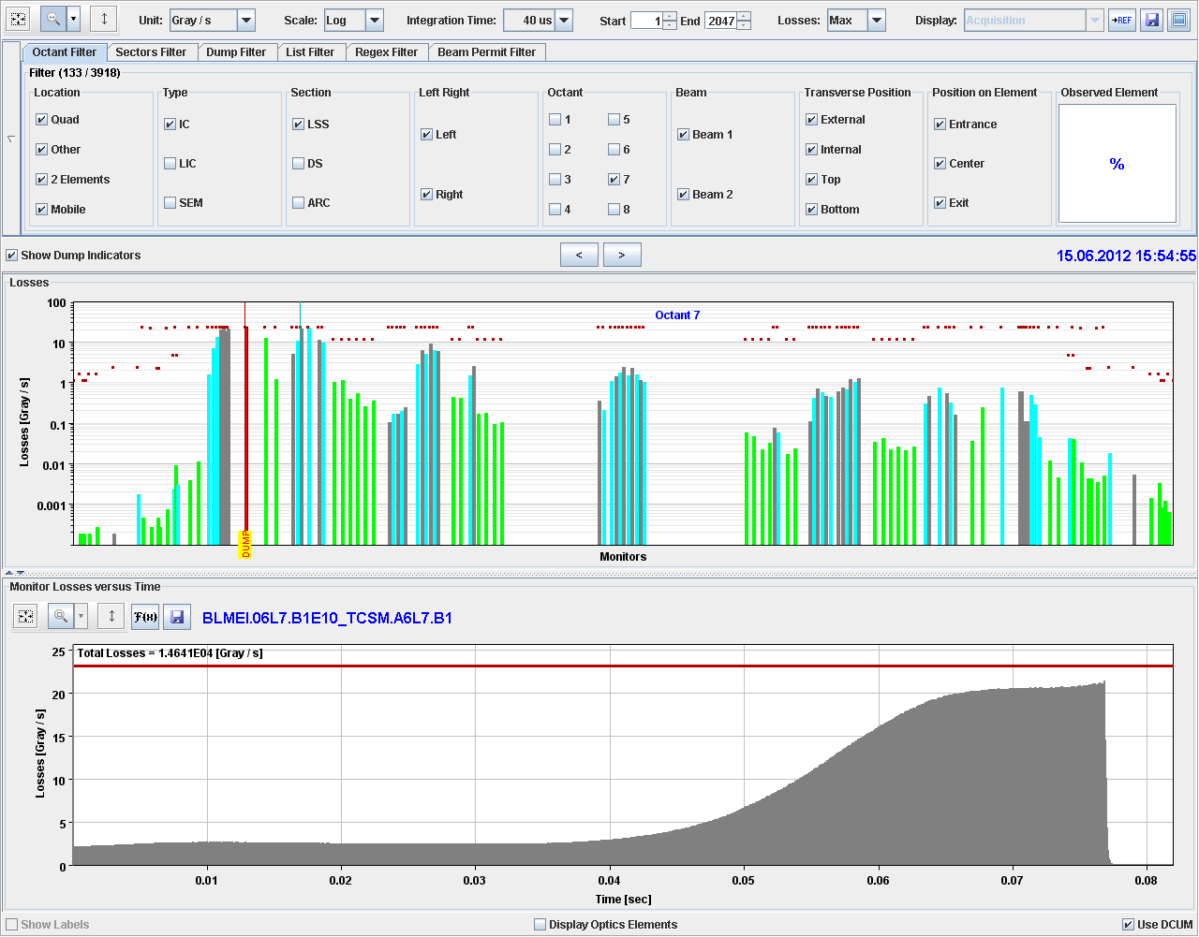
Beam losses beam 2 for fill 2734

Slide 10
Comments
This has been one of the standard cases during the design of the MP system, and the reason for the diverse redundancy in the systems
We would not have dared to test such case with high intensity beams
MP worked as expected…..
EPC should investigate how to send out a Powering Failure event in such case
In order to no only rely on the BLMs, the Fast Beam Current Change Monitor is required …

