Slide 1
Friday 15th June
01:11 Injection.
02:42 Stable beams #2733. Initial lumi: 6.7e33cm-2s-1.
08:17 Reached 5.976/6.042 fb-1 (ATLAS/CMS) for 2012.
15:54 Beam dumped, triplet RQX.L2 tripped. Delivered lumi 183 pb-1.
17:00 Drink for 5 fb-1
18:00 Drink for 6 fb-1
17:30 MKI temperatures ok, waiting on EPC and precycle RQX.L2.
19:45 Injection septum is misbehaving, getting FMCM RMSI.R8B2.
Injection problems, longitudinal and transverse
22:50 Stable beams #2734. Initial lumi 6.3e33 cm-2s-1
08:45 MKI.8D 4.5 % above temperature interlock level. This fill 150 pb-1 so far…

Slide 2
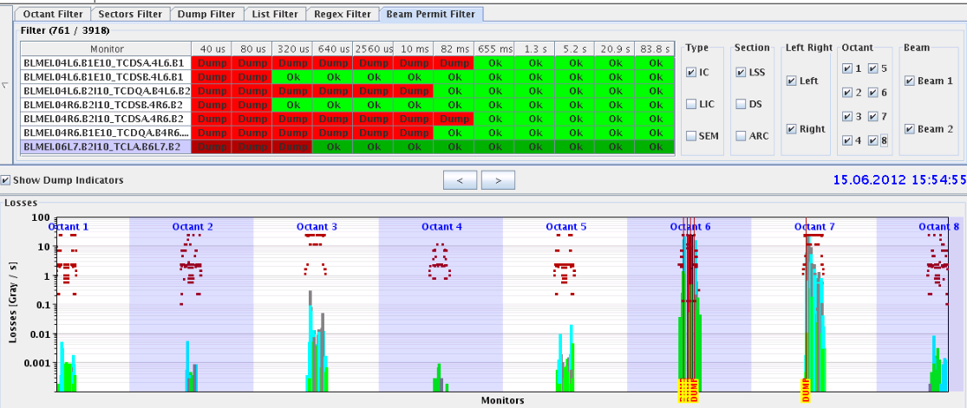
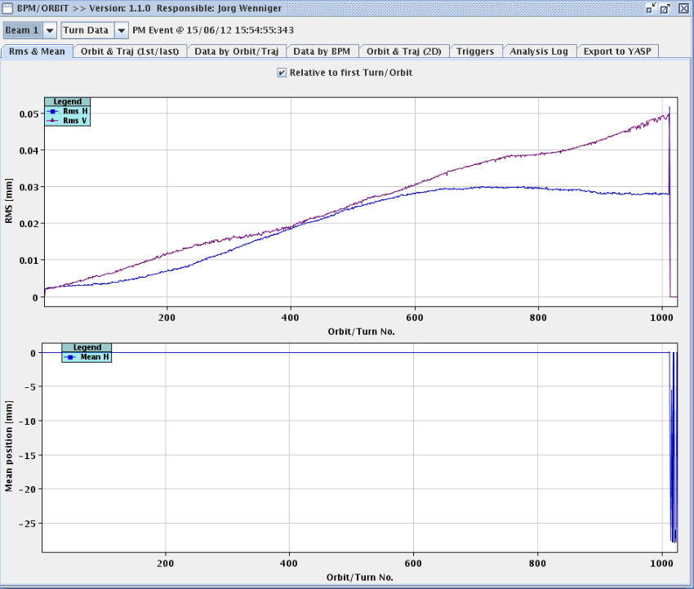
15:54 Beam dumped, triplet RQX.L2 tripped
The fault was originated by an internal problem on RTQX2.L2, which generated voltage oscillations of the three nested converters.
I_ref had a sudden jump; that was probably due to the change of current of RQX2.L2 by -5 A
This resulted in orbit oscillations
Beam was dumped by fast losses on TCLA.B6L7.B2
The pc tripped by overcurrent inside the RTQX1.L2, after 300 ms
N.B. Behaviour of the PC (and protections) correct, apart for the initial current change (which is not clear whether is coming from the PC.)
the subconverter 3 of RTQX2.L2 went probably in short-circuit

Slide 3
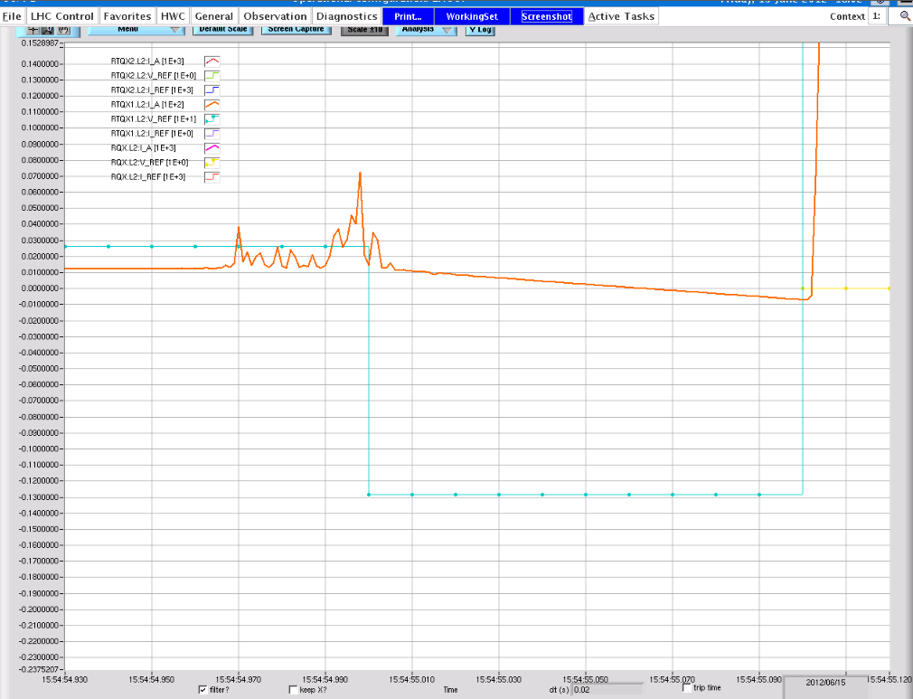
PC behavior

Slide 4
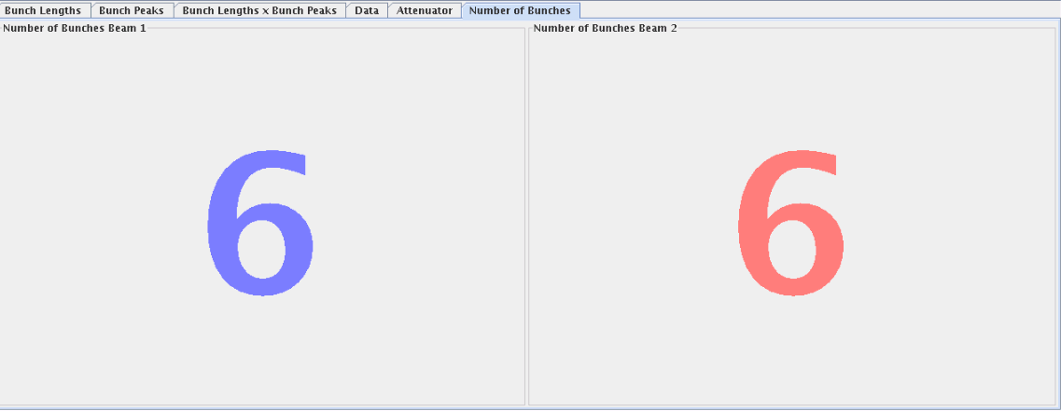
New Filling Scheme
6 bunches for first injection
BSRT emittances at 600 GeV, B1
BSRT in squeeze: B1 looks ok again…

Slide 5
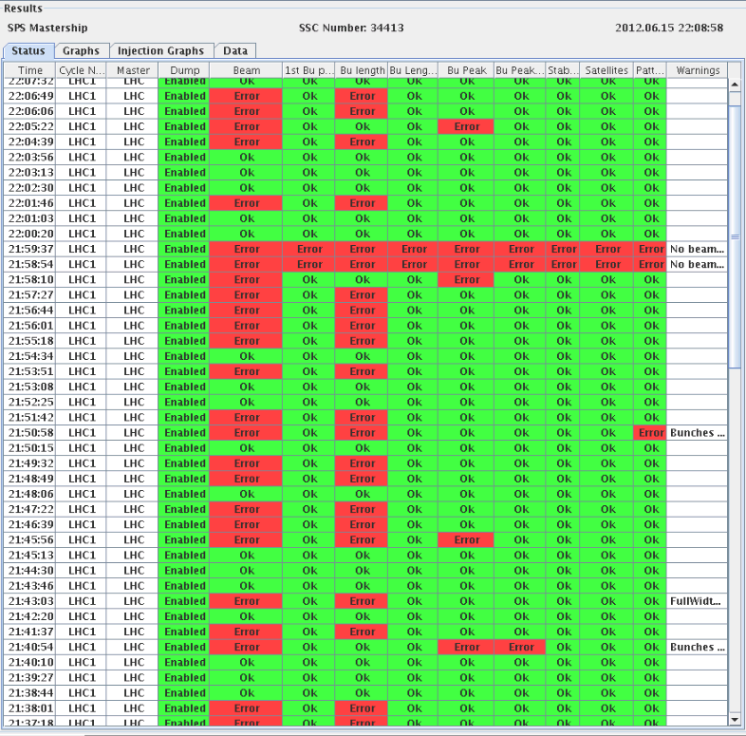
Injection not smooth
Longitudinal and transverse problems with beams from SPS
Problems with longitudinal blow-up during the ramp
Resulting in lower peak luminosities and possibly more heating of the MKI during the fill

Slide 6
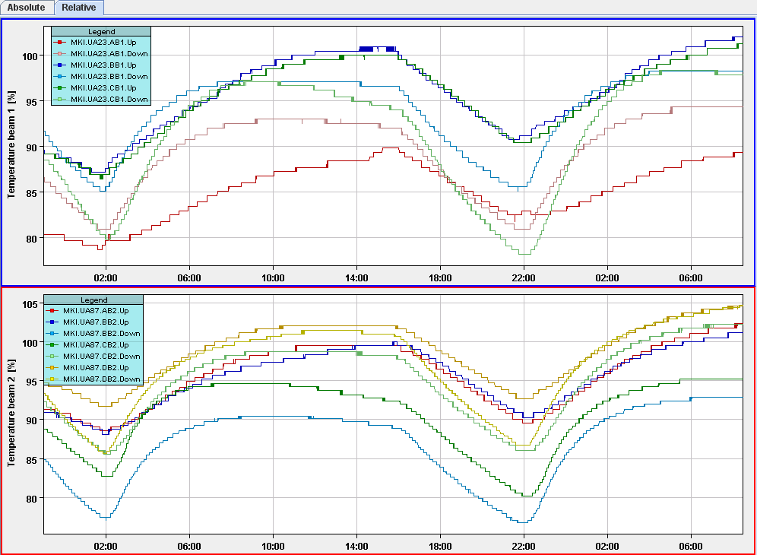
Injection kicker MKI temperatures
After increase of temperature thresholds on Thursday evening, MKI.8D is the limiting temperature which cannot be further increased as a reduced kick strength (faster rise time) has been measured for this magnet
Just before beam dump at 15:55 – MKI.8D.DOWN was going down in temp, MKI.8D.UP was flat, but not going down yet.
Max temperature 2 % above threshold – this depends on temp at start of stable beams
This is after 13 hours of stable beams … Needed to what about 1.5 hours after beam dump before ok – 30 minutes wait.
At this moment MKI.8D 4.6 % above threshold… would need a much longer wait
MKI.8D UP and Down
Temperatures higher than in previous fill. Problem with bunch lengths in ramp...

Slide 7
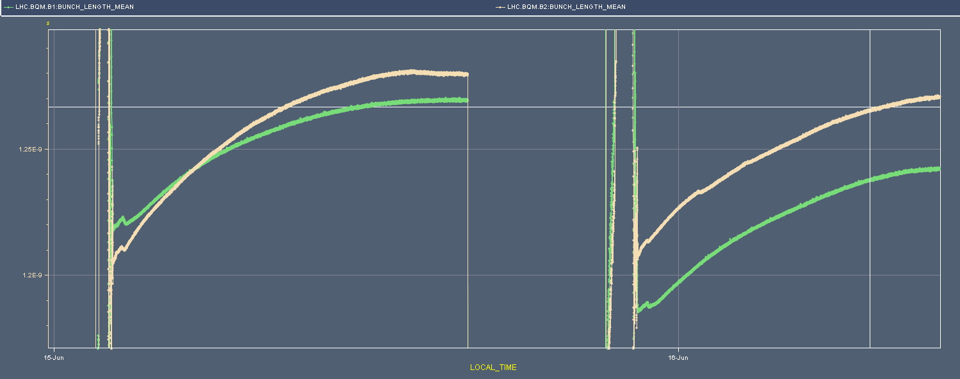
Individual bunch lengths at 8:50 this morning
Mean bunch length comparison last two fills. Especially B1 is shorter, but we see more heating for B1 and B2….

Slide 8
Planning Ahead
Delivering luminosity…
To be done…
RF: Long. blow-up at injection: tried it, to be re-visited after TS
New filling scheme (6 non colliding bunches for ATLAS/CMS): In - OK
ADT: Pilot for 15min. 6b for 15min.
Impact of TETRA on hump / beam: 30 mins at injection with probe bunches.
Access:
TCLIB.6R2.B1 electronics and LVDT sensor.
MAD PM15: motors of inner doors not working (at least 4 hours).
BI in Pt4 (3-4 hours, working hours).
TOTEM vacuum gauge (3 hours, not urgent).
MCBV18.L4B1 and RCO.A12.B1 to be repaired / replaced.
LBDS Check/repair Ethernet connection on FEC cfc-ua63-mkdtspm. 1 hour during working hours, N. Magnin.
Collimator cooling check TCT IR8 – Oliver Aberle
Pt.7 (IMPACT: 18638) to exchange two amplifiers for the diamond BLMs. 2 hours (Ewald).
BI: UA43 - lost remote communication with one of our controls front-ends. ½ hour.
BI: Q7R4 (RF zone) - install attenuator and temperature probes on the HT- monitor to be retrieved during the next TS. ½ hour.

