Slide 1
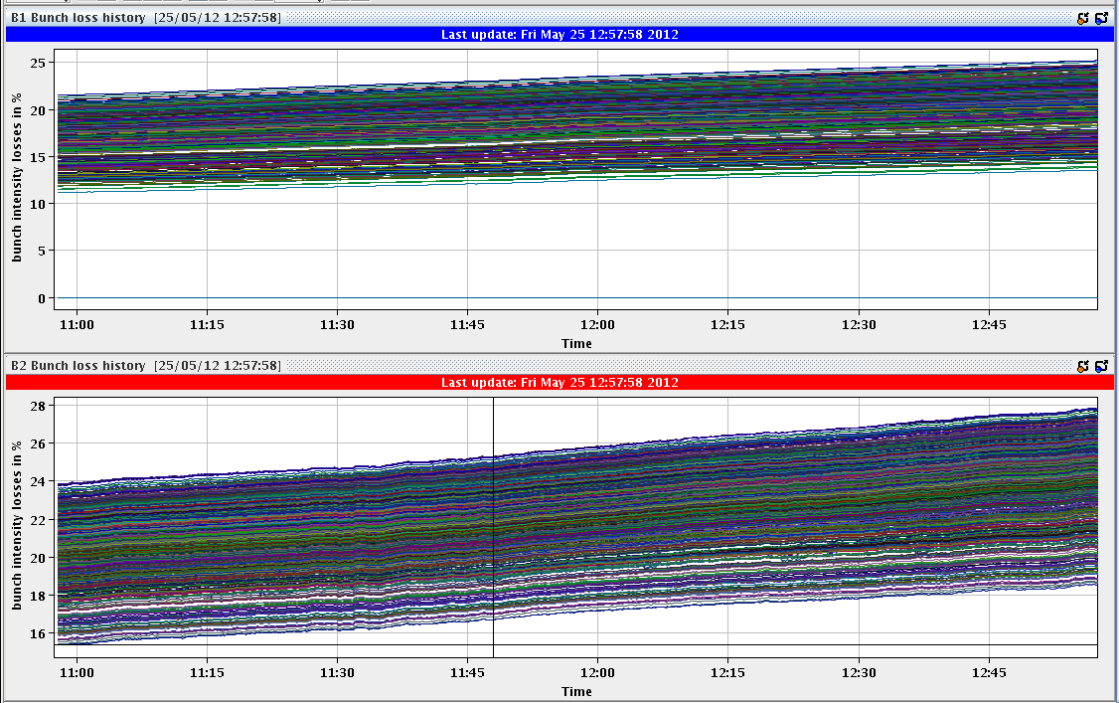
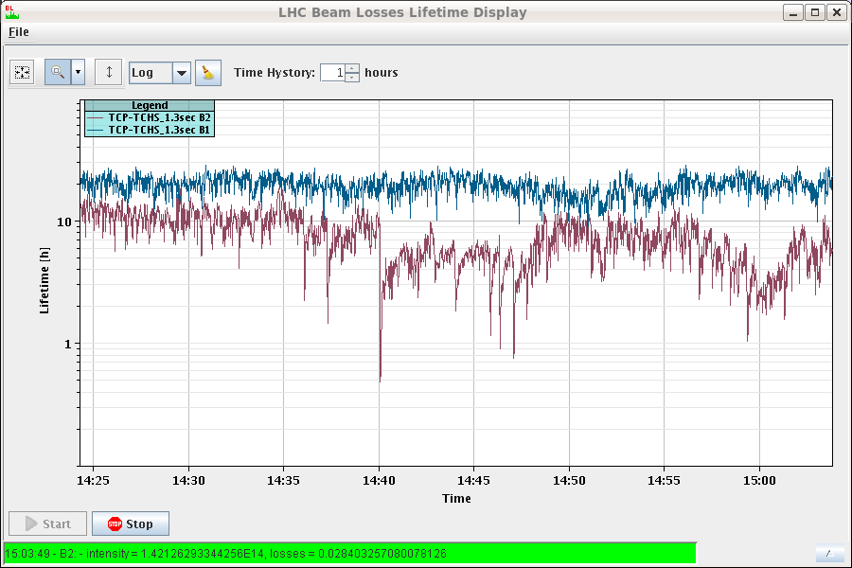
Friday 25.5. Morning
3:44 – 15:04 stable beams Fill 2663 (dumped by operator)
1.51e11 average bunch intensity
Peak lumi: 6.5 10³³ cm⁻²s⁻¹
Integrated lumi 167 pb-1
14:30 – 15:00 tune scan B2
Going up by 0.003 in H and V (0.001steps)
Going down by 0.008 in H and V (0.001 steps)
No improvements in lifetime

Slide 2
Friday Afternoon
15:00 – 17:30 Scheduled access
Atlas gas leak, LHCb
Pt 6 interlock BPMS cabling check and attenuators
Vacuum Pt 4 to repair a pumping group at 14R4
TOTEM LVDT bypass activated and BIC channel #4 (TOTEM) on B2 injection BIC (CIB.SR8.INJ2.2) disabled (spurious interlocks from Wednesday)
Summary of interlocked BPMs Pt6 access:
Found errors in cable numbers in the documentation which was used for placing the attenuators → corrected attenuator placement

Slide 3
Friday afternoon cont.
19:00 interlock BPMS B2 tests – all found OK
Testing the position interlock functionality with beam bump
Scraping B2 with TCP.D6R7.B2 (sensitivity test)
BPMSA.B4R6.B2 decreased from 6e10 to 4e10 BPMSA.A4R6.B2 increased from 1.1e10 to 3e10
Probes should now be invisible to the system when in low sensitivity.
Margin for single bunch loss with physics beams increased. Should now be OK down to 4e10.
These limits can probably still be optimised to bring the limits on all interlock BPMs to between 2-3e10. Requires access to UA67.
OP should still check bunch counts with the machine full to verify correct functioning with multi-bunch fills.

Slide 4
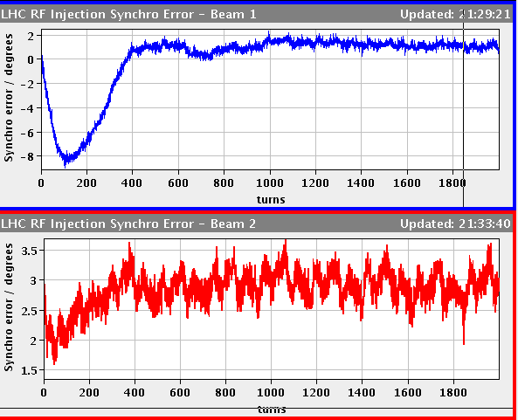
Night
Trimmed RF frequency at injection by +18Hz and corrected B2 TL
Controls problems on BBQ and OFSU fixed by rebooting/killing processes – to be followed up after the WE (30’)
21:50 IPCO communication problems with the LBDS and the MKI FECs (40’)
RQ6.R1 tripped at injection current (a spike on U_res of Q6.R1 triggered the heaters); powering subsector LR1 down (2:15)
0:50 Dry dump to check LBDS is OK now after the reboot of several FEC
0:55 re-injecting, +5Hz frequency trim ~1.53e11 bunch intensity, clean ramp and squeeze

Slide 5
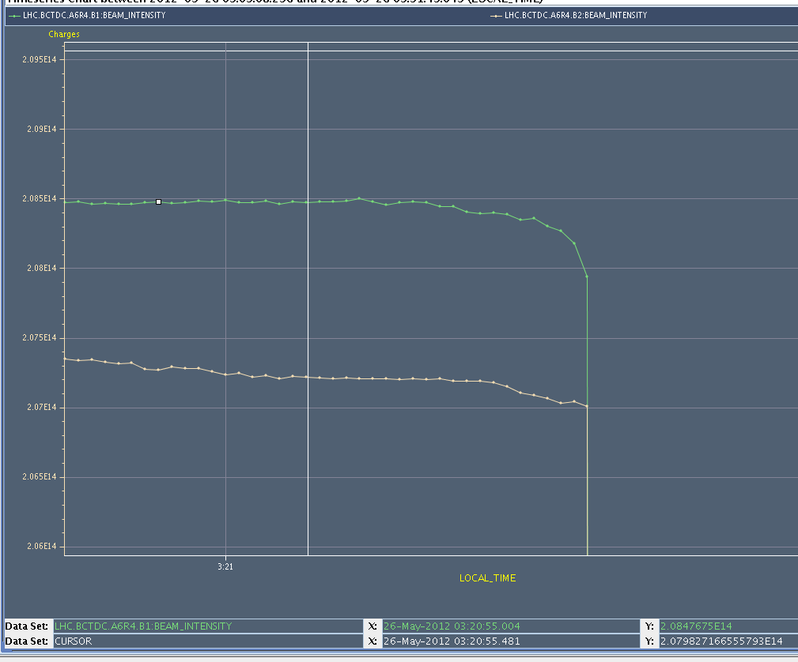
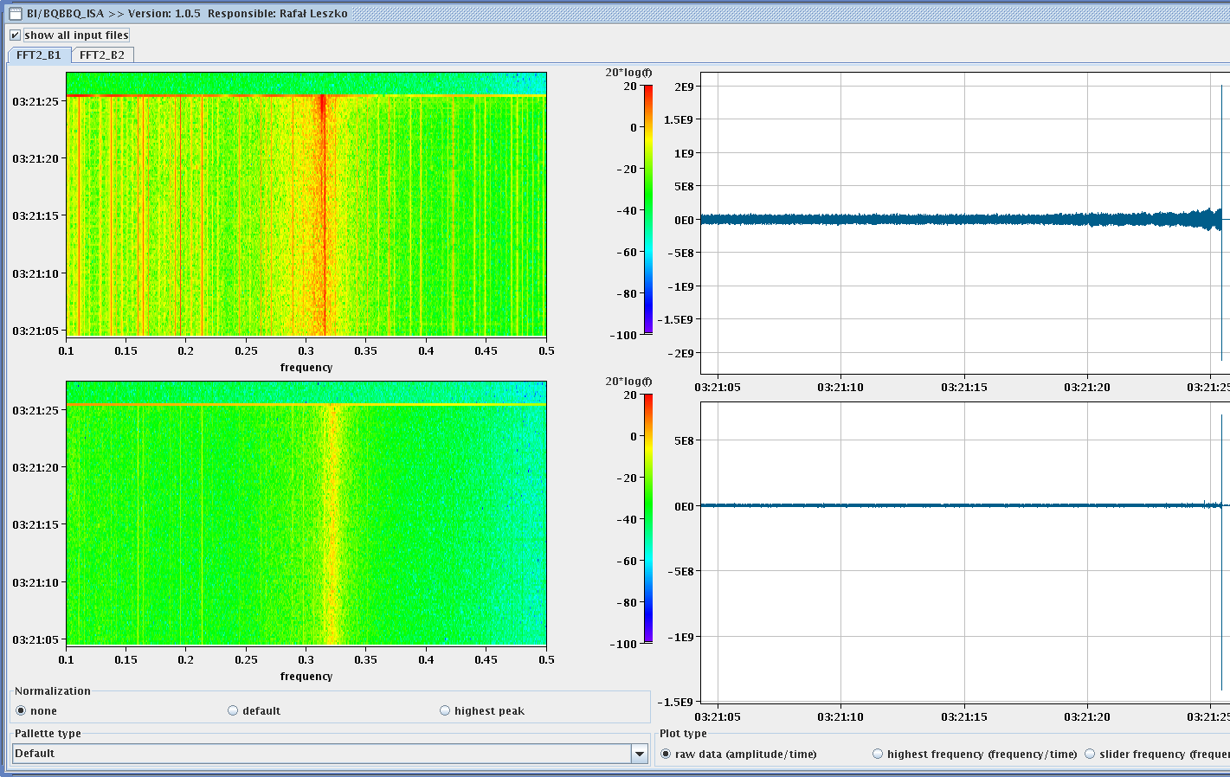
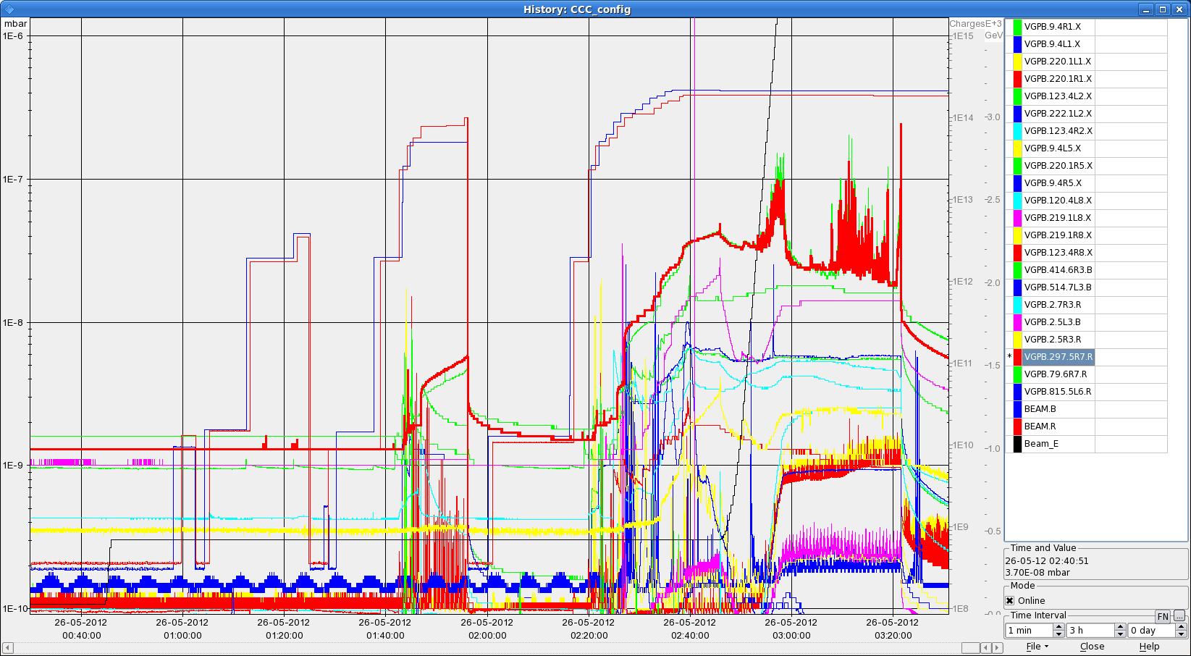
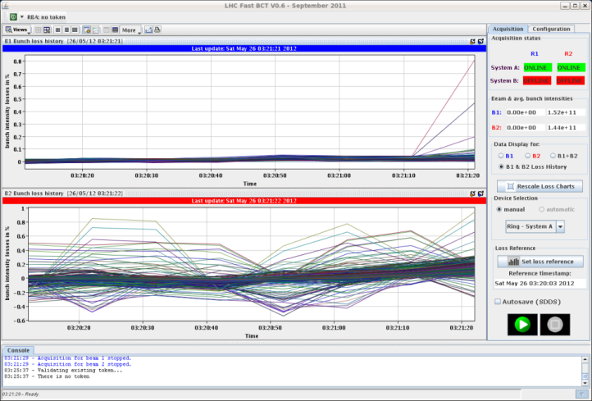
Saturday
3:21 Fill 2668 dumped by losses at TCLA.C6R7.B1 at the very beginning of collisions BP
B1 lost a total of 2.4e11 protons in 1 sec
B1 loss happened after the last update

Slide 6
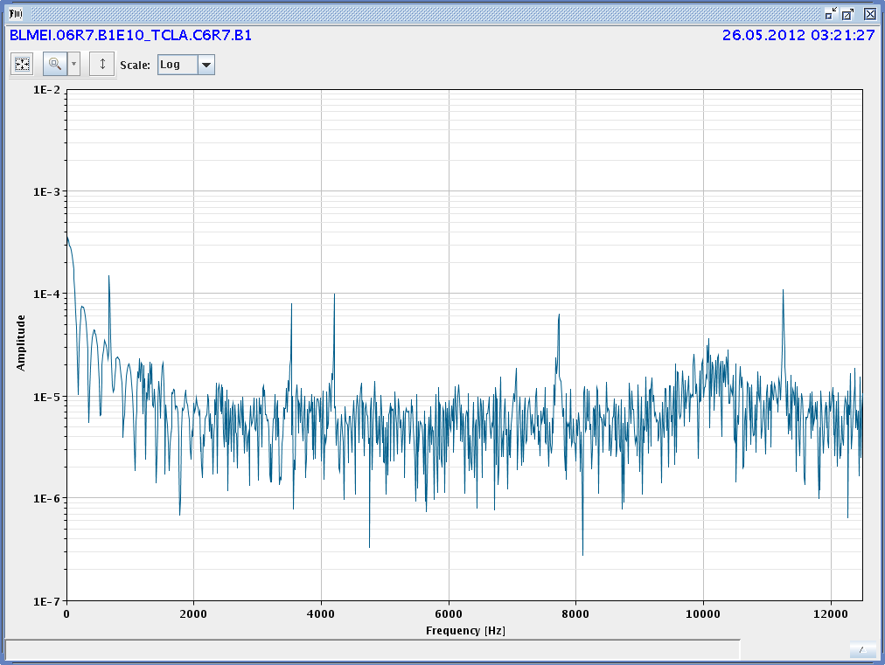
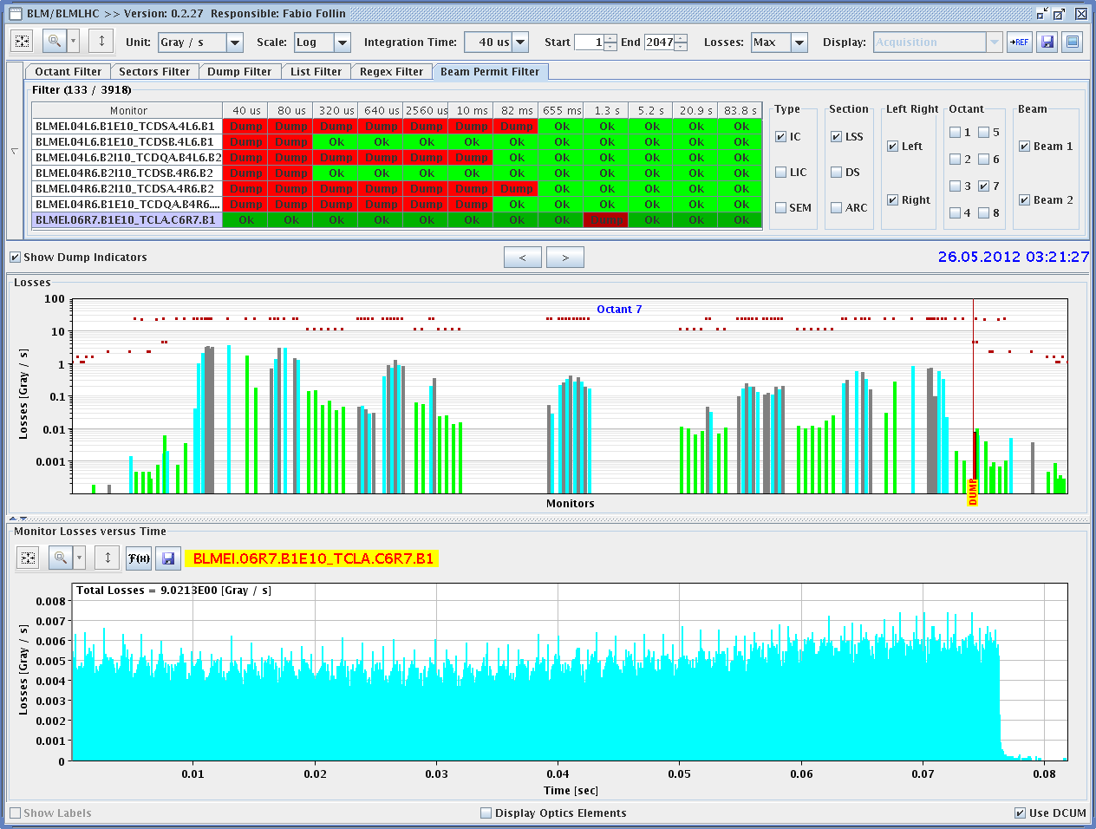
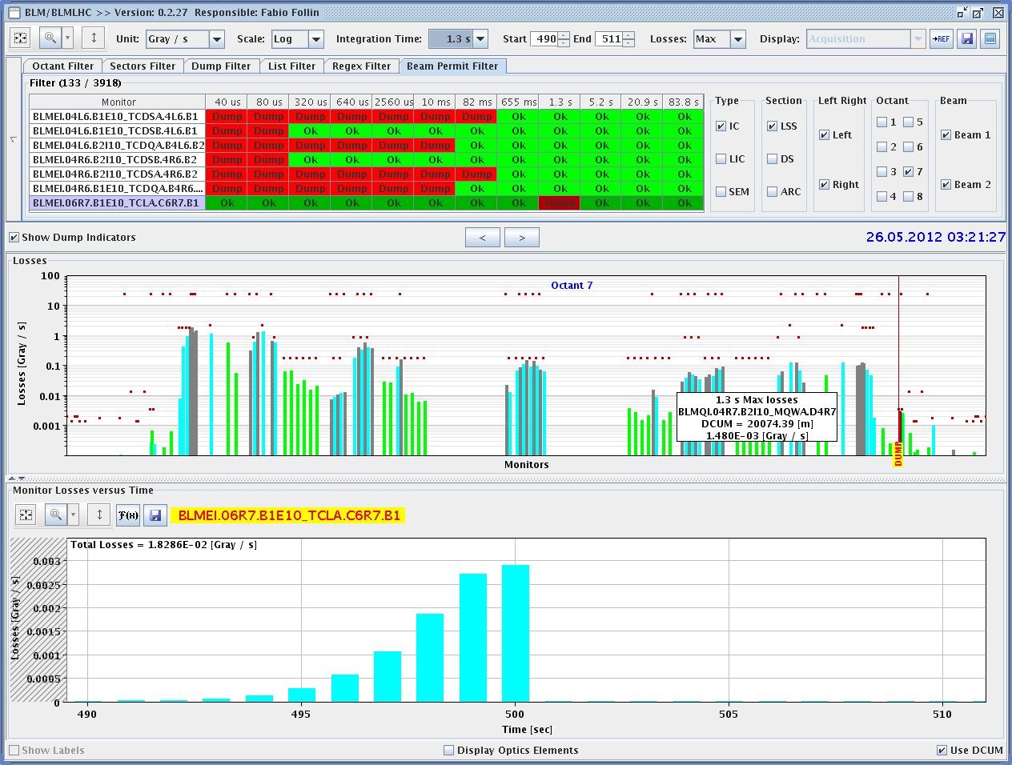
Dump of Fill 2668 BLM data
Frequency spectrum B1 losses → instability

Slide 7
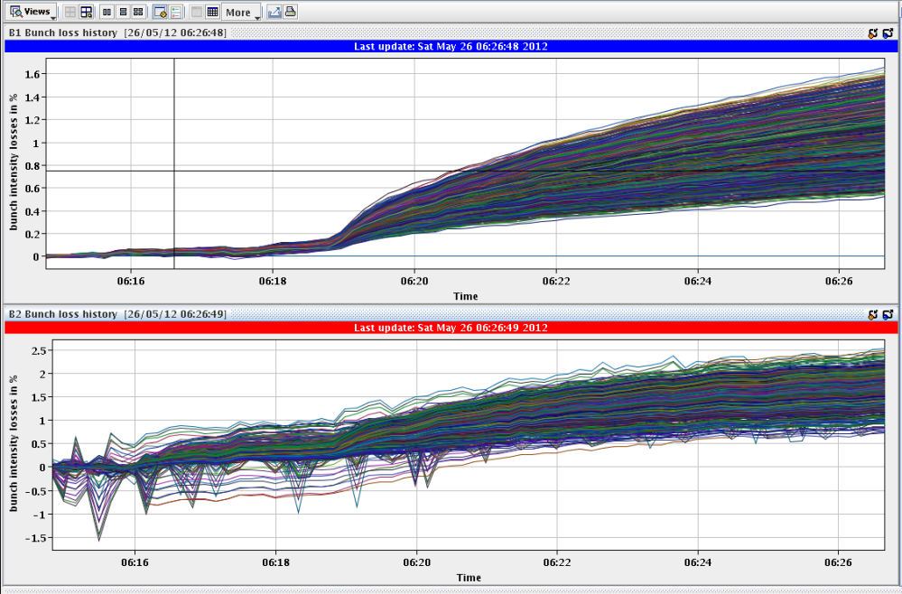
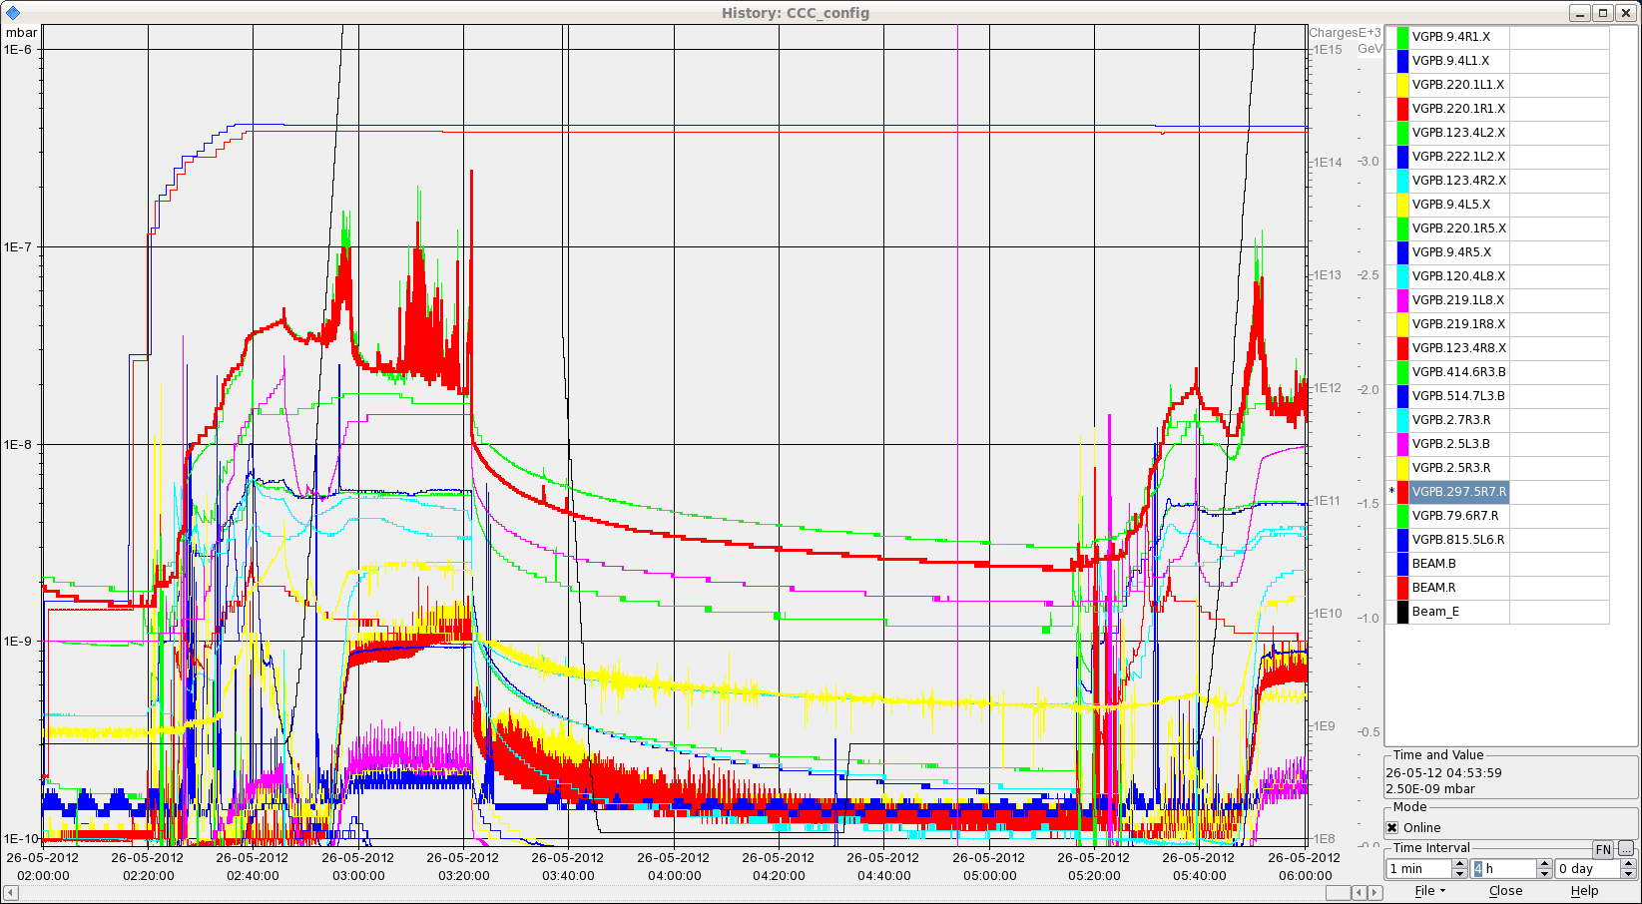
Fill 2669 Saturday morning
cavity 7B2 low level problem (45’)
Average bunch intensity reduced to 1.5e11
Trim RF down by -5Hz
BLM signal to 35% of threshold at start of ramp and to 32% at .215m beta*
6:24 stable beams
Peak lumi: ~6.5 10³³ cm⁻²s⁻¹

Slide 8
For the week- end
Luminosity production with 1.5e11 ppb
Monday meeting at 9:00
Summary of the week on Tuesday

