Slide 1
Wed 23.05.12
08:55 Fill 2653 stable beams
1.40e11 ppb, 5.6 10³³ cm⁻²s⁻¹peak lumi, 11.6 pb-1 total lumi delivered.
09:31 Dumped by collimator interlock:
TCDD (injection movable mask/collimator) for beam 1.
10:55 Access for replacement of power supply for PXI rack.
11:41 Access finished.
Recovering TCDD and TDI positions for beam 1.
In shadow: QPS board swap on RQTL11.L5B1 and RCD.A45B1.
13:02 Injection.
Steering TI2 and TI8,
14:05 problems with BPM interlocks from LSS4 and LSS6. PS and SPS need to readjust the beam.
14:15 TOTEM interlock for injection: intermittent fault. Experts checked but not understood. Seems to be on BIC side: CIBF (CIBU fiber). Take out TOTEM interlock? To be discussed with MPP.

Slide 2
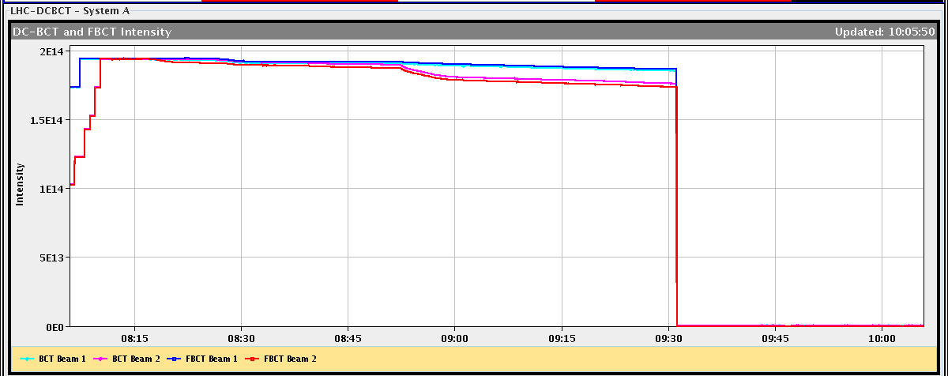
B2 Intensity Loss at Start of Stable Beams
Tune feedback locked on wrong peak → Q2h too low → slow emittance blow-up of all bunches → losses and reduced lifetime.
Stopped by manual tune change.

Slide 3
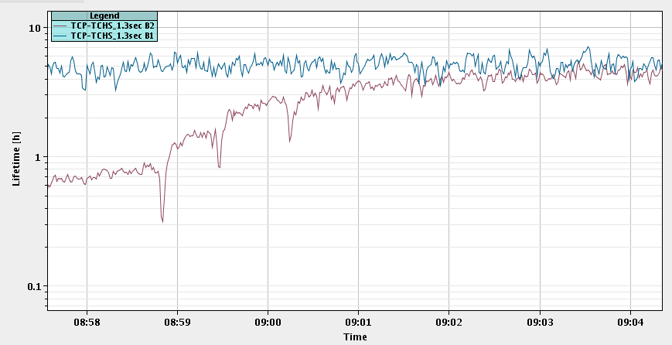
Adjusting Tune B2 H
Lifetime B1
ΔQ_{h} = + 0.001
ΔQ_{h} = + 0.001
Lifetime B2
ΔQ_{h} = + 0.001

Slide 4
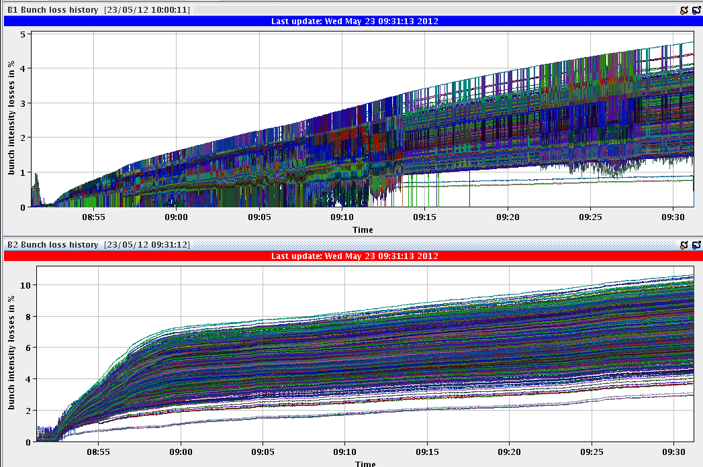
Bunch by Bunch Beam Loss
Q2h adjustment

Slide 5
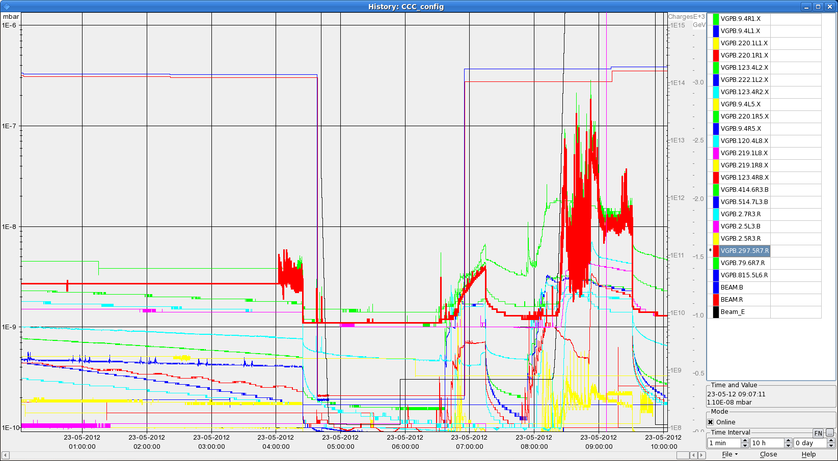
Effect on Vacuum (LSS7R)
Q2h adjustment

Slide 6
Wed/Thu 23/24.05.12
17:36 Injecting slightly higher bunch intensities: 1.47e11 average. Emittance from SPS: ~1.8 micron (on 12 b).
18:41 Stable beams.
At start of collisions: Some bunches with losses. Some instability observed: B2H. Lower beam 2 lifetime. B2H not trimmed up this time.
Stable after being in collision.
Peak lumi: 5.6e33. Higher bunch intensities did not result in higher luminosity → emittance blow-up!?
00:41 Dumped by interlocked BPM in IR6
The 3 bunches in ring 2 that collide only in 8 lost intensity at about 23:20, 23:50 and 00:25.
Note that the losses go in steps and seem to synchronize at time.
Bunches were at around 6e10 ppb at the time of the dump.

Slide 7
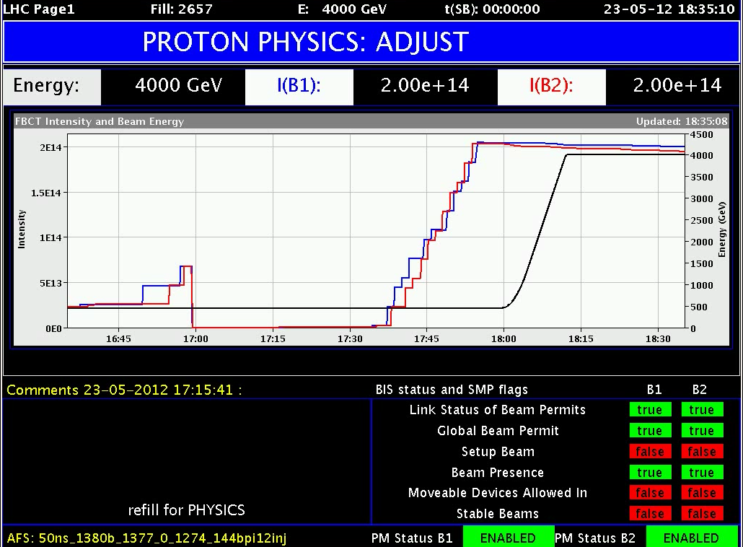
2/3 Design Intensity (130 MJ)

Slide 8
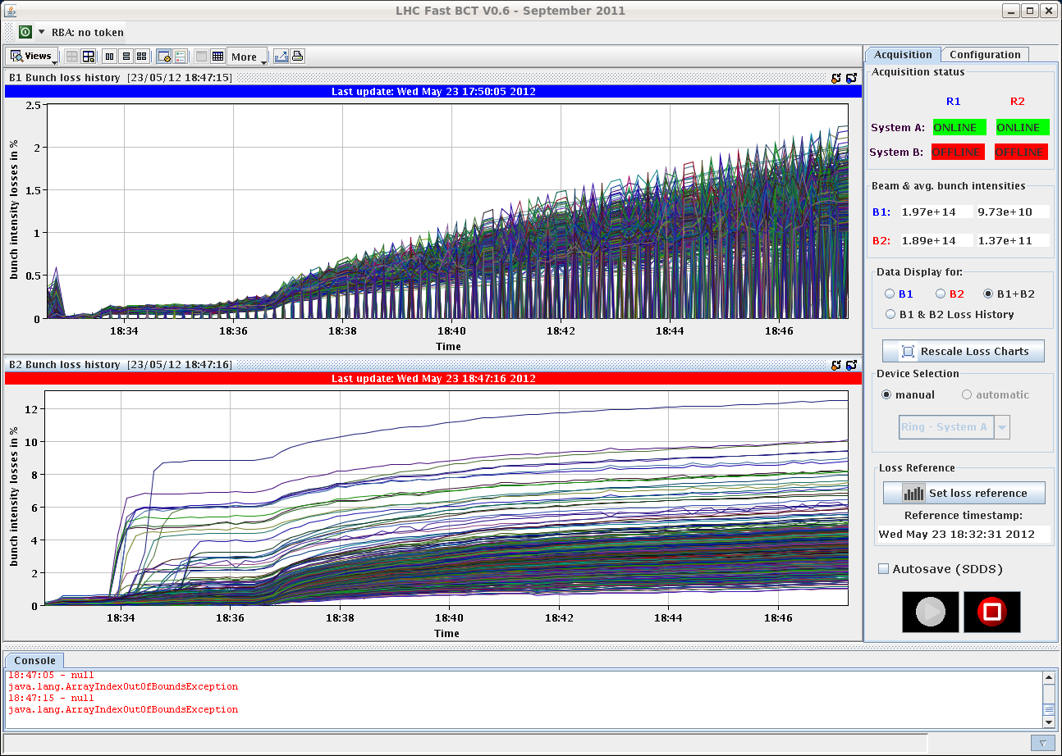
Bunch by bunch losses
Start collision process
Collision

Slide 9
Very Modest (No?) Increase in Peak Luminosity

Slide 10
Excitation Seen on B2H
G. Arduini

Slide 11
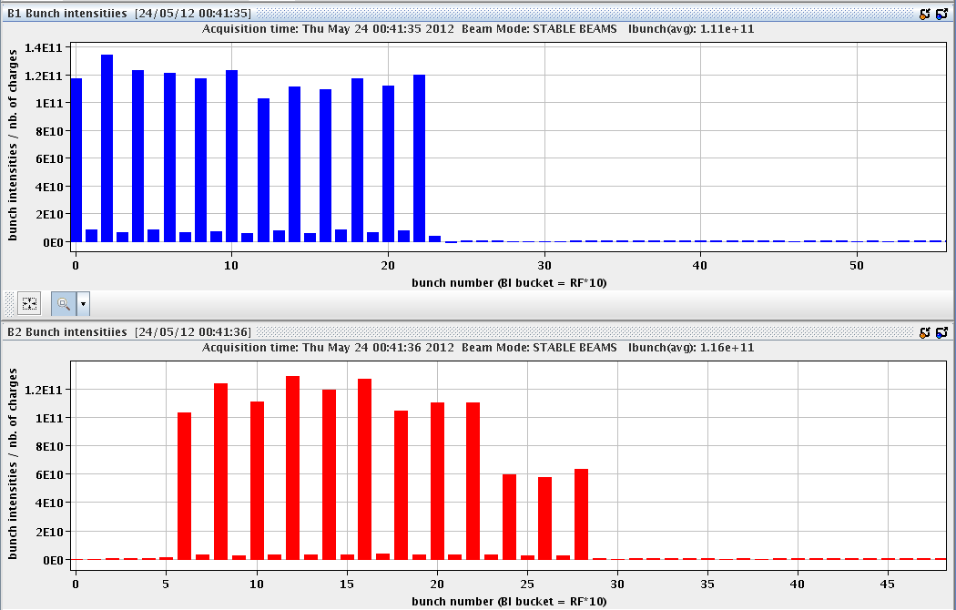
Bunch by Bunch Intensity @ Dump Time

Slide 12
Thu 24.05.12
01:22 Problems with TCL.5R1.B1 (recurrent issue).
A. Masi disabled the resolver check on lost steps.
To be followed…
02:11 Injection.
03:53 Stable beams. Peak lumi: 6e33.
05:14 RB.A45 QPS trip. Recovery…
Now preparing for injection…

Slide 13
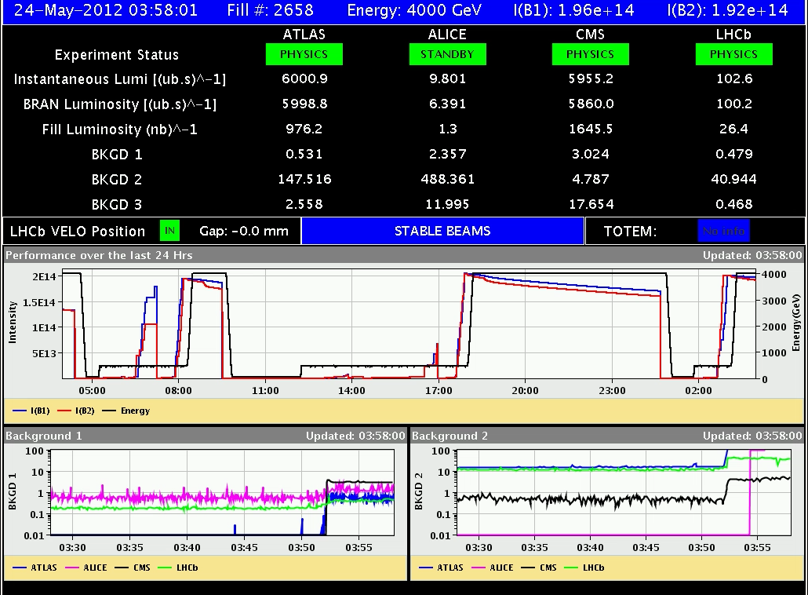
Fill 2658: Back to Best Performance

Slide 14
Emittances Before/After Collisions B1
H
V
H
V

Slide 15
Emittances After Collisions B2

Slide 16
Octupoles (E. Metral, S. Fartoukh)
Initially we decided to choose the sign of current in the ocupoles to generate a negative amplitude detuning in both planes in order to be far away from the the order resonnances.
As a result the octupole detuning fight against the beam-beam induced detuning.
Now putting some numbers
a) 500 A in MO at 4 TeV gives an amplitude detuning of -3.4 10^{-3} at 6 sigma peak amplitude
b) Nb=1.3E11, epsilon=2.5 micron, gives a beam tune spread of about + 5 10^{-3} for the bunches collding in IR8 only.
Therefore after some hours of coast, proton burning or emittance growth, the sum of the two can be equal to zero, something which also did not occur last year runing at only 100-200A in the octupole (the beam-beam tune spread was always bigger)
We could then suggest to try changing back the sign for the octupoles.

Slide 17
Planning Ahead
Delivering luminosity…
Inverting octupole sign?
Switching to new filling scheme (no IR8 “private” collisions).
Others: TCL follow-up. Strategy for intermittent TOTEM interlock for long weekend.
Non-urgent work:
End of fill tune scan to optimize beam lifetime through tune WP.
RF: end of fill time to fine-adjust the tuners (with beam). 1-2 hours needed.
RF: Install the operational batch-per-batch blow-up… when possible. 1-2 hours at injection.
Vacuum: Access to repair a pumping group in S45.
BI: Access to reconnect and repair head-tail monitor in IR4. 1-2 hours.

