Slide 1
LHC Status Sun Morning 20-Mai
Bernhard Holzer, Jan Uythoven
Status yesterday morning

Slide 2
Fri Morning
... investigating IP8 situation and / or bunch losses
* separation in IP8 checked during night shift: ok
* crossing angle for the diagonal leveling checked,
based on BPM readings (at s = 22m)
hor: ≈ 0 μrad
vert. ≈100 μrad
Sat Morning
Plan: lumi with new filling scheme

Slide 3
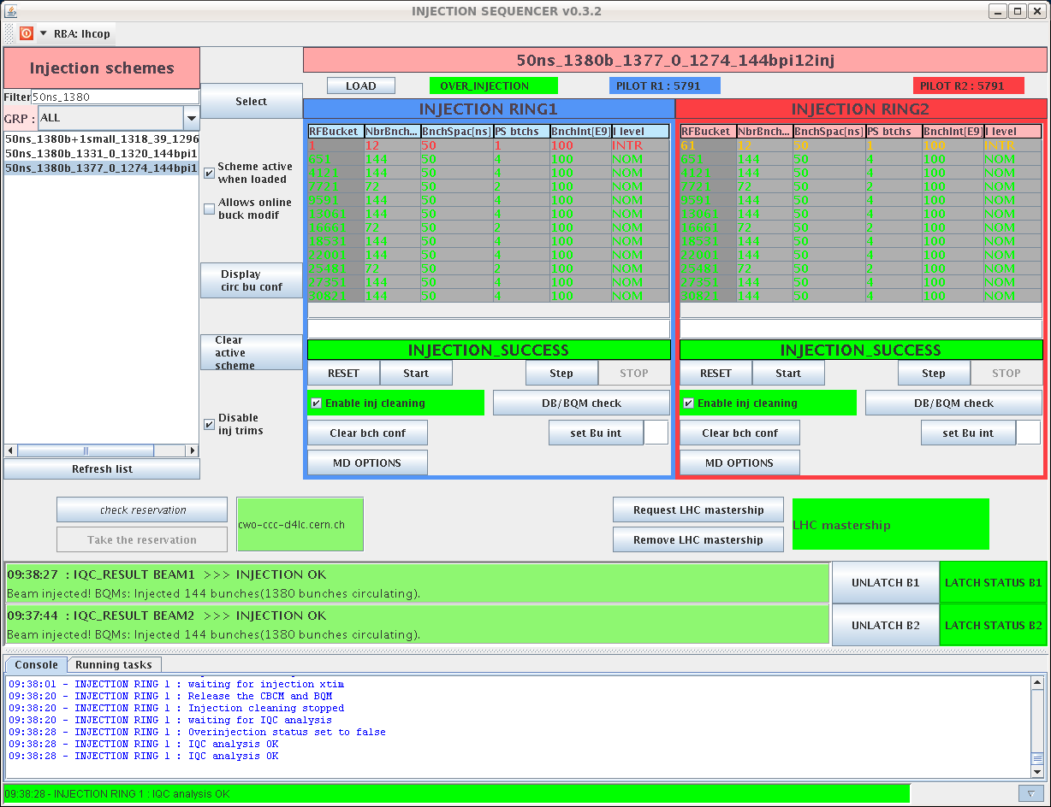
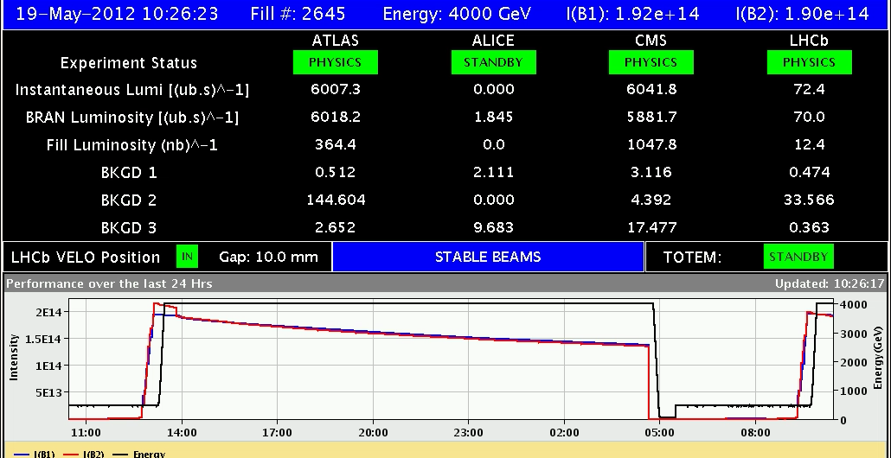
Sat Morning
09:16h injection for physics
again: very clean and clear
injection with new filling scheme !!!
09:46h ramp / squeeze / collisions: without any trouble
10:24h stable beams

Slide 4
Sat Morning
bunch intensities:
new scheme
old scheme

Slide 5
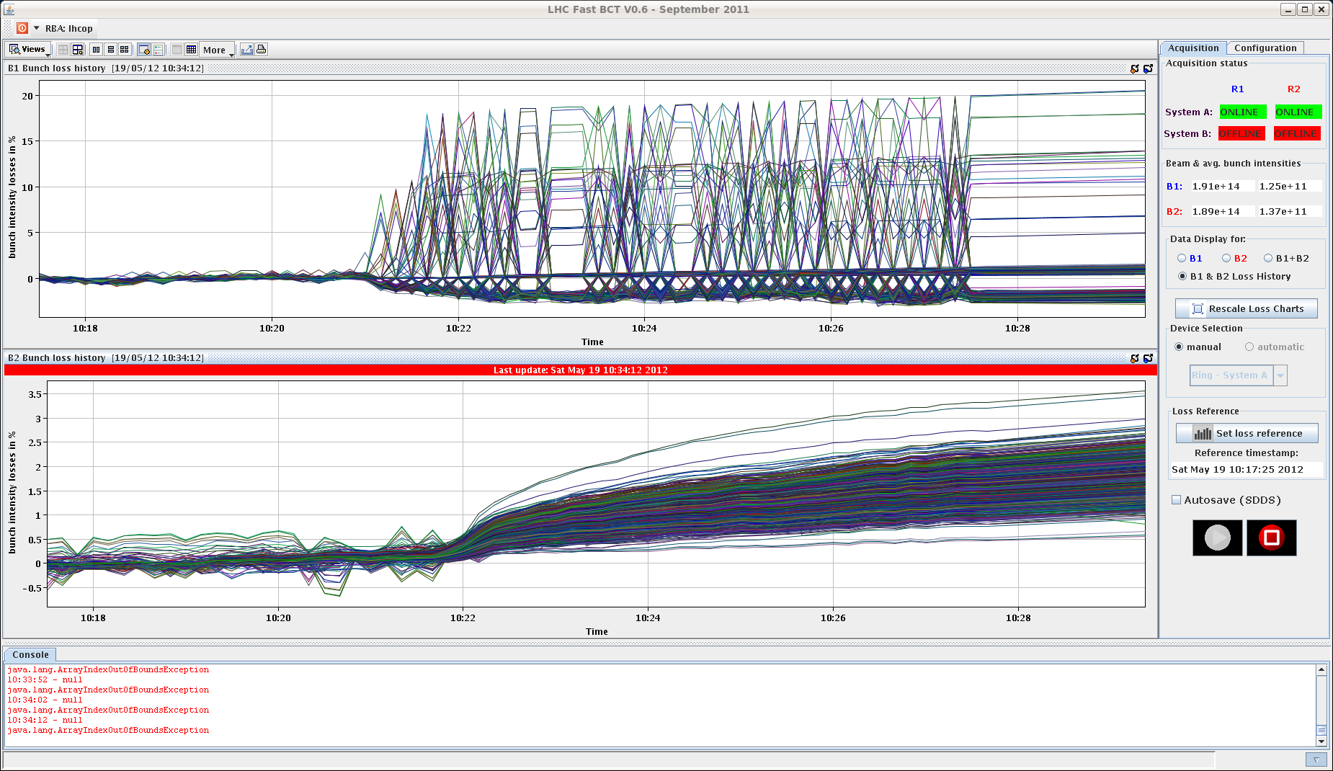
Sat Morning
still: losses of single bunch intensities in the very first part of “stable beams”
but very much reduced.
ΔI/I ≤ 20%
10:52h dump: BLM L1 spurious trigger ... difficult to stay politically correct
13:14h pre-cycle, inject, ramp-squeeze-adjust-lumi
again: new scheme

Slide 6
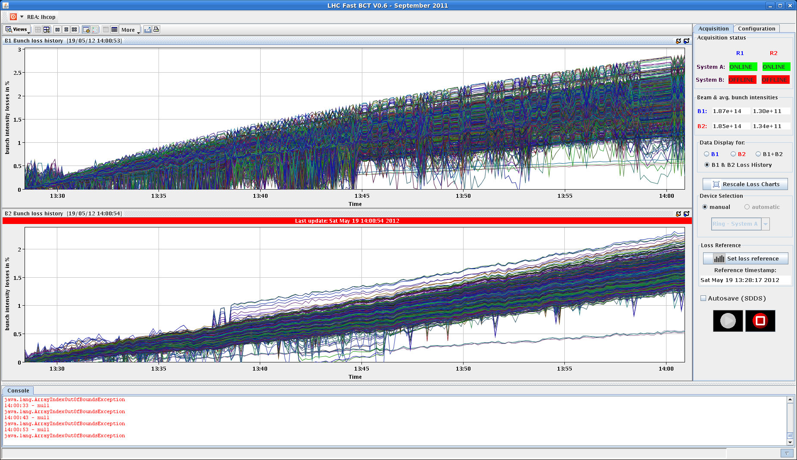
Sat Morning
This time losses are even better ! Maximum losses after 30 minutes stable beam
2%
bunch pattern after declaring stable beams

Slide 7
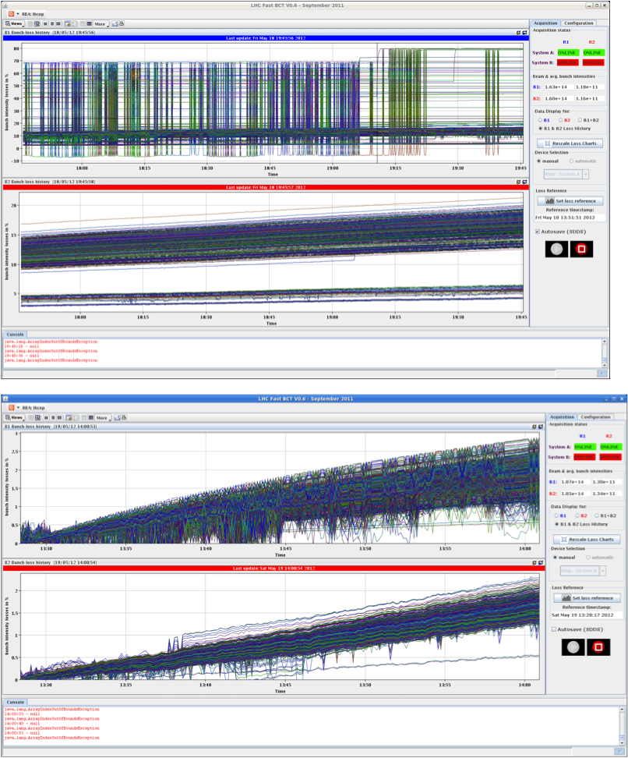
Sat Morning
70%
direct comparison:
single bunch losses
with new / old scheme
2%

Slide 8
Sat Late
stable beams, no problems

Slide 9
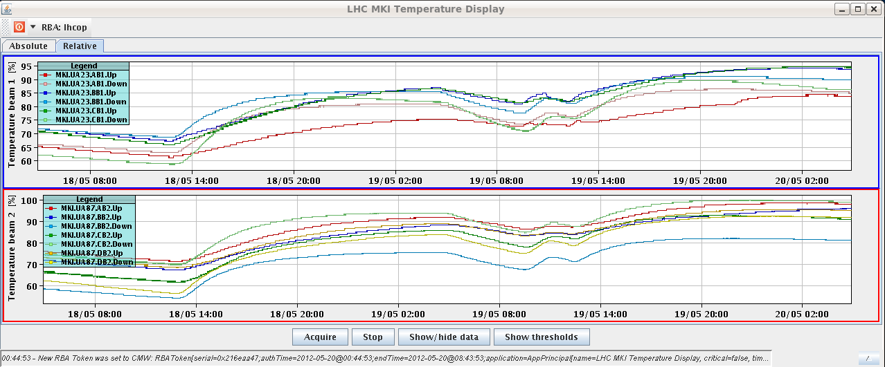
Sat Night
stable beams, ... price (that we happily are willing) to pay:
Kicker Temperatures
95%
we might have to wait a bit before next injection,
idea: soft start, check field
05:20h programmed dump

Slide 10
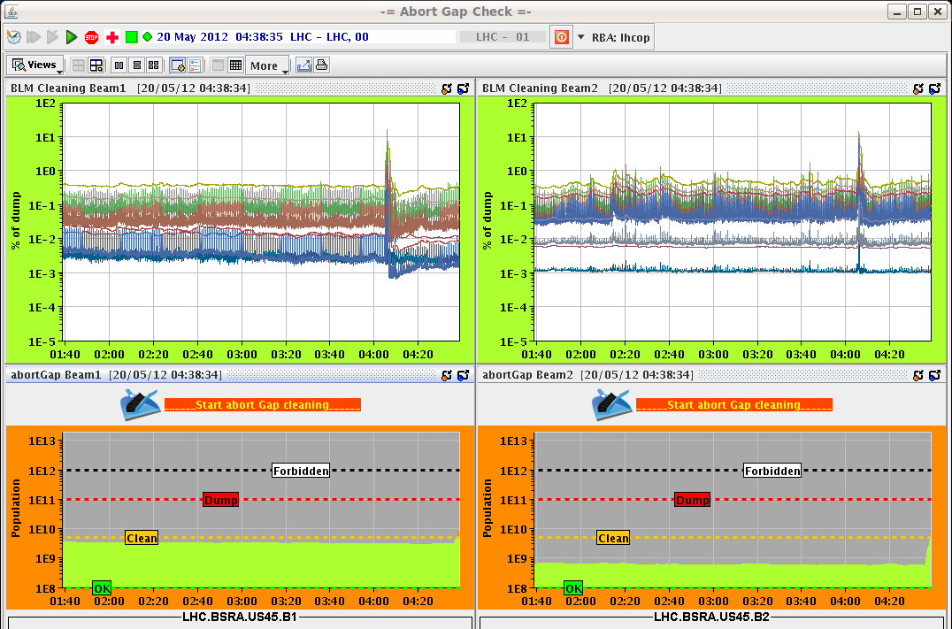
Sat Night / Sun Morning
04:40h abort gap cleaning required
reason not yet clear
05:37h Electrical glitch.
Lose sectors 45, 56, 78, 81 and RD1.LR1 and RD34.LR3

Slide 11
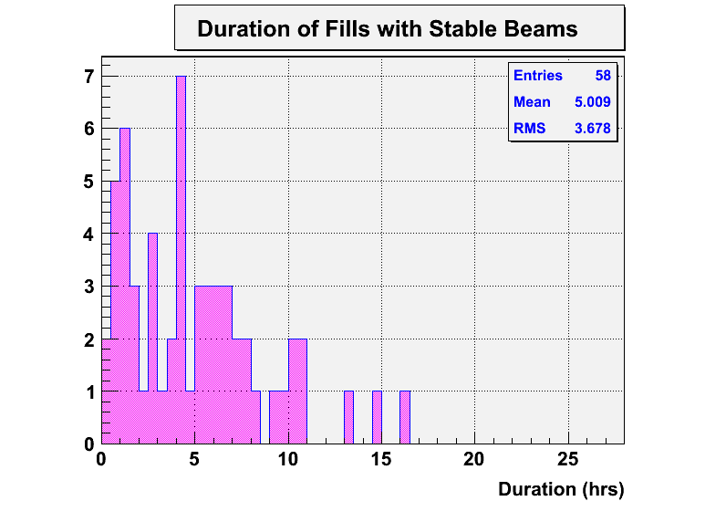
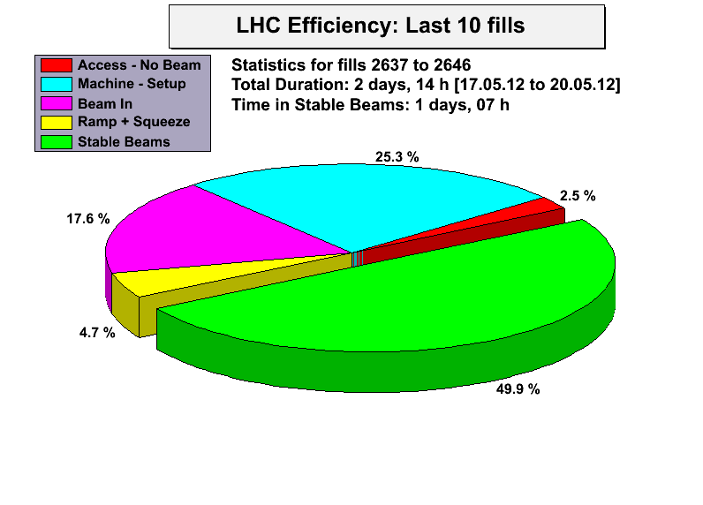
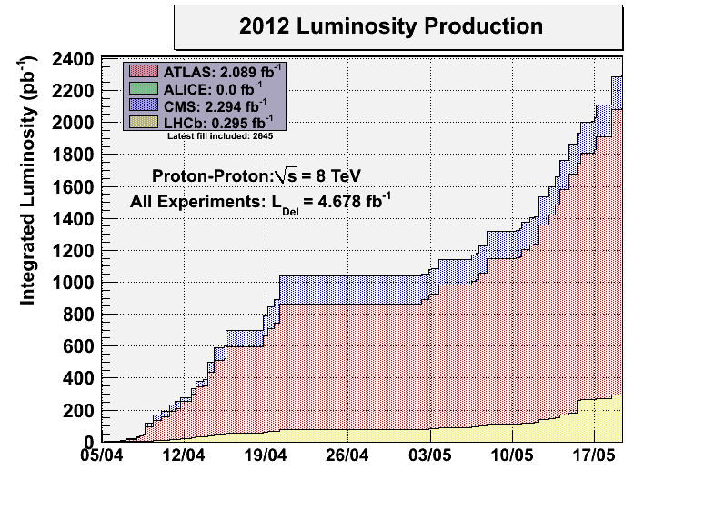
Sat Night
latest statistics
added since Tursday

