Slide 1
Saturday
Early morning reprise:
Thomas Bohl (SPS RF) solved the bunch length problem. The Longitudinal damper module was saturated. Now it's perfect.
Spikey losses in squeeze – more or less as normal – warnings to 48%
Long running sum losses going into collisions – TCLA, MQWs…
Tweaked tunes up for next fill
Also rolled back chromaticity trims to before TS

Slide 2
Saturday
Saturday 09:00 to 22:00 fill 2621
13h 17m of stable beams
119.4 pb-1 in Atlas
124.6 pb-1 in CMS
Peak luminosity
4.23e33 in Atlas
4.23e33 in CMS
1.23e11 ppb ~2.4 micron from luminosity

Slide 3
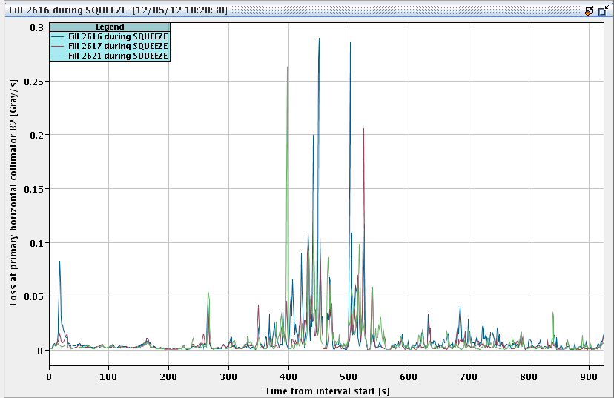
Losses in the squeeze #2621
Spikey

Slide 4
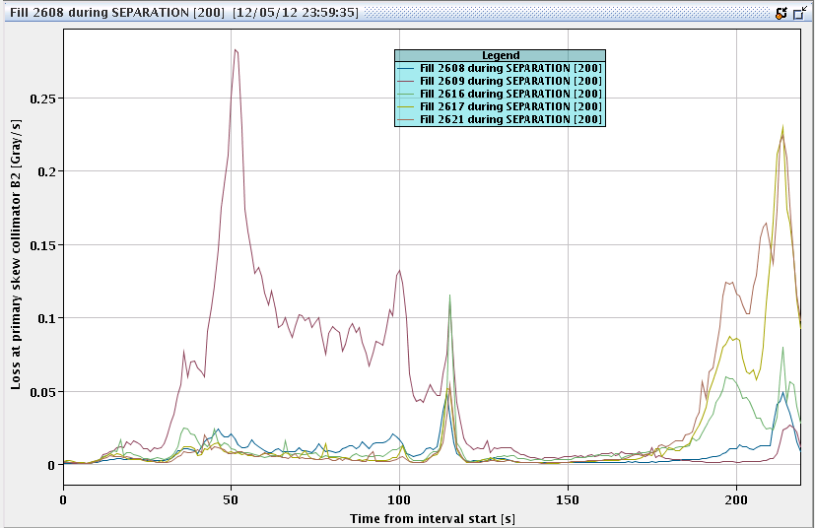
Losses going into collisions
Primary collimator – skew – B2

Slide 5
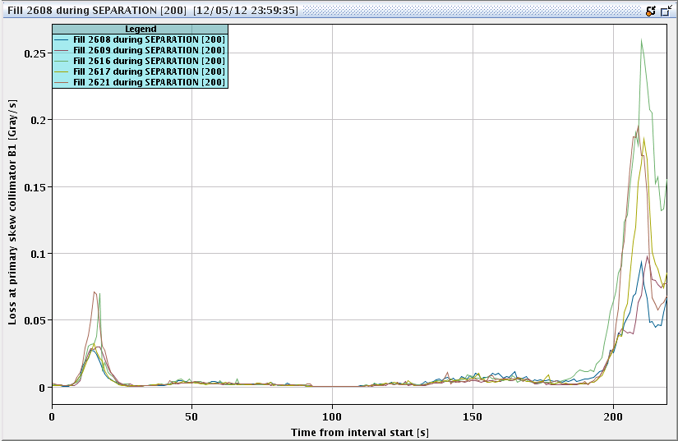
Losses going into collisions
Primary collimator – skew – B1

Slide 6
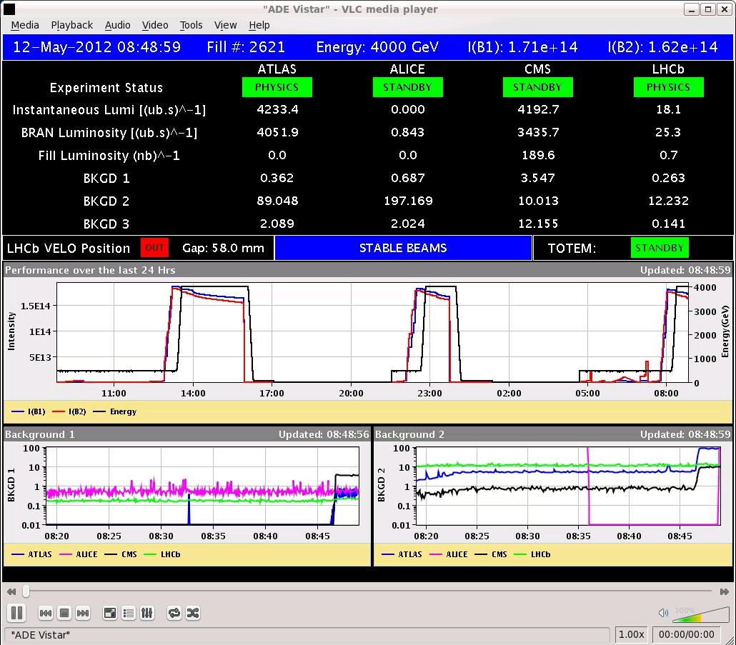
Sat – Sun – fill 2621

Slide 7
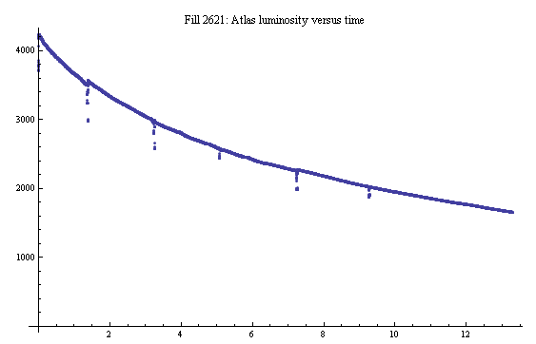
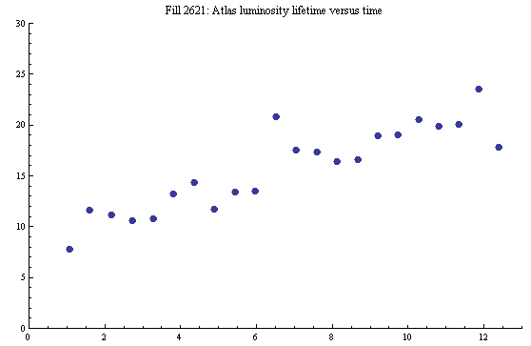
2621 – luminosity lifetime

Slide 8
Early Sunday morning
23:00 little delay with SPS bunch length and coupling adjustment
00:15 filling – slightly higher bunch current – 1.36e11 ppb
Heavy-ish cleaning at the end of the ramp
Assumed to be high chromaticity cleaning of tails
01:15 cryogenics supervision lost for S12
Resulting in a clean squeeze – one spike warning
But beams lost going into collision
lost 60A Power Permit in S12 at instant of dump
dump triggered by beam losses on RS10 of MQWA.E5R7 – loss already developing before PP went off
[PP won’t dump beam but will wait for BPF = false… tbc]
02:25 60A Power Permit ok again for S12 after reboot of cryogenics crate "cs-ccr-q18ds3"
03:00 injecting again

Slide 9
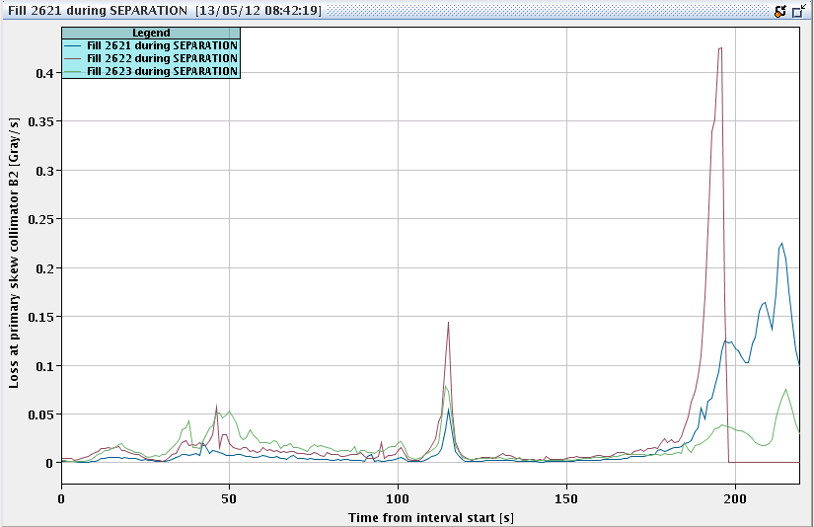
Nearly into collisions

Slide 10
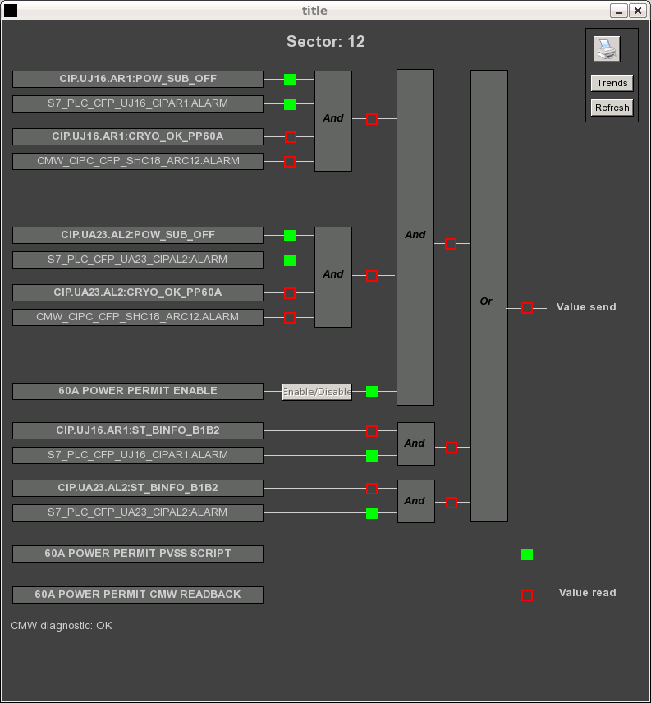
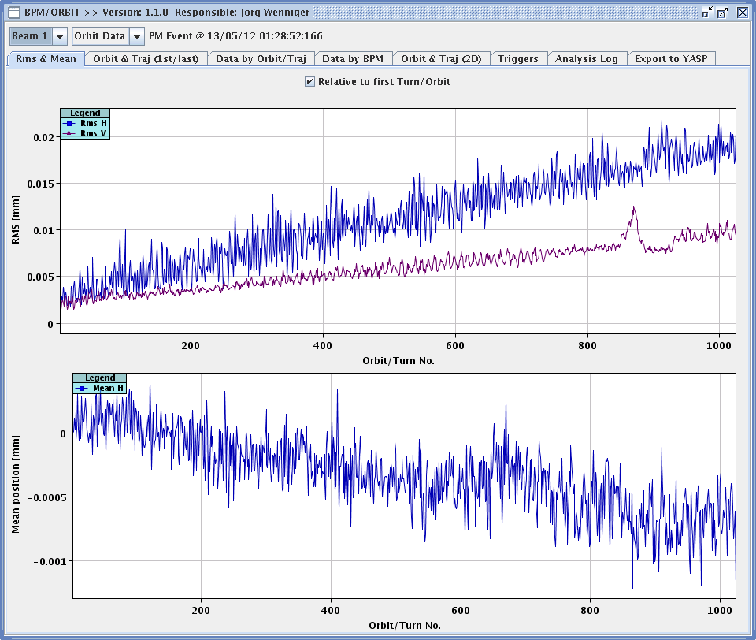
Orbit?

Slide 11
Sunday morning
03:50 start ramp
Squeeze
again a loss-spike at ~2.1m (~47%) and 1.5 m
no BLM warning level during collision BP
04:25 Stable beam #2623
1.23e11 ppb, 4.13e33 cm⁻²s^{-1.}
Emittance from lumi: ~2.5 micron
8:15 cold compressor off in point 2 – cooling water problem – cryo working feverishly to recover situation… maintaining stable beams in the meantime

Slide 12
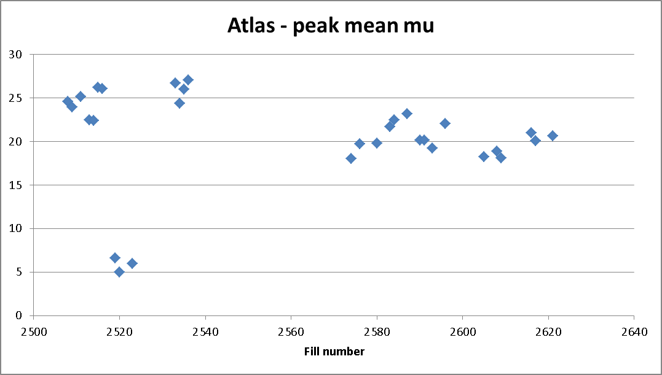
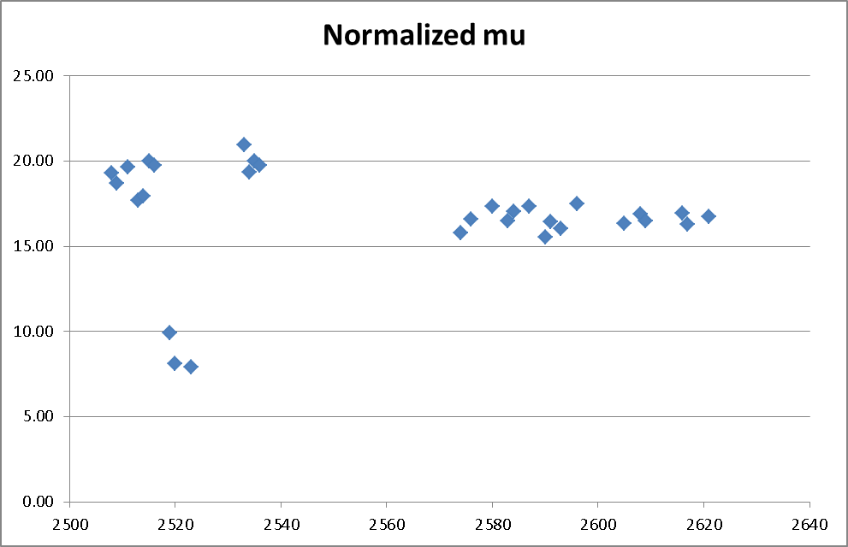
Pile-up through the ages
Clear drop in brightness after TS
Not good for performance
Also associated with the tails…
Scans

