Slide 1
Friday 11/5
08:00 RF communication problem solved. Ready to inject but beam not available from the injectors.
Injection line collimators opened from 4.5 to 5 sigmas
10:40-11:40 Access required for RF:
The problem with the RF functions observed last night is understood (and cured). While searching for the Cav8B2 problem yesterday, we have replaced a VME module, installing a spare whose firmware was NOT UPDATED. That PCB should NOT have been in UX45.
The problem with cfv-ux45-acsc8b2t CPU crash is not understood yet. We have replaced the Tuner module

Slide 2
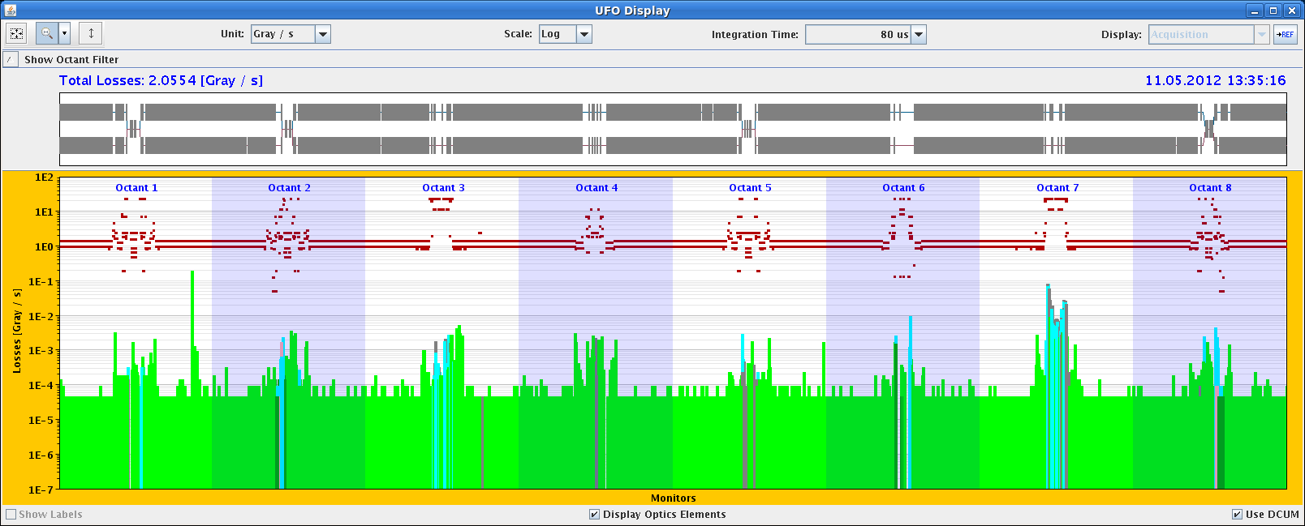
Friday 11/5
12:30 Injecting. Higher bunch intensity ~1.34x10¹¹ p/b
Warning levels (up to 50 %) on TCSG/TCLA/MQWA.A6.R7.B2 at the end of the ramp and during the squeeze + UFINO

Slide 3
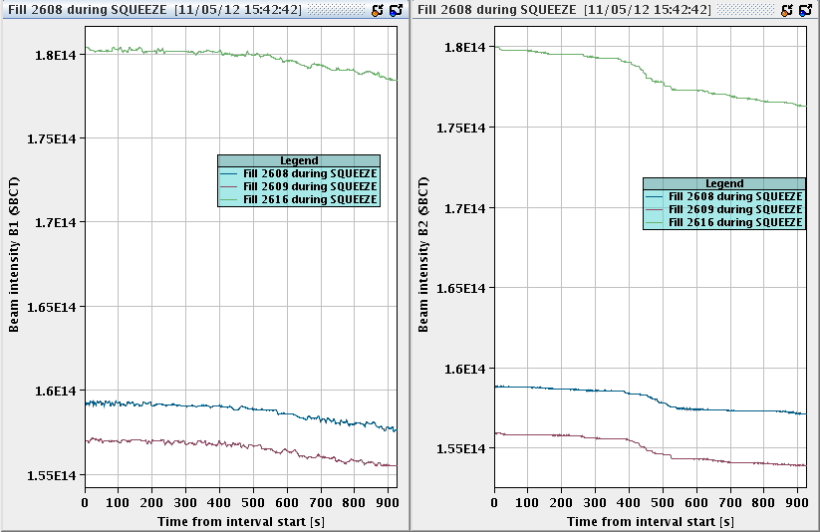
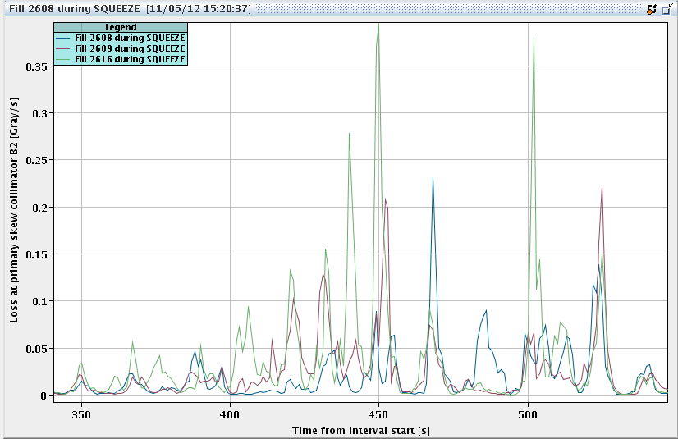

Slide 4
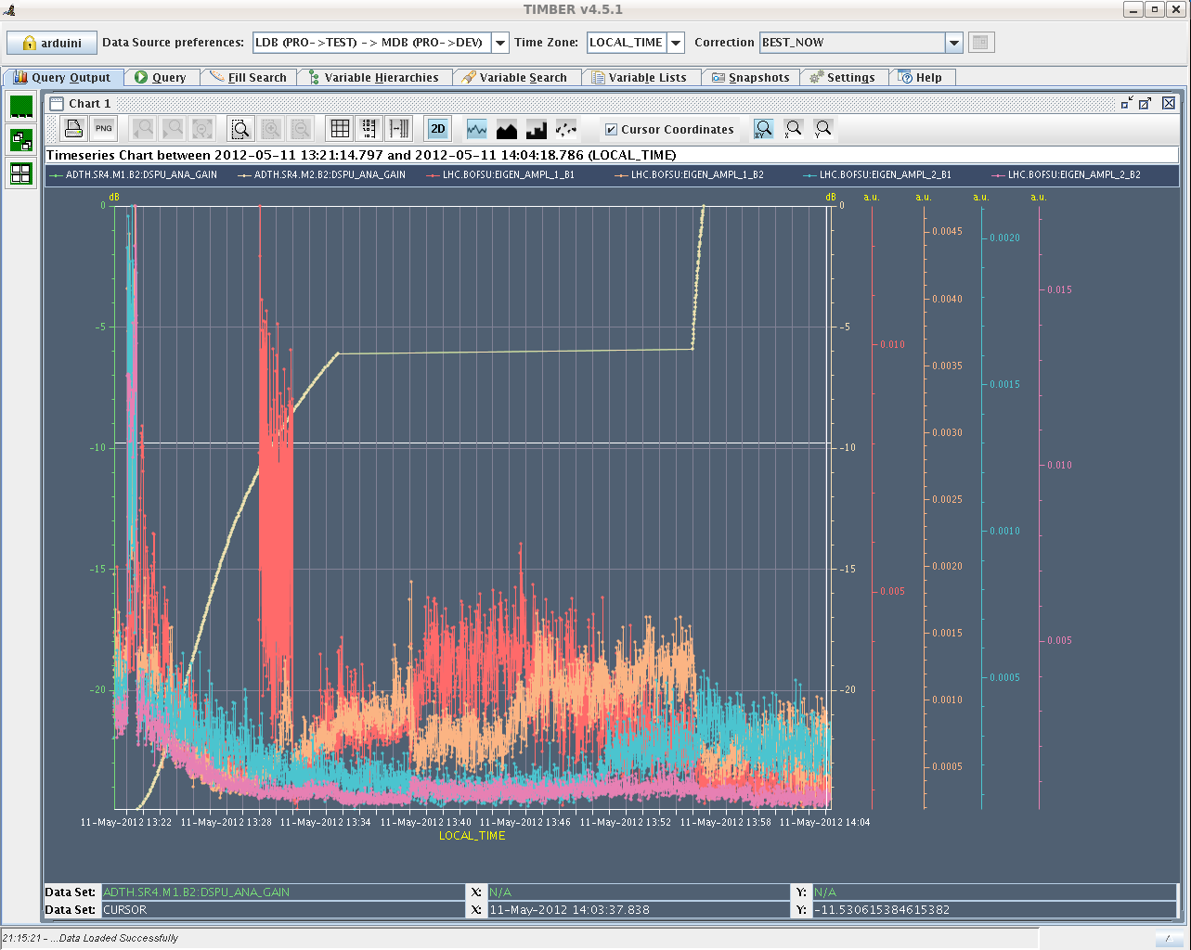
Chirp
Increased the gain of the damper by factor 2 during the squeeze for next fill

Slide 5
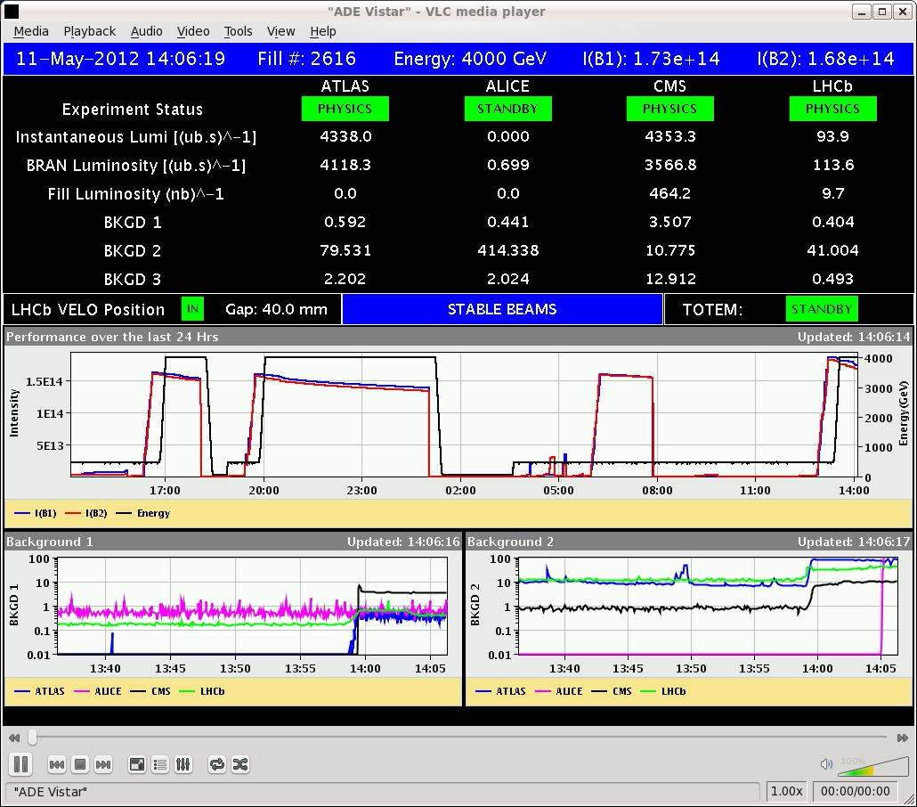
Friday 11/5
14:04 STABLE BEAMS #2616. 1.25x10¹¹ p/bunch. 4.3x10³³ cm⁻²s⁻¹.
15:57 Failure of a 24V power supply for vacuum control crate in point 7. Vacuum valves closed, Beam dump. End of fill #2616

Slide 6
Friday 11/5
17:00 -20:30. Access:
Vacuum control crate repair
Temperature gauge on current lead (Q10.R2) ➔ filter installed. Being monitored. Could be a bad contact.
World FIP repeater in Sector 78 affecting QPS for main circuits. Connector with a short to ground.

Slide 7
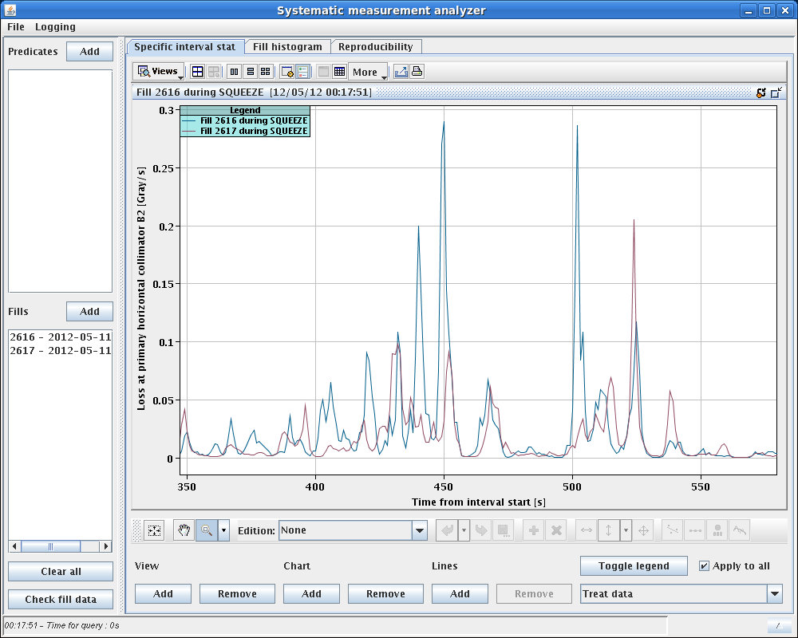
Injection slowed down by frequent SPS extraction with longer bunches (expert called in the night to optimize longitudinal properties)
Ramp and squeeze OK. Warning level (~30 %) reached only at β*=1.5 m otherwise no issues
23:20 STABLE BEAMS #2617. 1.23x10¹¹ p/bunch. 4.1x10³³ cm⁻²s⁻¹.

Slide 8
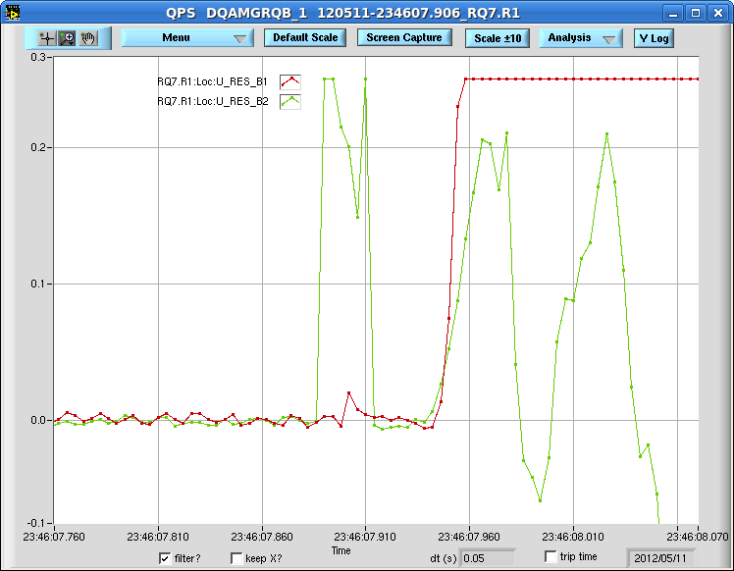
23:40 Trip of Sector 12: Q7.R1 (1st) and Q9.L2 (2nd) – Quench heaters fired – SEU? Quench?) during optimization of point 1 and 5.
No sign of instability from BBQ and no losses in the area.
00:30 OK from MP3 to restart the circuits

Slide 9
01:16 Temperature of RB dump resistor OK but problem with orbit corrector RCBCV9.L5B1 (120 A) requiring access for repair
03:30 Access finished – pre-cycle
04:30 – 07:00 Losses at injection on beam 2. Finally traced back to different super-cycle in the SPS
Still warning levels close to 50 % reached between 2.5 and 2 m
Smoking screen in CCC!!
Collisions

Slide 10
Plan
Crossing fingers!!!

