Slide 1
Wednesday 10/5
Cryo recovery until 18:30
17:50 Cryo recovery almost completed. Electrical problem in point 1. Temperature interlock on transformer (18kV/400 V) affecting ATLAS and LHC to minor extent (RD1.LR1)
18:30 Cryo OK
19:45 Trip of ROF and ROD during QPS reset (they were at running at 500 A for test since the morning in preparation of their operation at higher current)
20:20 Electrical network in point 1 OK.
20:20 Trip of ALICE dipole and access for flammable gas detection system in US15.

Slide 2
Wednesday 10/5
21:20 ALICE dipole and gas detection system OK. Origin of the ALICE dipole trip not understood. Prepare for pre-cycle. In the shadow RF control problem on cavity 8B2 requiring piquet intervention and reboot of a control crate
21:52 Trip of RB.A12 when starting pre-cycle.
21:56 Finally starting pre-cycle of all the magnets after intervention of power piquet
22:26 Unable to switch ON RF cavity 1B1. Workaround found for the night ➔ Need follow-up by RF controls expert
23:47 Finally injecting.

Slide 3
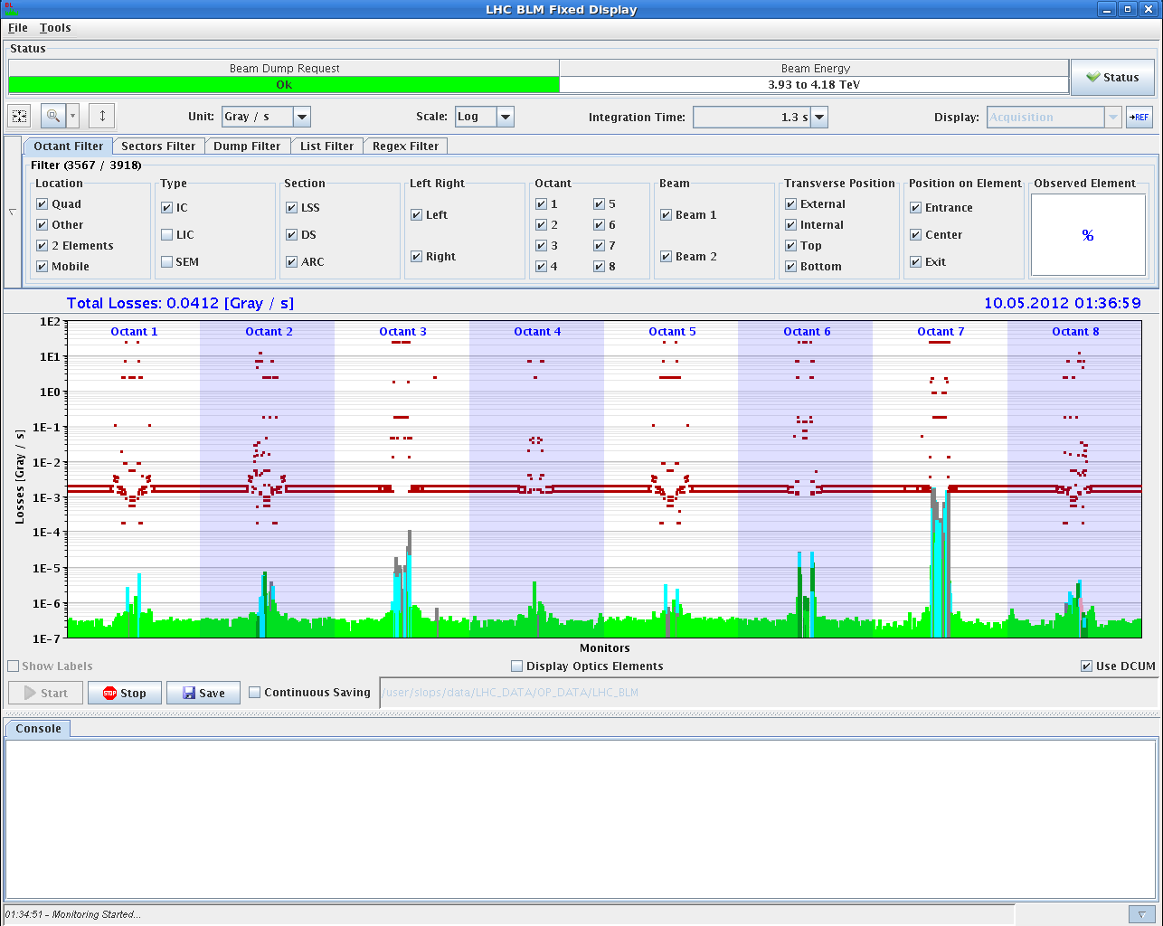
Squeeze
Very smooth after second iteration on orbit correction. No warning between 2.5 and 2 m.
Warning levels reached at 0.8 m because of a UFO at MKI2

Slide 4
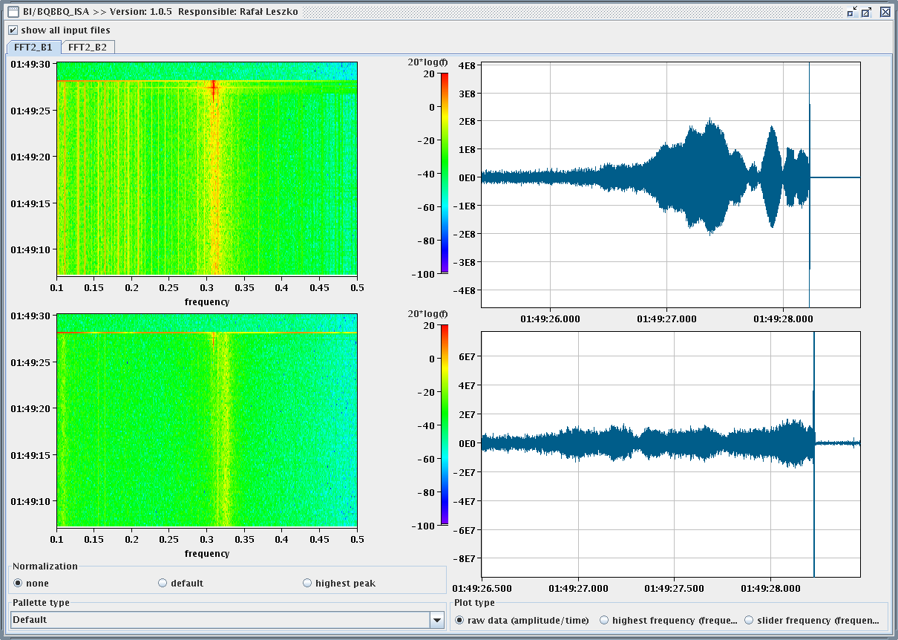
Collision
WE had increased the TFB gain by a factor 2 and the octupoles strength by 10% (now running close to the maximum current)

Slide 5
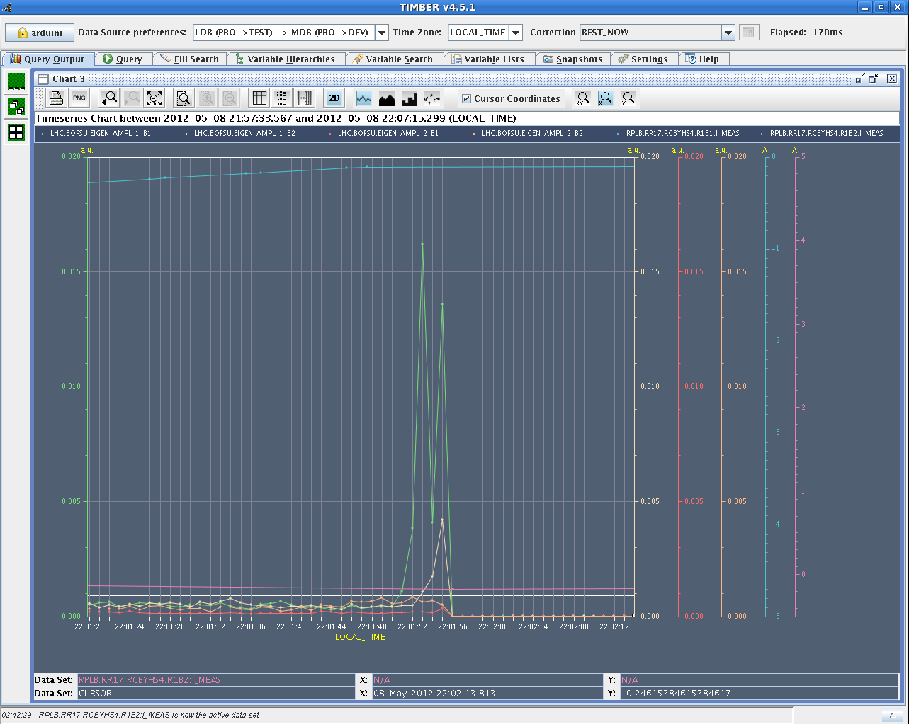
Instability

Slide 6
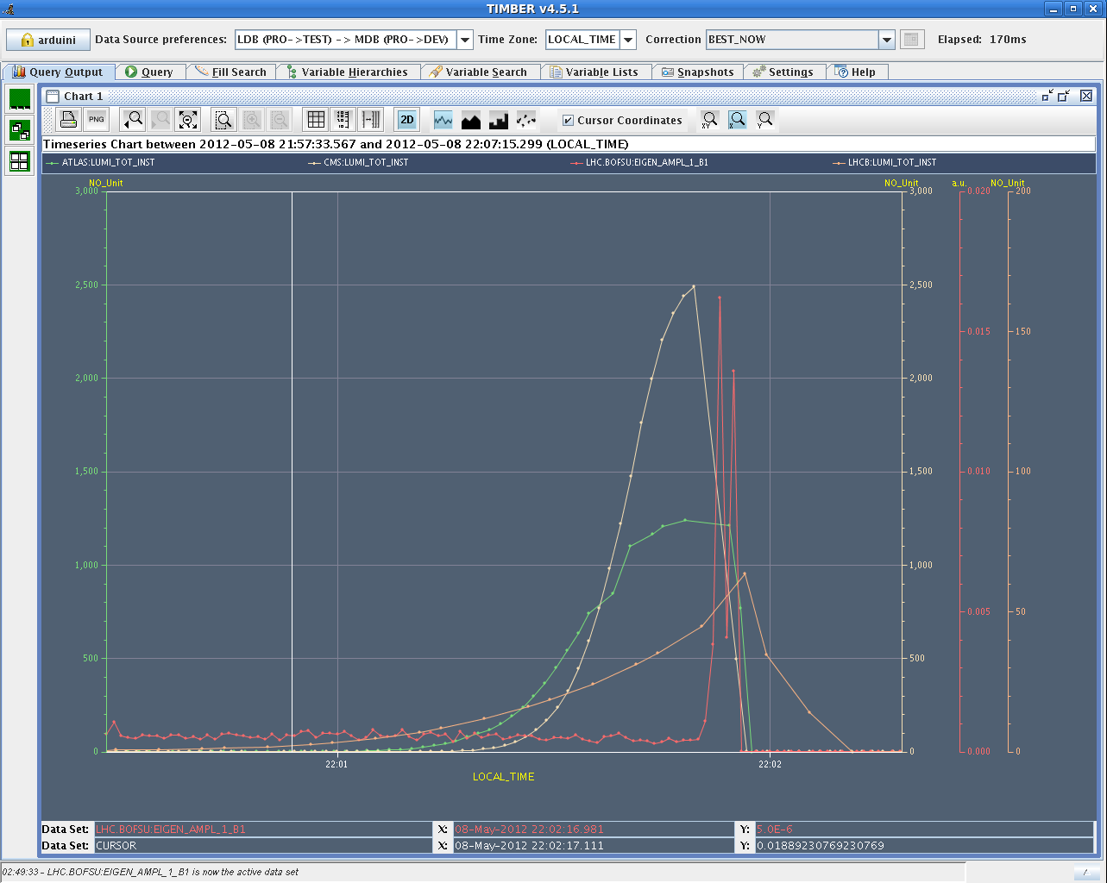
Instability
At the moment of the instability separation of ~2.1 σ in IP1 and ~1.2 σ in IP5 and 3.2 σ in IP8 (estimated from luminosities at the moment of the dump). The separation in IP1 and 5 is likely the effect of the orbit correction during the squeeze.

Slide 7
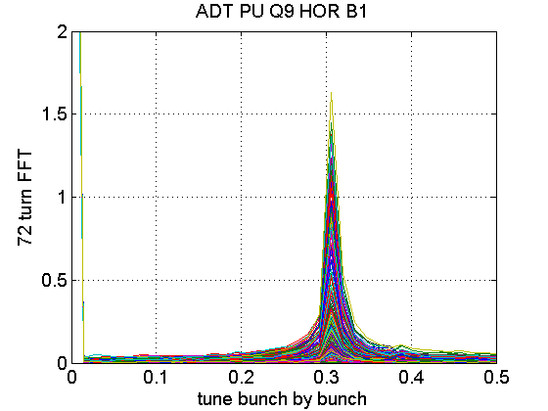
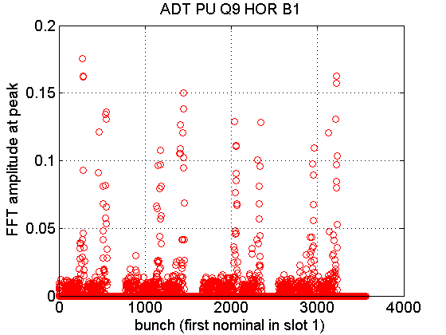
Instability Damper pick-up signals
Thanks to W. Höfle!!

Slide 8
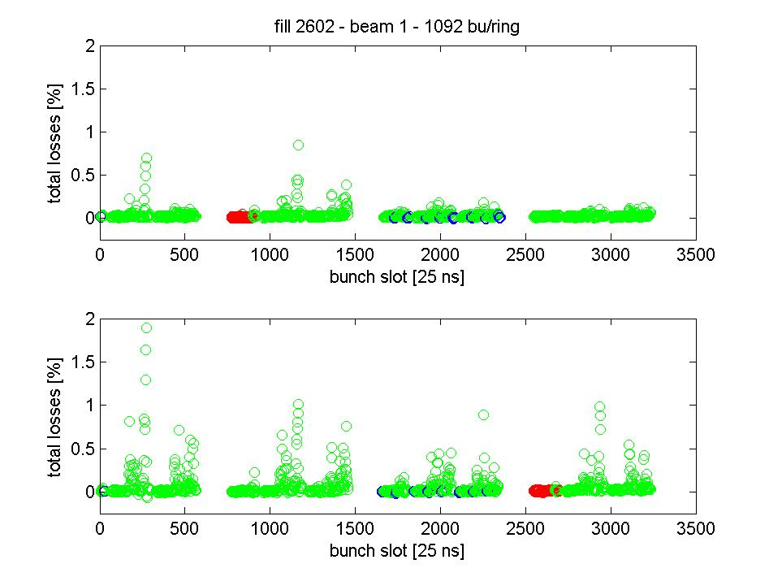
Instability on B1 H
Consistent with observation of losses on several bunches of B1 and B2 from the dump of the previous night.
G. Papotti

Slide 9
Actions
Went back to low number of bunches but with 50 ns spacing to get as much as possible same orbit
Luminosity scan to determine collision offsets and correct them ➔ incorporated for next fill
IP1 - H
IP5 - V
IP5 - H

Slide 10
Ongoing
Fill with 1092 bunches and moderate bunch population 1.1-1.2x10¹¹ p to verify the behaviour

Slide 11
Issues
Frequent RF control issues requiring piquet intervention
Access console: blue screen error
BLM sanity check failing (C. Zamantas):
The connectivity check was failing due to one SEM detector in SR7.C, i.e. the BLMES.06R7.B2I10_TCSG.A6R7.B2
Since none of the SEMs are part of the protection mechanism have increased the upper limit (from 856 to 1000 bits) to allow it to pass the check.
The monitor is connected and responsive to the modulation. Though, it’s response pattern has slightly changed indicating some kind of degradation.
Will add it in the list for exchange in the next TS.

