Slide 1
Wednesday morning / afternoon
Stable beams with 480b.
CMS in low pile-up mode.
Smooth...
15:00 Beam dumped.
LHCb polarity back to PLUS.
Settings for physics restored (pre-TS).
16:00 Check of the IR6 BPM interlock issue on B2.
Could not reproduce the issue. Effect of the probe bunch intensity, as it was higher in the early morning?
17:00 Filling for 852b. Loss levels high in the TLs...
17:30 dumped on beam losses after ~ 450 bunches (on 108b injection).
Short access for PSB.

Slide 2
Wednesday evening
18:00 ‘Double’ problem in SPS.
PC in TI2
Vacuum system problem in BA2 (valves closed). Lost communication with ion pumps.
20:00 Steering lines – impossible (once more) to inject unto LHC closed orbit and pass through the TCDIs.
Poor compromise between generating injection oscillations and minimizing losses.
Again probe B2 dumped by BPM interlock…
Page1 perturbed by FBCT problem. Reboot.
21:15 Injection for physics 852b, 1.3E11 p/b.
21:45 Ramp – with gain reduced gain on first 12b.

Slide 3
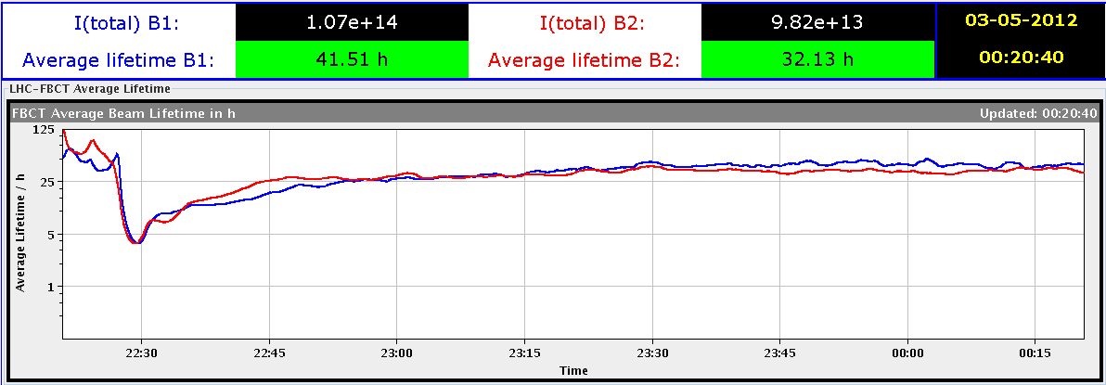
Wednesday evening
Squeeze – losses up to 60% on TCLA.B2 in IR7, also above 30% in IR6.
Correlated vacuum activity.
Corrector settings were cleaned during/after TS, but ~same orbit.
Collisions, similar losses, to ~50%.
22:30 Stable beams fill 2583, 852b. L ~2.7E33 cm-2s-1.
LHCb ~Ok, maybe a bit on the low side.
Some bunches lost up to 50% of intensity during the optimization. They had larger emittance (at least afterwards !)

Slide 4
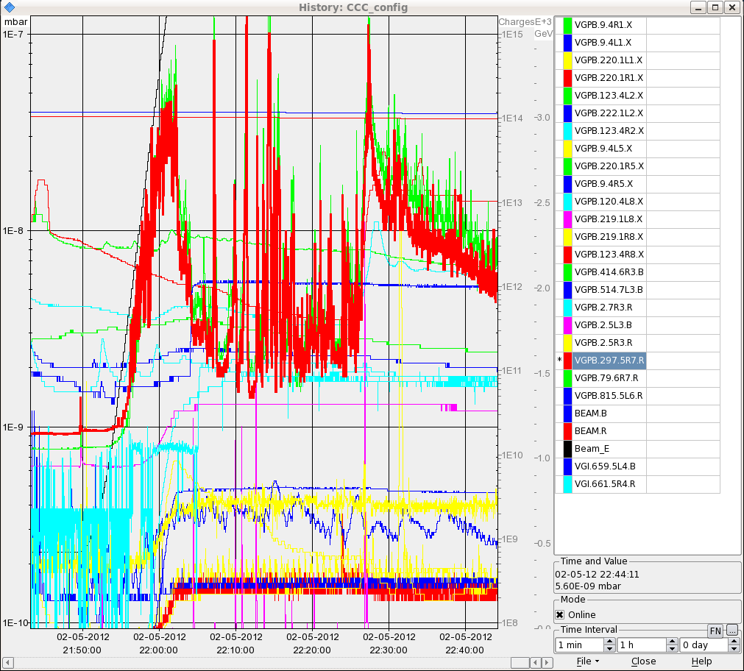
Vacuum IR7

Slide 5
Night
02:20 Beam dumped from RF trip B2.
RF trip module M2B2, L8B2. No alarms, but when trying to reset a crate was not responding (cfv-ux45-acsc8b2t). SUE??
03:40 The traditional dump on B2 from IR6 BPM interlock with probe.
04:40 Ramp start. Again high losses in squeeze.
Up to 50%.
05:15 Stable beam fill 2584, 852b. L ~2.7E33 cm-2s-1.
This time no bunch losses.
Forgot to optimize crossing plane in LHCb.
06:00 Beam dumped – triplet L8 tripped. Lost cryo.

Slide 6
Plan…
Access for intermittent problem on a WIC module in TI2.
Cuts PC during pulsing – not good …
Through Pt2.
RF vector sum (if possible).
Next fill with 825b, increased 12b intensity
We had now ~5 hours of stable beams.
Squeeze:
Roll back all orbit settings to pre-TS? Or is it something else?
High gain FB squeeze + FF? Requires at least 2 low intensity cycles.

