Slide 1
Saturday 28/4
06:30 staring injection and transfer line steering.
09:30 Steering completed after verification of the orbit at the SPS extraction
09:30-12:04 TDI checks

Slide 2
TDI checks (CB, VK, WB)
Rechecked TDI settings: - blowing up the beam (Tune Kicker) to the TCP - closing TDI jaws (50 um step size) starting from the operational values (angles in) separately until beam is touched Results are consistent wrt measurements on 26-March-12 and also last year's measurement: B1: measure a gap size between the two jaws 30 um smaller than at the TCP B2: measure a gap size between the two jaws 100 um bigger than at the TCP Looking at the gap size for the jaws separately: for B2 both jaws behave similarly, B1 jaws show a difference wrt to TCP setting of up to 500 um; still within our tolerances (angular + position tolerance = 1 sigma) but this eats up our margin left for deformation.
Still missing: repeat validation for TDI 8, and setting check of TDI versus TCP with blow-up (~3 hours)

Slide 3
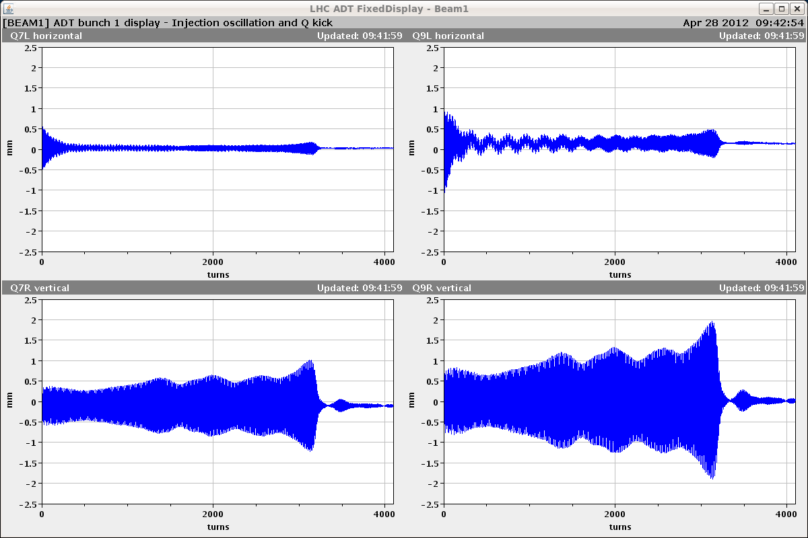
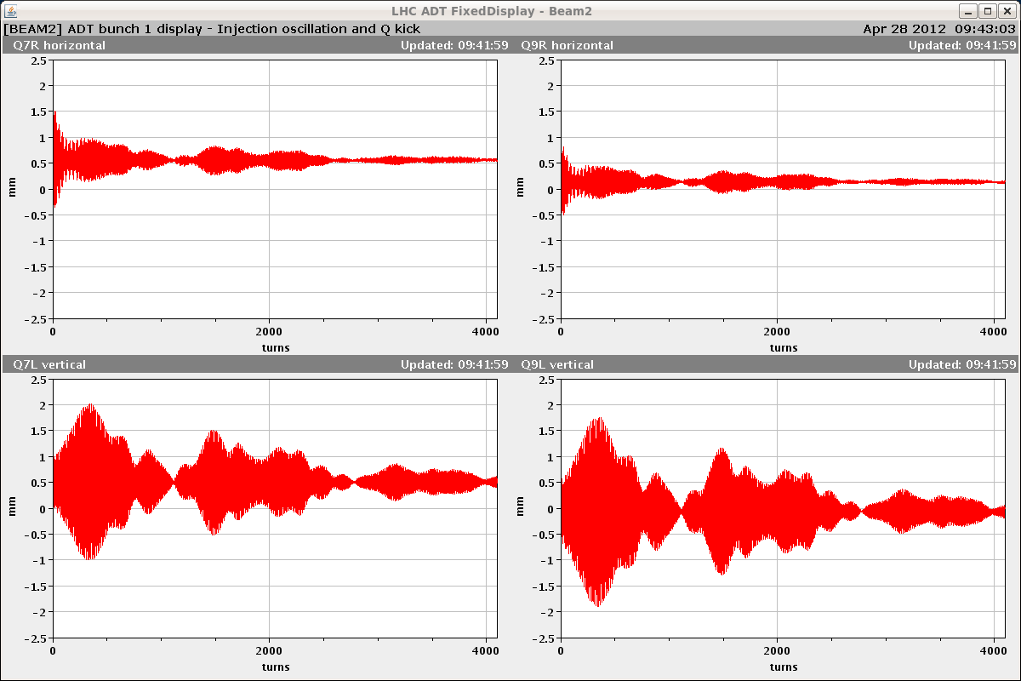
Issues
Damper driving the beam unstable mostly on V-plane
No problem found in the settings (left off for the time being but needed for nominal bunch ramps)
Could be the result of the maintenance on the power amplifiers ➔ need further investigation wit beam

Slide 4
RQF.A12
12:04: Trip of RQF.A12. Earth fault.
12:04-01:30 Earth fault on RQF.A12
Lengthy diagnostics requiring separating the various parts of the circuit:
Excluded power converter after disconnection of the cables
Excluded cold part after disconnection of the cables at the DFB
Reduced area to energy extraction switch + one warm cable to power converter after disconnection of dump resistor
Inspection at height revealed a metallic collar around the water cooled cable touching the metallic protection surrounding the cables. This was there since few years. Result of vibrations? Actions to be taken under investigation as we have several of these collars.
Re-commissioning of QF.A12 required: started (very carefully) with energy extraction at 100 A after closing the machine

Slide 5
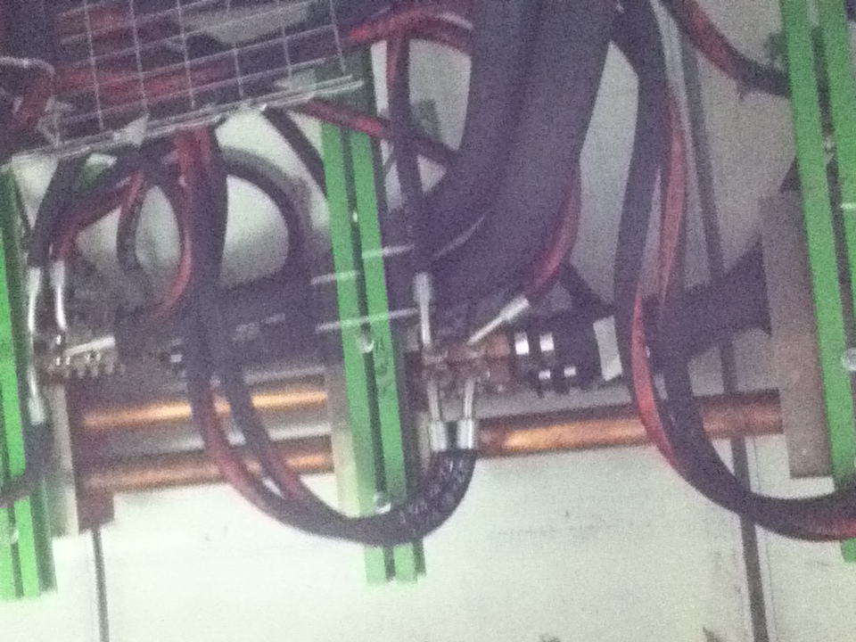
View from below

Slide 6
Plans

Slide 7
Pending issues
BIW in point 3 ➔ intervention done, second this morning
Handshake with ATLAS
BLM sanity check sequence ➔ CO
RCBV17.R7B2 tripped (it was replaced during the technical stop)
RCBV28.L8B1: FGC broken
OFSU crashes (not seen in the last 48 hours)

