Slide 1
LHC MD1 Report
Shortened program (2 days), as decided in LMC.
MD program worked very well → all MD’s on plan with ~foreseen beam time.
LHC in very good shape with excellent availability (no high current issues).

Slide 2
2012 MD#1
Sat
06:00 – 07:00 end of fill study (tune scan, …)
09:00 – 13:00 450 GeV: Longitudinal impedance
13:00 – 17:00 450 GeV → 4 TeV: ADT (no fast blow up)
19:00 – 00:00 450 GeV → 4 TeV: Collimation
Sun
02:00 – 07:00 450 GeV → 4 TeV: Aperture
09:00 – 17:00 450 GeV: RF batch by batch blow-up
17:00 – 23:00 450 GeV → 4 TeV: BI (emittance cross calibration with ADT blowup)
01:00 – 06:00 450 GeV → 4 TeV: ADT (tune compatibility)

Slide 3
Longitudinal impedance MD
3 fills with Beam1 and 2, each with 8 bunches of varied intensities. The first fill was with large longitudinal emittance (bunch length in SPS 2.0 ns).
The 2nd fill had no controlled long. emittance blow-up in the SPS and the 3rd fill was with blow-up in the SPS and phase loop was switched off.
We nevertheless observed that higher intensity bunches were longer. In the LHC measurements of the stable phase, bunch profiles, transverse emittances and Schottky spectrum were done for standard conditions and for BSRT and TDI in and out.
Some effect was visible for TDI movement, more details will come after analysis and simulations (as for IBS).

Slide 4
Saturday, April 21, 2012, ADT 4 hours
Part 1: 1.5 hours (scheduled)
first checked damping time in single bunch mode for high gain and low gain (0.25 and 0.02 in LSA) → follow-up of difference between the two planes and beams during technical stop, then re-check after technical stop
injected one nominal bunch (1.4-1.5x10**11) and waited about 40 minutes at 450 GeV observing emittances; 12 minutes with high gain, 11 minutes with low gain and 10+ minutes with high gain → emittance data to be analyzed offline
damping times:
(ratio high / low gain in LSA: 12.5; fillamentation significant for low gain setting !
single bunch mode at high gain between → 11 and 19 turns
single bunch mode at low gain between → 73 and 127 turns
50 ns settings high gain (expected 3x slower than single b. setting) → 35 to 51 turns

Slide 5
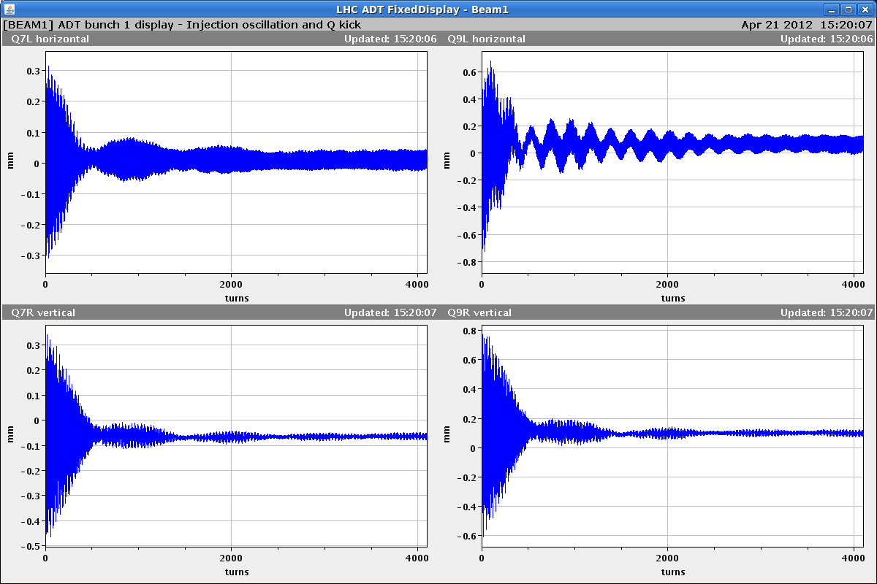
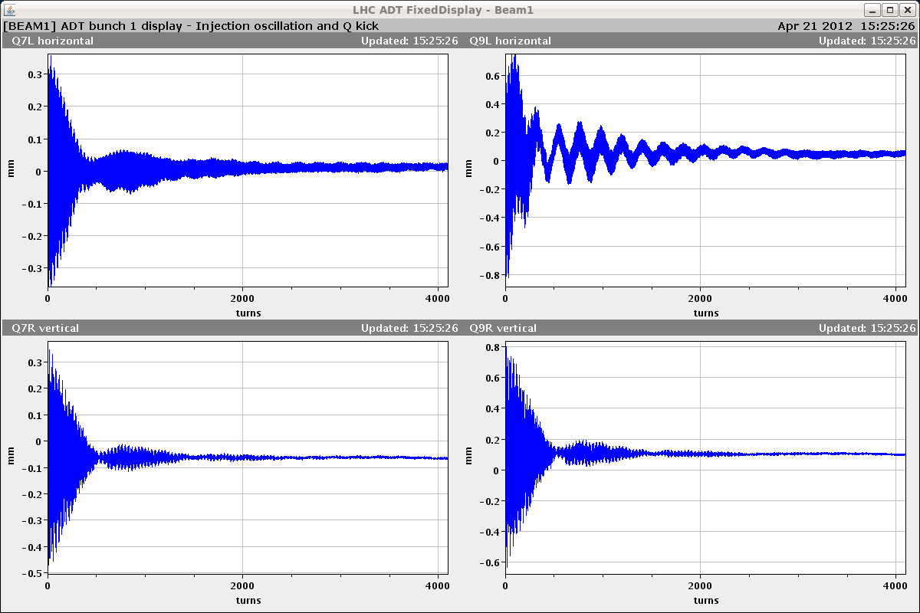
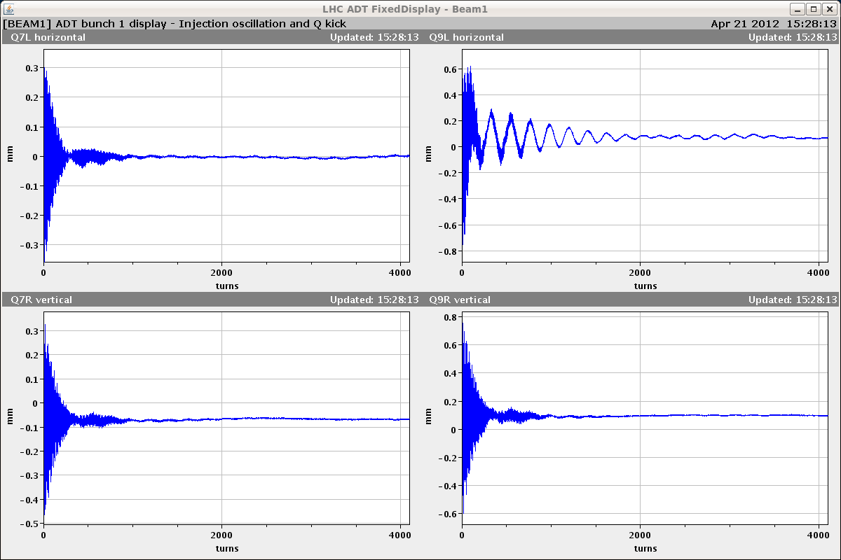
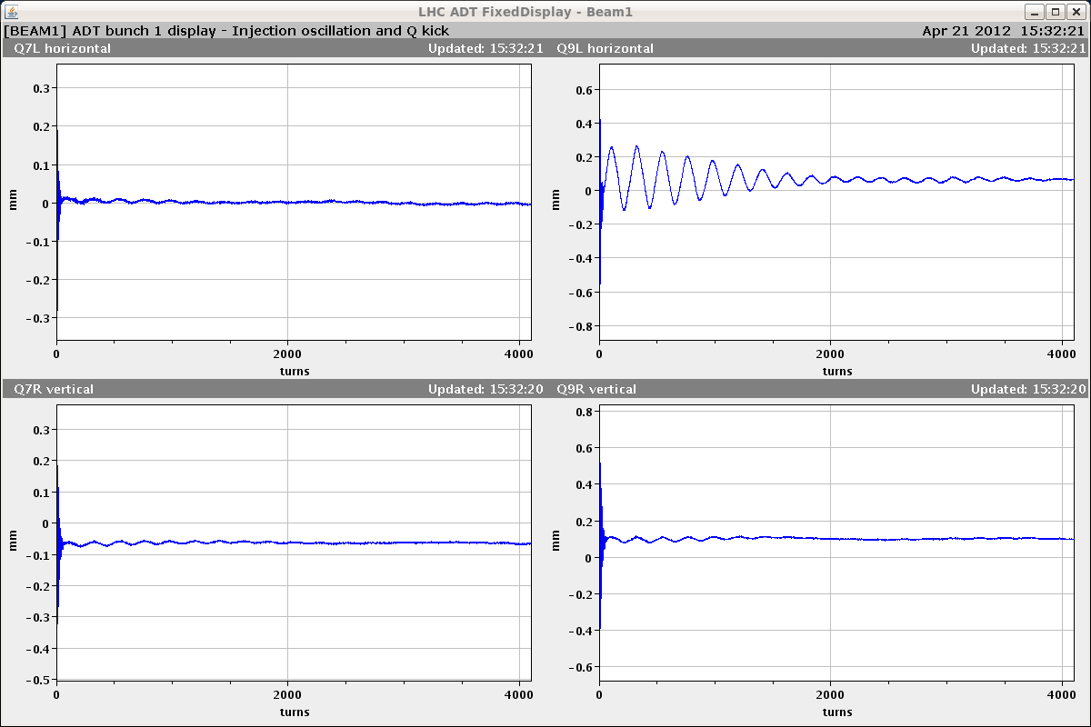
Saturday, April 21, 2012, ADT 4 hours
Part 2: 2.5 hours
commissioned batch-by-batch gain modulation factor of 0-127 in steps of 1
8 bunches injected with gains of ADT scaled by (0, 1, 2, 5, 12, 30, 70, 127)/128
verified by observing injection damping
bunch 1 gain 0
Bunch 3 gain 2
bunch 1 gain 12
Bunch 8 gain 127
g
gain 12
→ approx. prepare for ramp (LSA 0.02)
gain 127
→ high gain (LSA 0.25, injection setting)
first 4096 turns of the horizontal beam 1 injection oscillations are shown

Slide 6
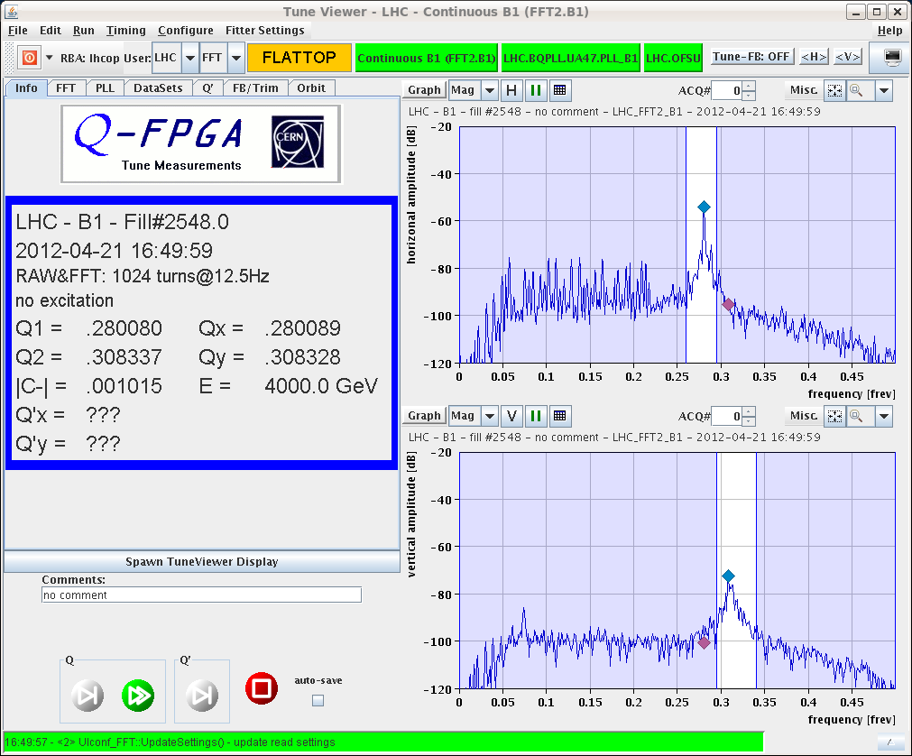
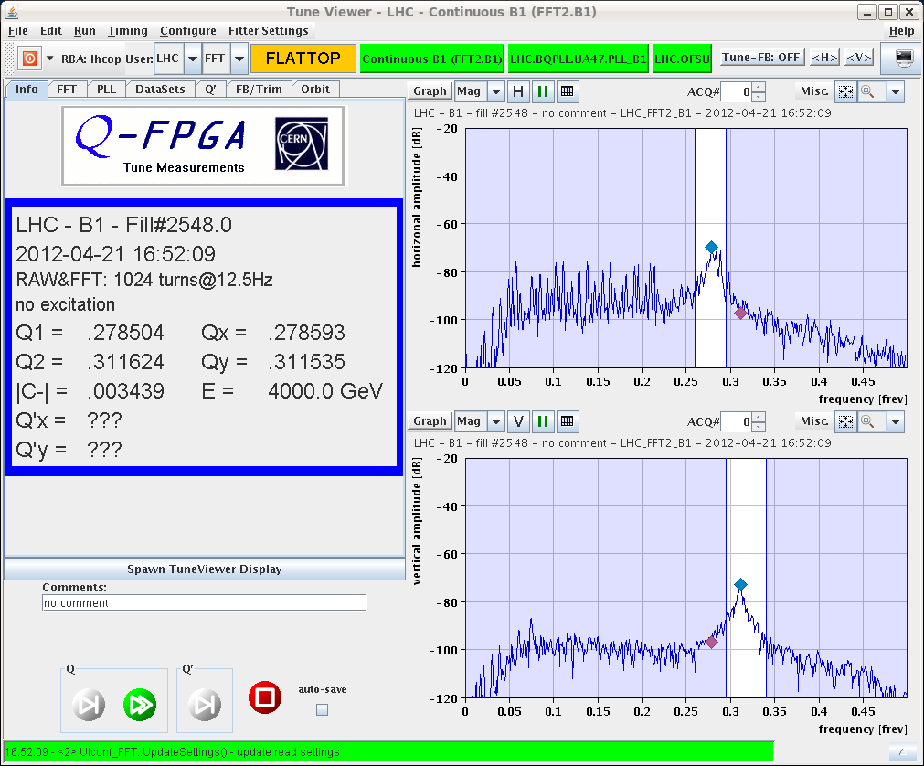
Saturday, April 21, 2012, ADT 4 hours
Part 2: 2.5 hours
ramped with normalised LSA gain at 0.25 at all times + gain modulation
LSA gain of 0.02 normally used in “prepare for ramp” corresponds to bunch 5 approx.
bunch with zero gain clearly blows-up
good BBQ signal thanks to low gain bunches (also higher intensity for bunch 1 as planned)
emittance data to be analysed (large scatter observed)
also recorded all bunches of HB1Q7 with new “continuous acquistion” in ADT
batch-by-batch gain mod. is feasible for Physics fill to see which gain gives highest lumi
1 of 8 bunches no gain
8 bunches high gain

Slide 7
Collimation MD I
Performing an alignment of horizontal IR3 (TCLA.7R3.B1 and TCLA.7L3.B2), for different cuts with TCPs in IR3, IR7.
Determine whether the BLM spike quality (when aligning the TCLA) is better for higher momentum cuts, and whether a better measured-to-nominal beam size ratio can be achieved.
The first TCLA alignment was done with a TCP cut in IR7. The Dp/p cut at this point was ~0.0018, and the beam size ratio was 181%.
With a Dp/p cut of 0.00073, the ratio decreased to 137%. The beam-based center also shifted by 350um for the TCLA.
With increased momentum cuts (Dp/p = 0.00069 down to 0.00055), the BLM signal quality was the same, the beam-based center did not shift by more than 15um, and the beam size ratio also the same.
Stop when the steady-state losses rose to > 1E-5.
The poor BLM signal quality for horizontal alignments observed for the March setups could be due to different parameters (e.g. octupole strength) rather than the momentum cut during the alignment.

Slide 8
Collimation MD II
The MD proceeded at 4 TeV with a test of new software:
Uses BPM-interpolated orbit at the collimators to move in the jaws from their initial positions to a safe margin in sigmas around orbit.
The margin takes into account an expected 500um offset between the interpolated and the actual centers.
The beam was dumped due to an error in the setting of the jaw position (settings sent in metres instead of mm).
The bug was quickly fixed, and the functionality of the software was tested at 450 GeV.
Beam-based alignment of the collimators in parallel was performed (IR3 and IR7, 26 collimators).
The whole alignment procedure (fully automatic parallel alignment followed by semi-automatic sequential alignment) took 1hr 45 minutes.
This translates to 4min/collimator, an improvement over the 5min/collimator recorded for the flat top setup in March,

Slide 9
4 TeV Aperture MD
For pilot intensities we started with the alignment of the TCTH collimators in IP1/5.
However, the aperture scans gave puzzling results.
Even if for both beams we measured more than 11 sigmas, we found different results than in the first measurements done during the initial commissioning period (B1-H bottleneck now found in IR1 separation plane).
Details will come after off line analysis.
We noticed that the horizontal scans were affected by losses at the vertical collimators, which are not understood.
We noticed also that the octupoles have an effect on the loss patterns during beam blow-up and on the estimated aperture values.
Very preliminary on line analysis indicates about 1 sigma more if octupoles are at 50A instead than 450A. To be checked in detail.

Slide 10
RF MD: blow-up
We first adjusted the position of the phase noise to hit the desired batch without leakage on the previous batch.
See "Blow-up Batch 2 B1" that shows the first injected batch untouched and blow-up (too fast!) of the other 12 bunches.
Then we injected 6 batches of 12 bunches and applied blow-up to all batches (at injection) except first and last.
See "6 Batches B2", Fill 2555. Result: large scatter in bunch length providing data for transverse emittance growth. Fill kept for 50 min.
We then moved to the test of the Injection Blow-up Sequencer that should control blow-up and inclusion in the main Phase loop average. We had some problems with the controls and returned to "manual" sequencing.
We made another fill B2 with 11 batches and blow-up at injection on all but the first 2.
See figure "11 bunches B2”.

Slide 11
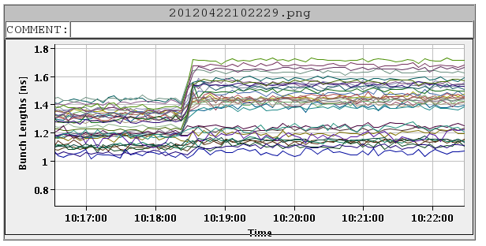
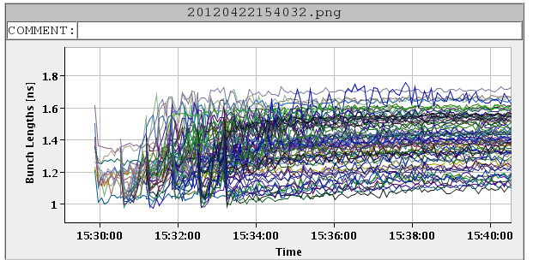
RF MD

Slide 12
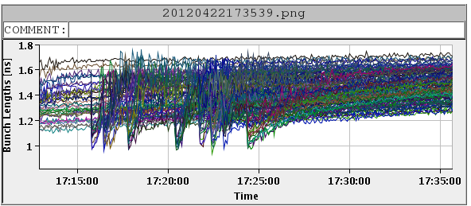
RF MD

Slide 13
RF MD: Conclusions
We can blow-up each batch individually at injection. It takes a few minutes.
The spread looks a bit large (maybe because we are too aggressive...). Will be analyzed.
The controls (Injection Blow-up Sequencer) must be updated during the technical stop.
The transverse emittance measurements will be analyzed and should correlate bunch length to transverse emittance growth, to really confirm the overall interest of the proposed scheme.

Slide 14
BI MD
Aim: Emittance cross calibration with ADT blowup
Started with k-modulation for beta determination at BSRT
encountered problems with k-modulation application
data to be analyzed (clear orbit oscillations were observable)...
BGI measurements
Results not really conclusive
BSRT:
The main aim was to study the heating that we observe with high intensity beams outside the SynchRad view port and if there is any effect on the measured beam size. We injected 1.1e14p on both beams ans stayed at injection:
B1 extraction mirror OUT --> no heating
B2 extraction mirror IN --> heating to be compared with physics fills characterized by ramp immediately after end of injection.
some hint of correlation among temperature-bunch length and vacuum --> to be studied
Little effect of heating on the measured beam sizes
Matching monitor test: almost nothing done due to delays from previous studies and issue with detector timing.

Slide 15
ADT tune measurement compatibility MD
We did two ramps, one with 8 bunches and one with 24 bunches
First ramp with 8 equal bunches. The gain function in LSA was 0.25 (i.e. full gain all along the 450 GeV plateau). Gain modulation was enabled to give the 8 bunches a different feedback gain same as used on Friday (0, 1, 2, 5, 12, 30, 70, 127)/128; the difference being that this time we did not have the leading bunch with higher intensity; recorded data with all ADT PUs internal to the ADT system for offline (tune) analysis
Second ramp with 2x12 bunches, 1st batch at 1.4x10**11 second at 1.15x10**11 per bunch; enabled tune modulation batch-by-batch, 1st batch at LSA-value*5/127 = 0.01, half of normal prepare for ramp setting; second batch stays with full gain LSA-value*127/128 = 0.25
Conclusion:
Gain modulation batch-by-batch is operational (enabling needs expert)
Emittance and damper oscillation data from three ramps (Friday and Monday/Sunday) need offline analysis for exact conclusions
Tune signal with gain modulation clean, but starts to get jittery when we switch to prepare for ramp (horizontal tunes more jittery). We survived the ramps with the tune FB switching off a few times, manually switched back on again. Our overall goal is to see how the gain modulation affected the emittances of the different bunches / batches and to see how we can get the tune from the acquired damper data - this both needs offline-analysis.

