Slide 1
Summary Week 16 & MD Report
Machine coordinators: R. Assmann & J. Uythoven
MD coordination: R. Assmann, G. Papotti, F. Zimmermann
Highlights:
v/d Meer scans: ALICE, ATLAS, CMS, LHCb
Improvements LHC orbit (Joerg)
Commissioning abort gap cleaning at 4 TeV
Injection 144b
Completion intensity ramp: 1380b
Increase bunch intensity: 1.4e11 p/bunch
New highest LHC luminosity: 5.6 10×³³ cm⁻² s⁻¹ (average ATLAS, CMS)
New highest stored energy: 120 MJ
First LHC MD in 2012

Slide 2
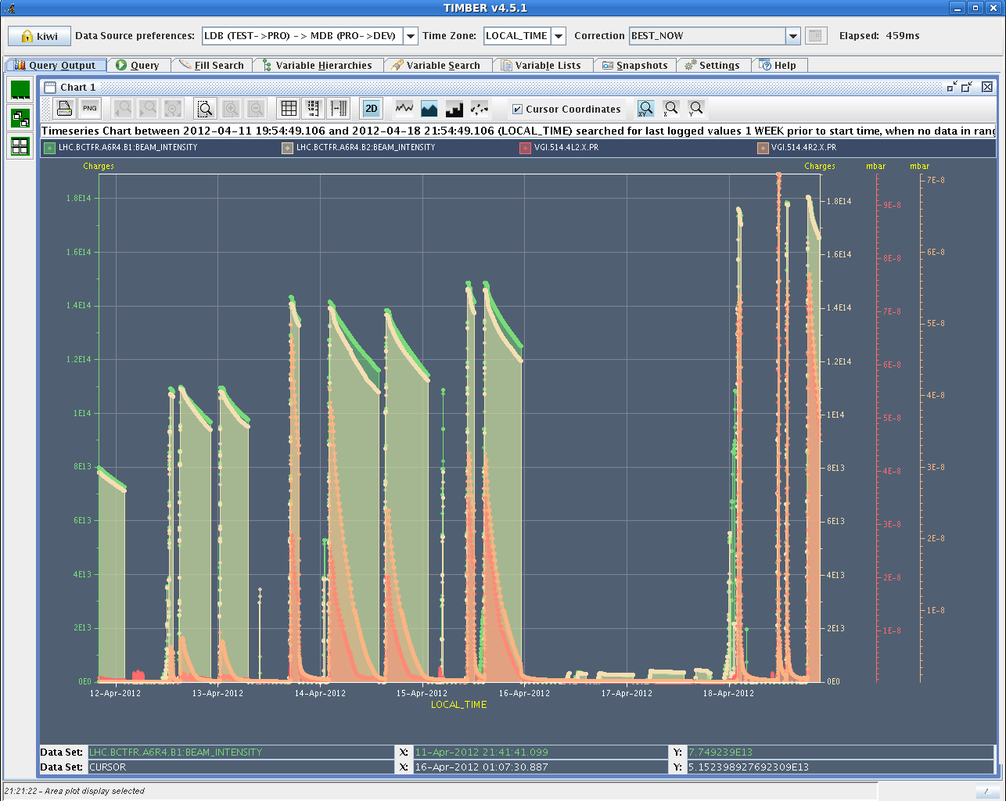
Intensity Ramp (& Vac L2): 1380 bunches
v/d Meer scans

Slide 3
Fill #2536
Average lumi 5.6e33 cm-2s-1

Slide 4
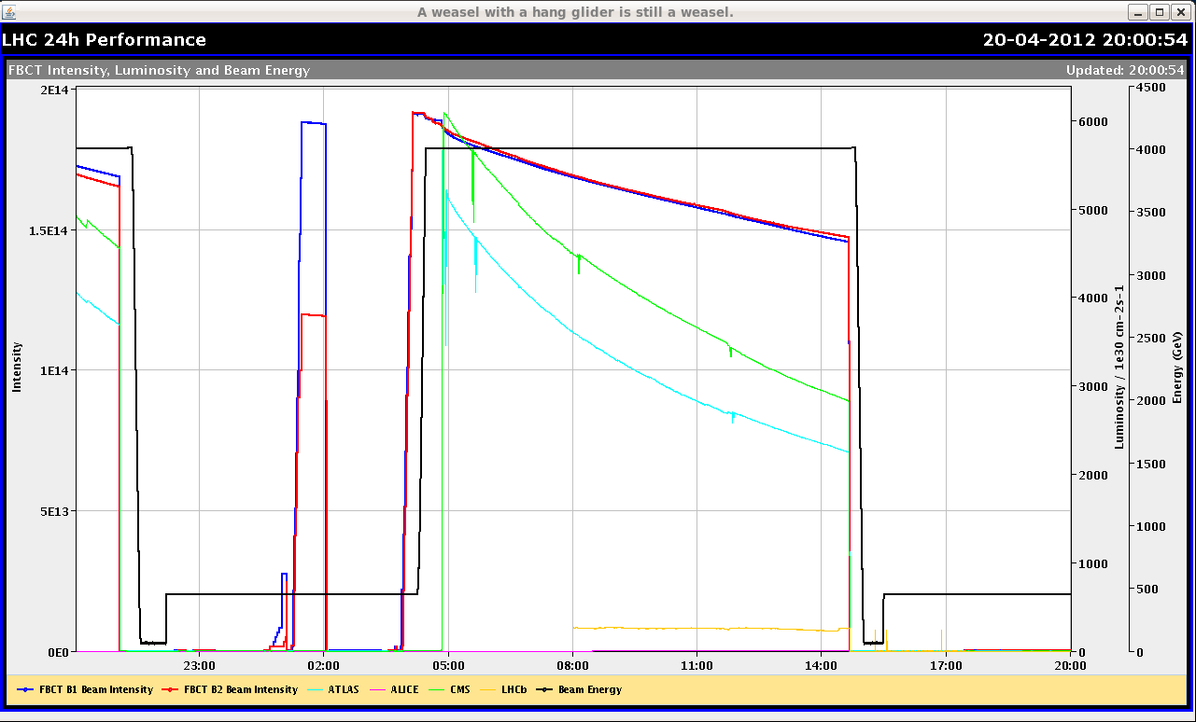
Luminosity Fill Friday (Last Before MD)

Slide 5
Peak Luminosity

Slide 6
Integrated Lumi: almost reaching 1 fb-1

Slide 7
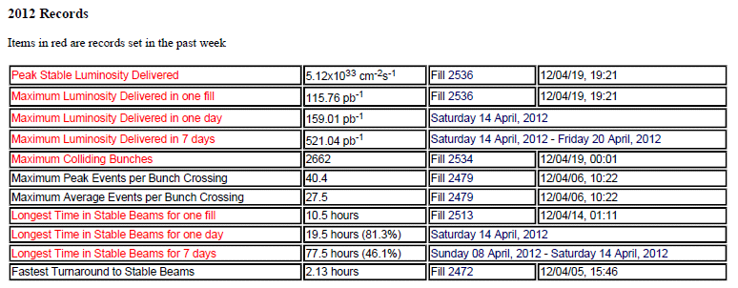
ATLAS 2012 Records
?

Slide 8
v/d Meer Scans: to be analysed
ATLAS scans

Slide 9
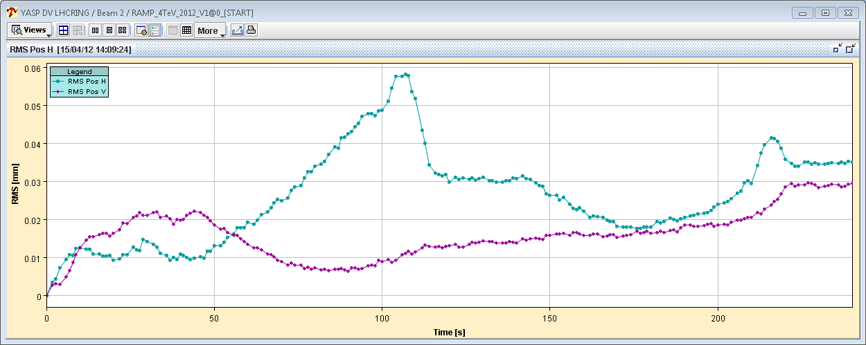
Orbit change in IR7 during collision BP
Before feed-forward
B1
50 μm
B2
50 μm
J. Wenninger

Slide 10
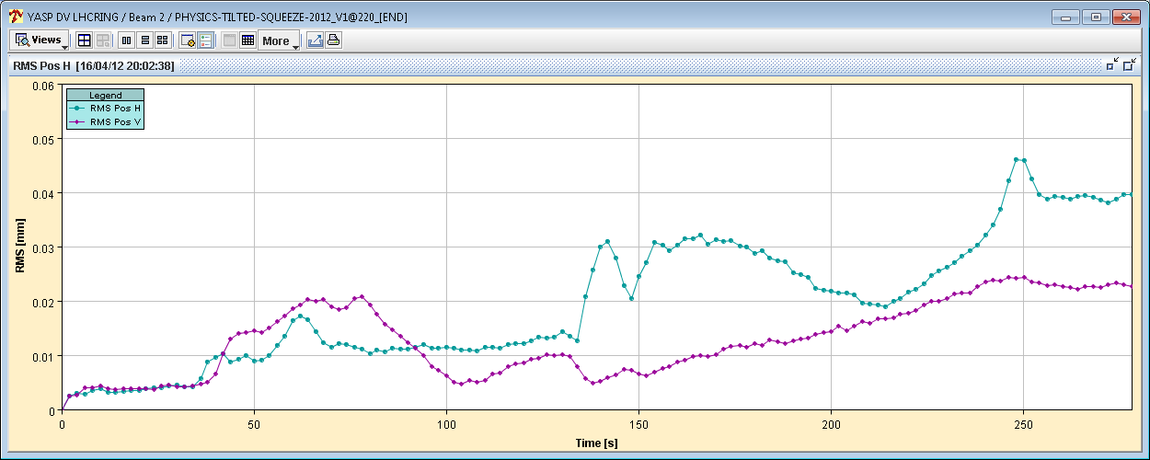
Orbit change in IR7 during collision BP
After feed-forward
50 μm
50 μm
J. Wenninger

Slide 11
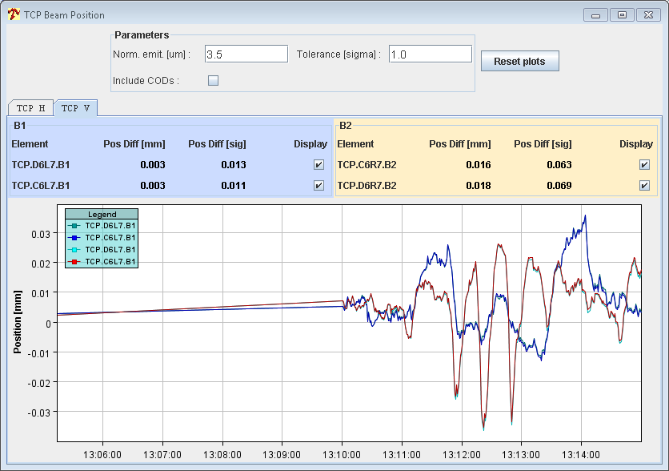
Orbit spikes during squeeze (3→2 m)
Amplitude of beam excursion spikes at B2 TCP (V plane) have been reduced by ~30-40%.
Tricky to correct – may try to flatten all corrections between 3m and 1.5m and restart on new basis (after TS1).
J. Wenninger

Slide 12
Abort gap population up to 9e10 p+ for B1
During ‘normal’ physics, see RF problem later

Slide 13
Cleaning the Abort Gap

Slide 14
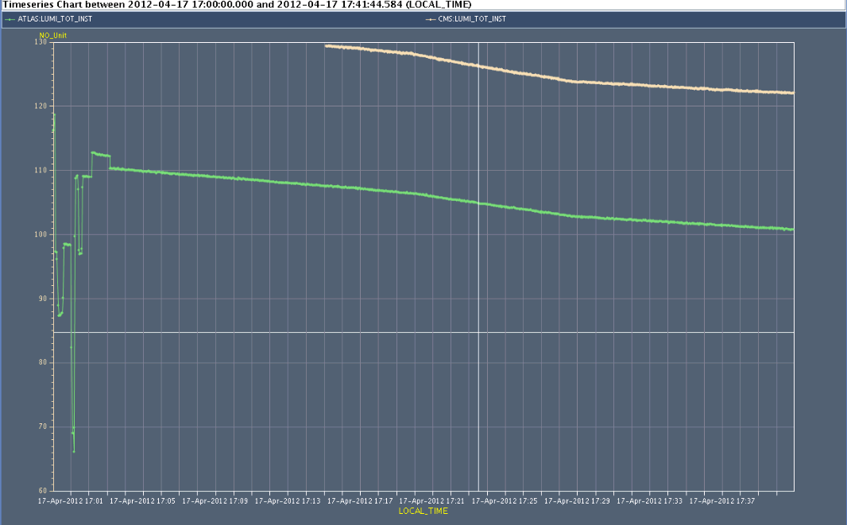
Atlas and CMS lumi’s
Effect of cleaning on luminosity – as in 2011
Strategy: only clean when required but then clean strong
Cleaning off

Slide 15
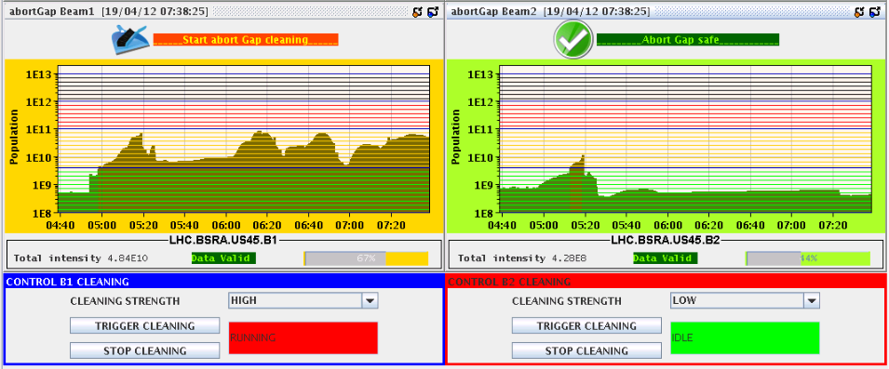
Abort Gap Cleaning
Allowed to keep the fill in during RF problems. Gained in efficiency!
Prevented from potentially dangerous situation of having to dump the beam with a “full” abort gap
With RF problem on B1
DUMP
Switched on cleaning for 1 min
No RF problem

Slide 16
Issues Encountered
Injection kicker pre-pulse problem b2.
Disabled ROF.A81B2 until TS.
The current of other octupoles increased to compensate.
Overload problem on COLSA.
Debunching problem for b1.
Instability when separating beams for length scale calibration.
World FIP problem
Injection steering (MSI)
ADT amplifier – 1 oo 4 off B1 vertical
TDI problem
HV interlock from BLM system

Slide 17
Injection kicker pre-pulse problem B2
Injection pre-pulse shifted, causing injection BETS to inhibit beam injection
144 bunches on the TDI
As beam to the core of TDI, not grazing, no magnet quenches
During tests the inhibition re-appeared once
Lengthened kicker resonant charging by 100 µs to prevent problem occurring
Continue investigations to understand cause of shift

Slide 18
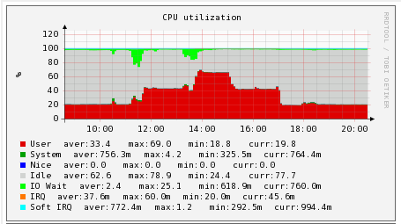
COLSA Problem (Report A. Bland)
Occurred on 18.4.
The CPU load and memory use on CS-CCR-COLSA (Concentrator for BPMs and BLMs providing data to the YASP steering program) rose a lot from 11:30. Marek Misiowiec restarted the Injection Oscillation programs on this machine at 11:37. A few minutes later the CPU load (perhaps due to lack of memory) rose for BUNCHORBIT processes.
From 11:45 to 11:48, nineteen of the Beam1 BPM Front End Fesa servers crashed and restarted after 20 seconds.
At 11:48 Verena dumped the beam as she could not see Beam1 any more.

Slide 19
COLSA Problem II (Report A. Bland)
A similar scenario occurred from 13:45 to 13:48 when ten of the Beam2 BPM Front End FESA servers crashed. Verena dumped the beam at 13:47.
Note that there was an unrelated event at 13:52 when the General Purpose Network Router of IT/CS for the CCC and Prevessin site crashed.
Later in the afternoon there were more problems with missing BPM data and unusual BPM response times in YASP so I rebooted CS-CCR-COLSA at 17:54 to clean up the memory.
The machine was swapping again, but less, during the injection around 18:30.

Slide 20
COLSA Problem III (Report A. Bland)
Upgrade to a more powerful machine.
Marek says that the amount of memory used by the CS-CCR-COLSA processes is proportional to the number of bunches requested.
The reason that the BPM Fesa servers on the Front Ends crash when there is a slow client like CS-CCR-COLSA needs to be investigated.
2 fills dumped

Slide 21
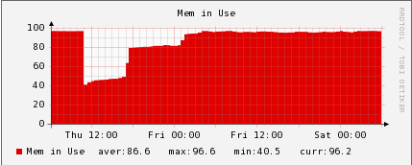
COLSA Issue Coming Back?
Sat: In YASP we again see (only at injection) momentarily missing BPM readings (crate by crate).
Checked the BPMs in daimon and all appeared OK.
However, we checked cs-ccr-colsa for CPU load and memory use, and observe that after the intervention on Thursday at 11:00, the memory use has again grown to ~95%, which does not seem normal.

Slide 22
B1 Issue (Debunching → RF?)

Slide 23
Luminosity Dropping Quickly

Slide 24
RF
With the measurements at SR4, we were able to correlate the debunching issues to abnormal noise levels in the RF reference signal of beam 1.
The RF reference is distributed from the surface at point 4 to the beam phase loop, all RF cavities, ADT, etc. The measurements without beam after the dump, helped us isolate the issue to the cables and modules distributing the reference signal to module 1-beam 1 in UX45.
Unfortunately, by the time we accessed the cavern, the issue disappeared. We preemptively replaced a few components, but not all modules to avoid introducing additional sources of error. We will continue monitoring over the next few fills.
However: it did the job !!!

Slide 25
... resulting difference after fixing RF
Beam currents
Abort gap population

Slide 26
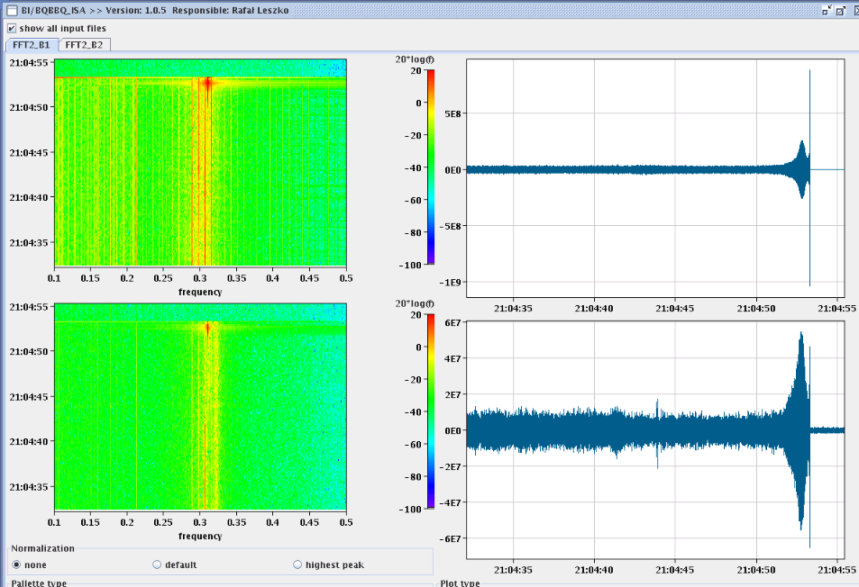
Length scale calibration...
Apparent instability when separating the beams by 2.5sigma in Pt 1. This then caused a loss in RS_08 of BLM at the TCLA_D_L7B2. The instability was in both beams an both planes.
Length scale calibration postponed until after TS (during intensity ramp-up)

Slide 27
World FIP problem
Cryo FIP communication problem S34: mask during injection.
Pierre Charrue:
We are aware of the WFip repeater in RE38 problem and we are ready to exchange it if ever this decision is taken by Cryo this morning.
I will be in the CCC to organize this with the Cryo people if this will take place.
For the record, please note that this is the 6th repeater breaking since the last 3 years.

Slide 28
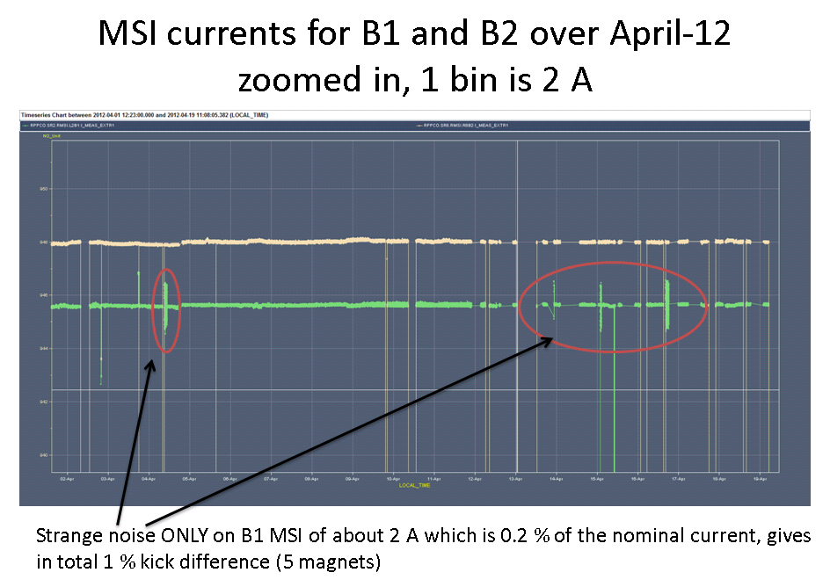
Injection steering problem B1 (W.Bartmann)
= what is needed to steer the line at the MSI
PC to be checked

Slide 29
ADT Issue (Wolfgang H.)
Currently one amplifier for beam 1, vertical (ADT) down.
There is one bad tetrode in there and the amplifier has been put in an idle state by blocking both tubes with the Ug1 voltage. The result is that we have with a loss of this amplifier 25% less gain and kick strength for vertical beam 1. For me this is acceptable. The intervention has been done by Gino Cipolla on the surface in SR4 (to take out the amplifier).
Ahead of the MD and the technical stop:
we from the LLRF (Daniel and myself) would like to go through all amplifiers of ADT with a test signal when there is no beam to check if there are other weak tubes that need attention before the MD or during the technical stop.
The matter is not so urgent, but still can you contact us at the earliest tomorrow a.m. for such a check when there are slots of 1 hour without beam ?

Slide 30
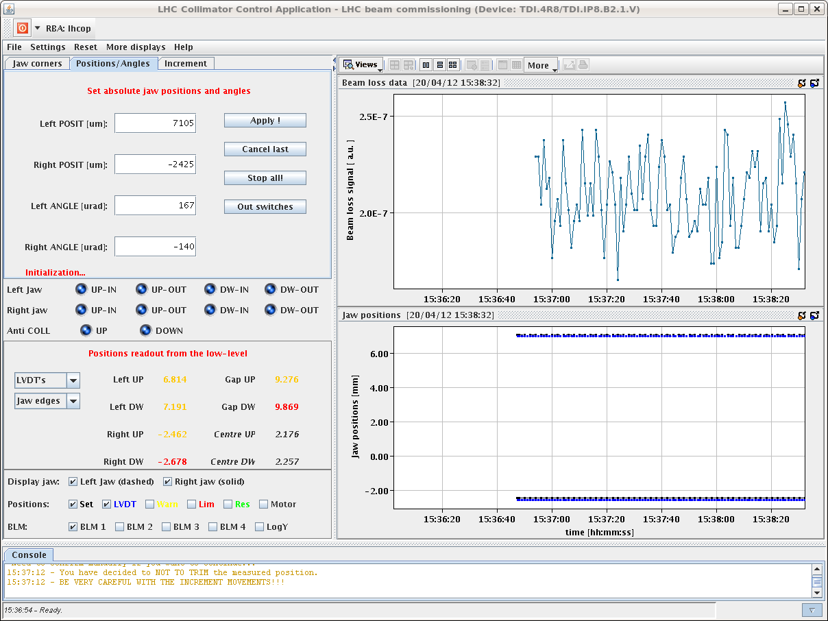
TDI Interlock Issue

Slide 31
TDI Problem
Problem:
drift of the LVDTs of TDI in point 8 outside position thresholds
Suspect deformation of the jaw induced by heating during injection:
the two LVDTs located at the 2 sides of each motor measure a symmetric offset corresponding to a tilt of the rod connecting the motor to the jaw.
LVDT reading jumping by up to 400 um when moving to parking and back to injection again
understood: motors stop driving the collimator to injection position when there is an error on the inner limit

Slide 32
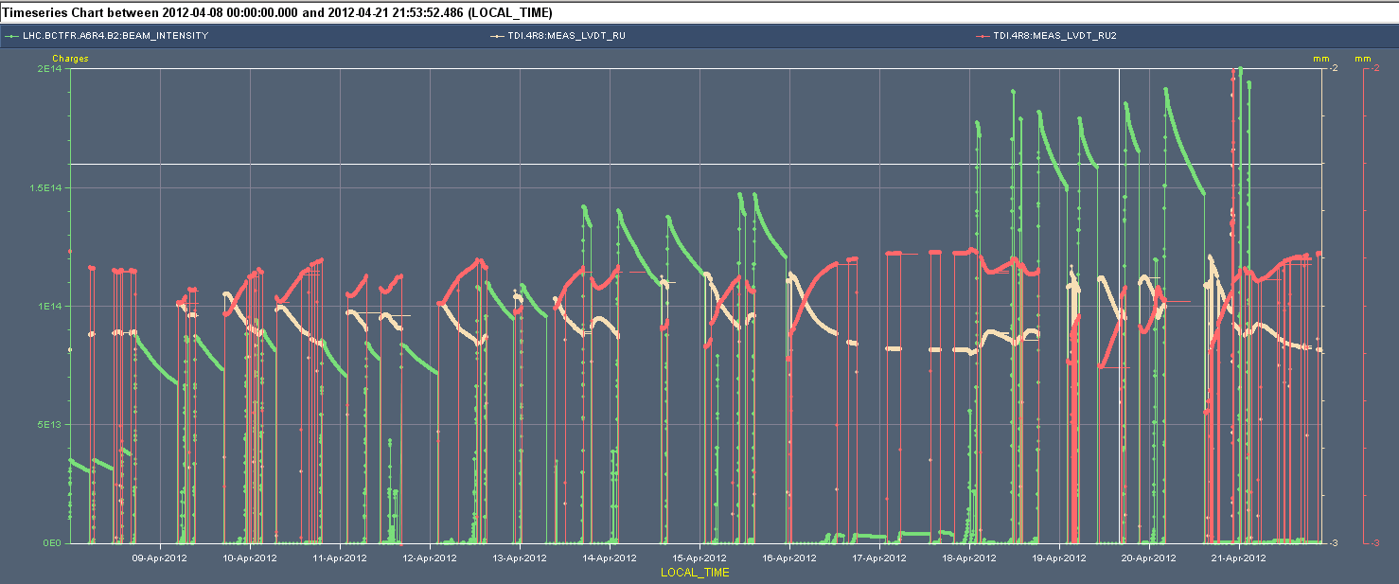
TDI LVDT Variations 2012
Movement of about 150 µm

Slide 33
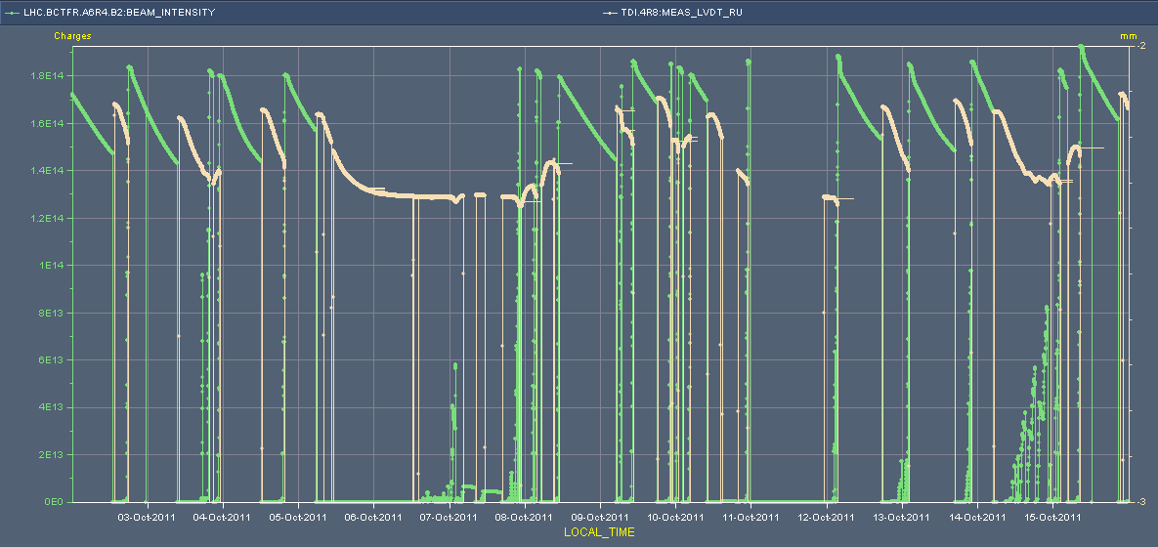
TDI LVDT Variations 2011
→ Same LVDT feature in 2011 and 2012. However, not seen in 2011, as limits were twice larger (0.5σ) than in 2012 (0.25σ).

Slide 34
TDI – check position
Check position of the TDI jaws with respect to the beam (nominally at 6.8 sigma) with pilot bunch
Opened vertical TCSG in point 7 in order not to intercept the beam
Used the transverse damper to blow up the beam until seeing losses at the vertical TCP in point 7 (losses at the TCP before than at the TDI ==> hierarchy still respected)
Moved the TCP away from the beam with 0.1 sigma steps (continuous beam blowup with damper)
Monitored losses at the TCP and TDI
Position of the TDI in sigma corresponds to the TCP position (in sigma) when losses at the 2 collimators are at the same level (then TDI losses higher than at the TCP)
We found:
B2 both jaws at 6.4 sigma instead of 6.8 sigma
B1 left (upper jaw) at 6.2 sigma and right (lower) jaw at 6.8 sigma
Small difference can possibly be explained by using a different method than used for the original set-up

Slide 35
TDI – check angle
Check angle of the TDI:
We repeated the same measurements we did on March 26th (see logbook of that date) to verify if any change in the angle occurred as a consequence of the warm-up
We found the same values within the measurement error (see plots in attachment)
By time of measurements jaws most likely cooled down again
Conclusion on position and angle:
We believe that there is a deformation of the jaws towards (safer side) the beam as a consequence of warm-up during injection (max. 0.6 sigma), we do not measure any significant variation in the angle and centre.

Slide 36
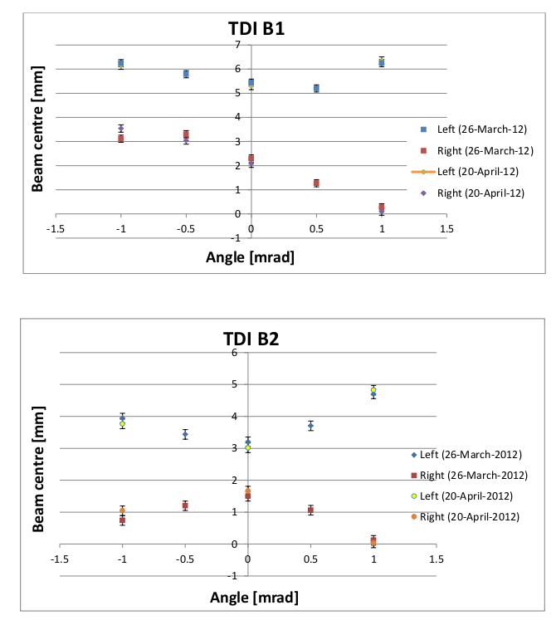
TDI Angular Alignment

Slide 37
TDI – OK?
If the problem reoccurs:
cycle the TDI to parking
if doesn't move anymore (hit inner limits) load the parking thresholds for TDI and cycle again
repeat several times and wait for possible cool down.
Problem not solved for the longer term
Especially have to understand situation when TDI is heated up and LVDT’s are drifting
Protection functionality guaranteed or not?

Slide 38
HV Interlock from BLM System
Fri 00h33 Interlock during ramp
IR7 HV interlock from BLM system (HV overload due to beam losses)
No BLM at dump threshold
Christos looked and found that the HV drop lasted for more than 1 minute and is certainly due to high losses in IR7.
Losses starting at 00:28 and continuously increasing until the dump. Not very high losses but lasting long enough.
Fri 01h46 Injection. Reduced intensity.
Fri 02h46 Interlock during ramp
IR7 HV interlock from BLM system (HV overload due to beam losses)
No BLM at dump threshold
Same as above

Slide 39
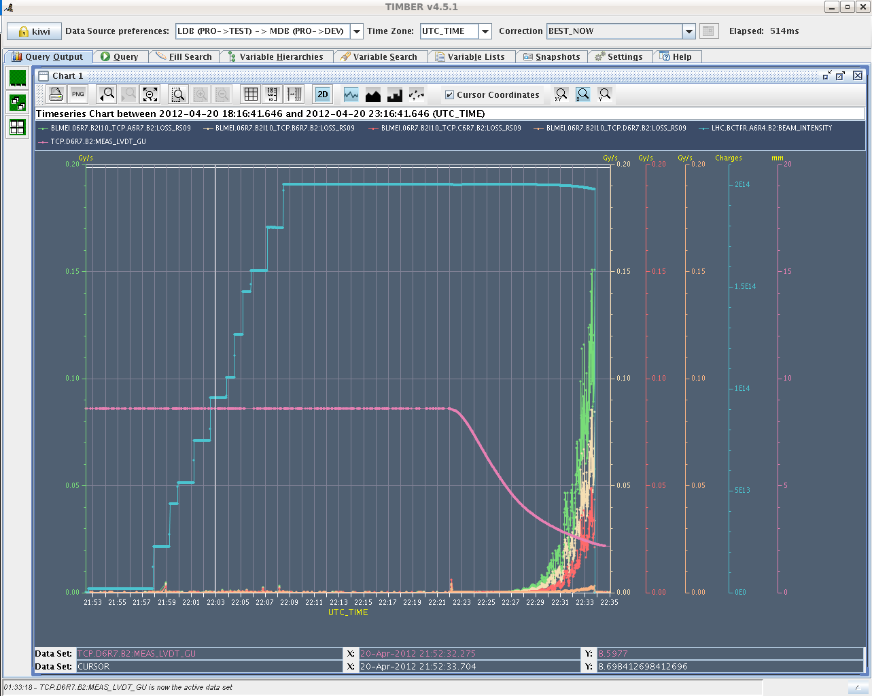
IR7 Modest Losses → HV Interlock

Slide 40
Ahead
Technical stop…

