Slide 1
Saturday 21st April
00:33 Interlock during ramp on BLM HV
02:46 Again, interlock BLM HV during ramp, with reduced bunch intensity
05:12 Pilot ramp for tune measurement.
05:26 Dump beams - ramp down - long. impedance MD
13:30 Start transverse damper (ADT) MD
17:06 Dump at full energy – end of ADT MD
18:30 Collimation MD @ 4 TeV starting
20:30 Beam dumped at 4 TeV, collimator moving into beam
00:14 B2 XPOC and IPOC failed due to no data for the MKD. This was due to the server cfi-ua67-mkdpm2 being down. Reset.
02:30 Aperture MD starting with beam at 4 TeV
07:20 Beam lost at 4 TeV while kicking with AC dipole for aperture measurements
07:20 Preparing RF batch by batch blow-up planned to start at 09:00

Slide 2
Longitudinal impedance MD
3 fills with Beam1 and 2, each with 8 bunches of varied. The first fill was with large longitudinal emittance (bunch length in SPS 2.0 ns).
The 2nd fill had no controlled long. emittance blow-up in the SPS and the 3rd fill was with blow-up in the SPS and phase loop was switched off.
We nevertheless observed that higher intensity bunches were longer. In the LHC measurements of the stable phase, bunch profiles, transverse emittances and Schottky spectrum were done for standard conditions and for BSRT and TDI in and out.
Some effect was visible for TDI movement, more details will come after analysis and simulations (as for IBS).

Slide 3
Transverse damper MD
Checked all dampers and determined damping time from injection oscillations; the differences observed need to be followed up in the technical stop and a "re-normalisation" is to be done
Emittance data to be analysed
The gain modulation batch-by-batch was commissioned
First bunch 1.7x10**11 & 7 trailing bunches at 1.5x10**11 . Ramped with the first nominal bunch without damper; recorded emittances. Relative damper gains used for the 8 bunches
Bunch with zero damper gain clearly blown up; also tendency visible for the other bunches of the train, but emittance measurements show large scatter; larger emittances measured in the ramp than at flat top: to be further analysed

Slide 4
Saturday, April 21, 2012, ADT 4 hours
Part 1: 1.5 hours (scheduled)
first checked damping time in single bunch mode for high gain and low gain (0.25 and 0.02 in LSA) → follow-up of difference between the two planes and beams during technical stop, then re-check after technical stop
injected one nominal bunch (1.4-1.5x10**11) and waited about 40 minutes at 450 GeV observing emittances; 12 minutes with high gain, 11 minutes with low gain and 10+ minutes with high gain → emittance data to be analyzed offline
damping times:
(ratio high / low gain in LSA: 12.5; fillamentation significant for low gain setting !
single bunch mode at high gain between → 11 and 19 turns
single bunch mode at low gain between → 73 and 127 turns
50 ns settings high gain (expected 3x slower than single b. setting) → 35 to 51 turns

Slide 5
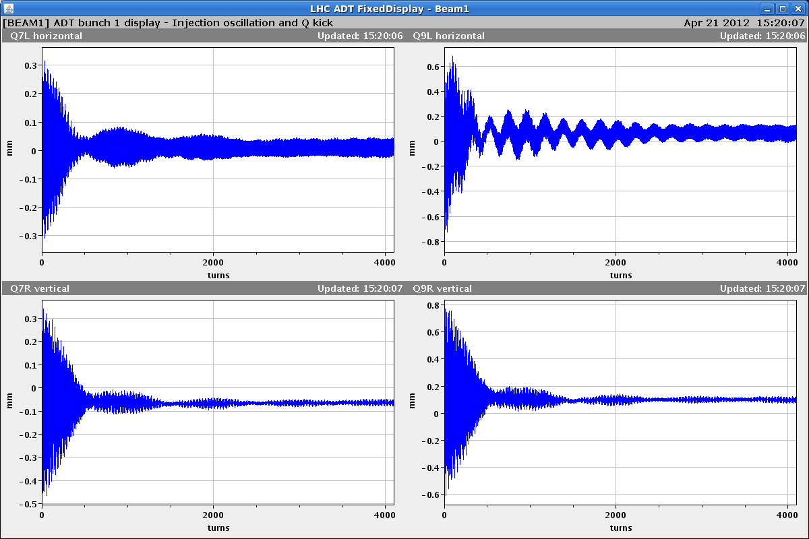
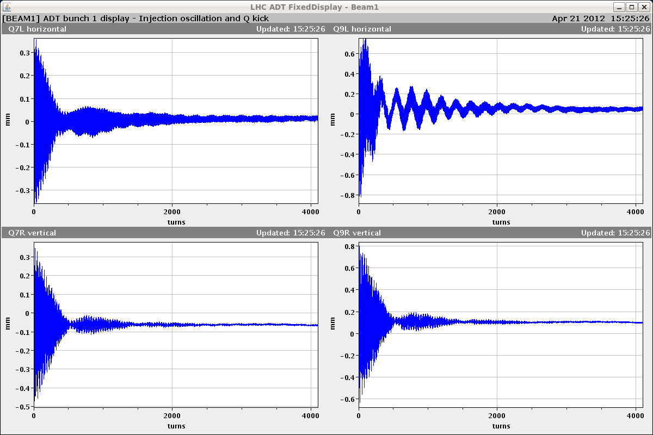
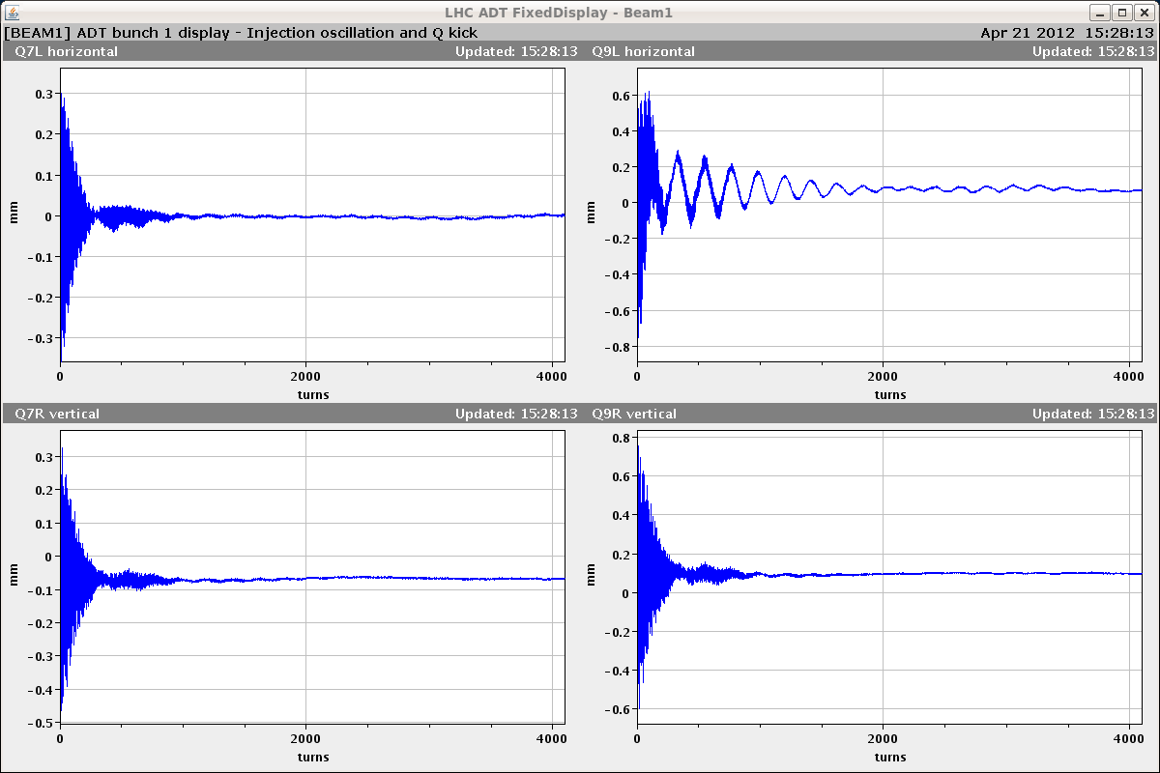
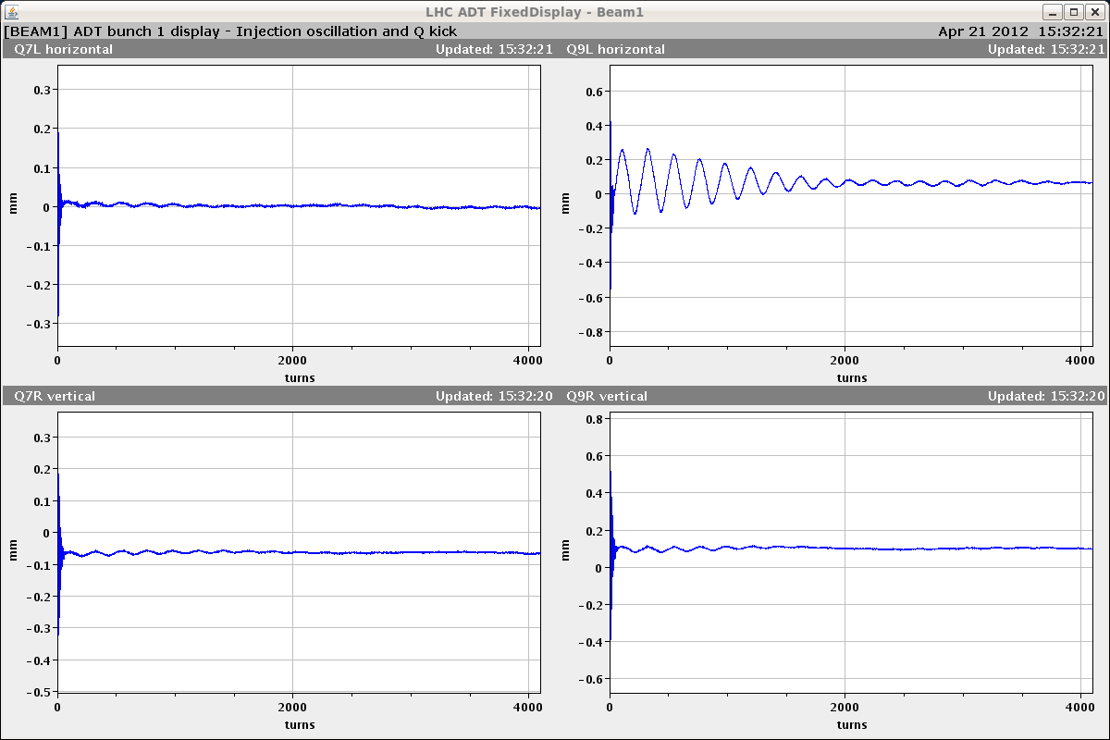
Saturday, April 21, 2012, ADT 4 hours
Part 2: 2.5 hours
commissioned batch-by-batch gain modulation factor of 0-127 in steps of 1
8 bunches injected with gains of ADT scaled by (0, 1, 2, 5, 12, 30, 70, 127)/128
verified by observing injection damping
bunch 1 gain 0
Bunch 3 gain 2
bunch 1 gain 12
Bunch 8 gain 127
g
gain 12
→ approx. prepare for ramp (LSA 0.02)
gain 127
→ high gain (LSA 0.25, injection setting)
first 4096 turns of the horizontal beam 1 injection oscillations are shown

Slide 6
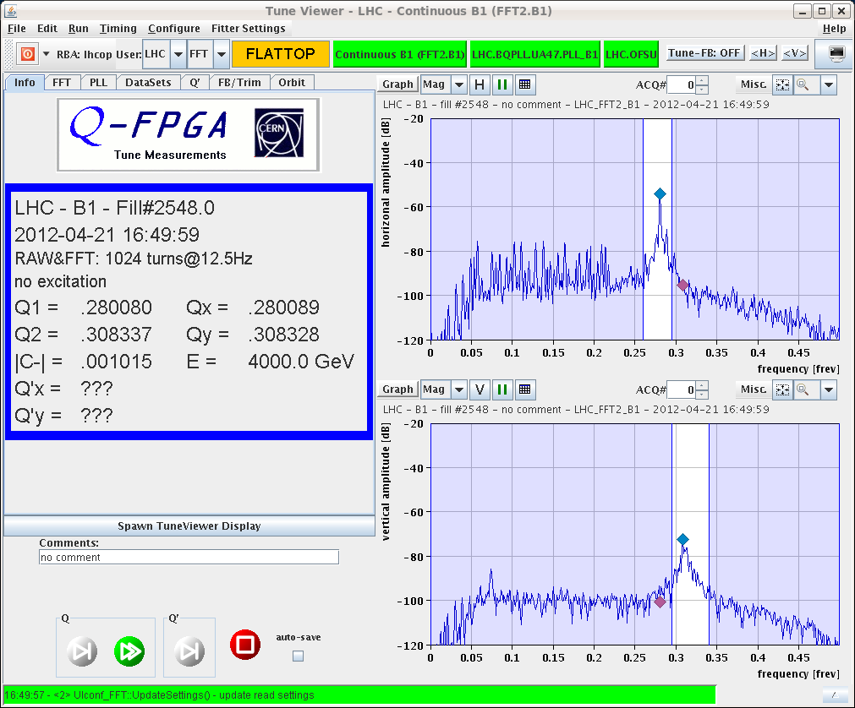
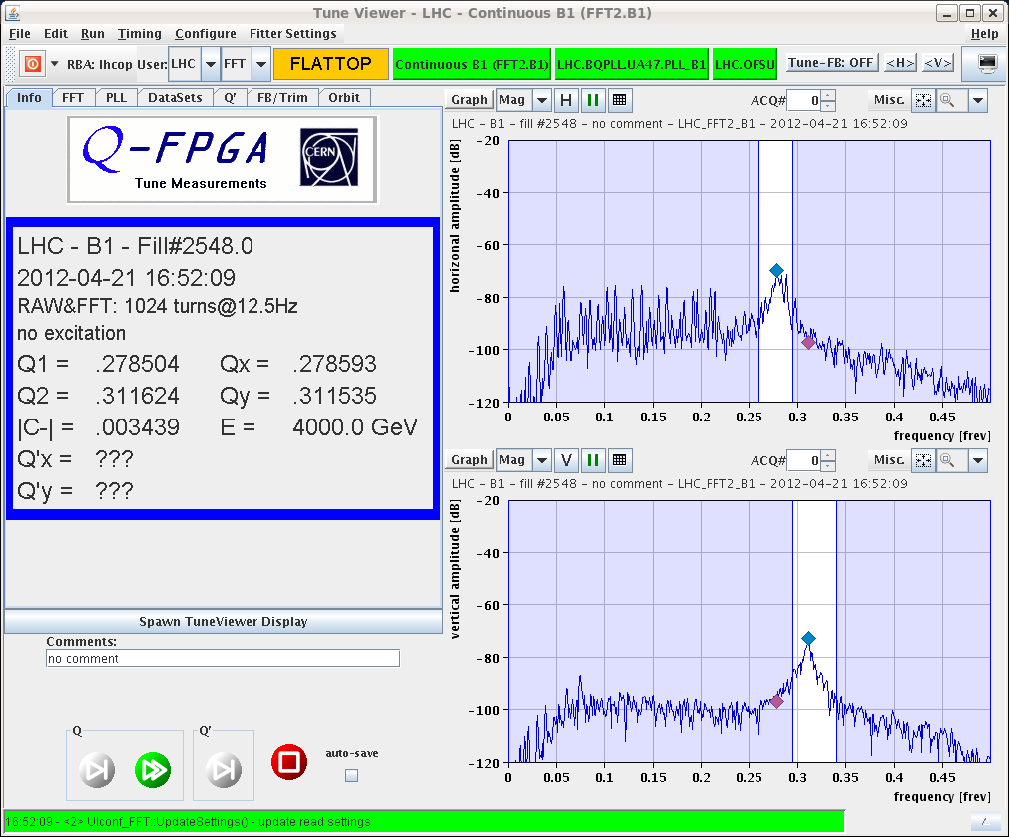
Saturday, April 21, 2012, ADT 4 hours
Part 2: 2.5 hours
ramped with normalised LSA gain at 0.25 at all times + gain modulation
LSA gain of 0.02 normally used in “prepare for ramp” corresponds to bunch 5 approx.
bunch with zero gain clearly blows-up
good BBQ signal thanks to low gain bunches (also higher intensity for bunch 1 as planned)
emittance data to be analysed (large scatter observed)
also recorded all bunches of HB1Q7 with new “continuous acquistion” in ADT
batch-by-batch gain mod. is feasible for Physics fill to see which gain gives highest lumi
1 of 8 bunches no gain
8 bunches high gain

Slide 7
Collimation at 4 TeV MD
The first part of the MD involved performing an alignment of a horizontal IR3
The poor BLM signal quality for horizontal alignments observed for the March setups could be due to different parameters (e.g. octupole strength) rather than the momentum cut during the alignment.
Test of new software, which uses the BPM-interpolated orbit at the collimators to move in the jaws from their initial positions to a safe margin in sigmas around the orbit
The beam was dumped due to an error in the setting of the jaw position (settings sent in metres instead of mm)
The bug was quickly fixed, and the functionality of the software was tested at 450 GeV.
With the collimators all at 6 sigmas after the initialization from the BPM-interpolation, beam-based alignment of the collimators in parallel was performed (IR3 and IR7, 26 collimators)

Slide 8
4 TeV Aperture MD
For pilot intensities we started with the alignment of the TCTH collimators in IP1/5.
However, the aperture scans gave puzzling results. Even if for both beams we measured more than 11 sigmas, we found different results than in the first measurements done during the initial commissioning period (B1-H bottleneck now found in IR1 sepration plane). Details will come after off line analysis.
We noticed that the horizontal scans were affected by losses at the vertical collimators, which are not understood.
We noticed also that the octupoles have an effect on the loss patterns during beam blow-up and on the estimated aperture values.
Very preliminary on line analysis indicates about 1 sigma more if octupoles are at 50A instead than 450A. To be checked in detail.

Slide 9
The Plan
Fri Physics with 1380b
Length scale calibration will be after the Technical Stop during intensity ramp up
Sat 06:00 Start of LHC MD #1 (cut short by 1 day)
Mon 06:00 Start of LHC technical stop (new software for orbit feedback)

Slide 10
Updated of shortened MD Schedule
Sat
06:00 – 07:00 end of fill study (tune scan, …)
09:00 – 13:00 450 GeV: Longitudinal impedance
13:00 – 17:00 450 GeV → 4 TeV: ADT (no fast blow up)
19:00 – 00:00 450 GeV → 4 TeV: Collimation
Sun
02:00 – 07:00 450 GeV → 4 TeV: Aperture
09:00 – 17:00 450 GeV: RF batch by batch blow-up
17:00 – 23:00 450 GeV → 4 TeV: BI (emittance cross calibration with ADT blowup)
01:00 – 06:00 450 GeV → 4 TeV: ADT (tune compatibility)

