Slide 1
Wed 28.03.12
05:40 Lost S78 - QPS controller.
Access for QPS and RB.A78.
Rainer: “Caused by a loss of 230 V mains power on rack DYPB. A27R7. Closer inspection by the stand-by service revealed that a 230V mains plug was not properly connected (connector not locked). Most likely the fault has been introduced during the winter shutdown but unfortunately not seen until now.”
09:30 Precycle. RQ6.L7 tripped during precycle.
QPS experts to reset RQ6.L7B. The trip was due to a zero-crossing voltage spike of PC. Spike was exceeding the filter capacity of the detection system, which in consequence tripped the circuit.
11:08 OFSU problems (connection problems for clients)…
FBCT ... both crates rebooted by the experts.
OFC down.
Fixed ramp functions for TCT's in IR8. Wrong sign of crossing angle.

Slide 2
Wed 28.03.12
13:06 Start ramp with 2 nominal bunches per beam.
RF blow-up on.
Transverse emittance very large, as requested (4.5 micron norm. at injection, 5 – 6 micron at top energy).
Smooth scraping of 15% of beam intensity.
Primary collimators moving in from 5.7 to 4.3 nominal beam sigma.
In real sigma: 5.0 σ → 3.4 σ (measured emittance).
In addition: not aligned.
13:43 Start of 4 TeV collimation alignment.
15:53 Beams dumped.
due to beam loss in Q7 of IR3
induced by longitudinal beam instability (phase loop with zero gain) and a small orbit correction.

Slide 3
Lifetime with Tight Coll. + Large Emittance
ramp

Slide 4
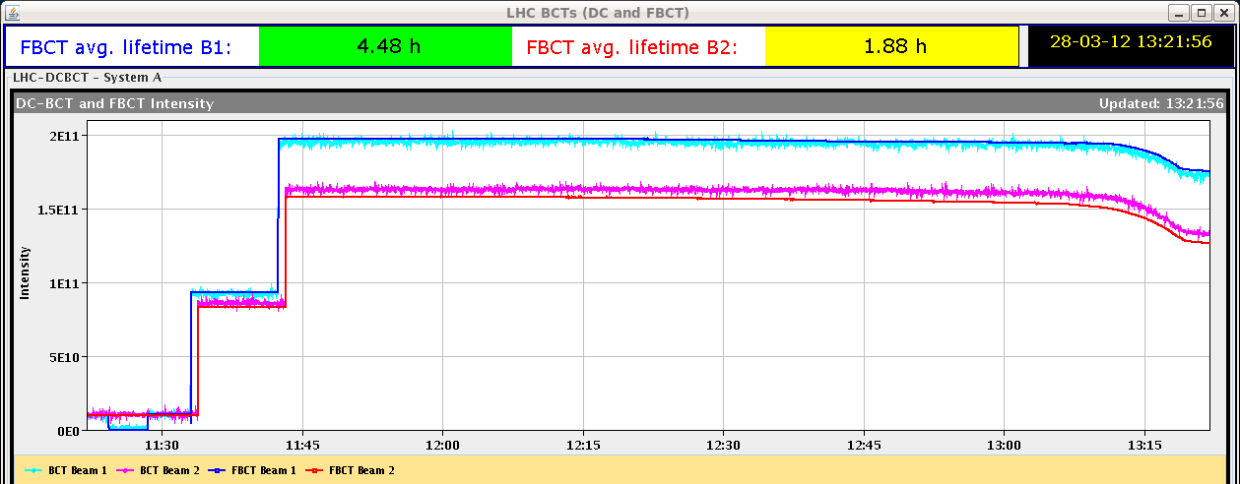
Beam loss during ramp
ramp
Transverse emittance very large, as requested (4.5 micron norm. at injection, 5 – 6 micron at top energy).
Collimator cut in real sigma:
5.0 σ → 3.4 σ (measured emittance)

Slide 5
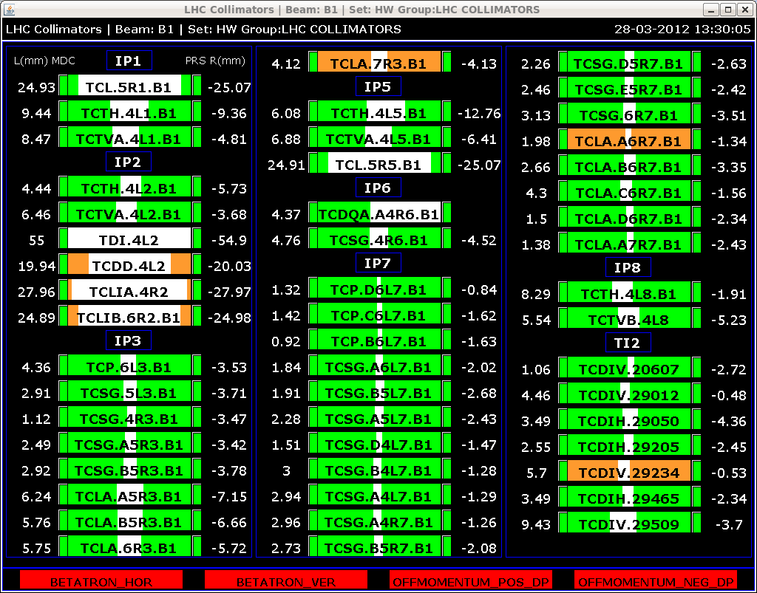
Collimator gaps at 4 TeV

Slide 6
Orbit during ramp
…nice and stable within 50 – 100 micron

Slide 7
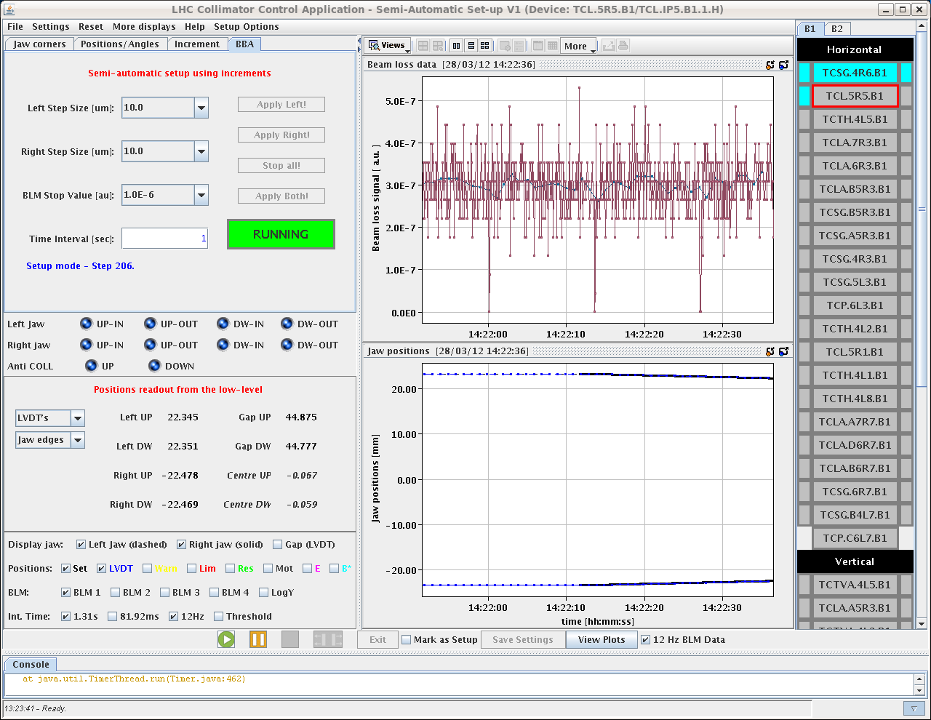
Collimator Setup Example

Slide 8
Summary Collimation Setup (~2h)
Collimator alignment started at 13:45. The horizontal B1 and B2 TCPs were aligned, followed by the B1 and B2 TCPs in IR3.
The horizontal B1 and B2 were aligned coarsely in parallel. The maximum number of steps taken by each collimator in sequential alignment after crosstalk during parallel movement needs to be increased from 100um to > 150um.
On occasions, the BLM spike recognition classified a VALID spike as INVALID, moving in the jaw further than was necessary (20um) until a VALID spike was classified. To be checked.
8 collimators in B1 and 1 collimator in B2 were aligned in 2 hours. However, ~30 minutes was spent re-aligning one of the IR3 collimators, as a large measured-to-nominal beam size ratio was noted for the 5 IR3 collimators (> 140% up to ~175%).
Collimator setup will resume tomorrow.
RA, BS, GV, RB, SR, LL

Slide 9
RF problems with longitudinal blow-up
In the first ramp with two nominal bunches per beam, the phase noise excitation did not have constant power around the ring.
This situation was used to achieve intentional different bunch lengths in an RF MD in 2011, but in normal operation, the excitation power must be identical for all bunches.
The result was a correct bunch length average (around 1.1 ns), thanks to the feedback adjusting the excitation amplitude from a measurement of bunch length mean, but different lengths for the two bunches.
Ring 1: Bunch 1 length 1.6 ns, bunch 2 length 0.6 ns
Ring 2: Bunch 1 length 1.4 ns, bunch 2 length 0.9 ns
With 0.6 ns length, the second bunch of Beam 1 became unstable in the last part of the ramp (instability driven by the longitudinal broadband impedance).
We observed quadrupole oscillations (bunch lenght modulation) of growing amplitude, resulting in debunching and finally beam dump caused by excess loss on momentum collimator.
John, Themis, Andy and Philippe

Slide 10
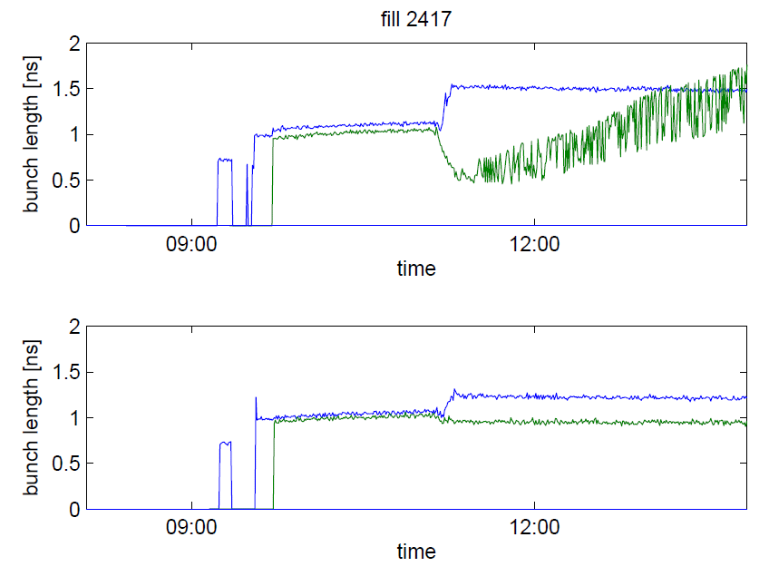
RF Stability Issue
Giulia P.

Slide 11
RF problems with longitudinal blow-up
The FESA class was corrected and we tried a new ramp around 18:30. This resulted in very similar behaviour for both bunches, each ring.
For Beam 2, the undershoot in bunch length is understood and should not happen in future ramps.
For beam 1, the second bunch still showed a 150 ps pk-pk lenght fluctuations during the last quarter of the ramp, stopping at flat top. That will be followed in later ramps.
The strength of the excitation has been doubled to, hopefully, track the target 1.2 ns more closely. We will monitor later ramps. John, Themis, Andy and Philippe

Slide 12
Wed 28.03.12
16:23 Cavity 3B1 tripped. Calling expert. Dry ramp for the RF with the blow-up
16:57 Injection.
18:32 Ramp of two nominal bunches for checking RF.
19:00 Some BI studies at flat top:
tune tracking tests,
switched on radial modulation and trimmed Q' in steps between -15 (not so good, see lifetime) and +15 (much better). Actually, Q'=-10 seems to be also OK.
19:49 Programmed dump.
Without beam: Test unsqueeze to 90m: no interlock!
21:50 Injection and dump.

Slide 13
Lifetime with Tight Coll. + Normal Emittance
injection
ramp
flat top
Both beam 1 and beam 2 lifetimes are fine at flat top.
Improvement for beam 2 due to RF changes?
Lifetime reduction during ramp is unavoidable and not surprising at all:
Collimators go down in normalized “real” sigma (8.2σ → 6.2σ) and tails are cut. Note: Tails do not contribute to luminosity!

Slide 14
Summary of injection protection studies
Validation of TCDI settings in both lines:
put TCDIs to +/-5 sigma of measured centre from last setup
create open oscillations in the TLs from 0 to 360 deg in steps of 30 deg in hor and vert plane
record losses at the BLMs close to the collimators with the highest loss level for the respective plane
measure maximum transmitted amplitudes per phase
FEI unmasked and checked if OK
Results:
measurements for vertical planes look better, probably due to better trajectory stability
transmitted amplitudes between 5 and 6.5 sigma --> below 7.5 sigma protection limit
TCDI validation OK

Slide 15
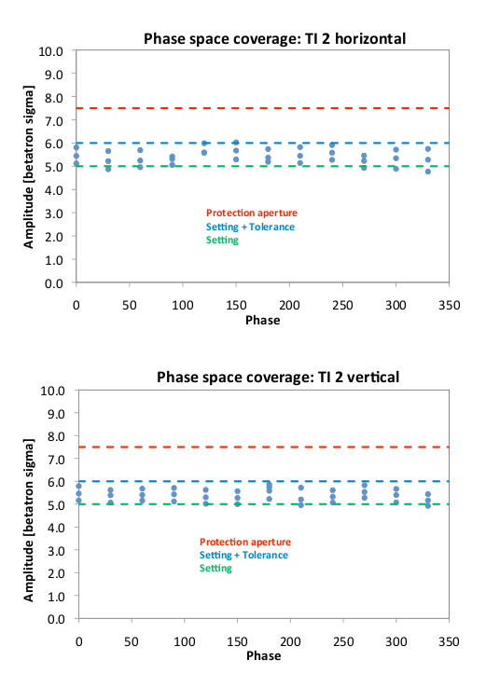
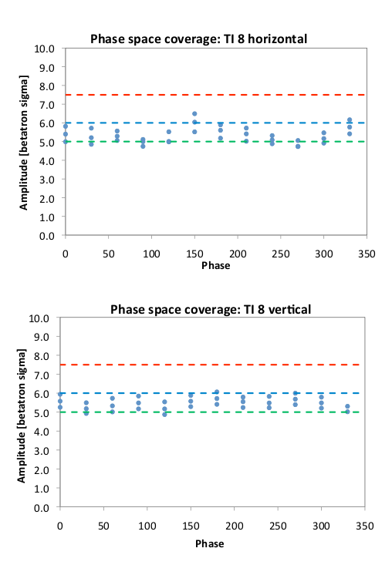

Slide 16
Thu 29.03.12
05:39 Injection for collimation setup at 4 TeV (2 nominal bunches, increased emittance)
06:19 Ramp
06:49 Start collimation setup at 4 TeV
Started on vertical plane: 13 coll done in 1.5 hour
Still RF blowup issues: to be followed
Might prevent full collimation setup at 4 TeV

Slide 17
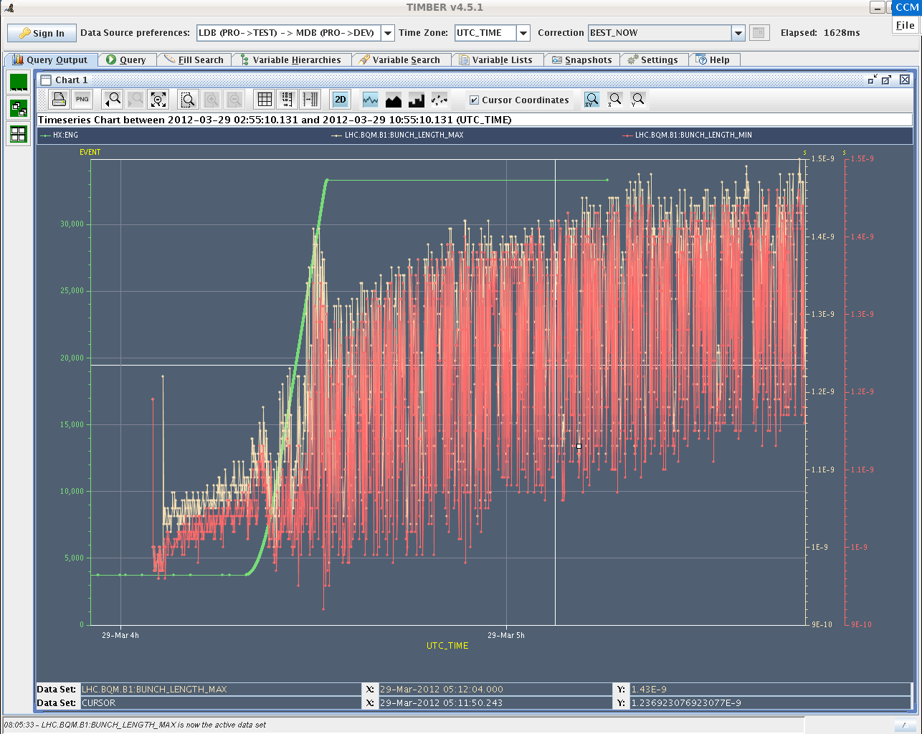
Bunch Length Beam 1

Slide 18
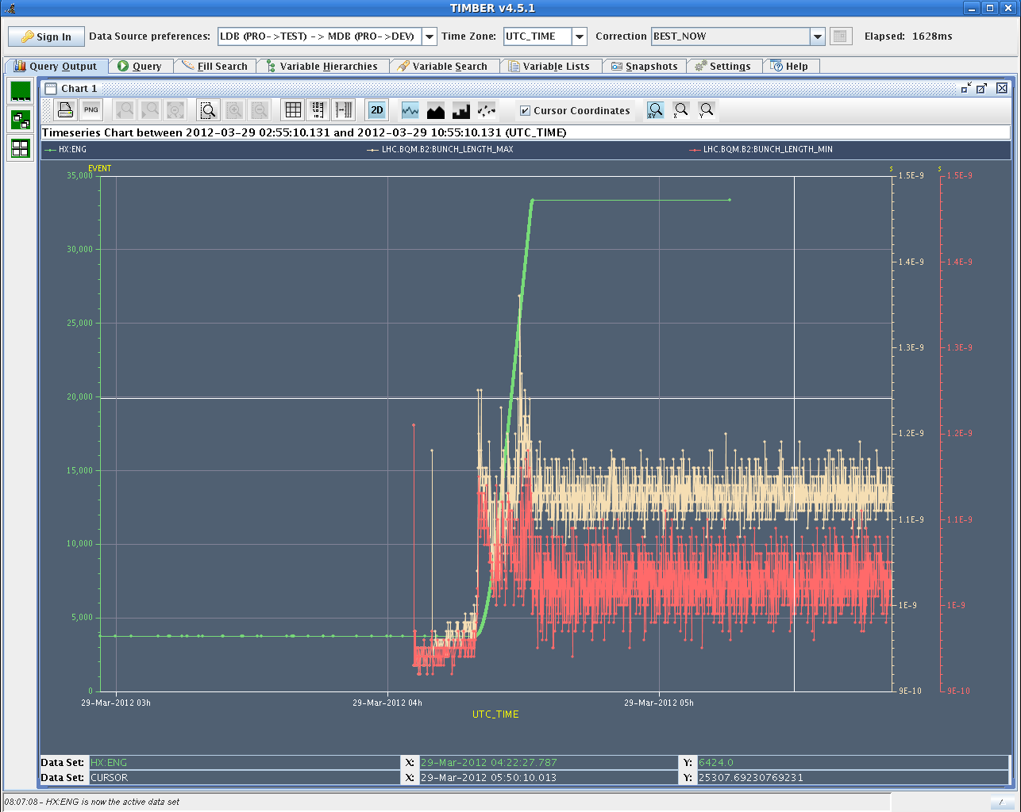
Bunch Length Beam 2

Slide 19
Ahead
Thu 06:00 Continuation collimation setup, RF tuning?
18:00 Inject and dump work
Fri 02:00 Optics, K modulation (or loss maps 4 TeV) 10:00 Take 1 nominal bunch 4 TeV through full cycle into collision 18:00 Aperture checks (or optics, k modulation)
Sat 03:00 Loss maps at 4 TeV 11:00 Take 1 nominal bunch 4 TeV through full cycle into collision, with TCT setup through squeeze and collision processes 19:00 BI setup 4 TeV without squeeze (12 nom b) nominal bunches)
Sun 04:00 Loss maps at 4 TeV (or injection) 12:00 Inject and dump work Qualification ramp with final processes (ramp, squeeze, collide)
Next week: Set-up for 50ns

