Slide 1
Week 12 Beam Commissioning
J. Uythoven, E.B. Holzer

Slide 2
Week 12
6 | MON | M | 10.5 | Ramp and squeeze test - injector stop (9 to 11)
6 | MON | A | 1.5 | EDF intervention
6 | MON | A | 7.5 | Aperture measurements at injection (global) (TDI2/8 - VVGSH.78.6L7.B - BTVs, IP6 orbit bump?)
6 | MON | N | 2.5 | BGI B1
6 | MON | N | 4.5 | BLM MPS tests
7 | TUE | M | 1.5 | K-modulation test
7 | TUE | M | 5.5 | RF setting-up (long. Blow-up in the ramp), 1 bunch 8E10 p
7 | TUE | M | 1 | ramp and squeeze
7 | TUE | A | 0.5 | test stretched squeeze function
7 | TUE | A | 7 | Injection studies
7 | TUE | N | 10 | Squeeze to 0.6 m revisited - optics (beta beat corrections)
8 | WED | M/A | 15.5 | Collimation setting-up 450 GeV
8 | WED | N | 5 | Squeeze to 0.6 m corrected (lengthen squeeze function and correct orbit)
9 | THU | M | 1.5 | TI8 stability check
9 | THU | M | 7 | b* at 0.7 m and 0.6 m
9 | THU | A | 1 | Splashes to ATLS
9 | THU | A | 1 | Commission energy feedback

Slide 3
Week 12, cont.
9 | THU | A | 4 | Ramp, squeeze with crossing angles and beam separation, collision beam process with LHCb crossing angle tilt
9 | THU | N | 10 | TCDQ set-up at 450 GeV (1:30 h no beam from injectors)
10 | FRI | M | 6 | Access and precycle
10 | FRI | M | 1 | MPS Verification tests (access and system changes)
10 | FRI | A | 9.5 | Aperture at 4 TeV, 0.6m (ADT)
10 | FRI | N | 2.5 | Ramp with flattened functions for Q and Q’ corrections
10 | FRI | N | 3 | MPS Verification tests (access and system changes)
10 | FRI | N | 2 | Ramp and squeeze with collimator ramp functions
11 | SAT | M | 10.5 | Access system problem and precycle
11 | SAT | A | 3 | Loss maps 450 GeV and async. dump test
11 | SAT | A | 3 | First ramp-up with one nominal bunch / beam and tight collimator setting; collimator set-up at flat top
11 | SAT | N | 6 | Pre-cycle or ramp (no beam) - decay measurement at 450 GeV
12 | SUN | M | 3 | longitudinal loss maps 450 GeV
12 | SUN | M | 6 | Sort out orbit (feedback) on the ramp.
12 | SUN | A | 9 | Injection protection set-up
12 | SUN | N

Slide 4
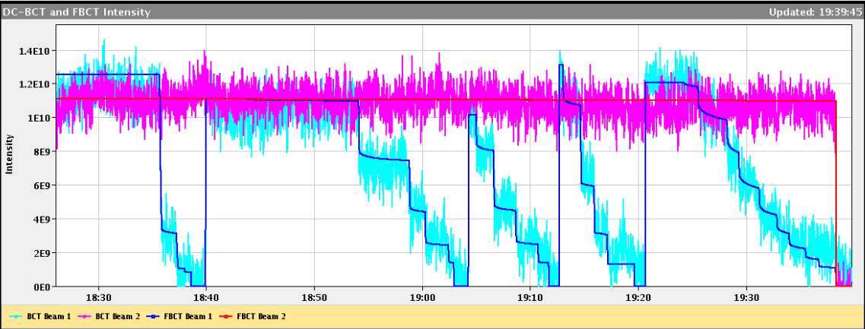
Aperture checks at 450 GeV - Monday
Use transverse damper (ADT)
For the first time a new setup with fast BLM acquisitions (12.5 Hz) and fast collimator movement requests (8 Hz)
“Limiting Apertures”
B1-H : Q6R2. Measured between 12.0 amd 11.5 sigmas
B1-V: Q4L6 between 12.5 and 12.0 sigmas
B2-H : Q5R6. Measured between 12.5 and 13.0 sigmas
B2-V: Q4R6 between 13.0 and 12.5 sigmas
For all cases, the locations of the global bottlenecks are the same as in 2011. The aperture is 0.5 to 1.0 sigma worse
For all bottlenecks, we performed local orbit bumps to check the aperture centre. offsets between -800 and 500 microns

Slide 5
Losses from Q4R6 to Collimator
ADT ~ constant loss rate (duration = 100s)
Knowing the gap of the primary collimator, we can conclude on the aperture. The result (between 13 and 12.5 sigma) is consistent with the previous measurement
One can get the aperture in one single measurement taking 1-2 minutes only.
Collimator position
Loss collimator
Loss Q4R6

Slide 6
Tuesday night – optics corrections during squeeze
Chromaticity, coupling, Beta-beat , dispersion measurements and corrections at 4 TeV during the squeeze.
Beta-beating down to 10-20% after local correction
Beta-beating down to 5% after global correction
Dispersion beat in horizontal reduced

Slide 7
Beam 2 beta-beating at 0.6m after local correction

Slide 8
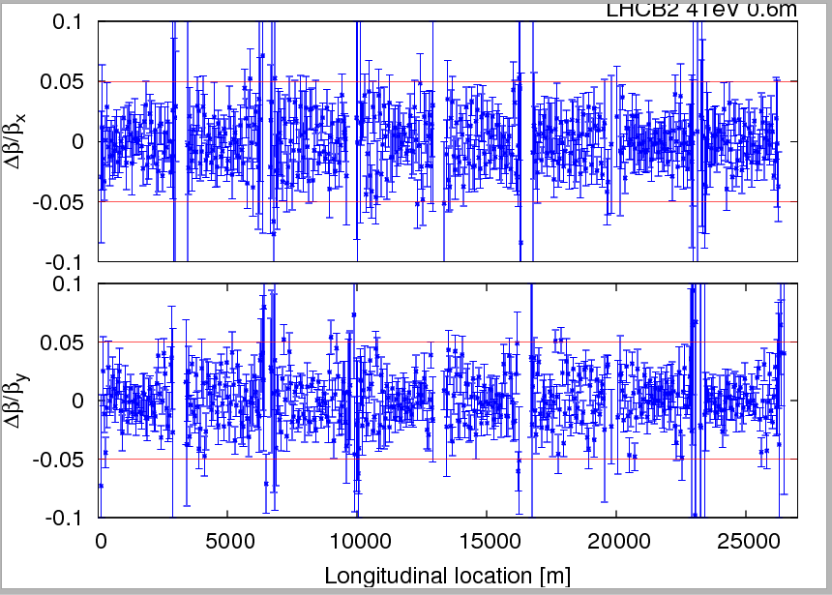
Beam 2 beta-beating at 0.6m after global correction

Slide 9
Beam 2 dispersion error (normalized) after global correction

Slide 10
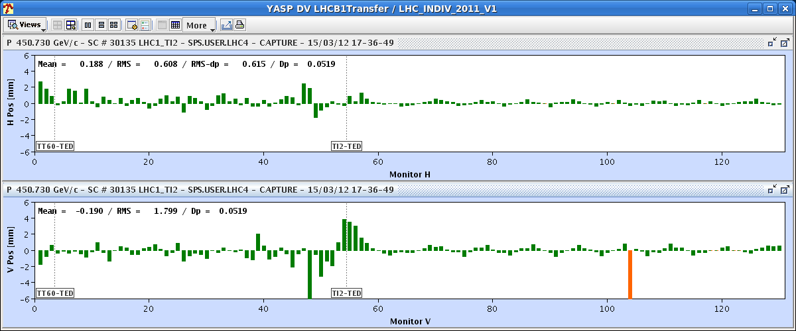
Tuesday evening – injection set-up
Aim: investigation on the origin of the vertical bump at the end of TI2 in
Scan of MKI delay and voltage: The settings of the MKI (delay and strength) were already optimized
Can not get rid of the bump without creating injection oscillations
But there is enough aperture available in the line → We can establish this year's reference with the bumps in.
No losses observed with a bump up to 18 mm (~11sigma)
Still unclear the origin of the bump (not there last year): roll angle of the MSI (vertical kick)? Realignment after layout change during TS? → To be investigated
LHC
TI2

Slide 11
RF Blow-UP tests - Tuesday
Philippe:
Good results from Blow-Up tests.
Controlled blow-up tests show a nice (1-Exp[-t/tau]) response.
Ramp with pilot (13:10), target at 1.2 ns. We get 1.17 ns both beams. Looks fine. However some length oscillations in the first few minutes. Will try another ramp without modification, then reduce gain.

Slide 12
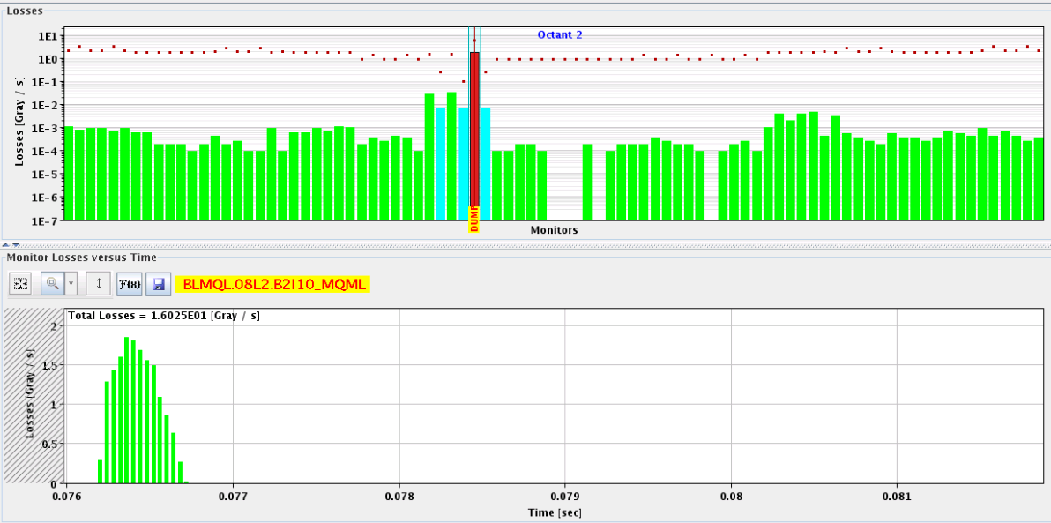
Ramp for testing of crossing through squeeze
Thursday
First ramp lost at 3.8 TeV due to losses on BLMQL.O8L2. B2I10_MQML
Not really explained, unusual loss pattern
It is on the ms time scale, could be something UFO-like
B2

Slide 13
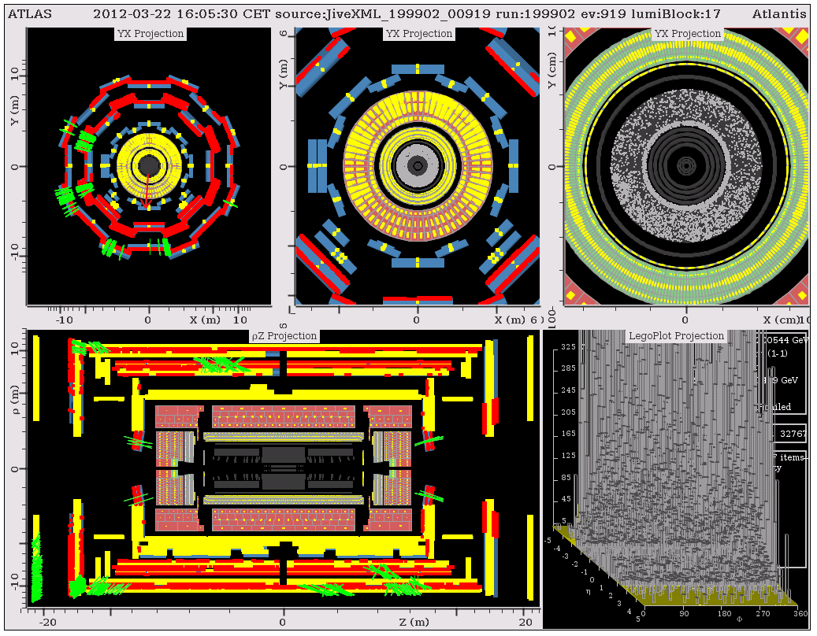
Splashes for ATLAS - Thursday
“As you can see, the calorimeters and muon detectors were nicely illuminated, which allows us to time-align them.”

Slide 14
Aperture at 4 TeV 0.6m – conclusion - Friday
The bottlenecks are found in the triplet of IR1/5 as expected
B1-V: limit in IP1-left (crossing plane). Aperture 11-11.5 sigmas
B1-H: limit in IP5 left (crossing plane). Aperture 11.5-12 sigmas
B2-V: limit IP1 right (crossing plane). Aperture 11-11.5 sigmas
B2-H: limit in IP1 right (separation plane). Aperture 11.5-12 sigmas
The latter result is a bit puzzling as the limit should be in IP5 (crossing plane). This case was repeated several times, but the loss location was always confirmed.
Beta* of 0.6 m looks promising

Slide 15
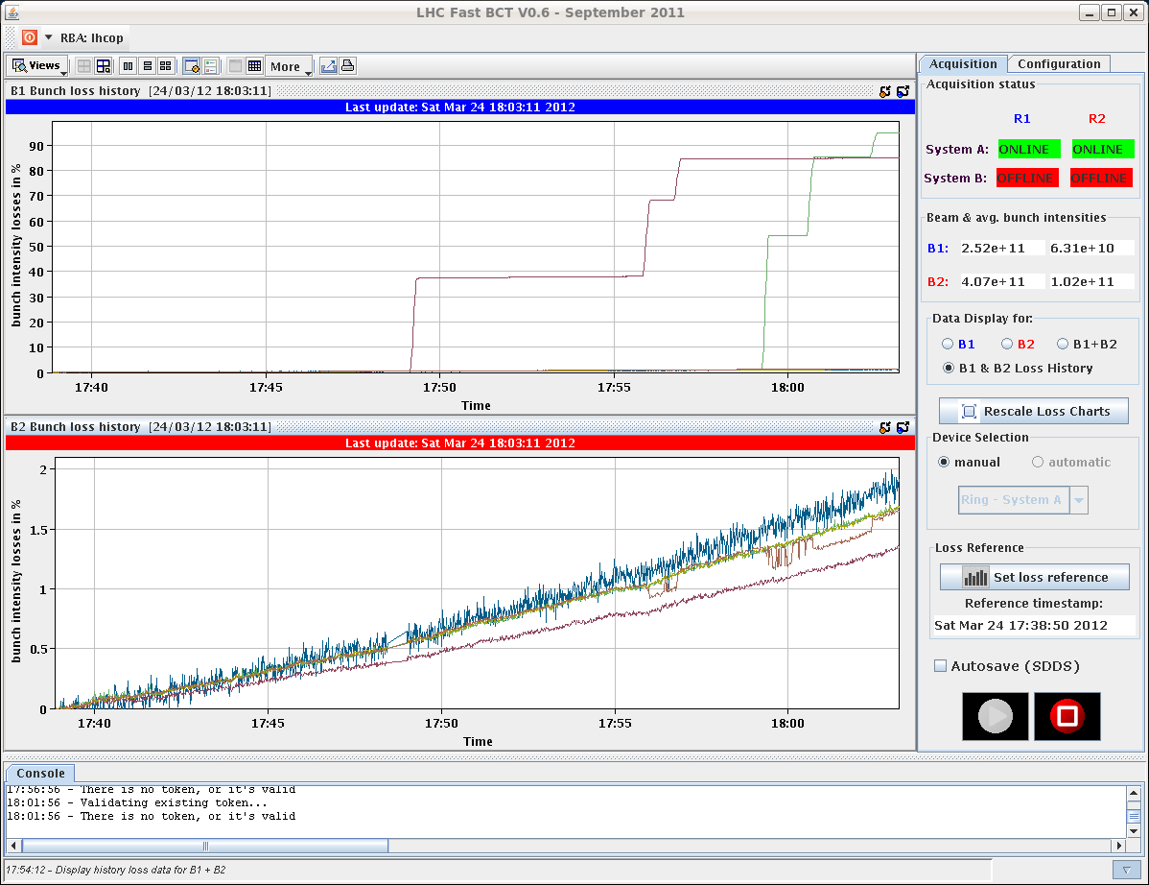
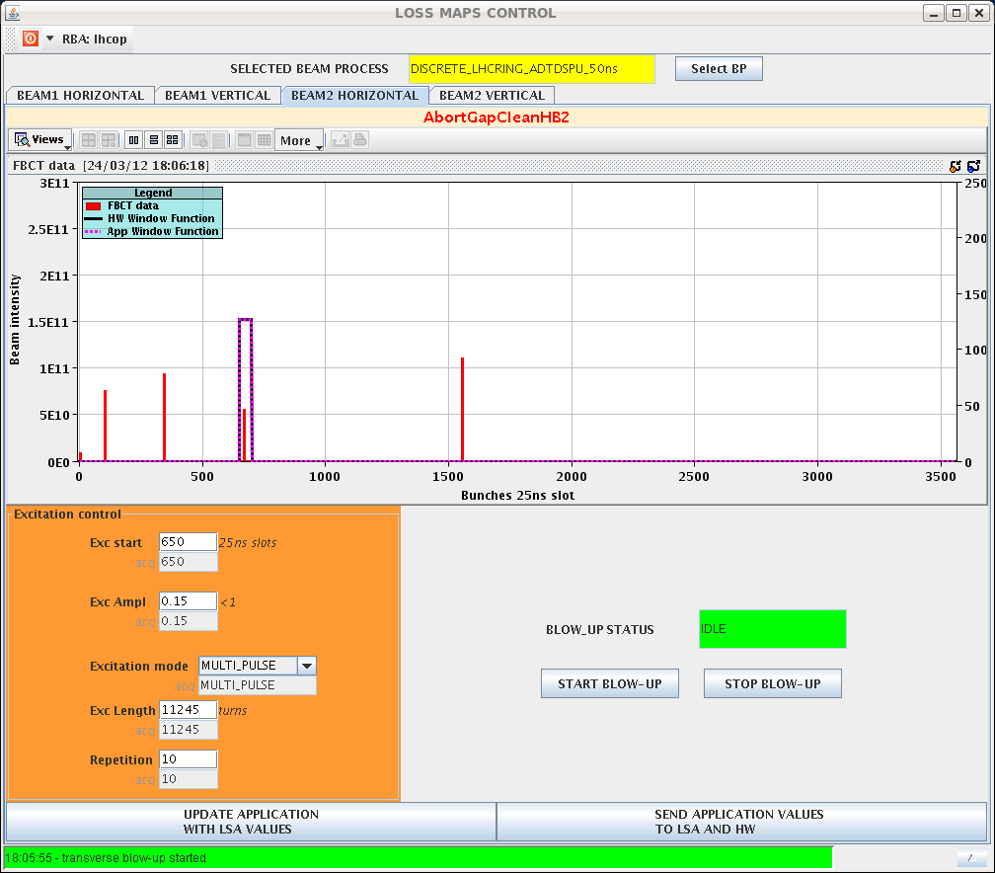
450 GeV loss maps - Saturday
Blow up individual bunches with ADT

Slide 16
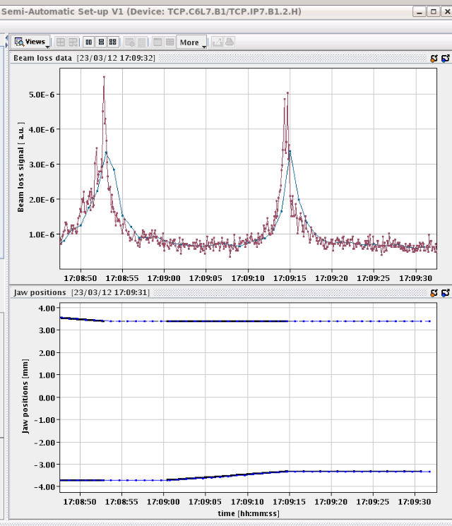
Collimation set-up at 4 TeV flat top - Saturday
Summary (Gianluca,Stefano):
The automatic collimator alignment application was tested at 4 TeV, starting from end of ramp tight settings. The fast acquisition of the BLM data (12.5 Hz) was used, moving the collimator jaws with a 5um step size at 8Hz. The two horizontal primary collimators of B1 and B2 were aligned automatically, and this was followed by a parallel movement of all horizontal collimators towards the beam
The parallel alignment was executed for 20 minutes, during which ~15 collimators were coarsely aligned to the beam.

Slide 17
Results beta* measurements (Rogelio, Glenn, etc.)
2 methods: AC dipole and K-modulation (agree within error bars)
AC dipole betas are around 0.6
K-mod are closer 0.7
We do not know the source of this systematic discrepancy. The K-mod measurement was done differently to last year plus the lower beta* makes it more sensitive to errors.
Both measurements give slightly more lumi to IP5 but consistent with no imbalance within the error bars
IP5/IP1 imbalance
AC dipole: (1 +/- 7)%
K-mod: (3 +/- 11)%
 | AC dipole | Error AC dipole | K modulation | Error K modulation
B1HIP1 | 0.6 | 0.06 | 0.71 | 0.09
B1VIP1 | 0.61 | 0.02 | 0.67 | 0.06
B2HIP1 | 0.59 | 0.03 | 0.72 | 0.1
B2VIP1 | 0.58 | 0.02 | 0.71 | 0.1
B1HIP5 | 0.6 | 0.05 | 0.66 | 0.07
B1VIP5 | 0.58 | 0.07 | 0.65 | 0.07
B2HIP5 | 0.6 | 0.02 | 0.73 | 0.09
B2VIP5 | 0.58 | 0.04 | 0.68 | 0.07

Slide 18
SUNDAY

Slide 19
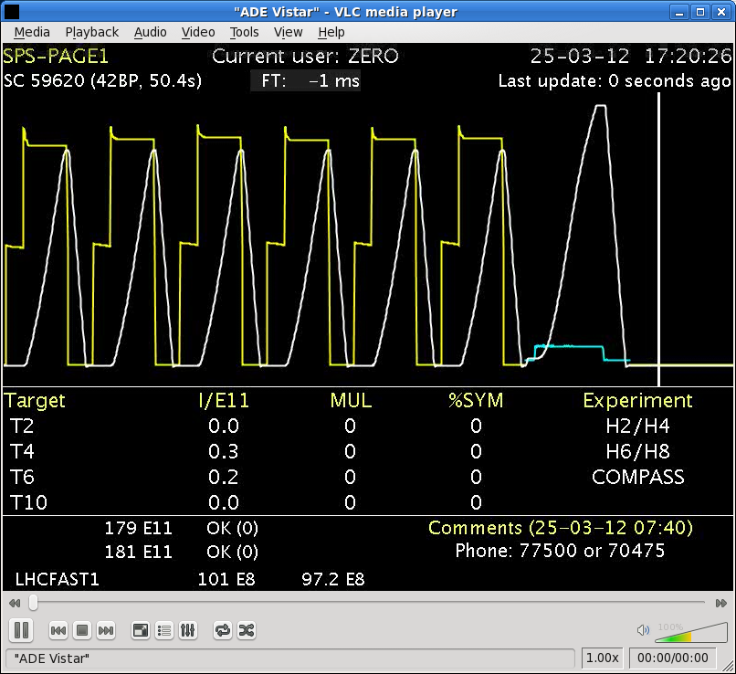
Sunday 25.3.
8:30 – 9:00 off momentum loss maps at 450 GeV (+/- 500Hz)
9:00 – 13:23 investigation into orbit kicks (B1 H); ramp and squeeze
13:23 Dump: MPS test of FMCM_RD34.LR3
13:30 M. Zerlauth changes the FMCM channel of RQ4.LR7 with the one of the RD34.LR7, to diagnose the problem on the FMCM of RD34.LR7. All FMCM channels at point 7 are masked in BIC.
15:00 -24:00 set-up of injection protection using new software tool
Inject and dump at every SPS super-cycle

Slide 20
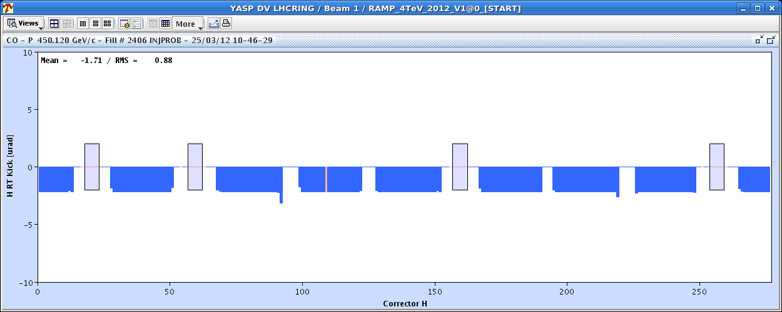
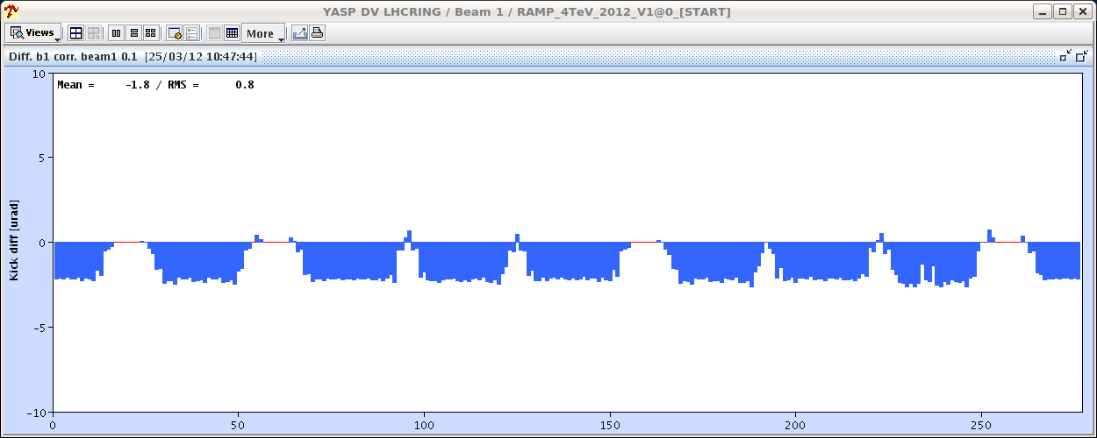
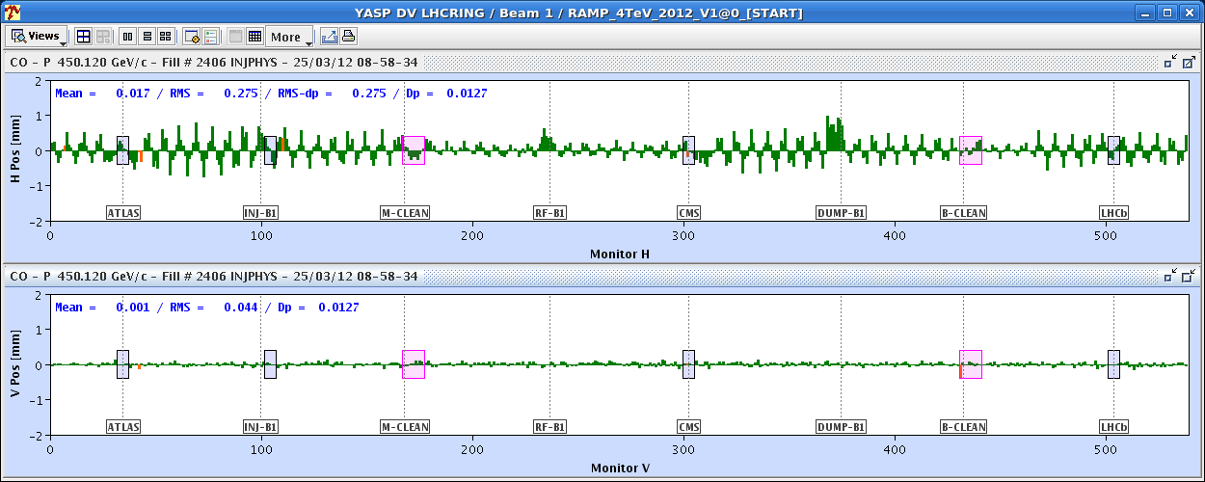
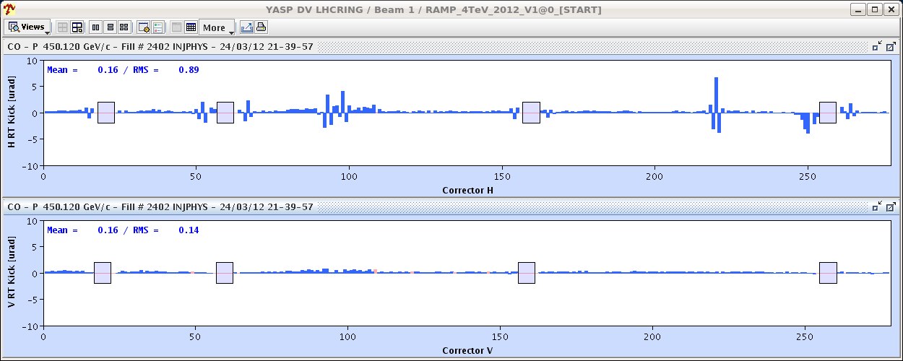
H orbit ‘features’ from Energy and Orbit FB (Ralph, Joerg)
Energy feedback (which counteracts the horizontal offset created by the orbit feedback) corrects the average of the effect by using only arc CODs that have a non-negligible dispersion function.
This Energy-FB correction COD pattern also creates a small orbit perturbation. It was initially believed that this is compensated by the Orbit-FB. But due to the limited number of eigenvalues used it is only partially corrected.

Slide 21
Mitigation
For the time being the number of eigenvalues has been reduced to 400 for the horizontal plane. This mitigates the initial effect of the Orbit-FB induced energy trims and thus reduces the necessary Energy-FB corrections and therefore the pattern introduced by it.
The next version will use an energy trim pattern that by-design compensates for the known orbit effect.
deployment planned for Monday
Ramp and Squeeze:
Lifetime low (especially B2)
At the end of the squeeze - RT trims are now good.
Did not continue to collisions, because the TCTs in IR8 are not properly placed to change the crossing angles.
TCTs in IR8 do not follow the bump shape evolution → strong losses in the squeeze.

Slide 22
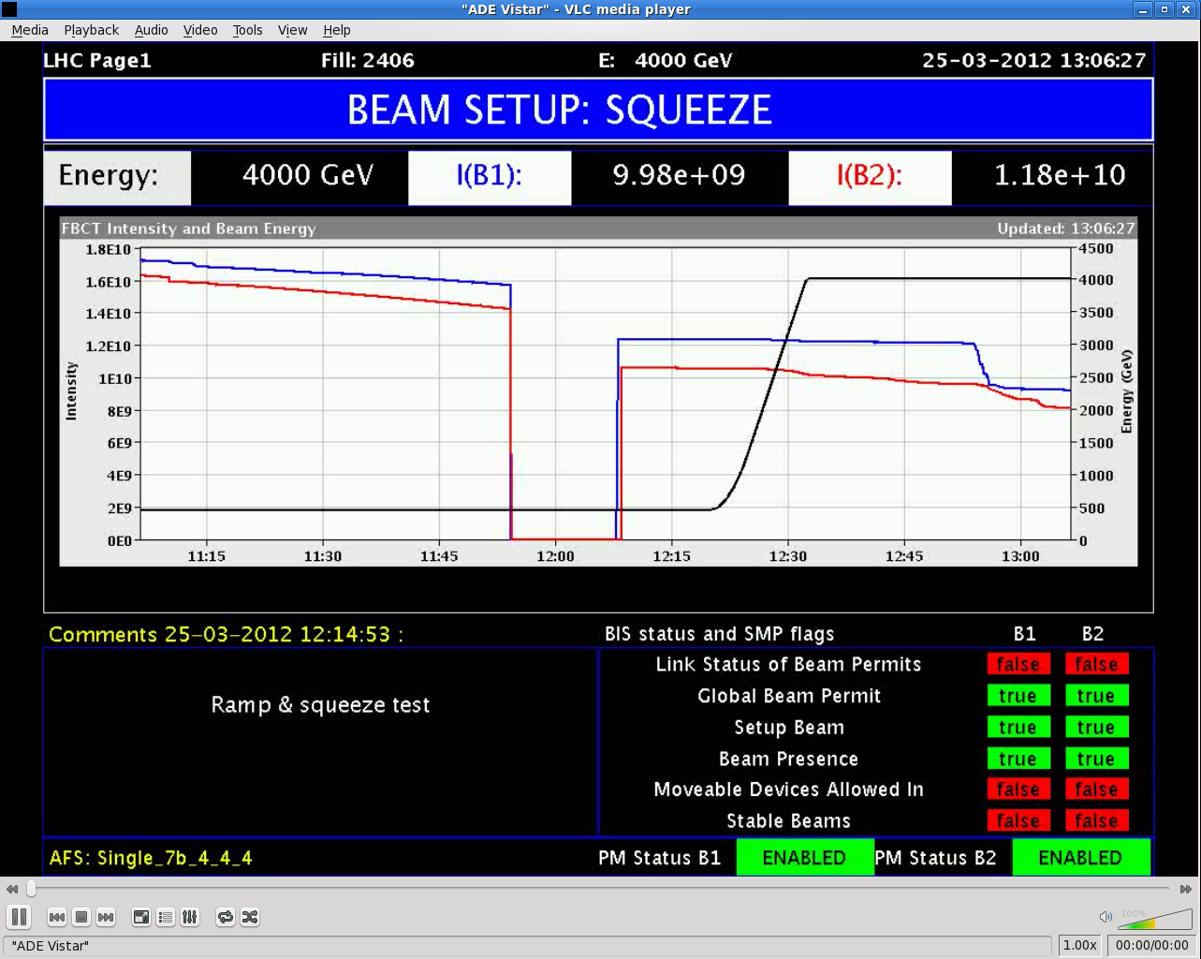
Ramp and Squeeze pilot with tight collimators

Slide 23
Sunday cont.
18:00 XPOC B1 failure – BIS and LBDS teams checking:
When the beam dump triggered there was a problem with sending the user_permit = false from the LBDS to the Injection BIC. The problem was that the redundancy as seen by the injection BIC was not preserved, as the A-loop signal was not received. This means that either there was an issue with the CIBU at pt 6 or that the loop A signal for the injection BIC was not generated by the LBDS. This latter option is suspected.
The problem occurred during the arming sequence and the BIS loop A was never armed (but the B loop was). There was no badly executed beam dump with missing redundancy, so the beam dumping system is again declared fully functional and safe.
We don't know why the arming sequence failed, but this is not safety critical

Slide 24
Summary injection protection set-up
Golden trajectories for both beams have been established. References trimmed, interlock settings updated.
Lost time due to various problems (beam dump and debugging of new software tool to automatically set up the TCDIs)
Eventually set up collimators in TI 2 partially using tool and partially manually. Cross-checked 3 collimators. TI 2 is fully set up. The injection settings are already updated (5 sigma for the time being). Validation still missing. Checked losses with one nominal bunch. Looks good.
Noticed that the new LIC BLMs read more about two orders of magnitude higher than the adjacent monitors. Could become a problem for higher intensities.
TI 8 could not be done yet. Left them at +/-10 sigma (centered around zero).
Loss level acceptable

Slide 25
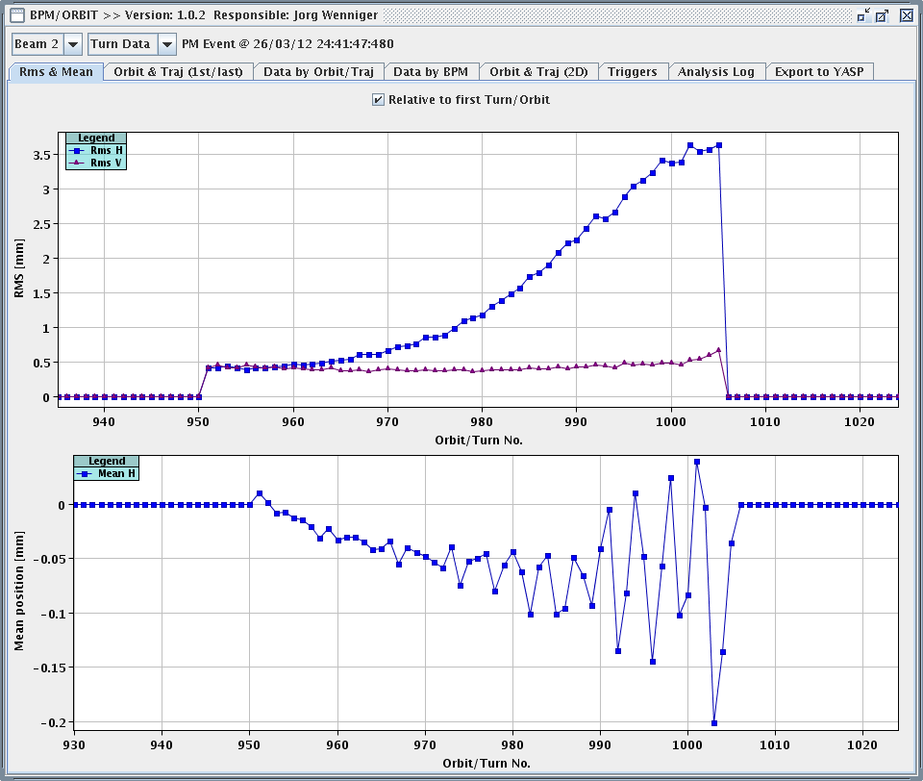
Sunday, cont.
24:00 – 01:00 ADT fast losses test – one pilot at 450 GeV
Achieved very fast losses (could be used for UFO studies)

Slide 26
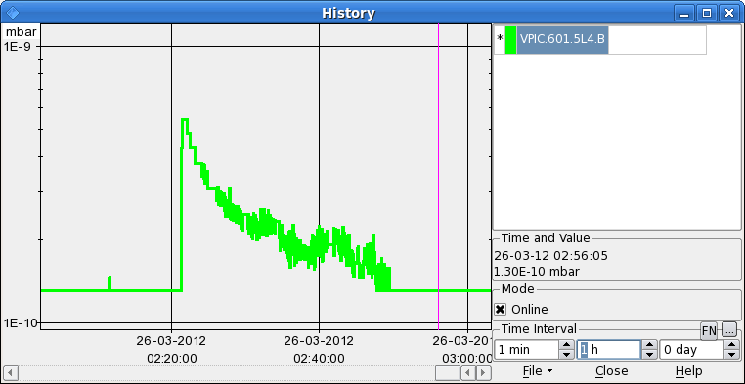
Sunday Night
1:21 reboot cfv-ua47-bctfra because no FBCT data in fixed display: afterwards different intensity in different applications (B1)
2:00 the recabled ADT system (Hor B2) was set up for pilot intensity
2:00 – 3:00 BGI test B1, 4 nominal bunches
3:00 – 3:30 LBDS: re-triggering error, B2 LBDS, on MKD K.
3:30 – 8:00 beta* with k-modulation,1.2e10 for each beam at 0.6 m, collimators stay at injection setting
Bumps in the orbit through the ramp (both beams) and big kicks
Orbit looks good as soon as in ‘squeeze’ (also RT kicks reduced)
8:00 lost cryo – expected back at around 12:00

Slide 27
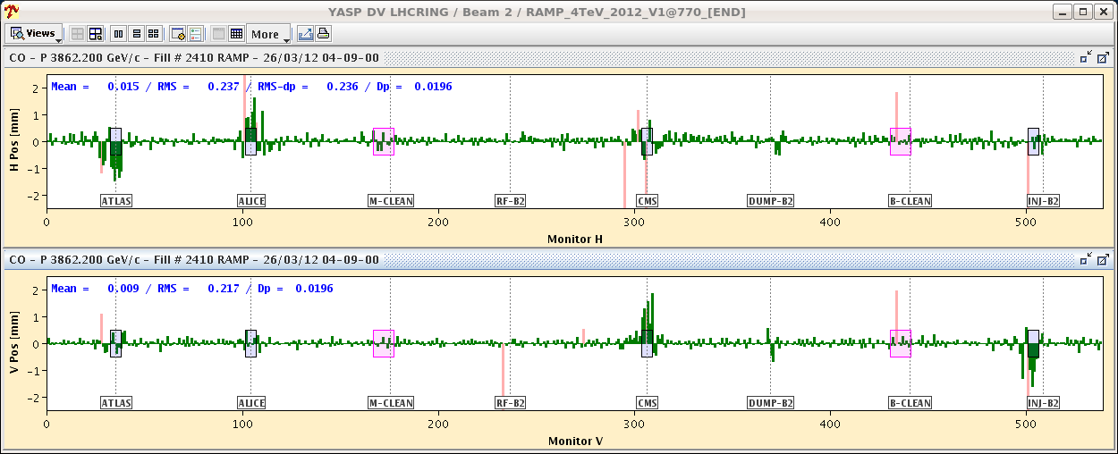
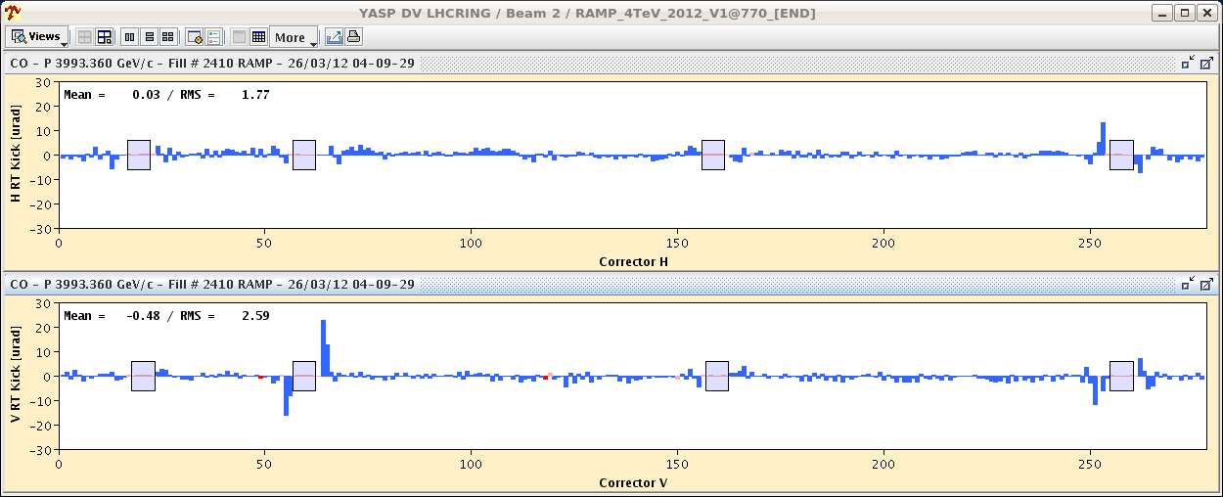
B2 at 3.6 TeV

Slide 28
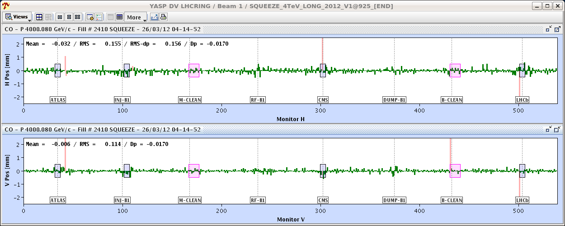
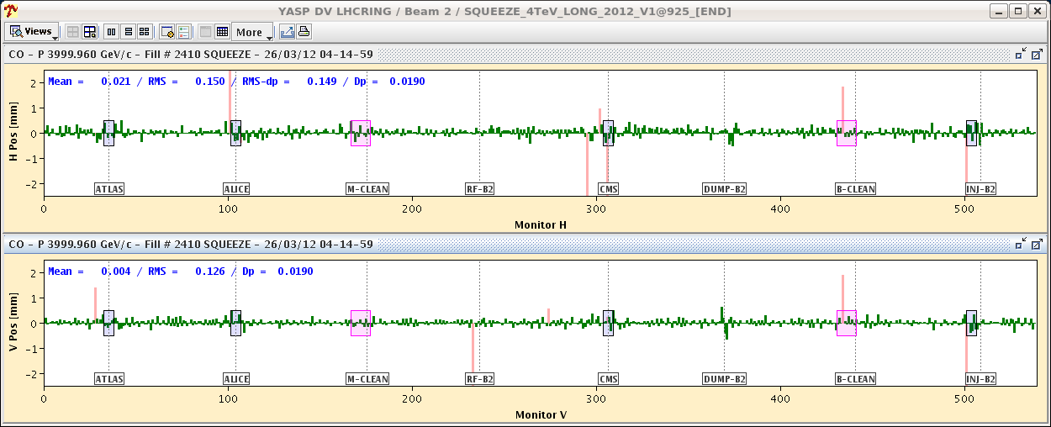
Orbit in Squeeze

Slide 29
Others
Beam dumps were used:
MPS tests (FMCM test by switching off war magnets)
Test the different possibilities to dump the beam
Feed forward QH/QV from ‘bare’ ramp - beam 1 only
Landau damping octupoles trimmed up to last year's level at end of ramp
Beam lifetime (longitudinal blow-up together with the dp/p modulation for the chromaticity measurement) solved? – tests needed
TCTVA.L2 out at injection as it shadows TDI
Sorted out during Friday morning access:
SBF glitches: Use 1 second moving average DCBCT data transmitted at 10Hz to the SMP system or increase SBF limit
FGC adapting the functions when they cannot be played
Polarity of BPMSW.1L5.B1/2 – V plane access
IP6 interlock BPMs access

Slide 30
Others, cont.
Tune feedback 5 times slower than 2011 proton run (bandwidth was reduced at the end of the ion run)
Fast tune changes cannot be followed → feed forward

Slide 31
Outstanding issues
FMCM on RD34 in 7 still not ok. Will prevent us from taking up more than 3 nominals to 4 TeV.
the BPMSW.1L5 is now OK in the V plane, but has the incorrect sign in the H plane
“un problème sur le circuit RCBV25.R4B1. Vous risquez de perdre rapidement ce circuit, (pb Alim Aux)”
TCDQ angular alignment to be revisited
BPMD giving bad reading
lost RCD/RCO.A34B1 tripping frequently (currently masked in SIS the “two PC state and one QPS OK interlock”)
B1 H orbit ‘features’ – feed backs
Energy FB stayed on after beam dump (confirmed on BI-QP fixed display)

Slide 32
Outstanding issues, cont.
Lifetime at flat top (especially B2)
3m to 1m squeeze: high losses on TCTH.4L8.B1
FIDEL: update of magnetic model
Signal on BLM LIC monitors too high?
FBCT display after reboot of cfv-ua47-bctfra

Slide 33
Schedule
TIME | WHAT
Mo 3:00 – Mo 8:00 | Check of beta* with k-modulation – team coming in at 04:00. At 03:00 (or earlier) take 1.2e10 for each beam up through the squeeze to 0.6 m, ready for Rogelio and team who are coming in at 4.
Mon 8:00 – 10:00 | Coupling checks at injection B2
Mon 10:00 | Continue collimation set-up at flat top
Tue AM | Put in coarse TCT settings 2-3 nominal at flat top and through the squeeze (after collimator set-up). need lumi data from all 4 experiments
Tue 13:00 – 23:00 | TCDQ angular alignment
 | Collimation set-up at collision
 | Injection and dump I
 | Injection and dump II
 | Injection and dump III
 | Loss maps and asynch dumps at injection with injection protection in
 | Loss maps and asynch. dump at collision
 | Collimation set-up at squeeze
 | Loss map and async. dump at squeeze

Slide 34
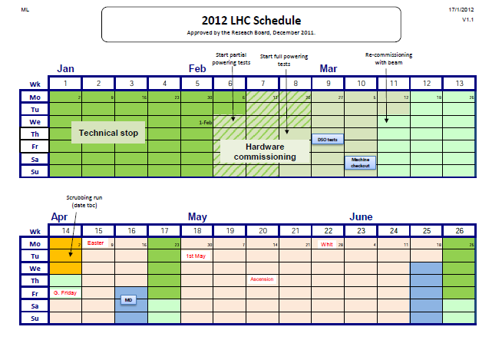
Schedule

