Slide 1
Saturday 24 March 2012

Slide 2
Saturday
06:30 Access interlock (from door between UJ83 and LHCb cavern US85)
Access needed for fixing the access system
12:30 Machine closed again
12:30 Bridge A cooling fault on RB.A67
Access needed
15:15 machine closed – precycling
17:00 450 GeV loss maps
injecting 4 nominal bunches / beam
First using ADT (H + V) (radial modulation left ON))
Then H + V + off-energy (RF freq shifted by +500Hz ) using ‘old’ resonance method for comparison
19:00 injecting new bunches (ADT loss maps, radial modulation off)
19:50 Asynch dump test at injection with injection protection out (RF off). → Losses at dump region as expected, and loss ratio (TCT/TCDQ) are at 5e-6 (b1) and 5e-4 (b2). OK to proceed

Slide 3
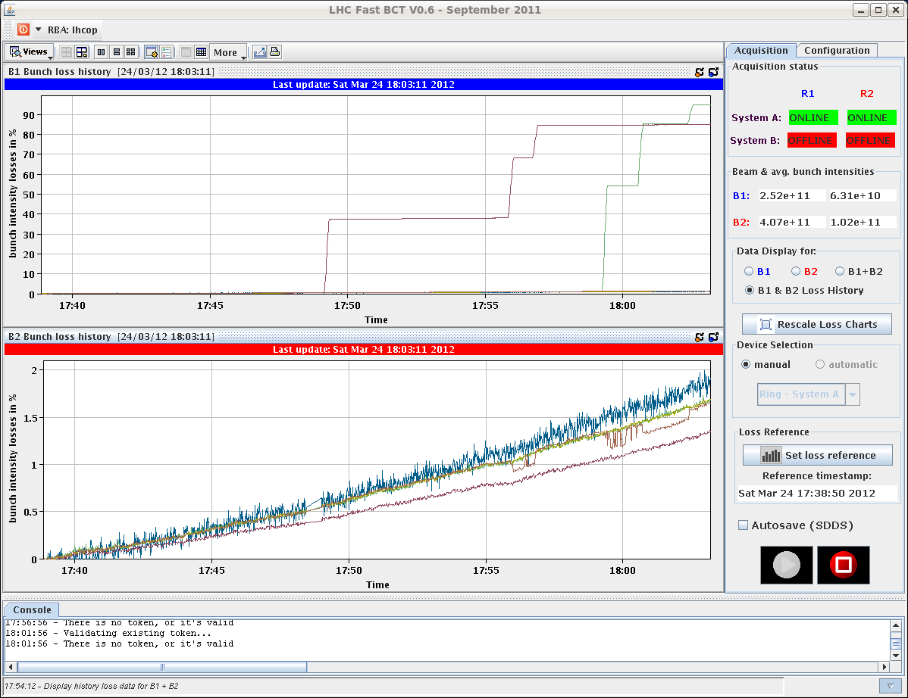
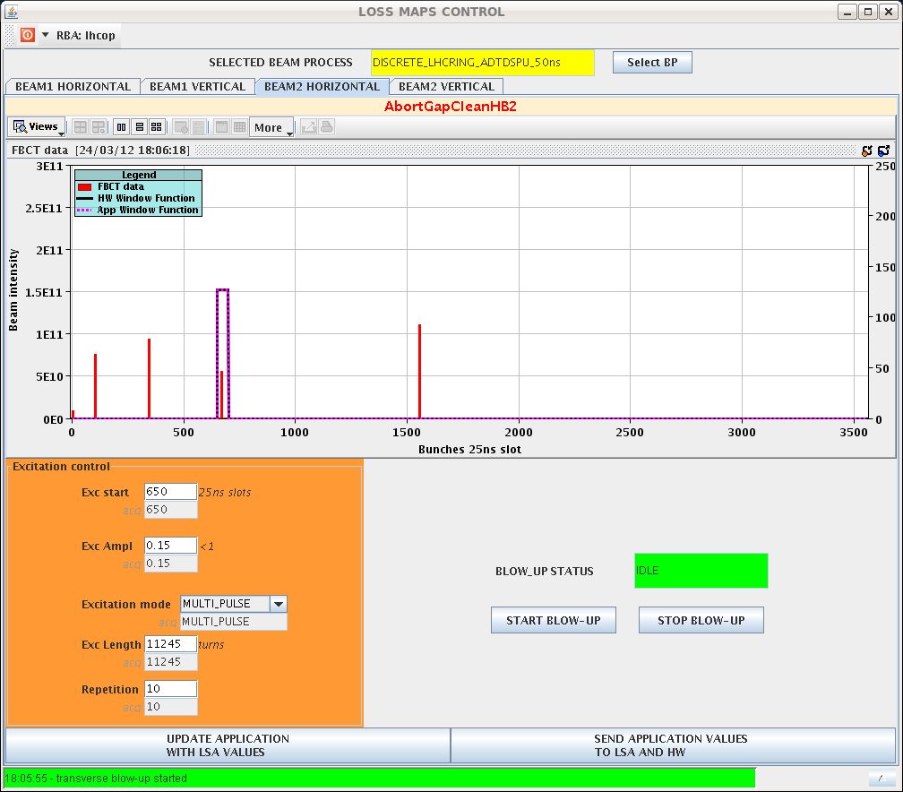
450 GeV loss maps
Blow up individual bunches with ADT

Slide 4
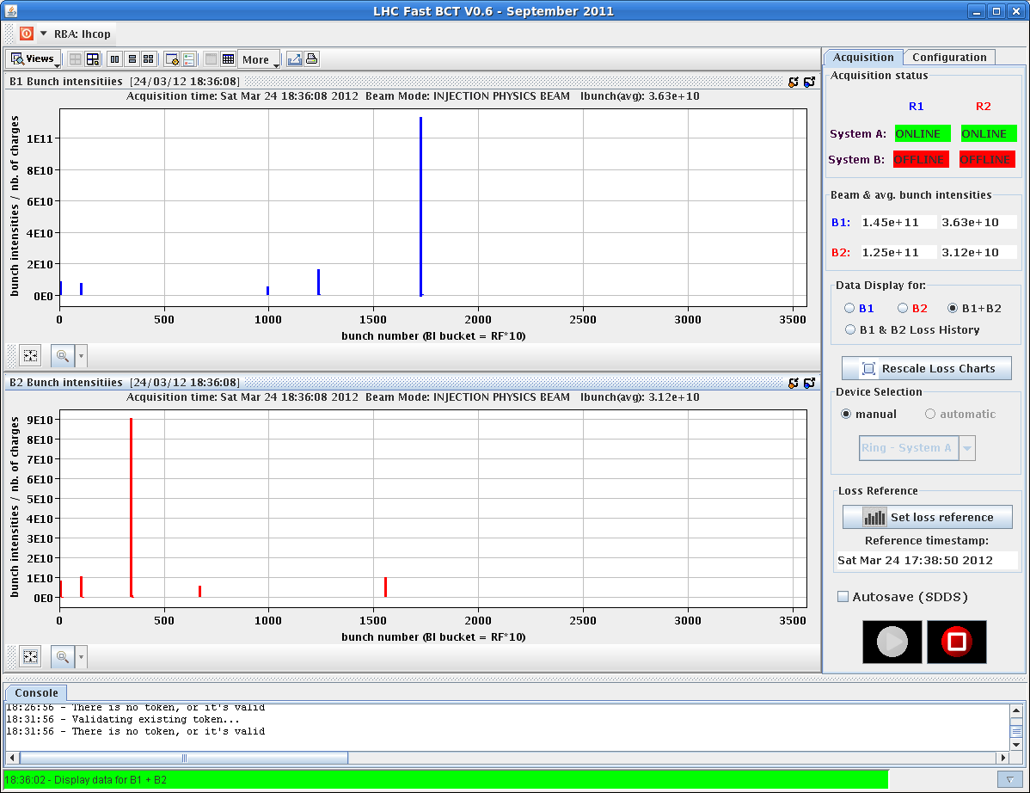
450 GeV loss maps, cont.
Classical loss map (tune change) with the remaining intensities (1 full nominal bunch per beam and the weak ones)
Loss maps look good, OK to proceed, detailed analysis will be done

Slide 5
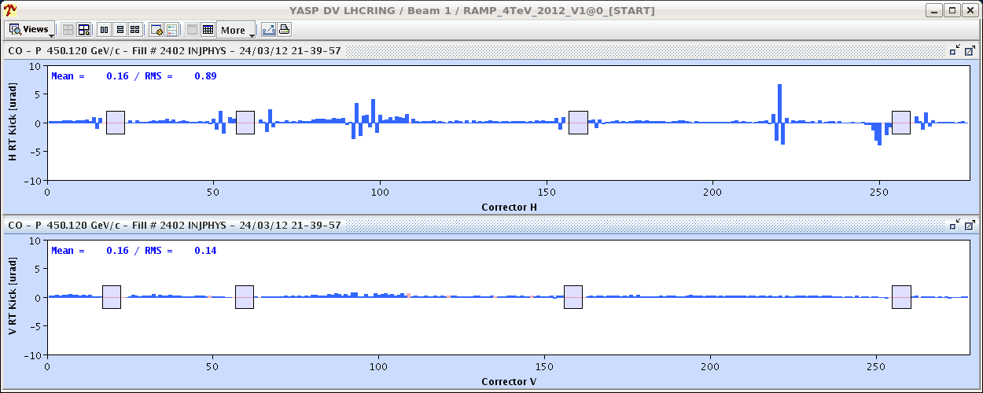
Ramp with nominal bunch
20:30 start new fill for first ramp-up with one nominal bunch / beam
B1 H already at injection (OFB on) – pattern in the orbit building up

Slide 6
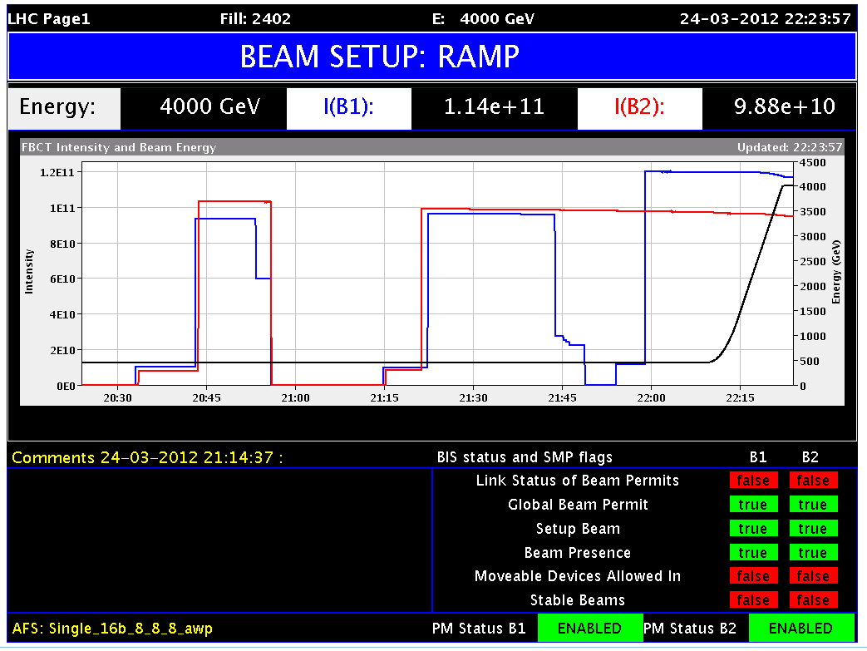
Ramp with nominal bunch, cont.
22:10 start first ramp with nominal bunches with tight collimator settings (with chirp and long. blow up ON)

Slide 7
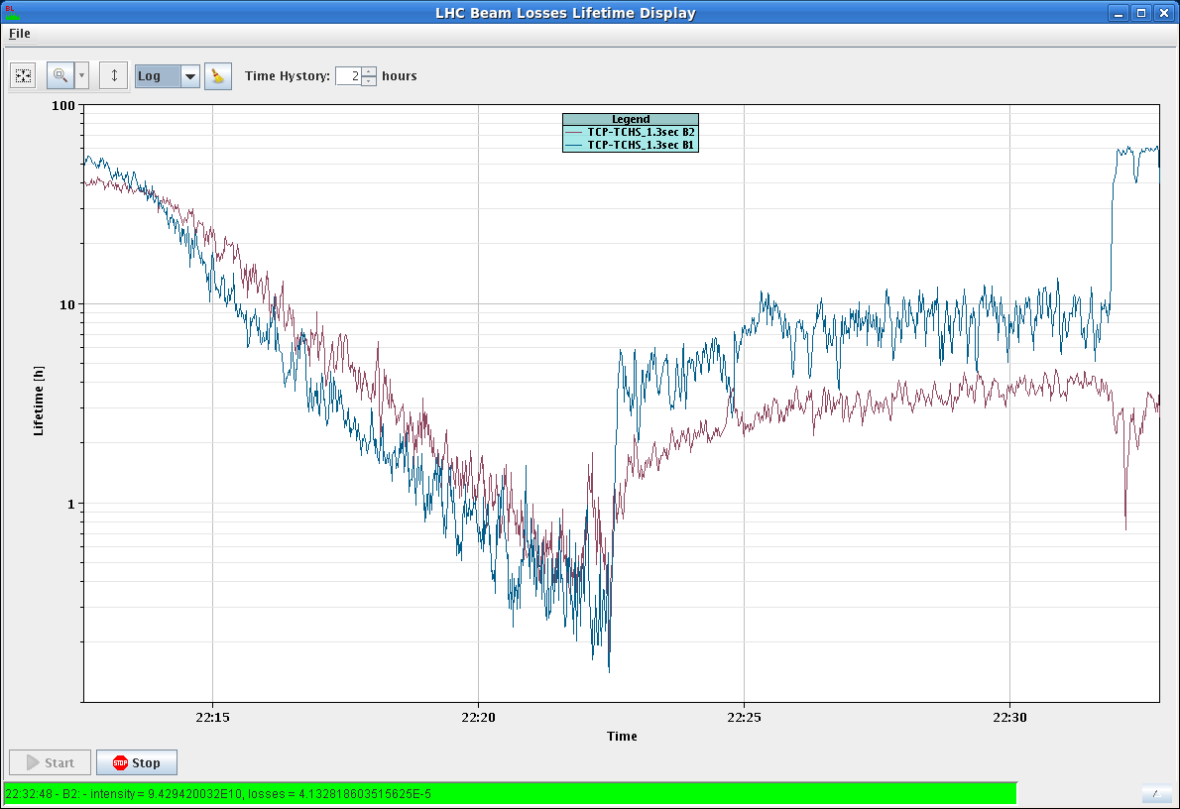
Ramp with nominal bunch, cont.
Lifetime is getting better after correcting the orbit (pattern introduced by feed-back?)

Slide 8
Collimation set-up at 4 TeV flat top
22:30 start set-up – 23:00 beam dump
Summary (Gianluca,Stefano):
The automatic collimator alignment application was tested at 4 TeV, starting from end of ramp tight settings. The fast acquisition of the BLM data (12.5 Hz) was used, moving the collimator jaws with a 5um step size at 8Hz. The two horizontal primary collimators of B1 and B2 were aligned automatically, and this was followed by a parallel movement of all horizontal collimators towards the beam
When multiple collimators stop moving due to cross-talk effects in the BLM signal, the application automatically moved each of the stopped collimators in sequence until the collimator jaw that was at the beam was determined.
The parallel alignment was executed for 20 minutes, during which ~15 collimators were coarsely aligned to the beam. The beam was dumped after the automatically calculated loss threshold was set too high (~3E-4). The maximum limit on the threshold will now be set to 5E-5.

Slide 9
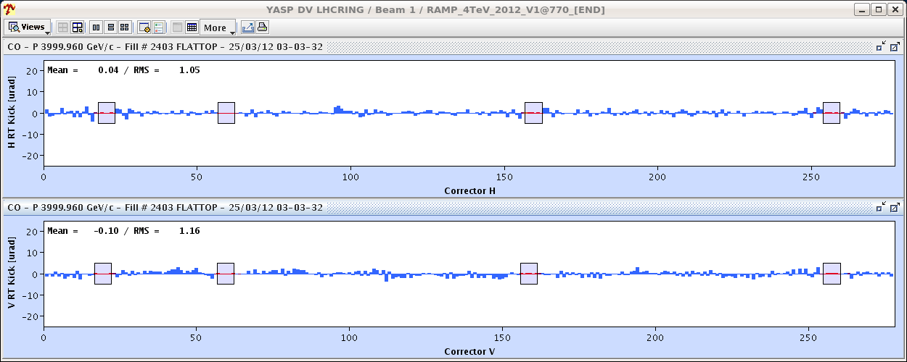
Saturday Night
24:00 injecting for FIDEL magnet decay measurements with probe beam – 3:00 dump
Long. Blow-up OFF, modulation ON for chroma measurement
Again lifetime low during the ramp

Slide 10
Saturday Night, cont.
4:40 – 5:50 second measurement ramp for FIDEL
6:00 preparing for 450 GeV off momentum loss maps
+500Hz
-500Hz

Slide 11
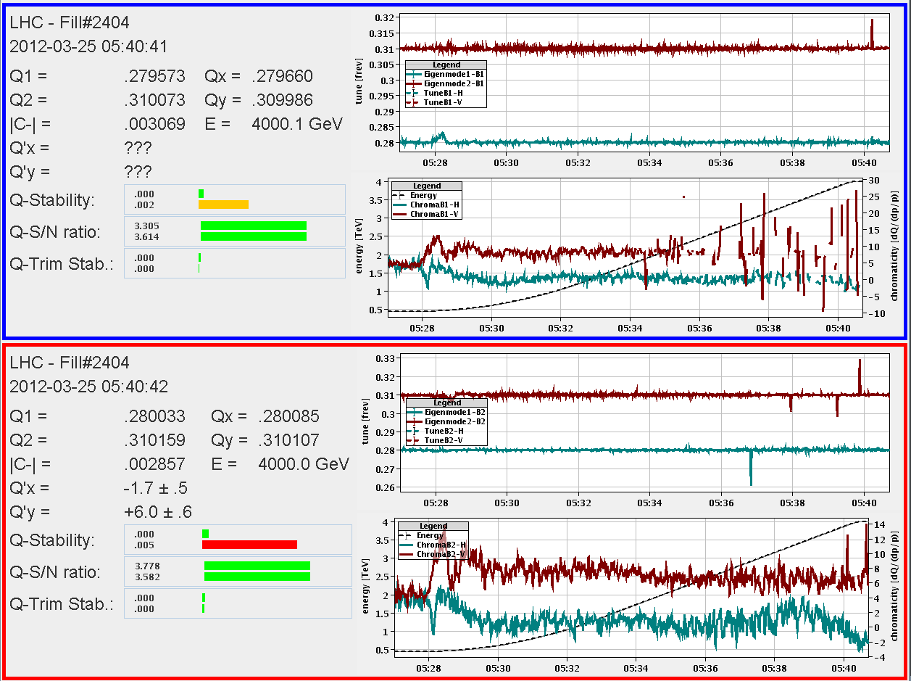
Others
Feed forward QH/QV from previous night's bare ramp - beam 1 only
Landau damping octupoles trimmed up to last year's level at end of ramp
FBCT fixed display works again after release of a new version
lifetime dips with tight collimators
QFB b2v starts turning off at the end of the ramp
Q variation at start of ramp could be handled by QFB in these two iterations

Slide 12
Access / outstanding
FMCM on RD34 in 7 still not ok. Will prevent us from taking up more than 3 nominals to 4 TeV.
the BPMSW.1L5 is now OK in the V plane, but has the incorrect sign in the H plane
“un problème sur le circuit RCBV25.R4B1. Vous risquez de perdre rapidement ce circuit, (pb Alim Aux)”
TCDQ angular alignment to be revisited
BPMD giving bad reading
lost RCD/RCO.A34B1 five time in 4 days, PC problem?
B1 H orbit ‘features’ – feed backs
ADT low-up in H – FESA class mode not set correctly
Energy fb stayed on after beam dump (confirmed on BI-QP fixed display)

Slide 13
TIME | WHAT | CONTACT
Sat 16:00 – 23:00 | Loss maps at 450 GeV with ADT. Asynch dump test. Ramp 1 nominal for the first time – orbit issues. 1 nominal bunch to 4 TeV and Collimation set-up at flat top. | Stefano/Ralph
Sat 23:00 – 09:00 | FIDEL measurements at 450 GeV; see instructions from Ezio sent by EBH | OP team
Sun 09:00 – 15:00 | Sort out orbit(feedback) on the ramp. Repeat ramps if possible to check for reproducibility. | Jorg/Ralph S.
Sun 15:00 – 23:00 | Injection protection set-up | Jan/Chiara
Su 23:00 – Mo 8:00 | Tbd.
Mo 8:00 – 10:00 | Coupling checks at injection B2 | Rogelio
Mo 10:00 | Put in coarse TCT settings 2-3 nominal at flat top and through the squeeze (after collimator set-up). need lumi data from all 4 experiments | Stefano Joerg
 | TCDQ angular alignment
 | Collimation set-up at collision
 | Injection protection
 | Loss map and async. dump at collision
 | Collimation set-up at squeeze
 | Loss map and async. dump at squeeze

