Slide 1
Monday 19th March
07:33 Lost (another) beam in the squeeze, beyond 2 m, B2 hits 1/3 resonance.
08:30 Start (another) ramp
Try to correct coupling and chromaticity throughout the squeeze
13:40 Lost beam in the squeeze between 0.8 m and 0.7 m, B2 Vertical tune hits 1/3 resonance
14:30 Waiting for EDF intervention on 18 kV SPS
15:15 SPS back – start aperture checks at 450 GeV
First ADT blow-up fine tuning: Daniel is happy
Very efficient aperture measurements with ADT: ABP is happy!
24:00 Beam Gas Ionisation (BGI) Monitor set-up
02:00 BLM Machine Protection tests
06:20 start precycling the machine after the trip of RQT11.R5B2, PC fault
07:40 Beams in again for K-modulation test and RF set-up

Slide 2
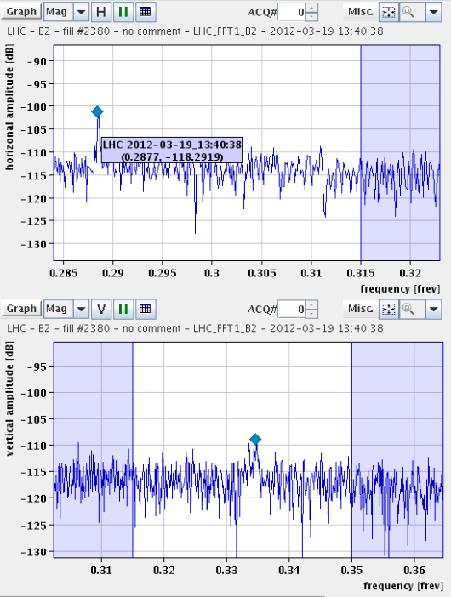
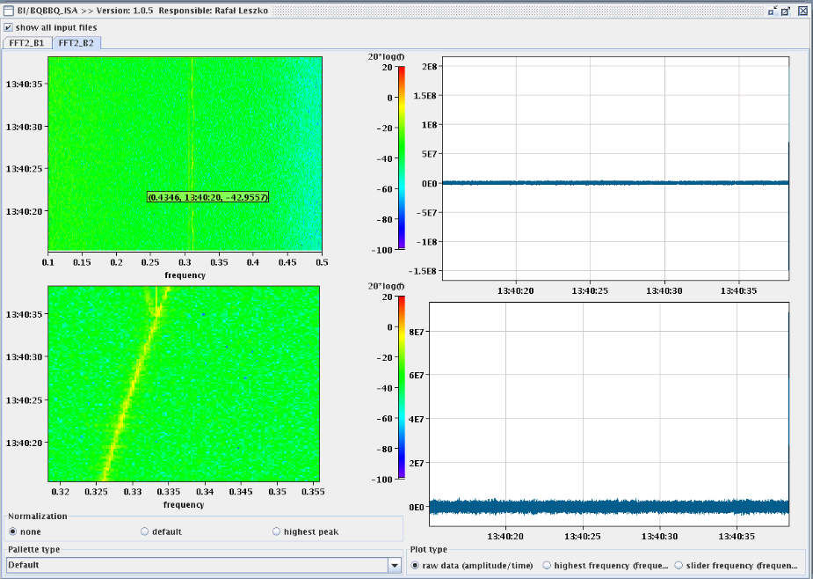
Ramps lost...
Problem with measurement of the tunes
The tune feedback does not stay on
At 4 TeV large beta-beat for small b*
Vertical tune crosses 1/3 integer resonance
Plan:
Fix tune measurement
Use/Fix feedback

Slide 3
Aperture checks at 450 GeV
Use transverse damper (ADT) blow-up to check losses, instead of going through betatron resonances by trimming the tune
For the first time a new setup with fast BLM acquisitions (12.5 Hz) and fast collimator movement requests (8 Hz)
First set up primary collimators TCP
“Limiting Apertures”
B1-H : Q6R2. Measured between 12.0 amd 11.5 sigmas
B1-V: Q4L6 between 12.5 and 12.0 sigmas
B2-H : Q5R6. Measured between 12.5 and 13.0 sigmas
B2-V: Q4R6 between 13.0 and 12.5 sigmas
For all cases, the locations of the global bottlenecks are the same as in 2011. The aperture is 0.5 to 1.0 sigma worse
For all bottlenecks, we performed local orbit bumps to check the aperture centre. The offsets were found to be between -800 and 500 microns
Check aperture of vacuum value IR7 which got stuck by applying local bump
Scan to find if the valve WGSH.78.6L7.B is a bottleneck: we increased the bump up to +/-18 mm before finding losses.

Slide 4
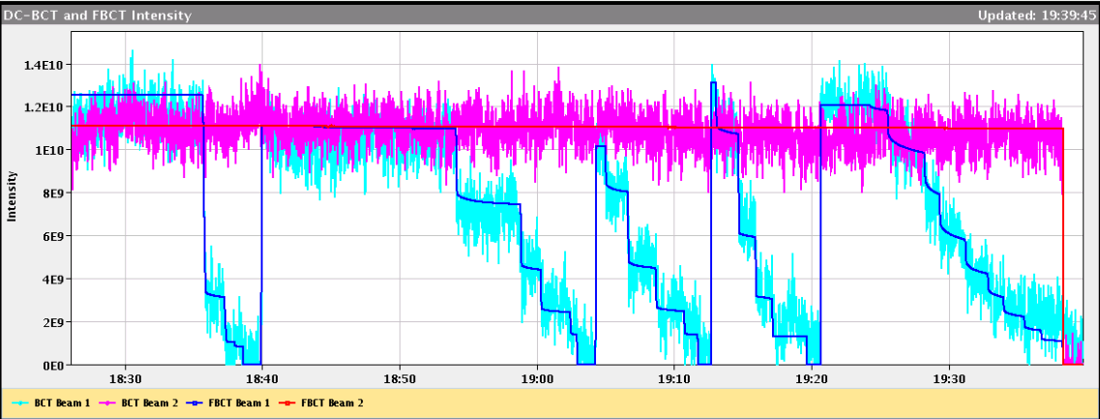
Aperture measurements with ADT
Aperture bottleneck B1-V: Q4L6 between 12.5 and 12.0 sigmas. Measured with one single injected beam blown-up 8 times, using ADT

Slide 5
Aperture measurement for B2-V with ADT
~ constant loss rate (duration = 100s) and performed a collimator scan during this time.
In the beginning of the measurements we observed a constant loss rate at the global bottleneck Q4R6.
While the collimator was moved in in steps, we saw dynamically the losses move from the aperture bottleneck to the collimator (see plot).
Knowing the gap of the primary collimator, we can directly from the plot conclude on the aperture. The result (between 13 and 12.5 sigma) is consistent with the previous measurement
One can get the aperture in one single measurement taking 1-2 minutes only.

Slide 6
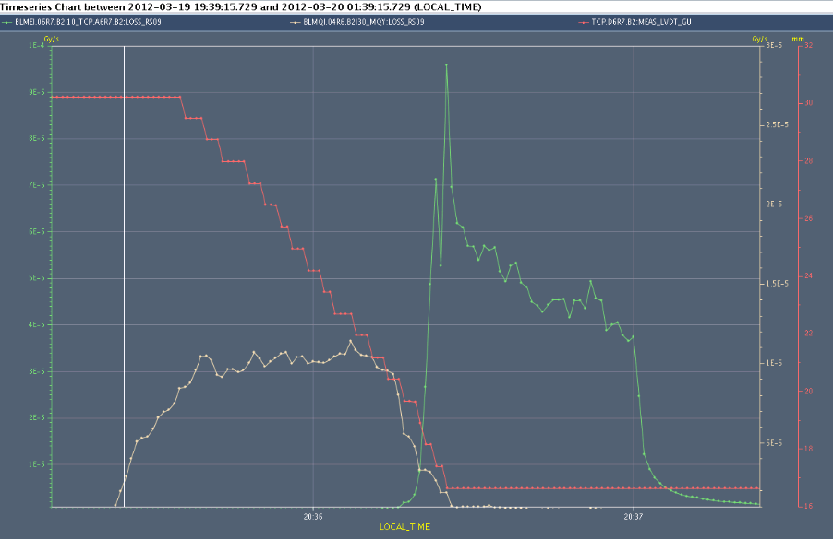
Losses from Q4R6 to Collimator
Collimator position
Loss collimator
Loss Q4R6

Slide 7
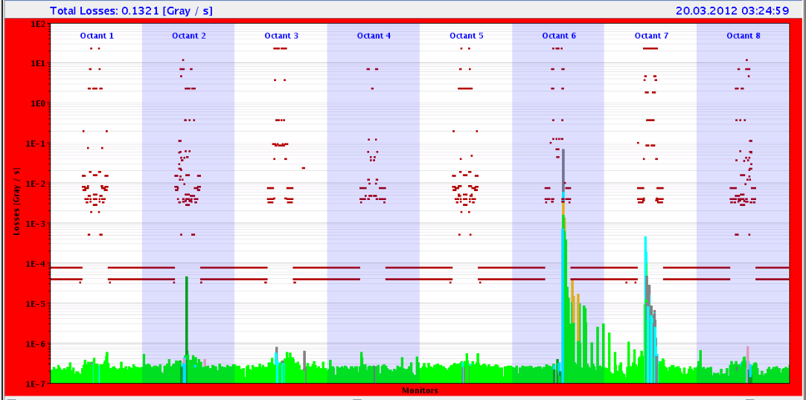
BI night
Mariusz checking the BGI
BGI calibration with orbital bump. OK for beam 1 only, where the MCPs have been exchanged during Winter TS. For beam 2 more intensity is needed. Did not measure with 4 nominal bunches. Gas injection: 8e-9 mbar beam 1 and 2e-8 mbar beam 2. Gas injection left to test if it will shut down after 8 hours (it was like that last year, but test needed this year).
Christos performing BLM Machine Protection Checks
Shoot beam on closed collimators and check time delays between Injection kickers and BIS.
Reduce BLM thresholds for the arc BLMs
In total, 21 (out of 25) crates were forced to request a beam dump. Crates that did not trigger are SX4.C|L|R and SR7.E. Latencies are as expected.

Slide 8
Plan
Tuesday
8:30 K-modulation check
8:45 RF phasing and blow-up in ramp
PM/Evening Injection checks, MKI timing, LBDS and Injection Machine Protection tests
Night Tune/Ramp, LBDS TSU tests, Chroma decay at 450 GeV
Wednesday
Beta-beat correction at 4 TeV
Collimation at 450 GeV

Slide 9
Lists
Access
LHCb 1 hour
Atlas 2 hours
BPMS point 6 1 hour (?)
FMCM RD34.LR7 1 hour
Suspected electrical problem on a fire detection unit in UX85. Access required at the next occasion
To be sorted out
SBF glitches: Use 1 second (or more?) moving average DCBCT data transmitted at 10Hz to the SMP system or increase SBF limit…
FGC adapting the functions when they cannot be played
TCTVA.L2 out at injection as it shadows TDI
Polarity of BPMSW.1L5.B1/2 – V plane
Squeeze length
BCTFR needs frequent reboot

