Slide 1
Summary of week 11 Machine Checkout Beam Commissioning
R. Giachino, M. Albert,
G. Arduini, J. Wenninger

Slide 2
Week 11 overview & milestones
Date | Time | Milestone
Wed 14.03 | PM | LHC ready for injection
 | 23:40 | Beam 1 injected
Thu 15.03 | 01:00 | Both beams captured, orbit and Q adjusted
 | 11:00 | Optics measured and corrected at 450 GeV
 | 20:00 | Reference orbit for flat machine
Fri 16.03 | 22:40 | Both beams at 4 TeV – in less than 48 hours
Sat 17.03 | 16:30 | Beam 1 squeezed to 0.6 m
Sun 18.03 | 11:15 | Both beams squeezed to 0.6 m
 | 18:00 | Separation and xing angles at injection

Slide 3
LHC machine check-out
Main targets:
Close the beam interlock loop,
Test the beam dump,
Test the injection kickers,
Run the LHC through a full machine cycle,
Check the control system.

Slide 4
Summary of Machine Checkout
R. Giachino @ LMC
Situation of the machine – last Wednesday:
The LHC magnet and powering system is fully commissioned at 4 TeV
RF 16 cavities conditioned up to nominal 2 MV/cavity. RF Low level ready for Beam.
LBDS & MKI operational and machine protection tests without beam completed.
Power Interlock, Beam Interlock, Warm Magnet Interlock are commissioned according the machine protection rules.
Essential Beam Instrumentation and feedbacks tested. – fine tuning with beam.
Control system operational – smaller issues will be fixed in the coming days.
Many Thanks to all people involved!!

Slide 5
Wednesday – first beams
16:00 SPS ready, preparing for beam – last pre-cycle.
18:00 Ready to inject…. 2 last minute problems!
One of the SPS SMP flags does not work.
MKE6 extraction kicker (Beam 1) does not pulse.
MKE6 problem was traced to an electronic card.
At 21:30 MKE6 pulsing again.
SPS SMP problem on the SPS Probe Beam Flag – flag is always FALSE.
Must be TRUE to inject into empty ring (ensure low intensity).
Traced to a reception error of a BCT information on the SPS SMP in the CCR.

Slide 6
SPS SMP
At 22:30 the SMP problem was solved by the SMP team and CO piquet with support from BI and CO/HT.
Beam injection was blocked as the SMPC SPS could not receive information from the BCT4 / 40S in SPS.
The problem was traced to a low RS485\MIL1553 transmission level in BA4, resulting in a low value of power being received in the CCR, which was unable to be decoded by the SPS SMPC.
A set of electrical repeaters were installed in BA4 to boost the signal strength to levels which could be decoded in the CCR.
Consolidation is required at next opportunity.

Slide 7
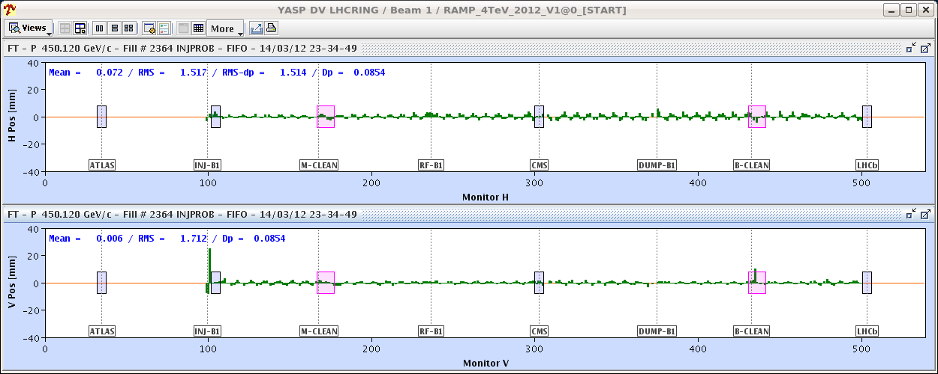
Wed Night : First beam in the LHC
23:00 Injecting into LHC and moving from one IR to the next (collimators).
Very little steering required.
23:40 B1 circulating and partly captured.
00:30 B2 circulating and partly captured.
Beam 1

Slide 8
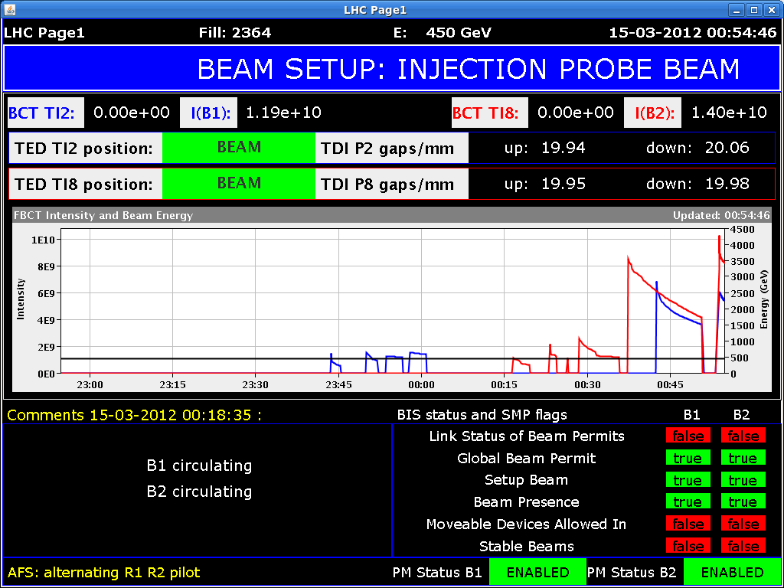
Wed Night : progress on capture and quality
Work on orbit, tune, Q’ – in parallel to RF capture tuning.
Thu 04:00 : ready for the optics measurements.

Slide 9
Thursday morning – optics at 450 GeV
Beta-beat , dispersion and coupling measurements and corrections at 450 GeV.
Beta-beating down to 5-10% from 20-40%.
Dispersion beat in horizontal reduced.
Local coupling corrections applied – significant reduction of the global coupling correction.

Slide 10
Beam 1 beta-beating at 450 GeV

Slide 11
Beam 1 dispersion error at 450 GeV

Slide 12
Thursday PM – nominal bunch & flat orbit
Transfer line steering was checked in view of injection of the nominal bunch.
A vertical bump is present at the bottom of both lines – required to injection onto the LHC (flat) closed orbit.
No change when separations and crossings were switched on Sunday PM.
Problem with the bunch placement on the MKI waveform? The bump is in phase with the MKI.
A kicker delay scan should be performed.
Injected nominal bunch without problems.
TCDI collimators at +/- 5mm
Except:TCDIV.29509 + TCDIV.88123 (at +/- 10 mm).
TDI to +/-6 mm (10 sigma) .

Slide 13
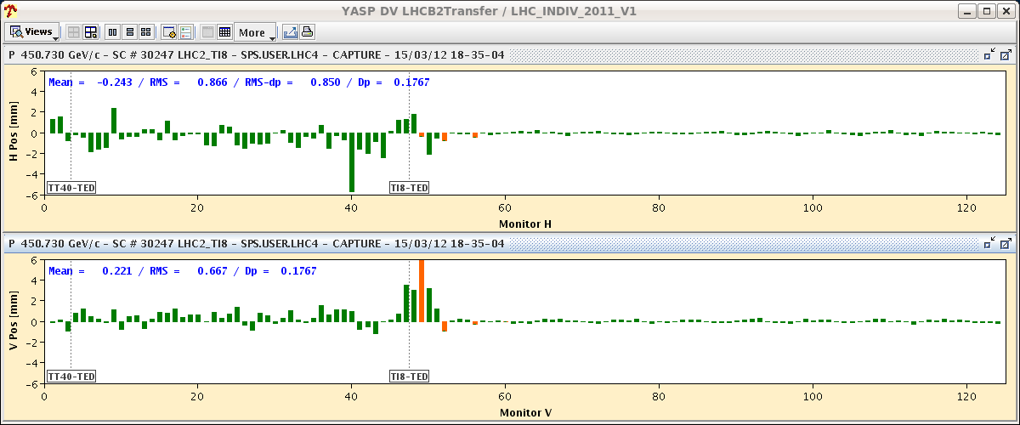
Injections
LHC
TI2
LHC
TI8

Slide 14
Orbit with nominal bunch
Orbit was re-corrected, first against 2011 reference, then some absolute corrections were applied.
Orbit is very similar to 2011 ref (0.2-0.3 mm rms difference).
The structures (mostly in the IRs) are ~ identical to last year.
BPM quality and response were checked.
Some scale issue possible (~ 10-20%) for IR BPMs.
Overall very good BPM quality, very few issues.
There are some ~25 problem channels (out of 2000) that had to be removed for correction (in particular for OFB).
All the ALFA BPMs (H and V, BPMSA.7xxx) give unstable readings with probe bunches.
There have been problems in the both squeezes around IR1 (large bumps) due to BPM issues.

Slide 15
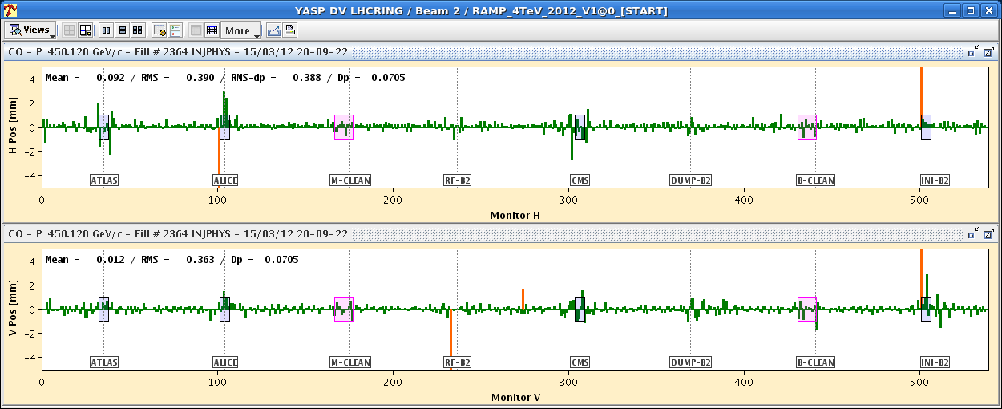
Reference – flat machine
0.47 mm
0.33 mm
0.39 mm
0.36 mm

Slide 16
BPM quality
BPM scale factor check using free oscillations from 2 correctors with ~90° phase advance for B1.
Oscillations reflect beta-beat and imperfect phase advance (not exactly 90 deg between 2 correctors).
Scale of BPMS in the triplets?

Slide 17
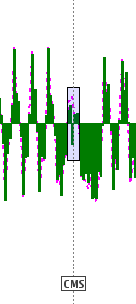
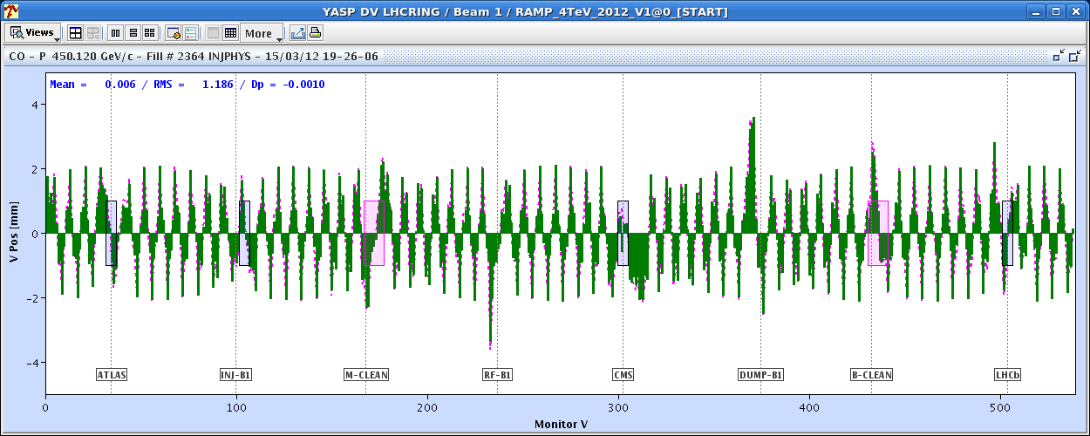
BPM quality
Response to corrector kick. Data (histogram) and model (points/line).
Sign error on BPMSW.1L5 at CMS – both beams, V plane
B1 V plane

Slide 18
Interlock BPM issues – critical !!!
One of the horizontal interlock BPMs of system ‘B’, BPMSA.B4R6.B2, frequently triggers spurious interlocks – sees 2 bunches when there is only in the ring…
Has been a ramp killer in coincidence with SBF issues (see later).
Must be solved asap to operate with unsafe beam.
The interlock limits and trigger counts have been temporarily set high enough to prevent problems (and make the BPM useless for protection).

Slide 19
On the way to 4 TeV
Thursday and Friday re-commissioning of the tune and orbit FB systems, continuous Q’ measurements etc…
Found a feature of the FGC software that was ignoring the real-time corrections → fix Friday morning.
Feedbacks have been used extensively for ramp and squeeze.
Struggling frequently with tune FB. To be understood – quite a lot of changes in this system.
Mixed with early commissioning mistakes, mishaps etc → quite some confusion in the OP teams.
Doubts on the chromaticity measurements (sign inverted).

Slide 20
Friday PM : on the way to 4 TeV
While preparing for the ramp, vacuum spike due to gauge out-gassing (between Q5.L5 and Q6.L5) triggered valve closure and dumped the beam.
Piquet opened vacuum valve.

Slide 21
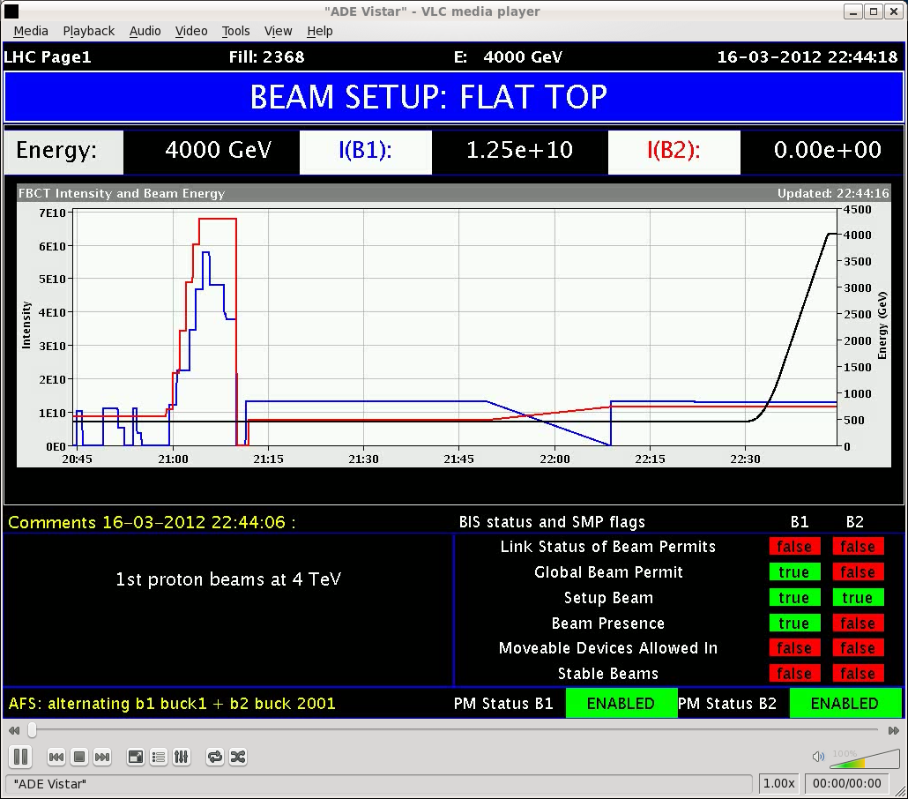
4 TeV !!!
But : beam 2 dumped after a few minutes at flat top due to a glitch in the safe beam flag combined with a latched interlock on BPMSA.4R6.B2.
Problem occurred a second time on Saturday morning !

Slide 22
Safe Beam Flag Beam 2
The cause of the SBF glitches was identified by B. Todd & SMP team:
Noise on BCT2B gives values above the safe beam limit (2.4×10¹⁰ p @ 4TeV).
For the time being, we operate at 4 TeV with Relaxed Safe Beam Flag (~1.2 ×10¹¹ p @ 4TeV) even for the probe bunches, and with relaxed thresholds on noisy BPMSA.B4R6.B2 (see before)
SMP post-mortem
17/03/2012 | 09:07:55 | 2818 | BCT2B | 8.70E+09
17/03/2012 | 09:07:55 | 102318 | BCT2B | 1.70E+10
17/03/2012 | 09:07:55 | 202318 | BCT2B | 1.11E+10
17/03/2012 | 09:07:55 | 304318 | BCT2B | 1.30E+10
17/03/2012 | 09:07:55 | 404068 | BCT2B | 1.77E+10
17/03/2012 | 09:07:55 | 502318 | BCT2B | 1.87E+10
17/03/2012 | 09:07:55 | 602318 | BCT2B | 7.20E+09
17/03/2012 | 09:07:55 | 702318 | BCT2B | 1.51E+10
17/03/2012 | 09:07:55 | 802318 | BCT2B | 7.70E+09
17/03/2012 | 09:07:55 | 903943 | BCT2B | 2.69E+10
17/03/2012 | 09:07:56 | 4443 | BCT2B | 1.17E+10

Slide 23
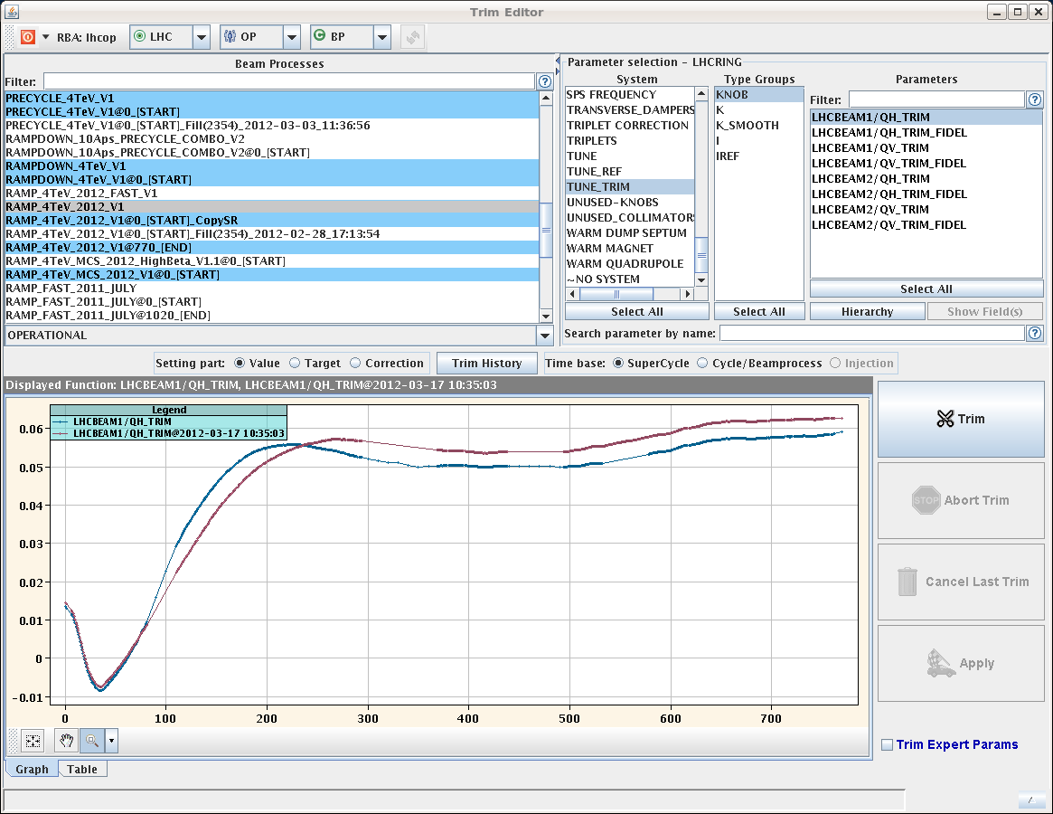
Ramp to 4 TeV
Tune, chromaticity, orbit, coupling measured.
Bootstrapped with 2011 Q / Q’ corrections.
First rough feed-forward on tune and orbit in the ramp.
Most changes occur ~ 1 TeV – as in previous years.
QH 2012
QH 2011

Slide 24
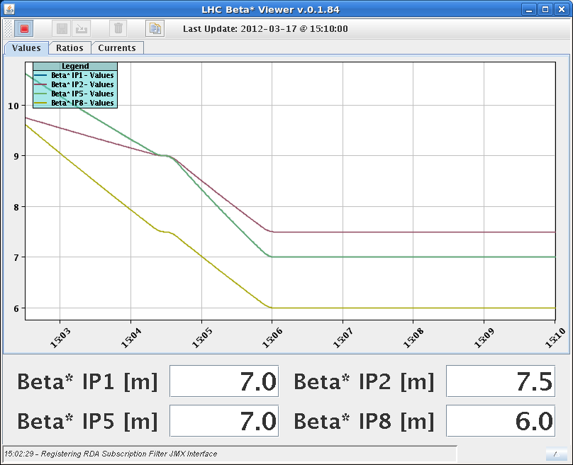
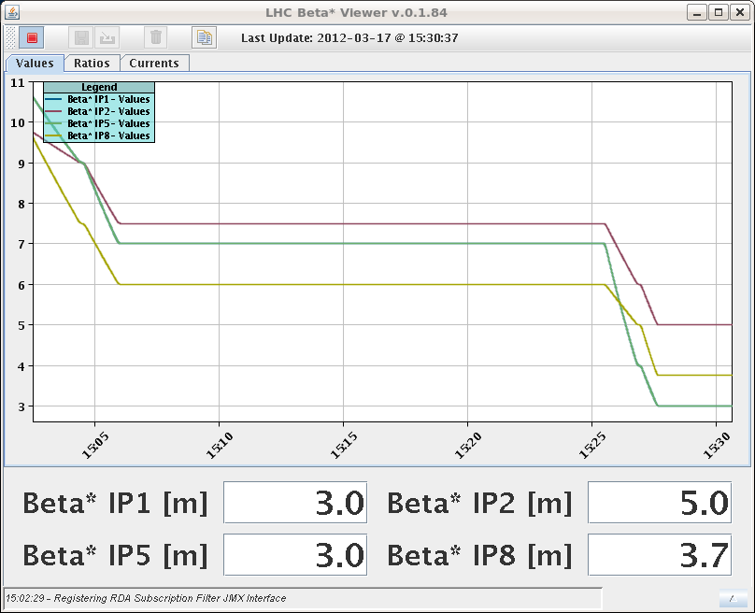
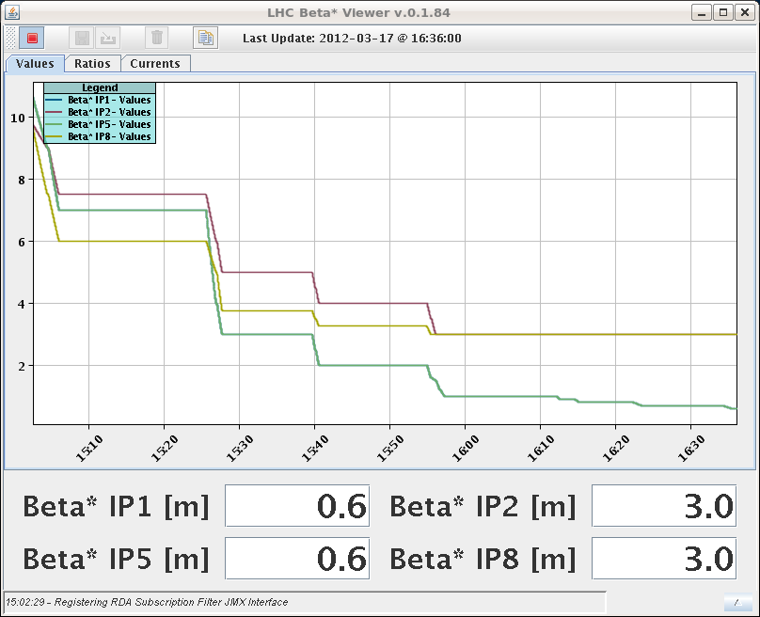
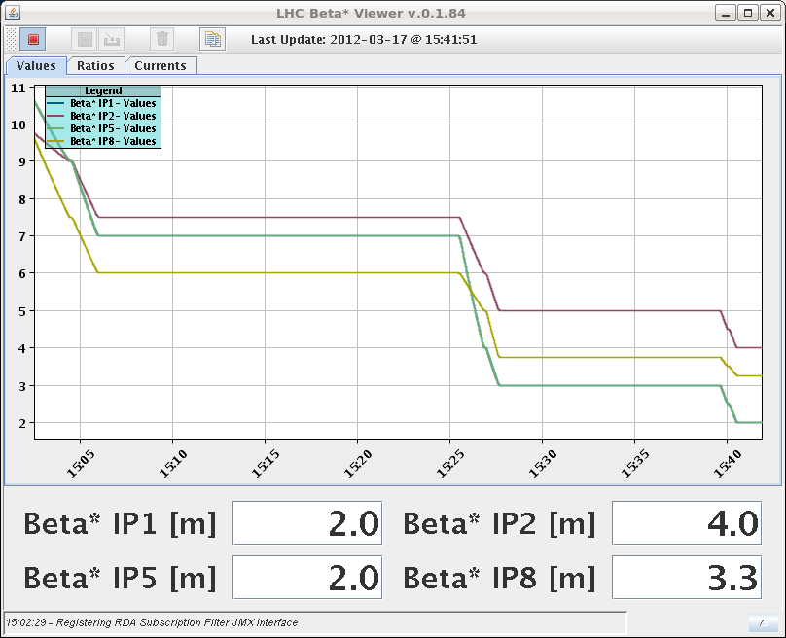
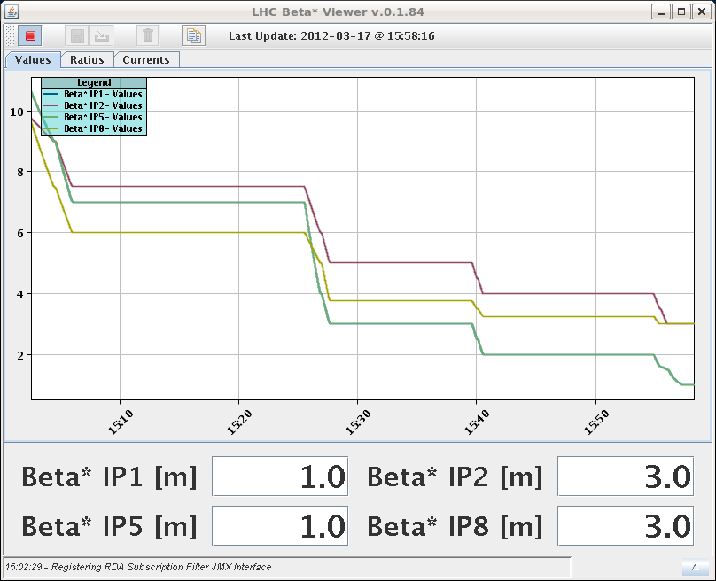
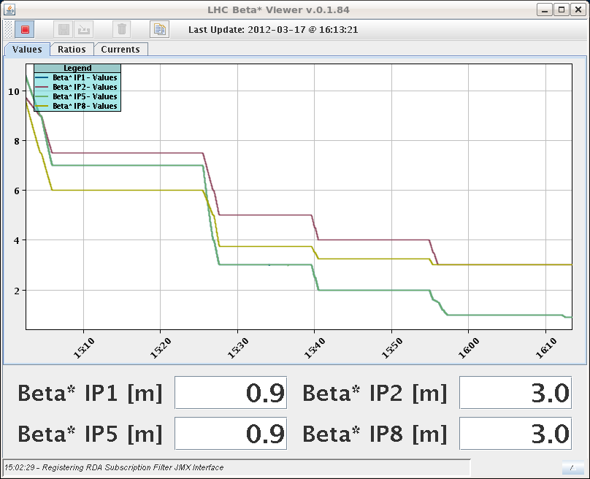
Squeeze : attempt no 1 – Saturday
No beam 2 from the SPS on Saturday due to problem with extraction magnetic septum power converter MSE.418.
Decided to go through the squeeze with beam 1 only

Slide 25
Squeeze to 60 cm
Rather smooth.
No lifetime dips (when we have the correct Q…).
Rather gentle corrections required.

Slide 26
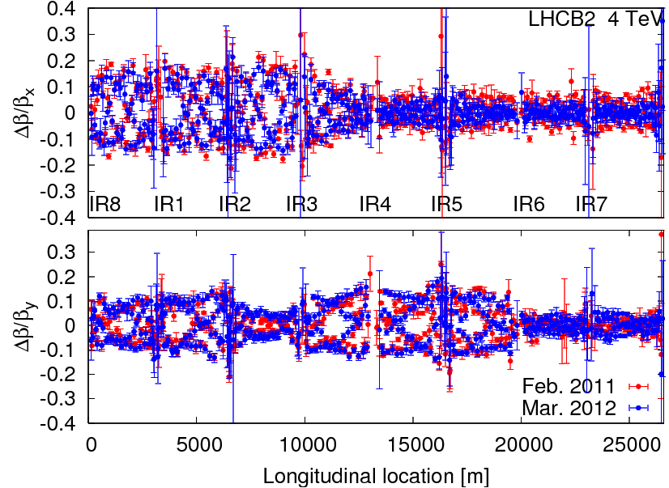
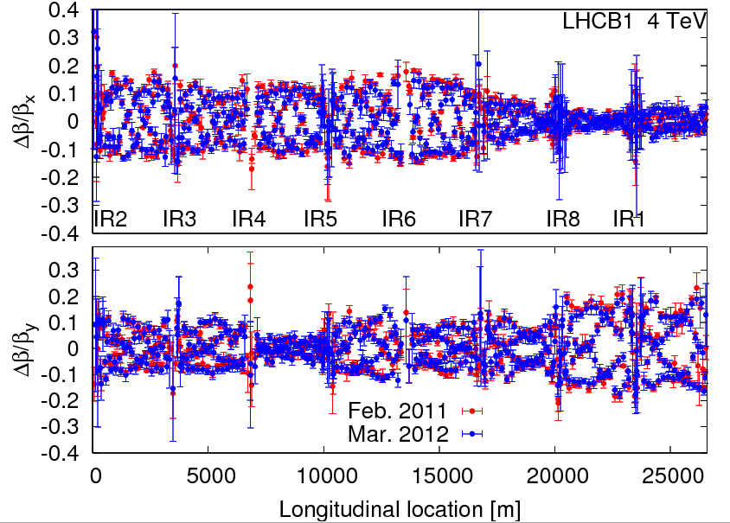
Squeeze : attempt no 2 - Sunday
This time full optics measurement campaign.
Plus orbit cleaning in IRs (with MCBX).
Machine at 4 TeV very similar to 3.5 TeV.

Slide 27
Optics measurements in the squeeze
Beta-beating measured at 10, 3, 1, 0.9, 0.8, 0.7 and 0.6 m.

Slide 28
Optics measurements in the squeeze
Beta-beating 90% at 0.6 m – expected !

Slide 29
Sunday PM: Towards final reference orbit at 450 GeV
ALICE and LHCb spectrometers/solenoid switched on, small leakage corrected – all polarities +.
Separation and crossing angle bumps trimmed in one by one and corrected locally using the same correctors used for the bumps.
Good compensation, but also indication that the scale of BPMS in the triplet are off by ~10% (too small reading).
Full separations measured to be 3.5 to 3.6 mm (missing 10% from BPMSW?) – consistent in all (measurable) IRs.
IR | ½ separation (mm, B1) | ½ Xing (μrad, B1)
1 | -2 | -170
2 | +2 | -170
5 | +2 | +170
8 | -2 | -170

Slide 30
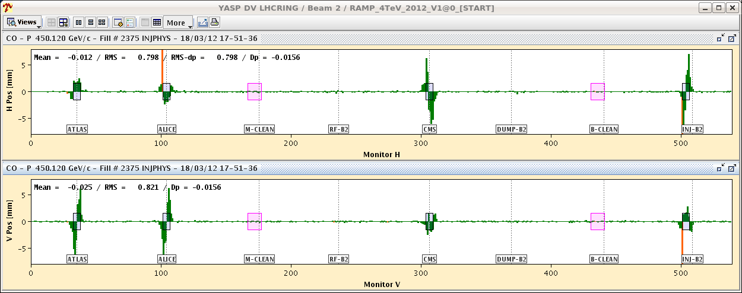
Difference all bumps - flat
±8 mm

Slide 31
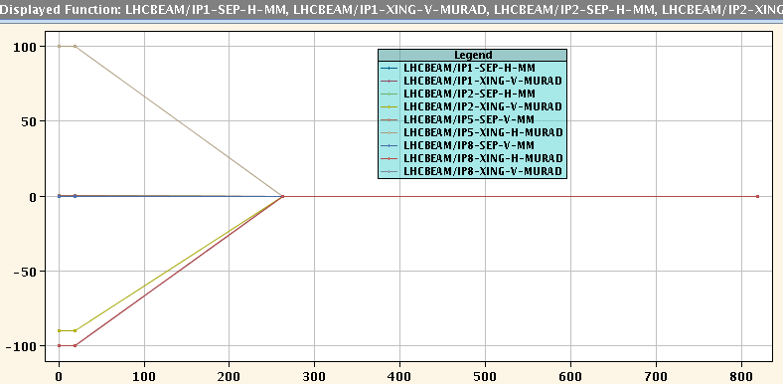
Dynamic reference for orbit FB
Tested up to first point in squeeze – seems OK.
‘Special temporary configuration’ for ramp and squeeze.
Injection : nominal bumps.
Flat top: nominal separation (0.65 mm / beam), reduced Xing angles (-100/-90/100/-100 μrad).
Squeeze: Xing and separation reduced to 0 at 7 m – flat orbit in the part with large beta-beat.
Squeeze

Slide 32
Ramp & squeeze – temporary configuration
This configuration provides:
Nominal conditions at injection
→ collimator and injection setup.
Ramp with separation
→ ramp with separation, FB tests/training.
Flat squeeze beyond 7 m
→ wait until beta-beating corrected.

Slide 33
Status of ramp and squeeze
Orbit and orbit FB under control, also with new dynamic references for OFB – special configuration (prev. page)
Reference ~final at 450 GeV.
Given the large beta-beating in the squeeze. OFB can become unstable in the squeeze : injection optics and large beta-beating.
OFB performance ~fine for the present conditions.
Still struggling with tune FB in ramp and squeeze.
Coupling, no signal, Q stability, reproducibility, plus mistakes…
>> Sit together to assess the situation
Coupling, Q’ reproducibility in the squeeze.
Forgotten settings incorporations …?!
Requires more work…

Slide 34
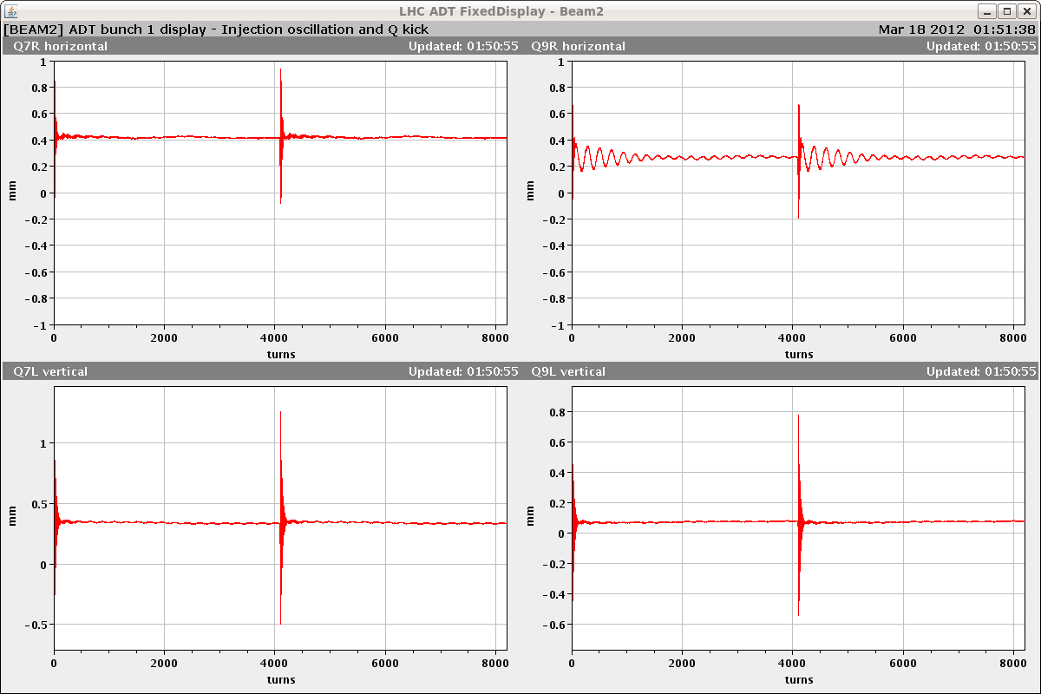
Damper setting-up
Summary of ADT setting up:
checked/adjusted loop parameters for all units.
Injection gap and abort gap cleaning is preliminarily set up.
Beam centered within < 0.5 mm in ADT BPMs – could be tuned further.
Transverse blow up available for both beams.
The ADT has settings for nominal intensity and 50ns or greater bunch spacing.
The blow-up strength and mode is set to safe values (zero and OFF) so there is no accidental trigger before proper rbac roles are prepared.

Slide 35
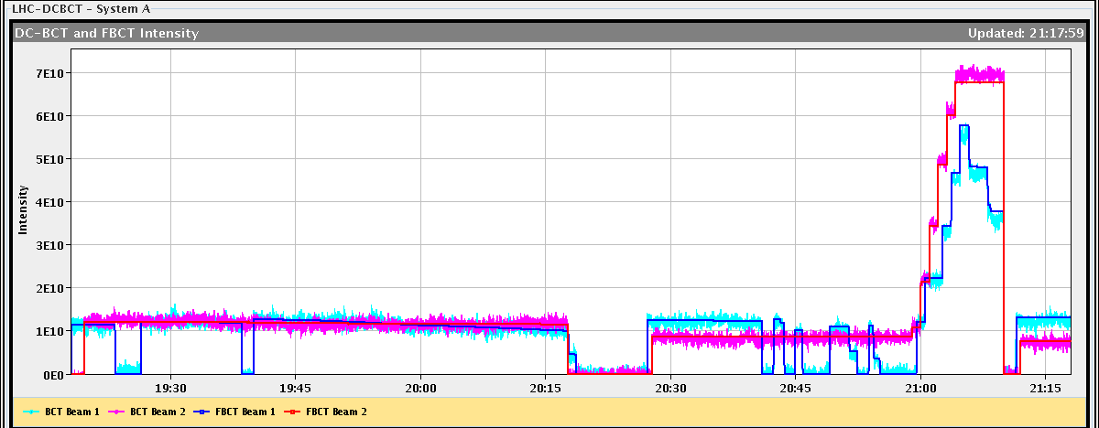
Loss map by controlled transverse blow-up
Preliminary global aperture measurements (H plane only) and validation of transverse blow-up for aperture and loss maps. To be analyzed.
Example of B1 horizontal blow-up with ADT.

Slide 36
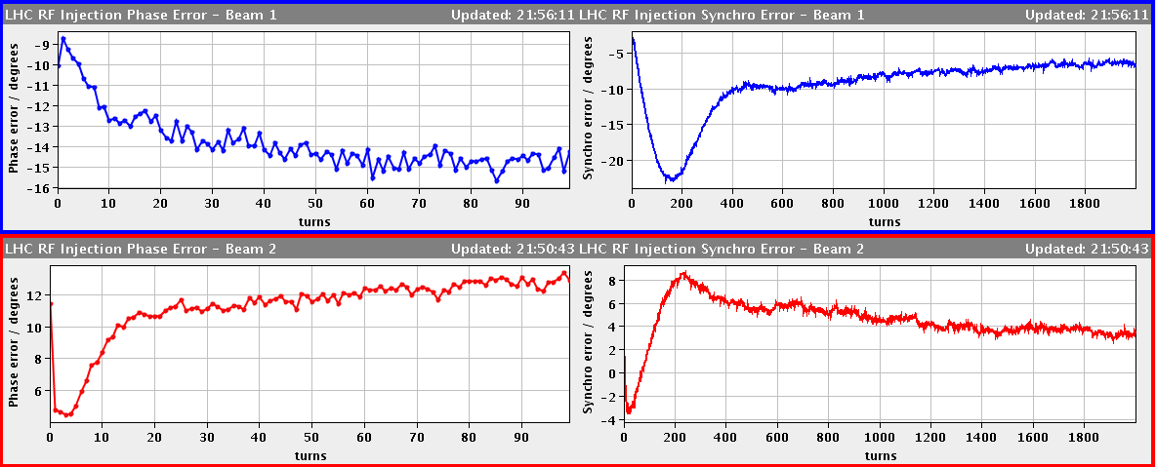
Energy matching
Synchro-loop error reduced (nominal bunch) by matching energy to SPS using horizontal orbit correctors.
Energy mismatch at the level of dp/p ≤ 5E-5 on both beams.
Consistent between injected beam trajectory and synchro-loop.
To be observed and fine tuned.

Slide 37
FIDEL
FIDEL mechanics working, including the longer ramp for spool correctors.
But the actual corrections ‘seemed’ to be off (Q’) – to be confirmed when have consolidated all measurements.
Decay measurement last night – initial Q’ looked OK.
More analysis needed.

Slide 38
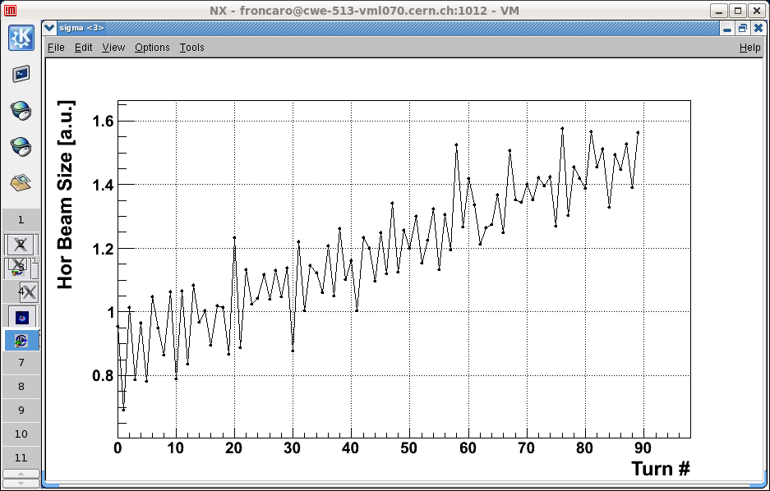
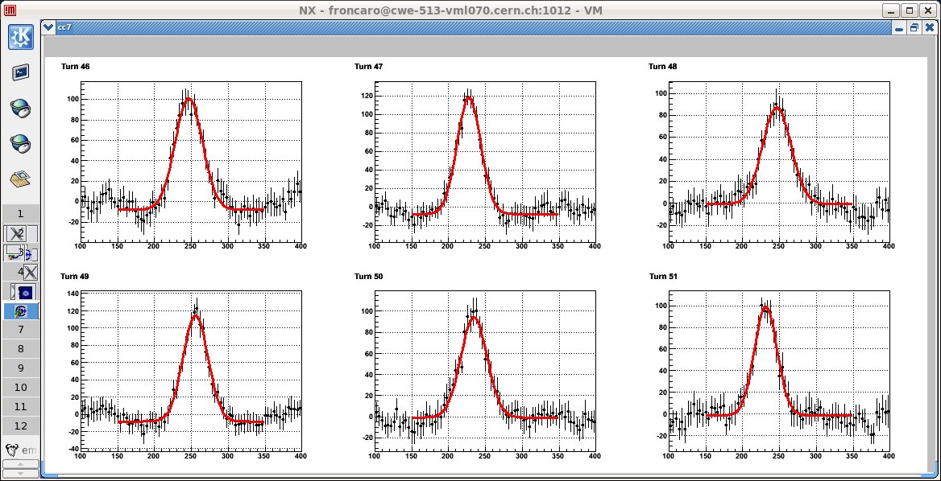
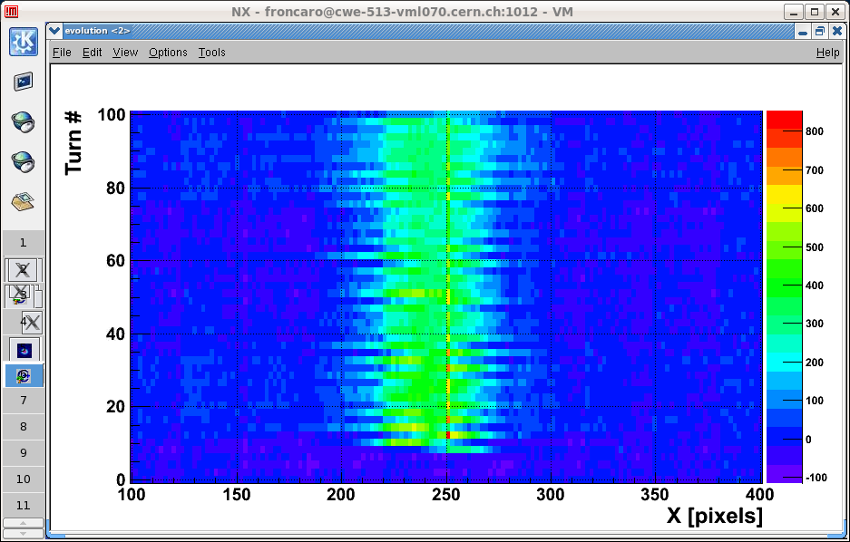
A ‘new’ instrument
Matching monitor gave first images and profiles.
Turn-by-turn profiles for optics matching of the transfer lines to the LHC ring.

Slide 39
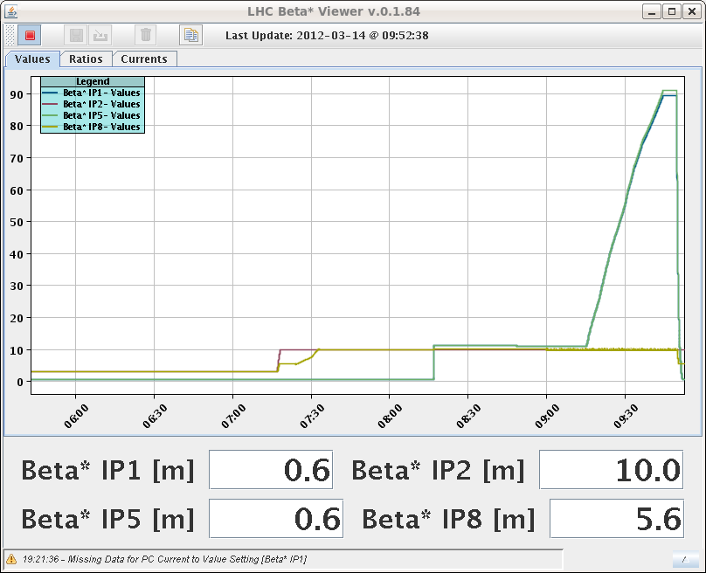
FGC & squeeze
This year no PC trips at first iteration of squeeze settings.
For nominal squeeze and 90 m unsqueeze.
S. Redaelli found this good news very suspicious…
Last year some ‘manual’ stretching of the functions was always required (error on L for Q4/Q5/Q6).
90 m

Slide 40
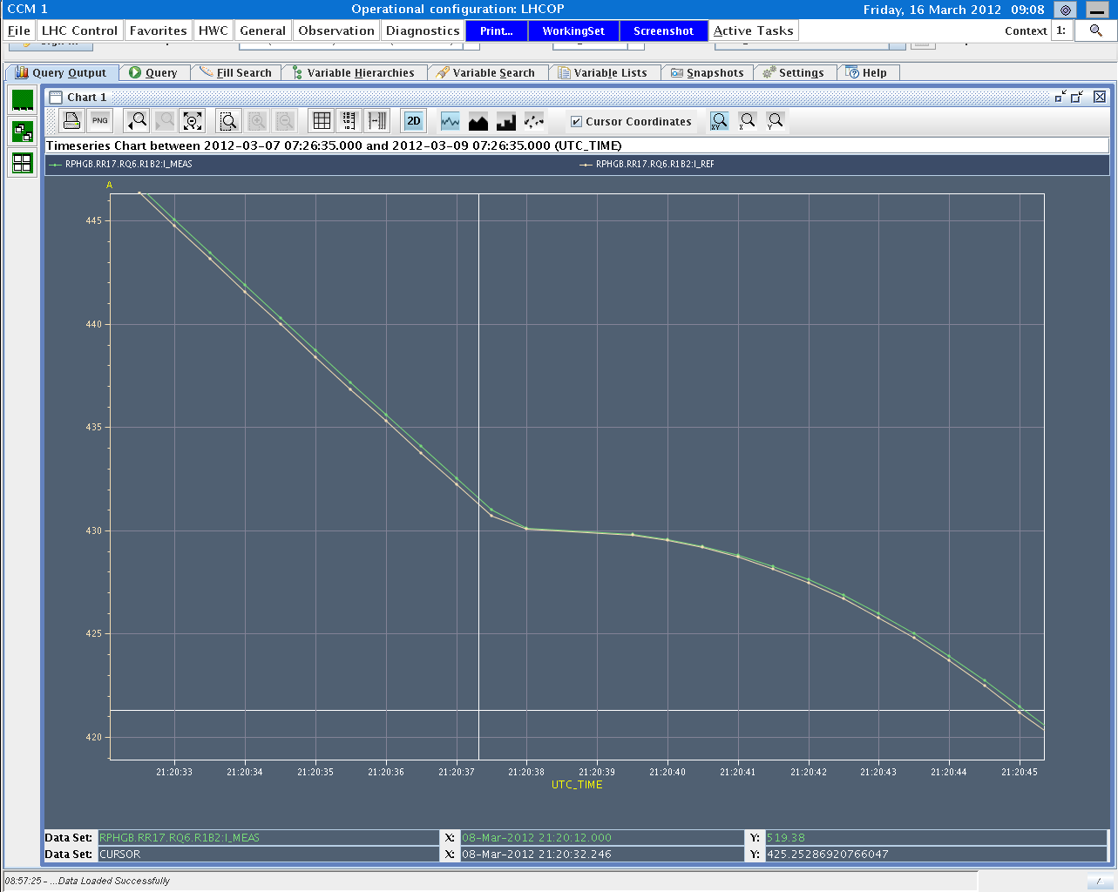
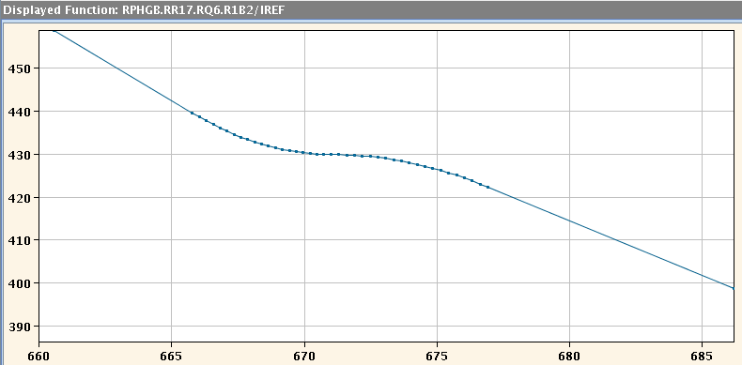
FGC & squeeze
Check of logging showed perfect tracking…???
Close inspection showed that the logged PC reference does not (always) correspond to our reference…
Tweak on the reference by FGC software – will be changed.
>> We may have to generate a longer squeeze and copy over all settings…
Reduce transient beta-beat
PC is not tracking

Slide 41
Last 24 hours
Sunday morning : optics in the squeeze.
14:15: Beam1 to the TDI, but MKI pulsed. Beam and kick not synchronous?
15:00 ALICE and LHCb ON.
17:00 Separation and Xing on at injection.
Then 2 ramp and squeeze attempts to test dynamic references for OFB.
QFB switching off…
Q across 1/3 order resonance during Q change at start of squeeze → large trim incorporated into functions in the squeeze of the morning !
Second attempt ‘sort of’ OK.

Slide 42
Last 24 hours.
23:00: FIDEL decay measurements.
02:00: Ramp and squeeze attempt.
Lost beam due to wrong reading of temperature sensor in cell 23.R7 – lost CS/CM.
Triplet IR5 trips when sending to PCs to precycle start.
Ramp rate to high? To be followed.
06:30 New ramp and squeeze.
Ok for orbit.
QFB switching off in the squeeze – lost beyond 2 m – Q across 1/3 order resonance.

Slide 43
Time off – past, present…
Friday morning: access
Dump resistor inspection in S81 – high voltage during discharge at 6. 8 kA. Nothing abnormal was found.
PC repair.
Some delays due to IMPACTs (not ready…).
IMPACT deactivated for access for the moment.
Saturday : 8:00-20:00
PC problem on SPS magnetic extraction septum B2 (MSE.418).
Today : 09-12:00
Injectors off – ramp & squeeze in the shadow.

Slide 44
Time off – …future
Sunday morning – fire in BA3 RF rack.
Input HV monitoring cables have burnt (unknown reason), and have been short-circuited to ground.
This has induced an 18 kV to ground fault.
Decision has been taken to switch ‘OFF Line’ TX4, and to operate with TX3 until repair, i.e. only a quarter of full power is delivered to cavity #2 (out of 4 cavities).
Investigation and repair of the fault will be done in parallel to operation beginning of the week.’
E. Montesinos BE-RF
OK in SPS for probe and nominal single bunches.

Slide 45
Issues
SPS BCT to SMP transmission.
BPMSA.B4R6.B2 spurious interlocks.
BCT B2 noise → LHC SBF.
Polarity of BPMSW.1L5.B1/2 – V plane.
Chromaticity measurement and feedback displays.
Vacuum gauge outgassing between Q6 and Q5.L5.
Probably vacuum gauge outgassing when switching ON.
> 6 spurious triggers of FMCM RD34.LR7 on Sunday.
Squeeze length.
Decide soon – need to copy settings by hand !

Slide 46
Issues
MKI fired but missed the beam (→ TDI) on Sunday.
To be investigated.
Beam to TDI in IR2 : dump trigger from new TCTVA BLMs.
To be investigated – TCTVA intercepting beam ???
Suspected electrical problem on a fire detection unit in UX85. Access required at the next occasion.

Slide 47
Tentative planning
Thank you to all who contributed to this fantastic start-up !

