Slide 1
Saturday March 5th
09h30 meeting: OK to go ahead with nominal bunch intensity from beam dump.
Last 24h: Very good on plan as presented yesterday ➔ What is special on weekends? Can we declare the week as weekend?
10h20: Beam dump with RF interlock from freq. trim
Beta beat correction complete at 3.5 TeV down to 1.5m
Coupling correction complete at 3.5 TeV
Beta* measured but not corrected
Ramp down and recover.

Slide 2
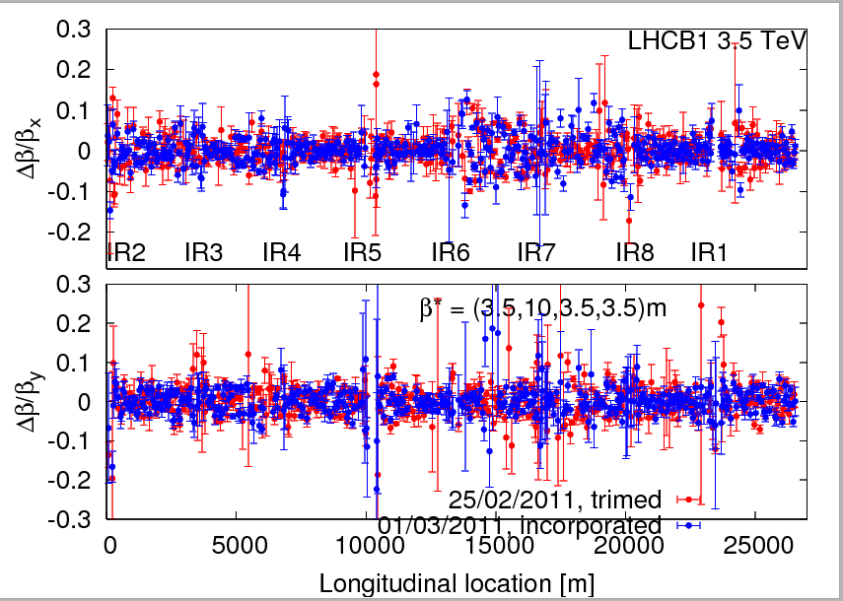
B1 beta beat

Slide 3
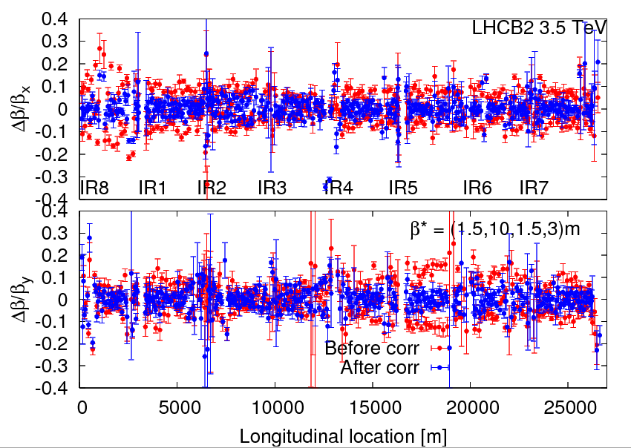
B2 beta beat

Slide 4
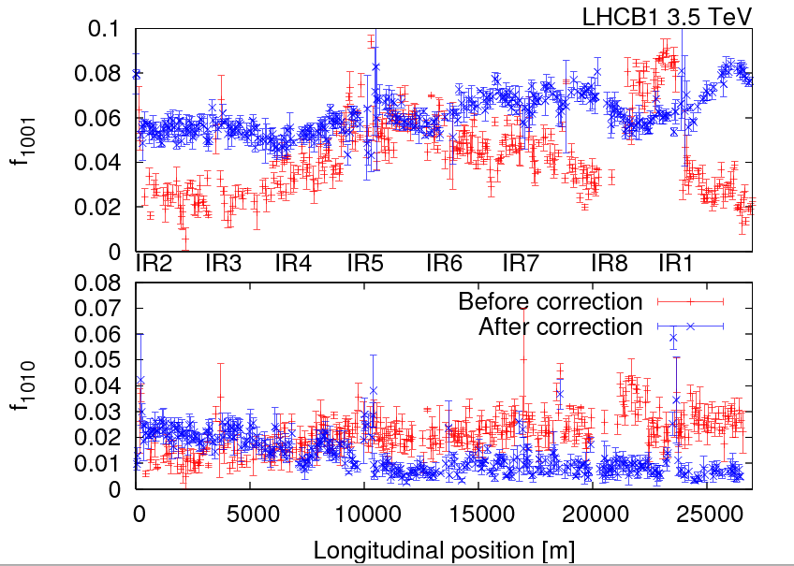
B1 coupling

Slide 5
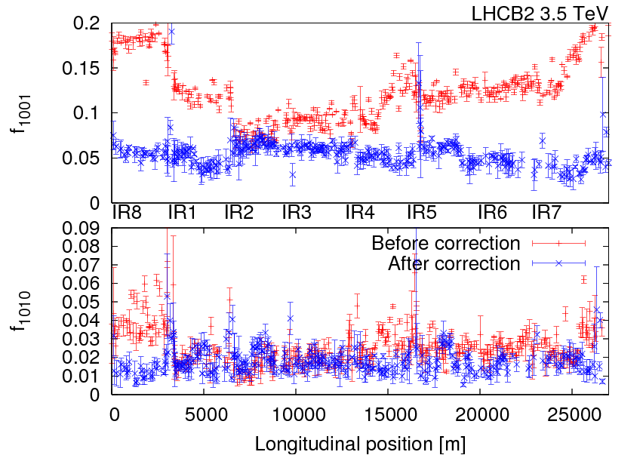
B2 coupling

Slide 6
Saturday March 5th
11h20: Injection nom. bunch. Ramp.
12h53: At 3.5 TeV with 1 nominal bunch per beam.
Fine ramp.
Adjustments. Orbit saved.
Adjustment blow-up functions.
14h53: Dump. Ramp-down and recover.
15h09: RF module 2B2 down. RF piquet.
16h40: Ready for injection.
17h01: Start injection protection setup.

Slide 7
Fine ramp with nominal bunch…

Slide 8
Lifetimes…

Slide 9
RF blowup and bunch length

Slide 10
RF trip

Slide 11
Saturday March 5th
17h01 – 00h24: Injection prot. setup. Inj. prot. team.
TDI angle measurement:
took data for TDI.B1 -1mrad and TDI.B2 +/- 1 mrad, finished for the data, analysis pending
TCDI protection validation tests (phase coverage):
finished data taking for TI2, TI8 to be done in I&D mode
TCDIs put to 5 sigma settings
TCP and TCLA in P3 closed to avoid losses in P6 (XPOC)
calibrated beam loss on the TCDIs for a 2 sigma orbit displacement
recorded beam losses in TL and ring for whole phases space in 30 deg steps for oscillation amplitudes of 4, 4.5, and 5 sigma
results look good but full analysis to be done

Slide 12
Full collimator + protection settings B1

Slide 13
Full collimator + protection settings B2

Slide 14
Saturday March 5th
During injection protection setup: several dump problems, requiring piquet and Etienne Carlier.
00h30: Loss maps.
Comparing two gap calculations (nominal and calibrated gaps).
Results to be analyzed.
Probably to be redone with nominal intensity.
05h30: Loss maps done. Prepare beam for collimation setup at 3.5 TeV.

Slide 15
Loss map example

Slide 16
Ahead
Sun 07:00 inject and ramp 1 nominal bunch to 3.5 TeV (no squeeze) Establish final reference Collimation setup at 3.5 TeV Sun 18:00 MPS checks at 450 GeV Mon 00:00 Transverse damper setup at 450 GeV (Daniel Valuch et al) Mon 08:00 Injection & dump protection Mon 16:00 Collimation setup at 3.5 TeV

