Slide 1
Monday February 28th
8h00: Injection
8h41: Injection and dump protection setup
14h21: XPOC problem
15h28: RF calibration
17h42: Access for RF
20h16: Access finished. Pre-cycle
21h30: Injection
22h34: Ramp
22h52: Squeeze for orbit checks

Slide 2
Monday February 28th
SUMMARY of injection studies (Verena, Wolfgang, Chiara):
Defined reference trajectories for B1 and B2 pilot and nominal bunch, in the catalog
Recentered 4 TCDI collimators (3 vertial and 1 horizontal), new settings and thresholds (1/4 of sigma around actual position) updated in the trim application.The setup was done with pilot bunch in inject and dump mode. Settings should be rechecked when injecting nominal bunch intensity.
New settings @ 4.5 sigma: Left Right TCDIV.29012 2.37mm -2.14mm TDIH.29050 3.92mm -2.97mm TCDIV.29234 2.88mm -2.65mm TCDIV.29509 7.88mm -3.87mm

Slide 3
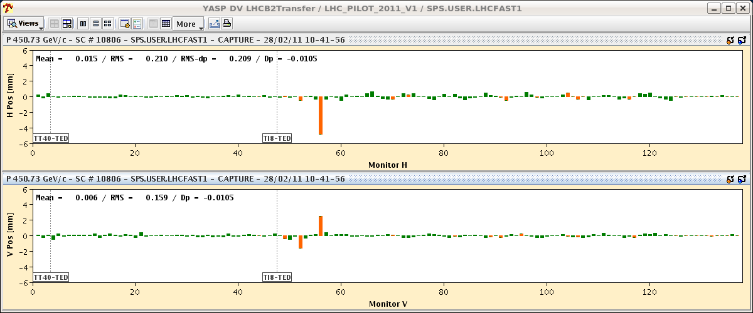
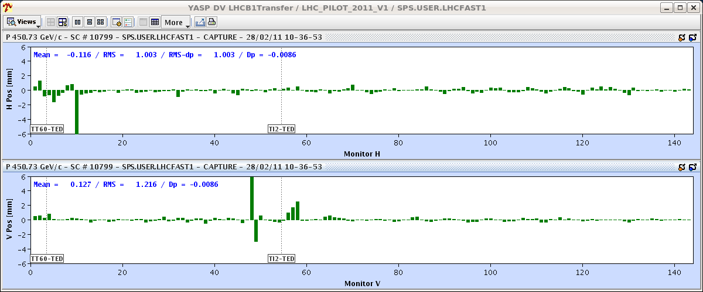
Monday February 28th

Slide 4
Monday February 28th
RF study summary I (Philippe, Greg, Jose)
First cavity phasing. Identical set-phase from the function generators: beam to see identical phase of the cavity field when crossing each cavity. Use beam as a probe: observe beam longitudinal position (beam phase) in SR4, compared to the phase of the corresponding RF, while we create a bucket with a single cavity. We transfer the bunch from one cavity bucket to next cavity bucket (temporarily having two cavities ON for the transfer) and wish to observe no difference in beam longitudinal position (resolution better than 0.5 degree at 400 MHz).
Then move on to the calibration of the Vector Sum of 8 cavities (per beam) used by the beam phase loop. With cavities correctly phased (see above) we now observe the cavity sum output in amplitude and phase (w.r. to the SR4 RF reference) and again, use one cavity at the time and wish to see no variation in amplitude/phase. This is done without beam and implies adjustment of RF attenuators and delay lines in UX45, thereby calling for access to the cavern.

Slide 5
Monday February 28th
RF study summary II (Philippe, Greg, Jose)
All calibrations fit very well with 2009 and 2010 settings (see more details attached) except for Cav4B1 where one cable was replaced during the hdw commissioning 2011.

Slide 6
Monday February 28th
Summary of the squeeze test for orbit (Joerg, Kajetan):
We stepped in one go through the squeeze with a varying reference. - The start of squeeze reference consisted of the base orbit with the bumps matched to 10/11 m. The end squeeze reference consisted of the base orbit with the bumps matched to 1.5/3 m.
The 10/11 m bumps were programmed to be taken out linearly through the squeeze, while the 1.5/3 m bumps were programmed in linearly.
The result was an orbit error of arround 1 mm on the outgoing beam sides in IR8, roughly half as much on the incoming sides. Below 6 m the effects in IR8 became even smaller. This looks like an acceptable way of operating until a cleaner solution is implemented.
We also observed some spikes of up to 0.3 mm rms of the orbit at different moments in the squeeze and that seemed to correlate with the stop points. To be understood tomorrow.

Slide 7
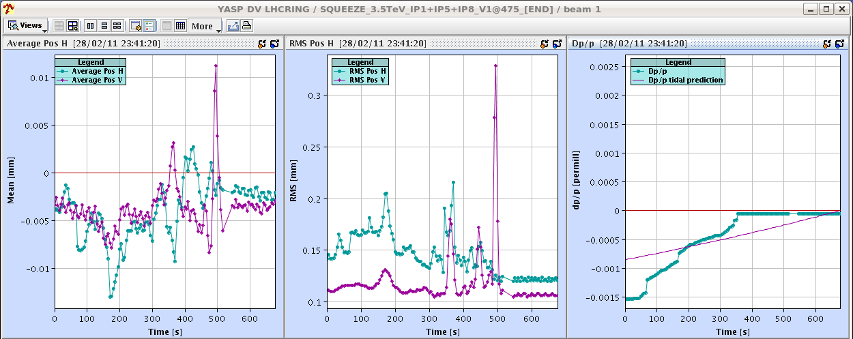
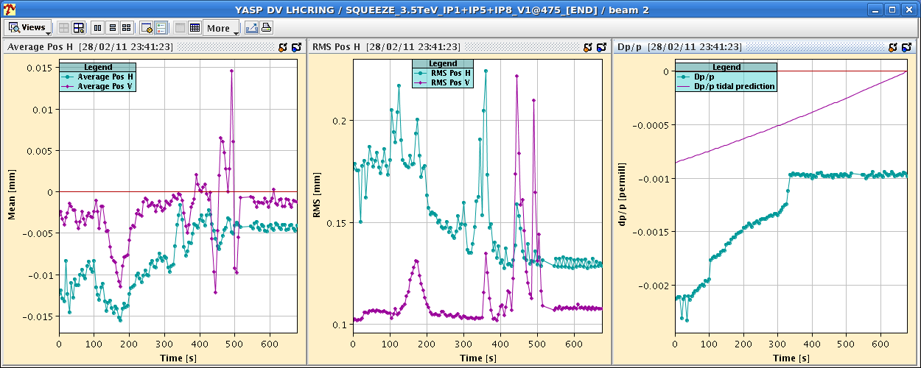
Monday February 28th

Slide 8
Tuesday March 1st
00h01: MPS tests (RD1.LR1 off). Recover and rampdown.
00h51: Injection. Reboot of OFC and OFSU fixed problem.
02h36: Ramp
03h06: Squeeze.
Beta beat correction (B1 complete, B2 to be completed).
Beam 2 affected by RQS.A78B2 trips.
Coupling not corrected (2 beams required).
08h12: Beam dump.

Slide 9
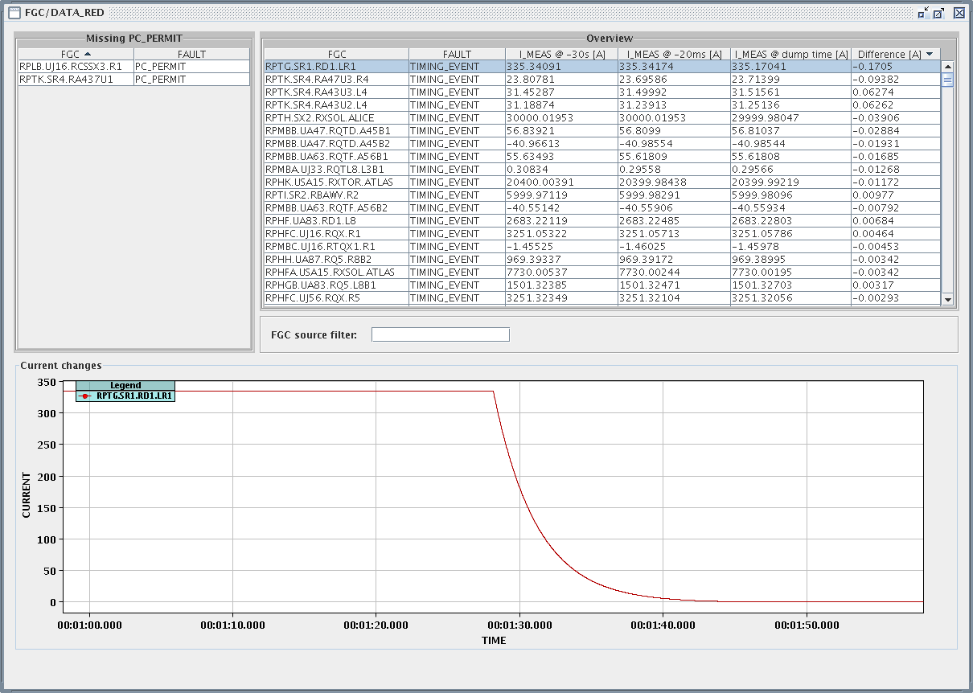
Tuesday March 1st
Summary MPS test (Joerg, Kajetan):
MPS test with beam at 1.5 m beta* with RD1.LR1 (PC off) - OK!
The FMCM triggered first, with a current change of 0.17 A/ 335 A (5E-4) at dump time. No visible orbit change is observed.
One notes a small loss spike on the TCTH in IR1 during the dump action: the loss signal is larger than in IR7.
Note that a radial modulation is on (visible on the orbit).

Slide 10
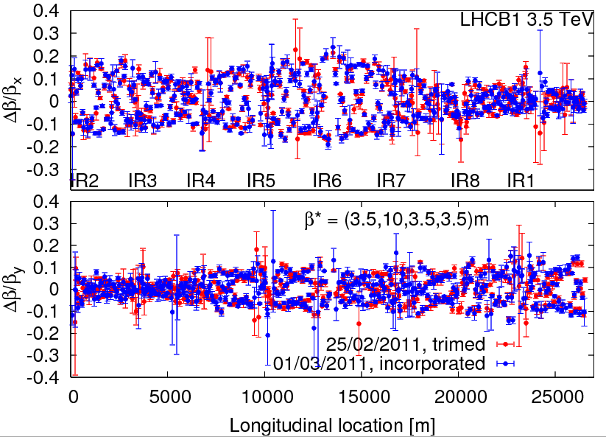
Tuesday March 1st

Slide 11
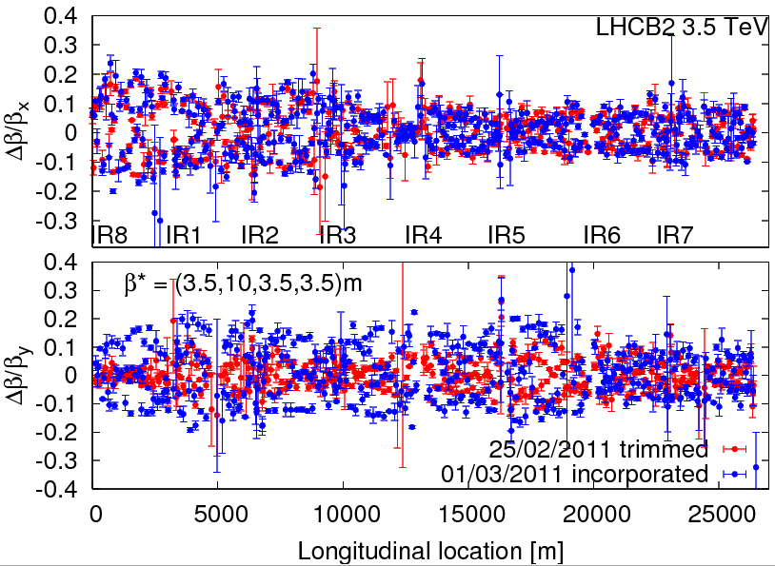
Tuesday March 1st

Slide 12
Ahead
28 | MO | 23:00 | 8 | Beta beating & coupling correction and measurement through the squeeze
1 | TUE | 9:00 | 4 | Collimation continued
1 | TUE | 13:00 | 6 | Inj. & dump protection - 450 GeV
1 | TUE | 19:00 | 6 | Ramp and squeeze to 3.5 TeV: MP and test collisions
1 | TUE | 2:00 | 6 | Collimation validation at 450 GeV
2 | WED | 9:00 | 8 | Trial ramp to 3.5 TeV with 1 nominal bunch (RF blowup, orbit, emittance, damper, ...)
2 | WED | 15:00 | 4 | Transverse damper for multi-bunch
2 | WED | 19:00 | 5 | 1.38 TeV ramp with pilot bunch
3 | THU | 0:00 | 8 | Check of beta beat, orbit, coupling
3 | THU | 8:00 | 8 | Collimation setup 3.5 TeV before squeeze, 1 nominal bunch
3 | THU | 16:00 | 8 | Injection and dump setup (higher inetnsity, MP, …)
4 | FRI | 0:00 | 4 | TL measurements
4 | FRI | 4:00 | 4 | Ramp to 1.38 TeV, 1 nom bunch, test collisions
4 | FRI | 8:00 | 8 | Collimation setup 3.5 TeV before squeeze, 1 nominal bunch
4 | FRI | 16:00 | 8 | Injection and dump setup (higher inetnsity, MP, …)

