Slide 1
Summary for LPC (March 7th, Ralph Assmann)
Last week: Rocky… Plenty of access up to start of weekend.
Up to 11h access per day.
Many problems (see daily slides).
Major impact: Feedback software and control. OK presently.
Major impact: Beam dump problems. Many accesses. Rollback of software. More or less OK (still 1 problem per day). Brennan at LMC.
Very smooth and efficient weekend (we need more weekends and less weekdays).

Slide 2
Where are we for 450 GeV?
Injection optics and orbit OK.
Aperture OK and measured.
Measure DS aperture and response.
RF system OK.
Transverse damper OK.
Feedbacks OK.
Emittance small but not controlled.
Injection ring collimation OK..
Machine protection OK.
Some final adjustments to be done.
Injection transfer line collimation OK.
Checks to be completed for TI8.
Then move to multi-bunch injection.

Slide 3
Full collimator + protection settings B1

Slide 4
Full collimator + protection settings B2

Slide 5
Loss map example

Slide 6
Where are we for the ramp?
Pilot and nominal bunch. OK.
Chromaticity, tune, orbit OK.
RF blowup. OK.
Some minor optimizations still ongoing. Philippe.
Feedbacks OK.
Transmission and lifetimes OK.
Collimator ramp:
To be done once endpoint is known (3.5 TeV setup)

Slide 7
Fine ramp with nominal bunch…

Slide 8
Lifetimes…

Slide 9
RF blowup and bunch length
Philippe et al

Slide 10
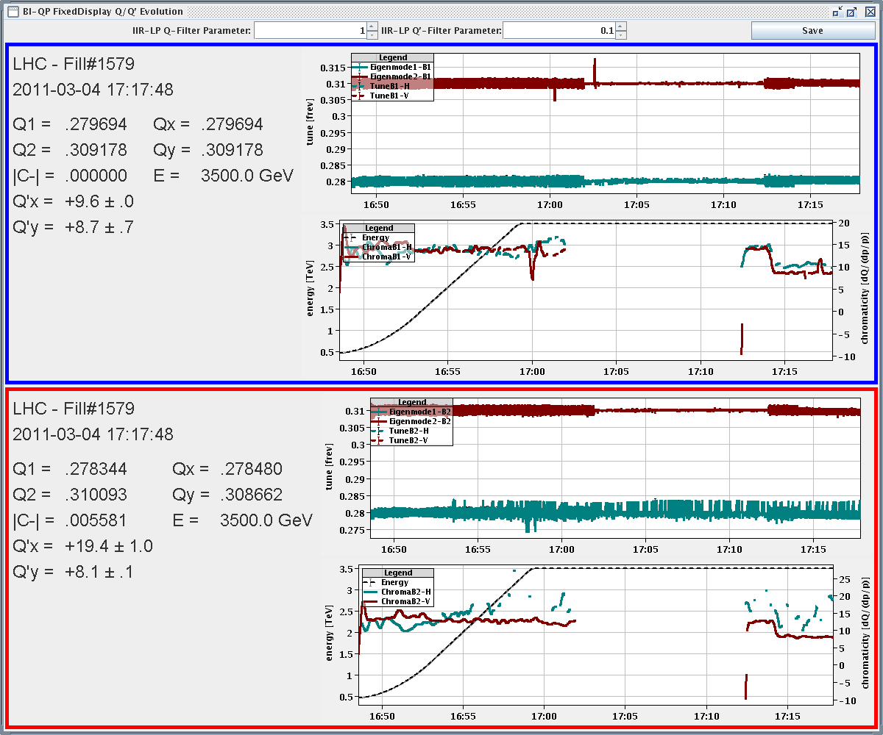
Tune feedback and chroma

Slide 11
Where are we for 3.5 TeV?
Chromaticity and tunes OK.
Beta beat and coupling through squeeze OK.
Beta* correction to be done with k-modulation.
Squeeze with dynamic orbit reference OK.
Sequence with feedbacks OK.
Pilot collisions and vernier scans OK.
Final 3.5 TeV reference orbit defined (nominal bunch).
30 – 40% of collimators calibrated for flat top.
To be completed.
Dump protection setup and check.
To be done.
Loss maps for qualification. Asynchronous dump tests.
To be done.

Slide 12
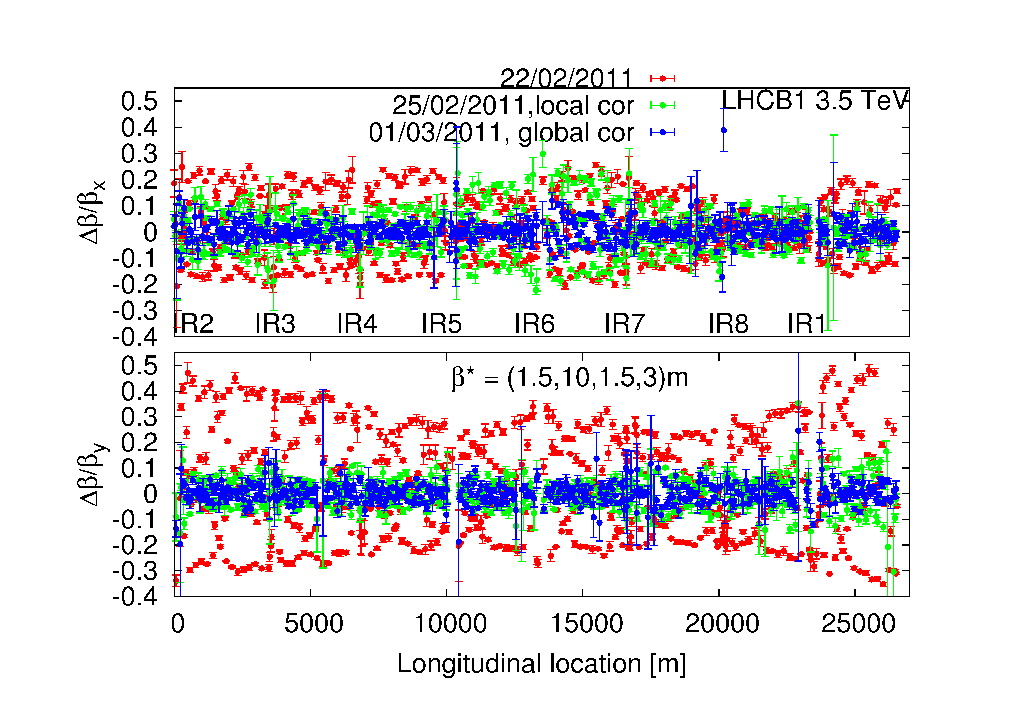
B1 beta beat
Rogelio, Glenn, Ryoichi, Masamitsu, Rama

Slide 13
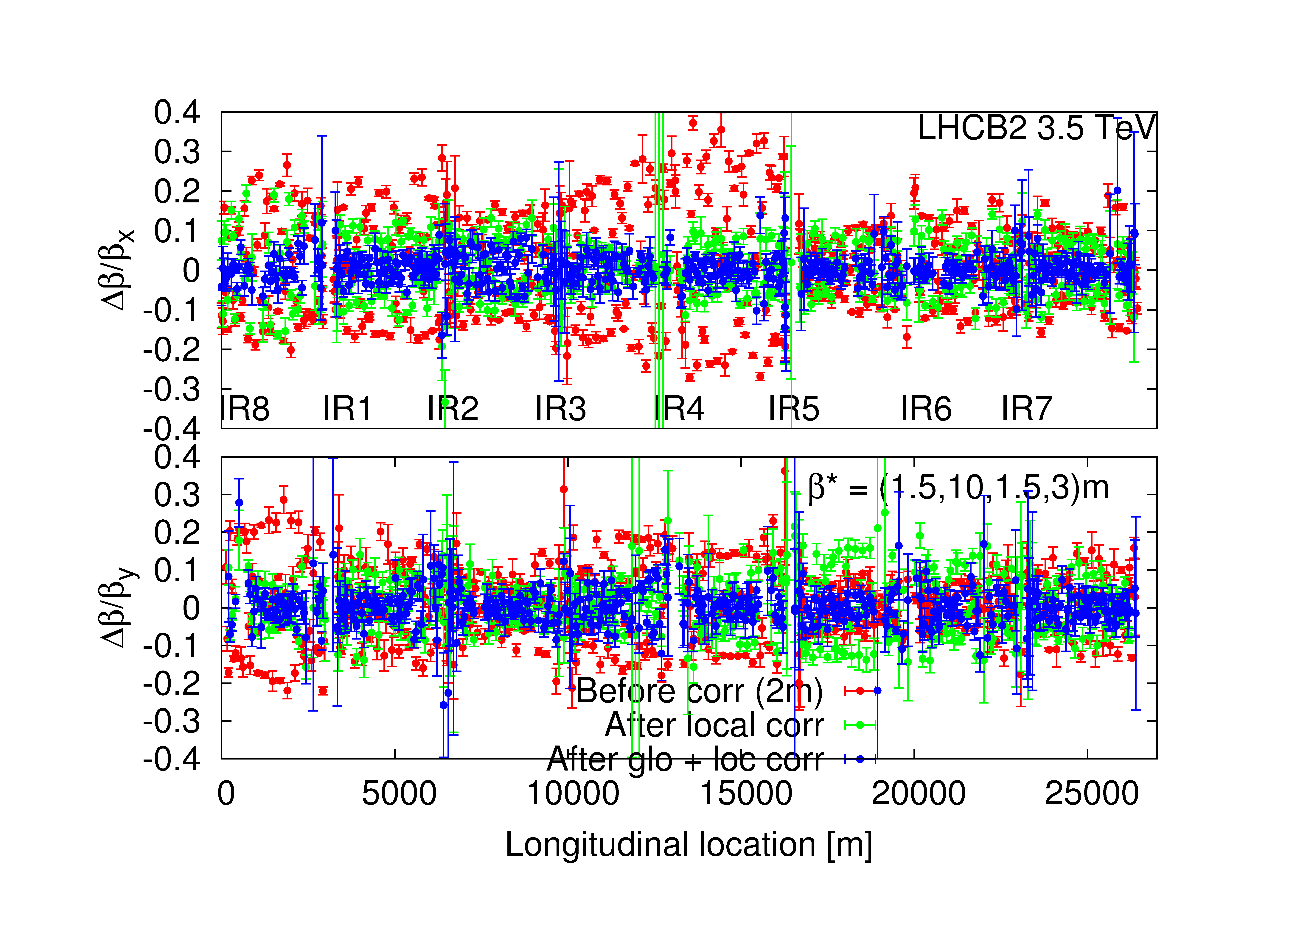
B2 beta beat
Rogelio, Glenn, Ryoichi, Masamitsu, Rama

Slide 14
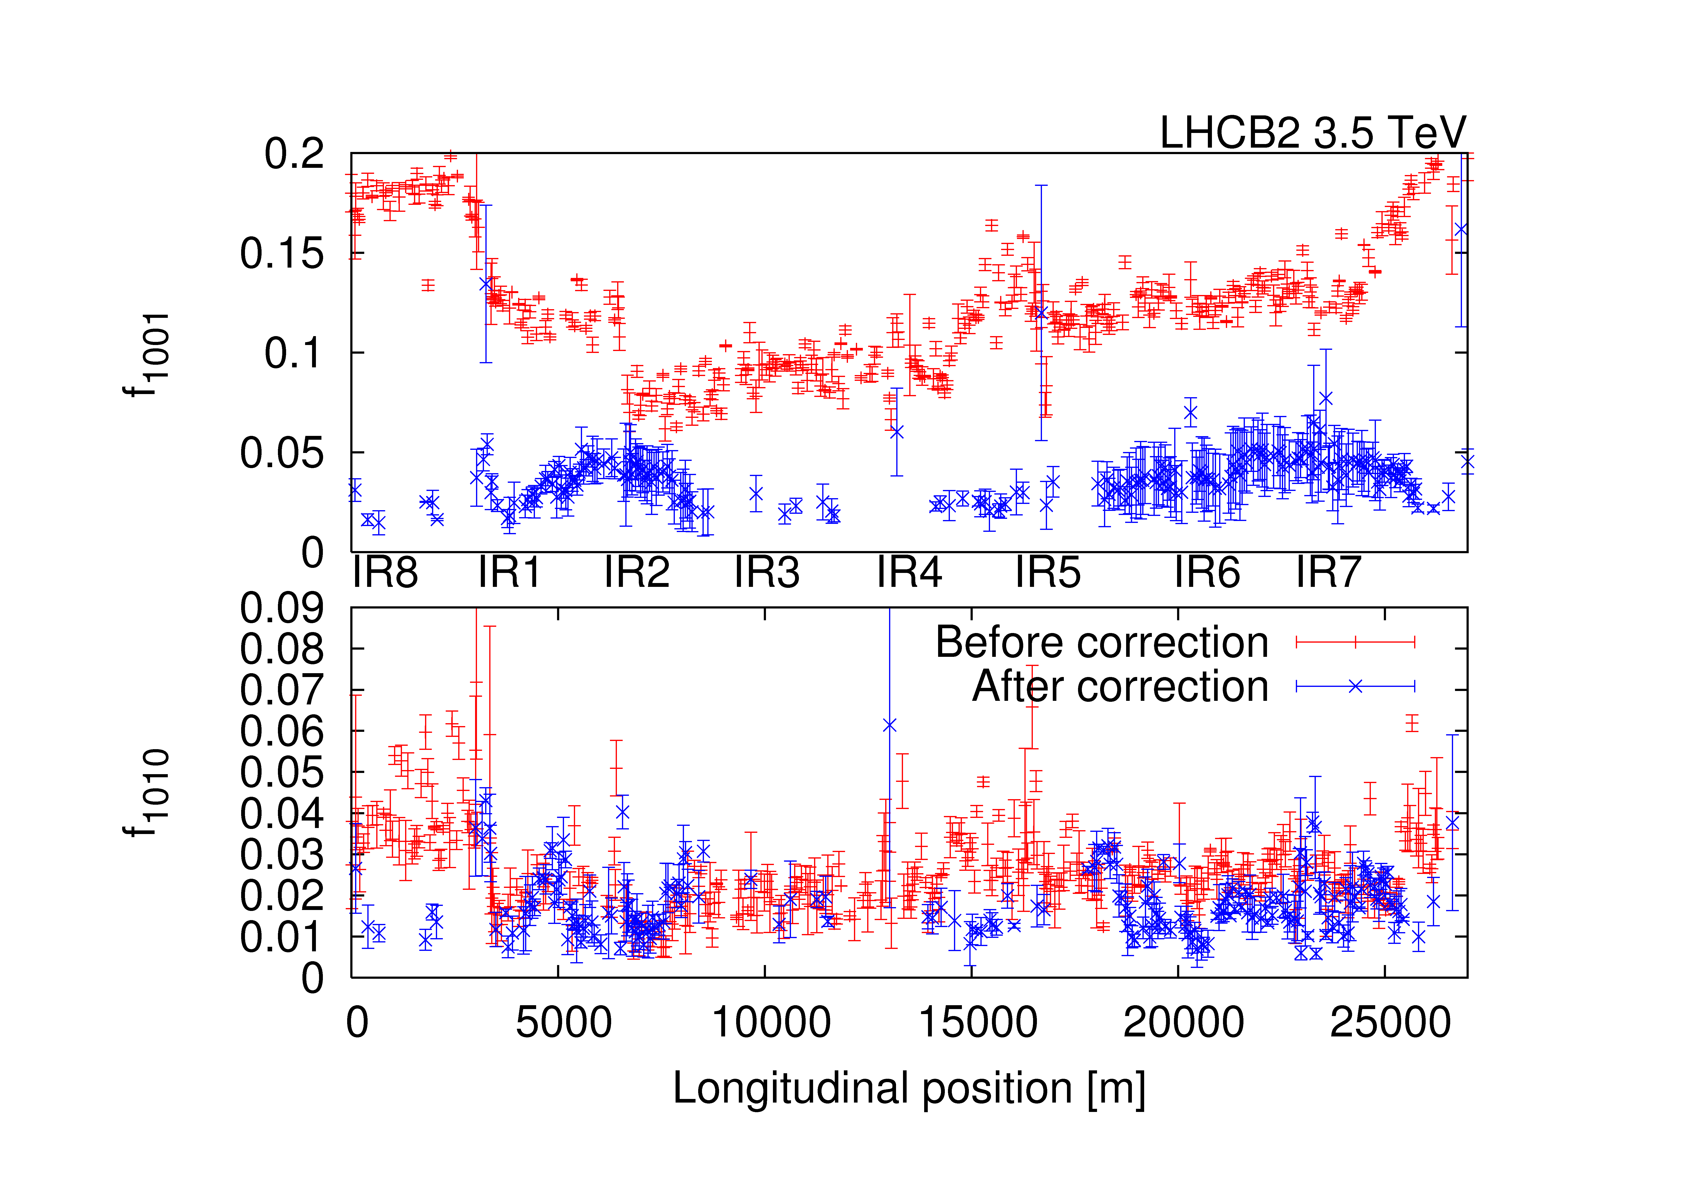
B2 coupling
Rogelio, Glenn, Ryoichi, Masamitsu, Rama

Slide 15
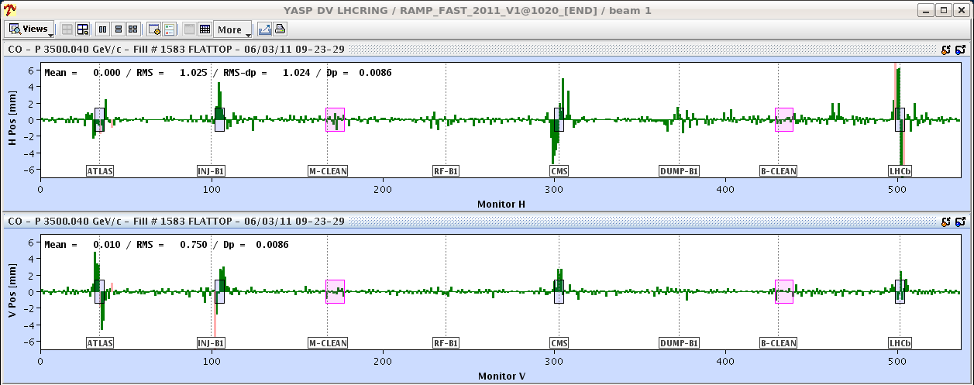
3.5 TeV Orbit High Intensity B1

Slide 16
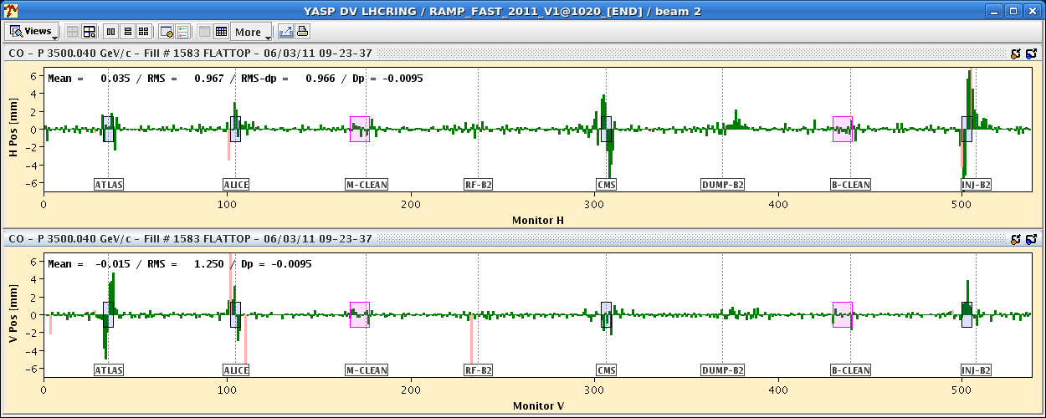
3.5 TeV Orbit High Intensity B2

Slide 17
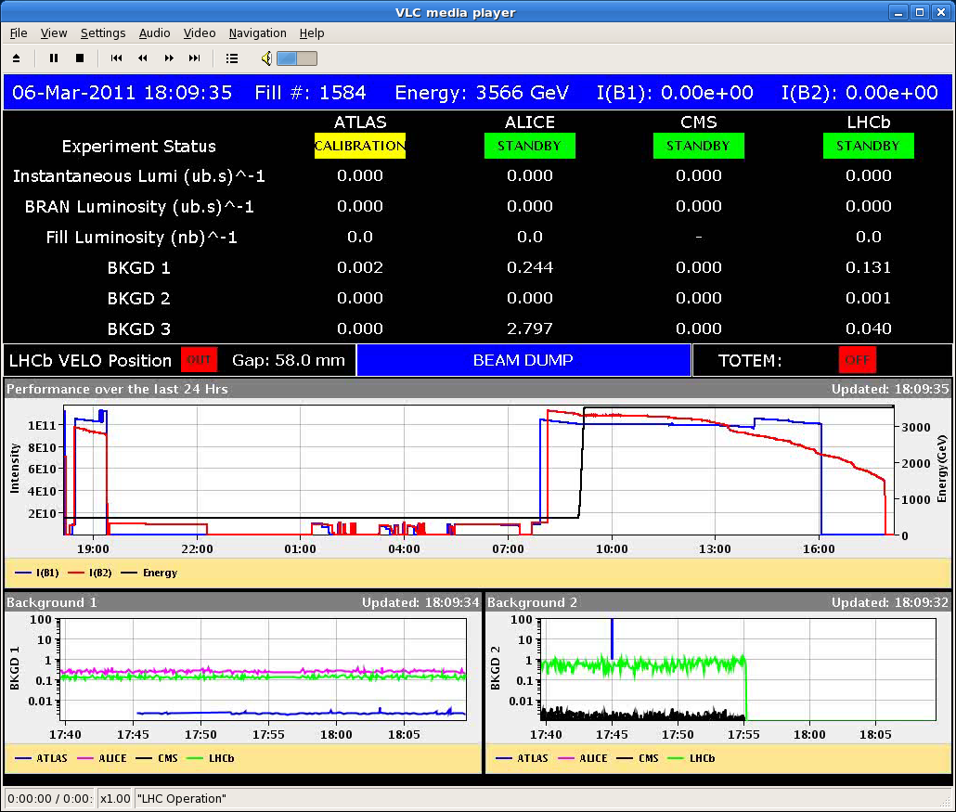
Shaving of Beam During Collimator Setup
Coll team

Slide 18
Tune Shift from Single Collimator?
B. Salvant and N. Mounet

Slide 19
IP beta values (Glenn Vanbavinckhove et al)
Beam1 (after local and global correction):
IP β*_{x} (ex) β*_{y}(ey)
IP1 1.68 (0.08) 1.62 (0.20)
IP5 1.53 (0.18) 1.45 (0.72)
Beam2 (after local correction, no global correction):
IP β*_{x} (ex) β*_{y}(ey)
IP1 1.43 (0.06) 1.62 (0.06)
IP5 1.64 (0.16) 1.48 (0.03)
11.7% imbalance
9.5% imbalance
To be refined and corrected with k-mod technique!

Slide 20
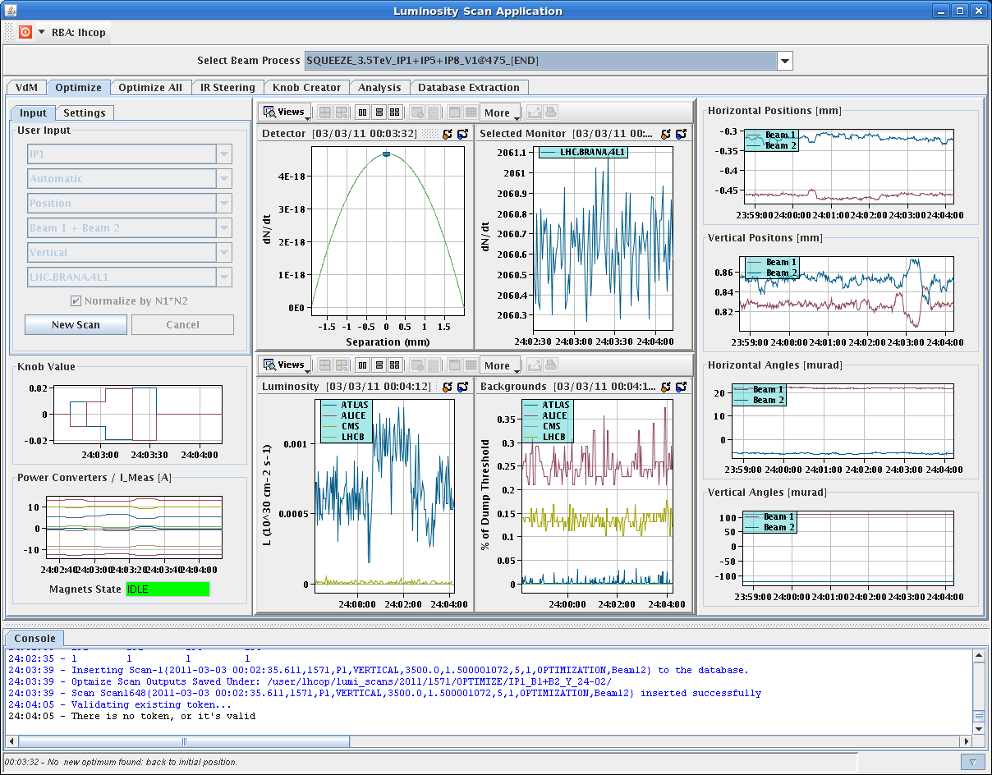
Beam-beam scan

Slide 21
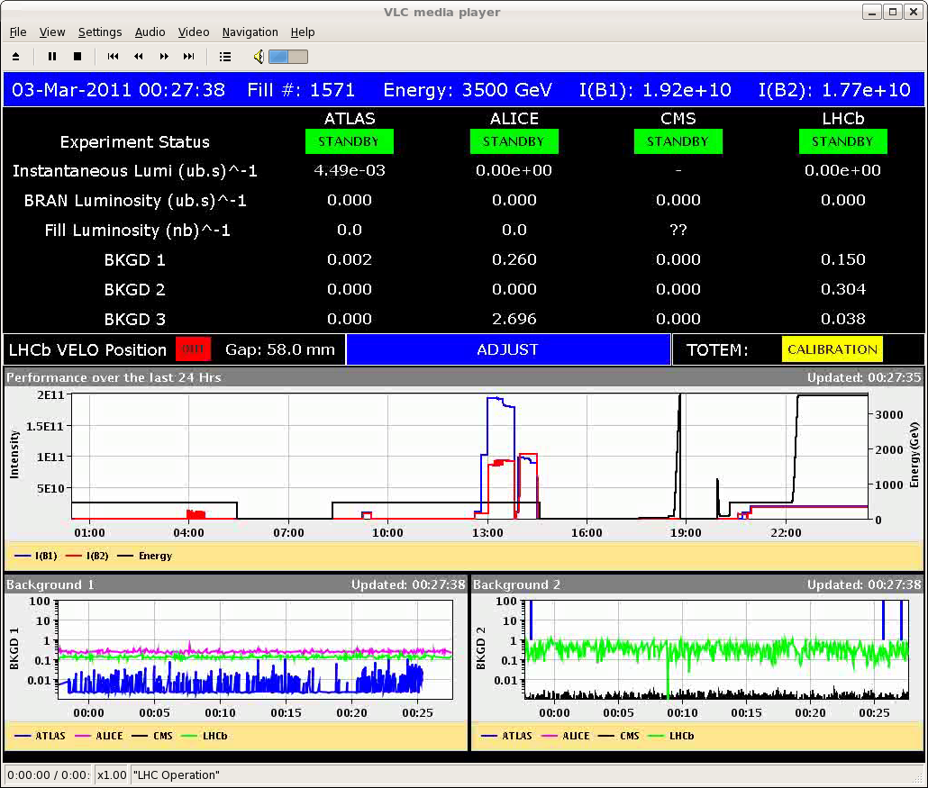
Tiny but First Luminosity…

Slide 22
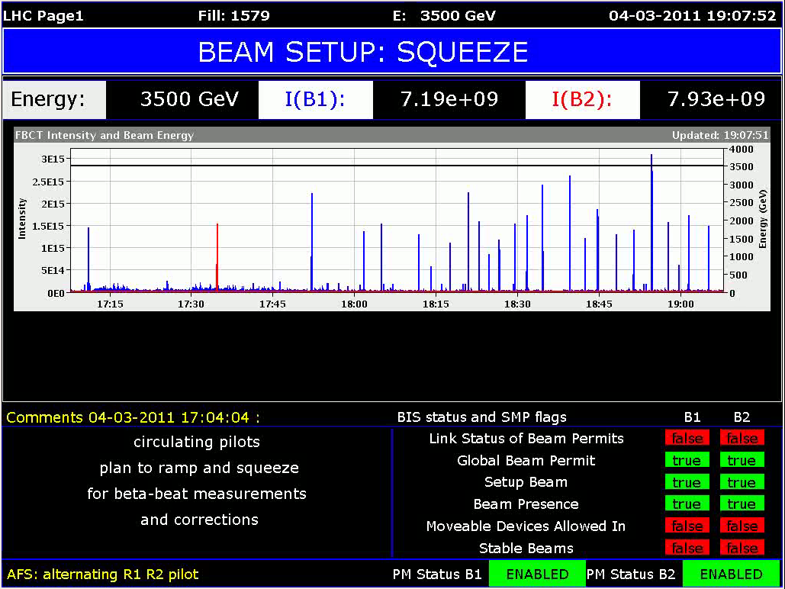
3e15 protons in?
Not yet…

Slide 23
Ahead...
Continue collimation & protection setup at flat top (before squeeze)…
About two more shifts…
Then qualification during night.
TCDQ setup and tests. Asynch dump tests.
Then: Ready for squeeze with nominal bunch…
Squeeze to 1.5 m but do not collide
Establish orbit
Set up 16 tertiary collimators
Qualification loss maps. Asynch dump tests.
Then: Ready for collision…
Collapse separation bump
Vernier scans and establish good “colliding” orbit
Set up 16 tertiary collimators
Qualification loss maps. Asynch dump tests.
~ Wed
~ Thu
~ Fri

Slide 24
Ahead...
Ramp with collimators
Requires completion of 3.5 TeV collimation setup
About 1-2 days for function generation
Preparation of multi-bunch injection
First multi-bunch injections today or tomorrow
Correction of β* with k-modulation technique
Measurement of aperture and BLM response in DS
~ Thu
ongoing

