Slide 1
Sunday 27th
AM: Transfer line/LHC matching
screens and dispersion
13:00 – midnight: Collimator set-up at 450 GeV continued
Interrupted by site wide glitch at 17:12:06
23:30 Lose cryo-maintain in P2. Access required.
B1 19 collimators setup (~19min per collimator)
B2 21 collimators setup (~17min per collimator)

Slide 2
Sun 27th – Mon 28th
Overnight
beam back by 04:00
Big losses on the MSI at the injection of B2 caused a beam dump + PM. MKE4 problem at the SPS under investigation
Losses at the end of TI8 caused a trip of a QPS controller that unfortunately required another access in the machine for a local reset.
After access, we started the pre-cycle at about 6h30.

Slide 3
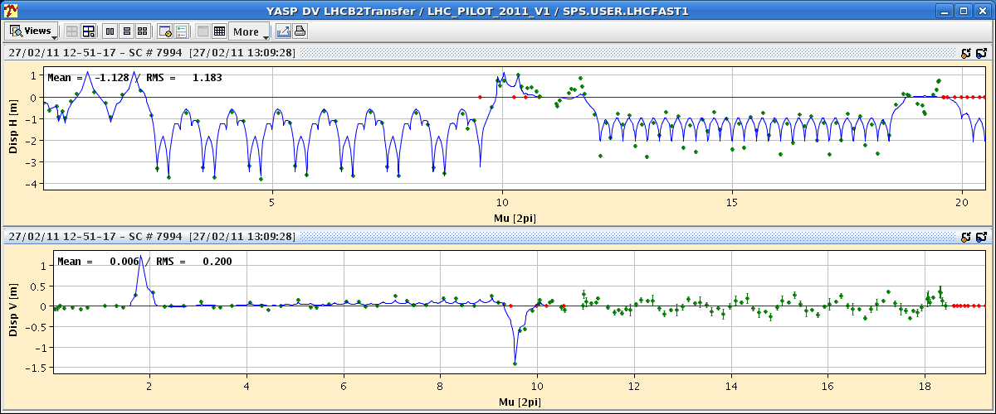
Dispersion TI8/LHC
Small oscillation from the beginning and then at the injection point a bigger one, up to 0.5 m. There also seems to be a coupling into the V plane.
Correction proposed
Kajetan & Verena

Slide 4
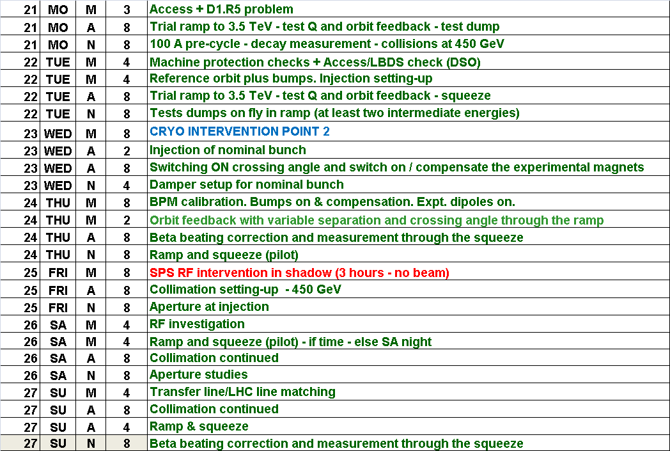
Week 8

Slide 5
450 GeV
Crossing angle and separation bumps on
non-closure knobbed
Separation, Xing angles and non-closure knobs trimmed into the ramp.
LHCb on with positive polarity
ALICE on with negative polarity
MBs pre-cycle down to 100 A
Decay well measured but dynamic correction still to be deployed

Slide 6
B2 Chroma Evolution at 450 GeV
Alick Macpherson

Slide 7
Ramp
Fast ramp in place
680 s for energy ramp
1020 s with plateau for decay
FIDEL a little off with snapback compensation, chromaticity swings handled with feed-forward
Tune feed forward – looks good
Tune feedback working well
Orbit feedback looks good, scaling of bumps in ramp now in place.

Slide 8
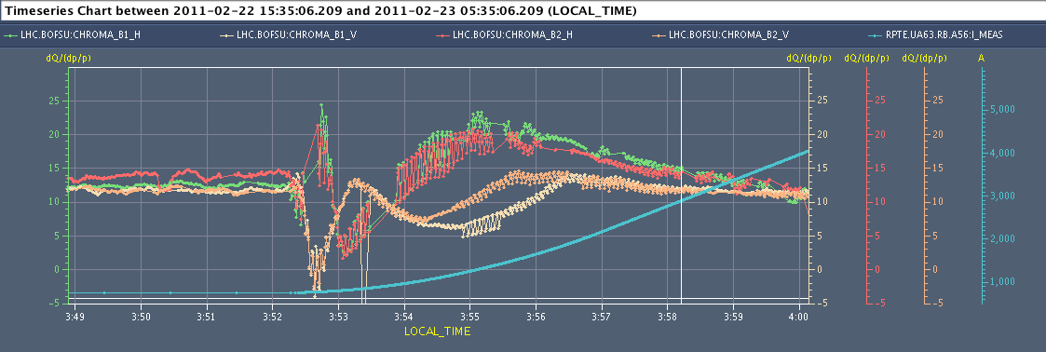
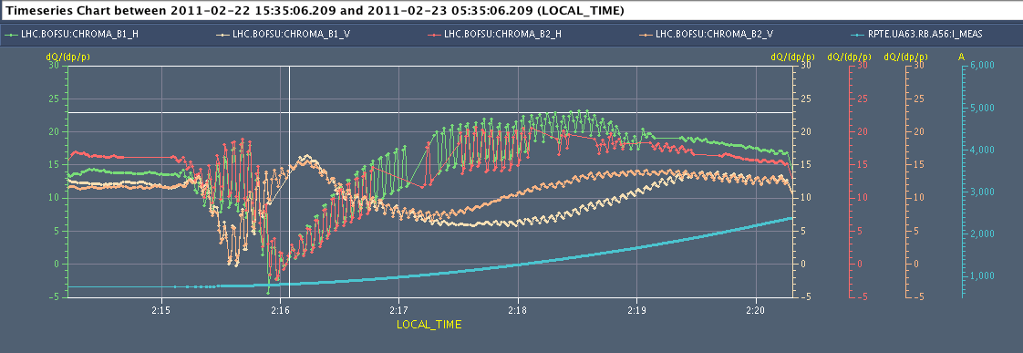
Time from RB@100A to Ramp start = 60min
Q’H
Q’V
Time from RB@100A to Ramp start = 129min
Q’H
Q’V

Slide 9
Squeeze
New squeeze to 1.5/10/1.5/3.0 in place
475 s
Pilots B1/B2 successfully through without stopping
Tune, chromaticity, coupling corrected
Coupling: both empirical global and calculated local
Orbit
bumps constant in squeeze
issue with strange features creeping in – particularly in LHCb
tracked down to change in bump shape with changing optics
solution under discussion

Slide 10
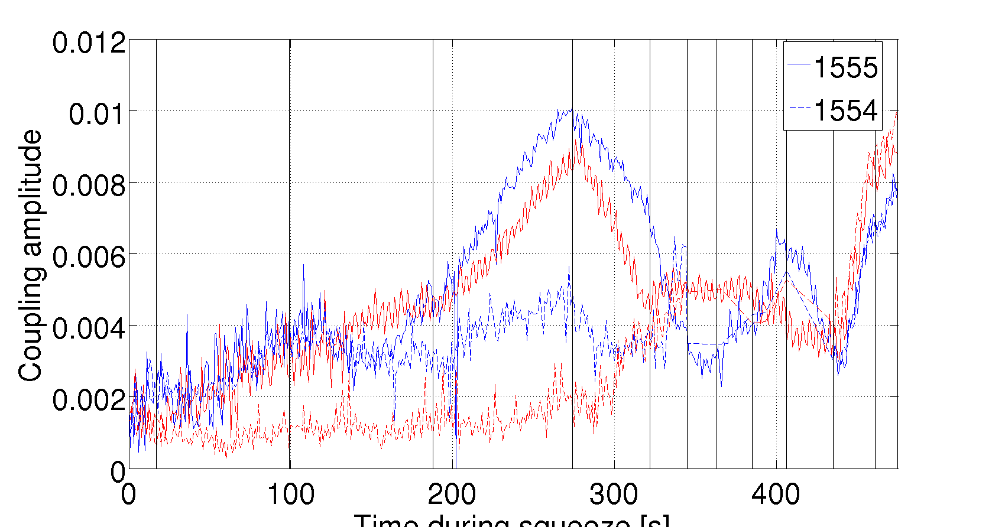
Coupling in squeeze
Xavier Buffet

Slide 11
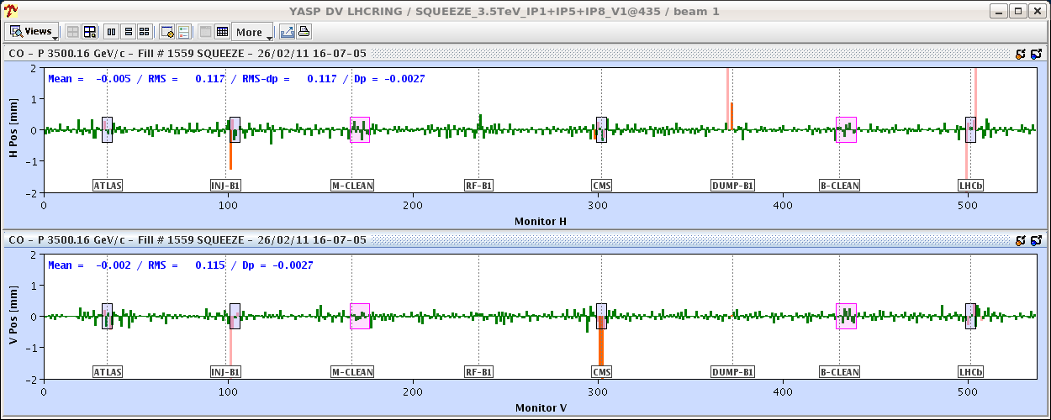
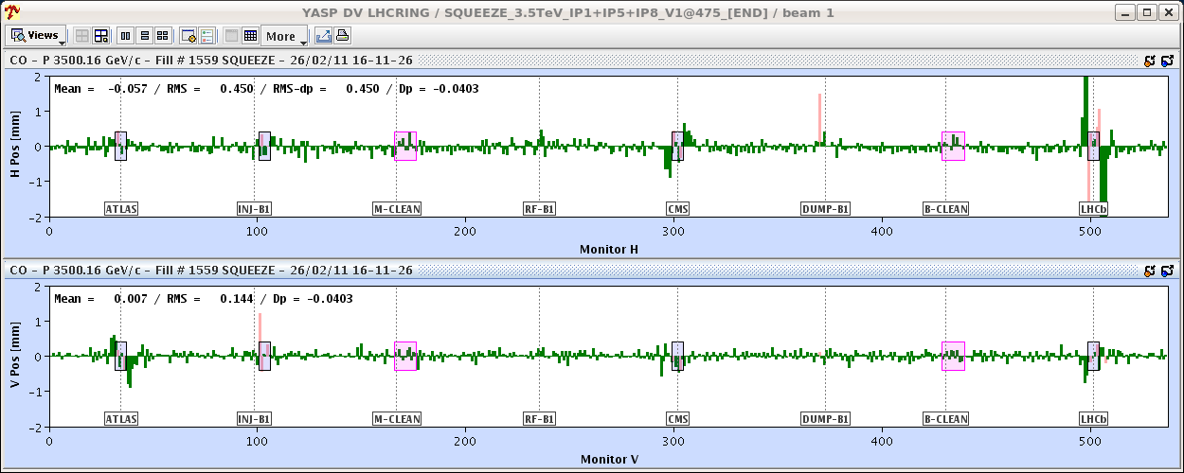
Saturday afternoon
Up ramp into squeeze
Step through looking closely at the orbit (Jorg & Kajetan)
At 1.5 m with correct 1.5 m bump reference.
The same real orbit as in the previous entry, but this time compared to the 10/11 m reference.

Slide 12
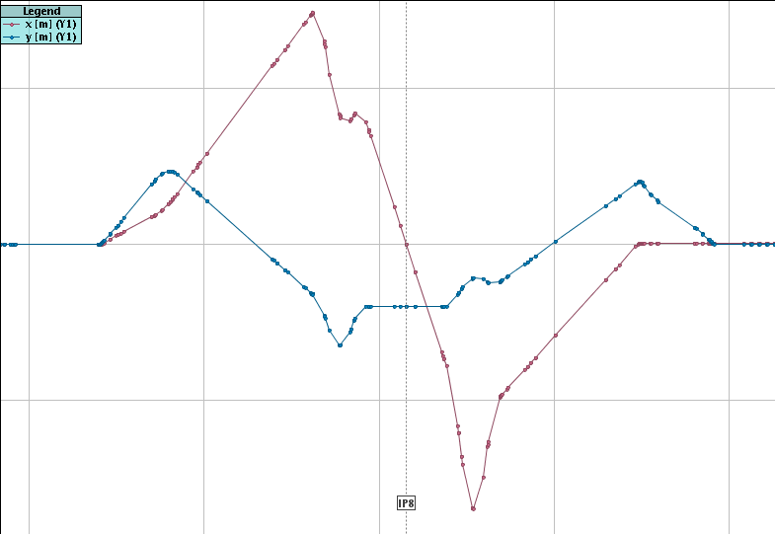
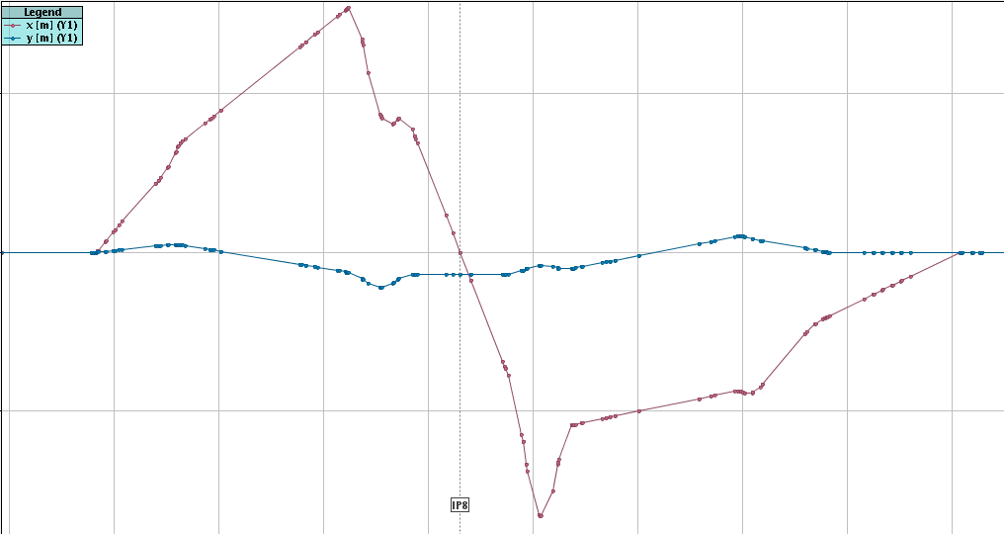
Crossing angle bump shape change
Kajetan

Slide 13
Orbit in squeeze
The orbit issue that we had in IR8 (IR1/5 to a reduced extend) is understood to be a large change in the shape of the Xing angle bump in IR8 (>> than in IR1/5) that we had unfortunately not checked.
The difference in BPM readings reaches ~5 mm (!!!) around Q4/5, and the change is most pronounced between 10 and 6 m.
The present reference strategy of the OFB was to give a constant reference in the squeeze, which clearly does not work.
Alternative strategies enumerated…

Slide 14
Optics
Beta beating measured at 450 GeV, flat-top and through the squeeze
Corrections calculated, deployed and optics re-measured
Local coupling measured and corrections applied
Local corrections have made an excellent job all the way between 3.5m and 1.5m
All peak-beatings after correction are between 15% and 20%
R. Tomas, C. Alabau, R. Calaga, R. Miyamoto, F. Schmidt,
G. Vanbavinckhove

Slide 15
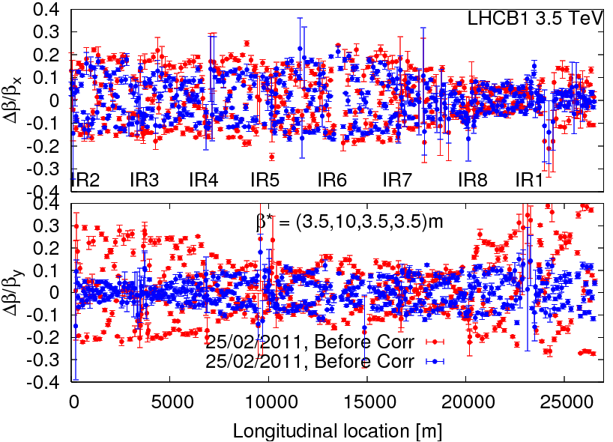
beating correction: beam 1 3.5 m

Slide 16
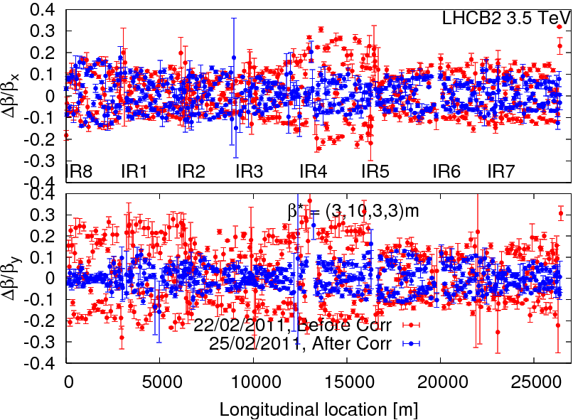
beating correction: beam 2 3.0 m

Slide 17
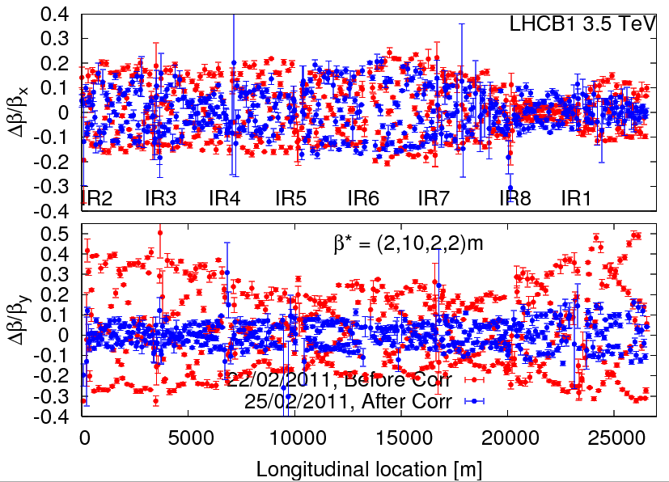
beating correction: beam 1 2.0 m

Slide 18
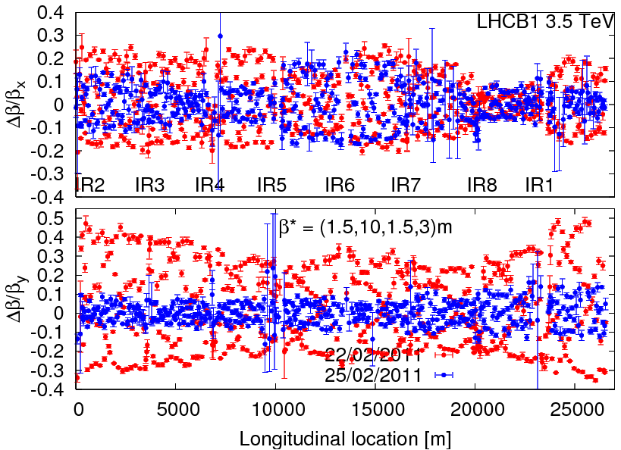
beating correction: beam 1 1.5 m

Slide 19
Aperture measurements
Global measurement…
First rough estimate of global aperture at injection (detailed analysis to follow):
Must be reviewed by folding in beam loss per measurement. Seem to have higher BLM response (factor 1.5-3) at collimator compared to magnet (different result from last year) -> we can lose a sigma or so from this. .
 | 2011 | 2010
B1H Q6R2 | ~12.0 | ~12.5
B1V Q4L6 | ~13.0 | ~13.5
B2H Q5R6 | ~12.5 | ~14.0
B2V Q4R6 | ~13.0 | ~13.0
Ralph Assmann, Stefano Redaelli, Gabriel Muller, Roderick Bruce, Daniel Wollmann

Slide 20
Aperture in triplets
Performed local scans at the triplets for both beams, in the crossing planes. Preliminarily, we found the following aperture values:
 |  |  | Aperture
IR1 | B1 | V | 16.1
IR1 | B2 | V | 15.0
IR5 | B1 | H | 15.4
IR5 | B2 | H | 16.9
IP2 | B1 | V | 14.5
IP2 | B2 | V | 15.0
IP8 | B1 | H | 16.0
IP8 | B2 | H | 16.0
Ralph Assmann, Stefano Redaelli, Gabriel Muller, Roderick Bruce, Daniel Wollmann

Slide 21
Collimation setup – intermediate summary
R.W. Assmann, M. Cauchi, A. Rossi, G. Valentino, D. Wollmann
Setup status @450GeV (preliminary):
B1: all horz. and vertical and 2 skew collimators were aligned so far. 7 skew secondary collimators to be done.
The measured and expected beam sizes agreed within about 30%. TCSG.B5R3.B1 (140%), TCTH.4L2.B1 (137%), TDI.4L2.B1 (182%) and TCDQ (64%) need to be re-visited.
All B2 collimators aligned.
The Measured and expected beam sizes agreed within ~30%. The TCSG.A5L3.B2 (174%), TCP.6R3.B2 (167%), TDI (138%) and TCDQ (50%) need to be re-adressed.
Settings were loaded into the BP: CollimatorBP-450GeV_V1@1
To be continued (7 skew collimators in B1)...

Slide 22
Other
Single bunch damper setup completed for both beams
BPM
calibration, temperature compensation
polarity checks
95% of test of beam dump/injection tests without beam completed
Access to Beam dump OK. DSO tests are now considered to be completed successfully

Slide 23
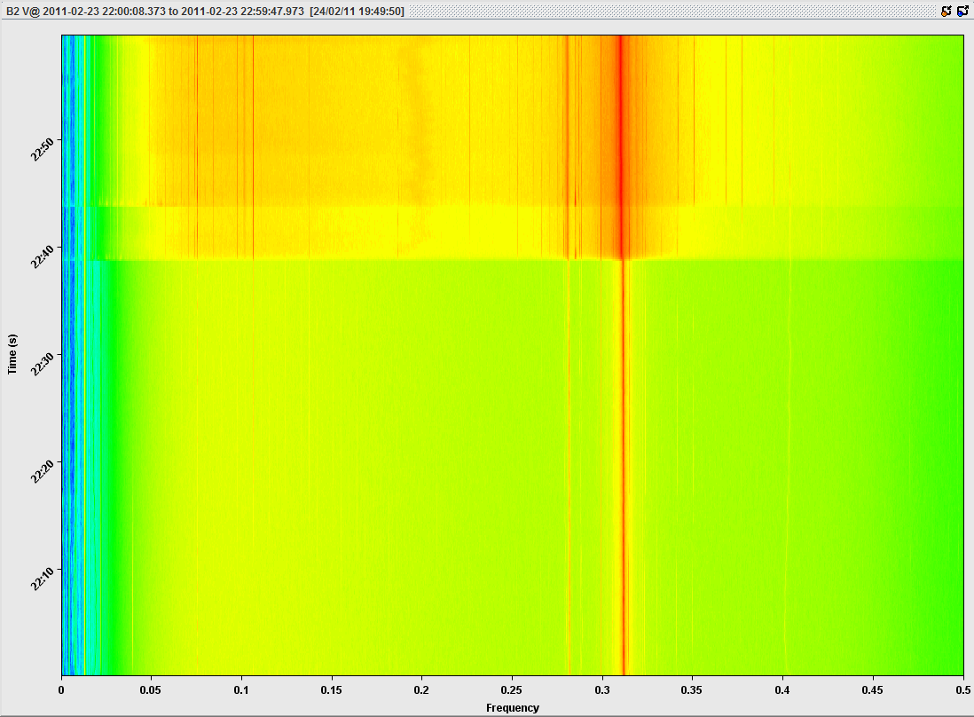
Premature rumours of hump’s disapperance

Slide 24
Availability excellent…

Slide 26
Incoming this week
Finish collimation set-up at 450 GeV
Injection and dump protection set-up
Validation of above
Ramp above
Beating though squeeze revisited, test collisions
RF - Phasing Cavities plus Cavity Sum Calibration
Transverse damper set-up (bunch trains, cleaning)
Coordination: Ralph Assmann & Bernhard Holzer

Slide 27
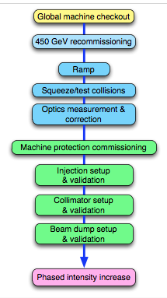
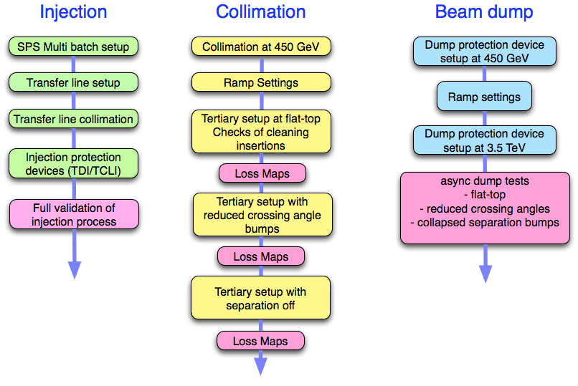
Re-commissioning continued

Slide 28
Conclusions
Mechanics of pre-cycle, ramp and squeeze in good shape
Base parameters under control
Optics measured and corrected through the cycle.
Instrumentation re-commissioned and in good shape
Feedbacks operational, features being addressed
Collimation set-up progressing well…

