Slide 1
Friday
Access in shadow of SPS interventions (RF, extraction septa power supply)
Lead into problem on the cooling of the extraction septa in SPS
Both beams back around 13:50
14:35 Start ramp
no problem, scaling of bumps in ramp looked good
Squeeze to 1.5 m in one go
Both beams – no losses
475 s
However still issues with orbit, coupling…

Slide 2
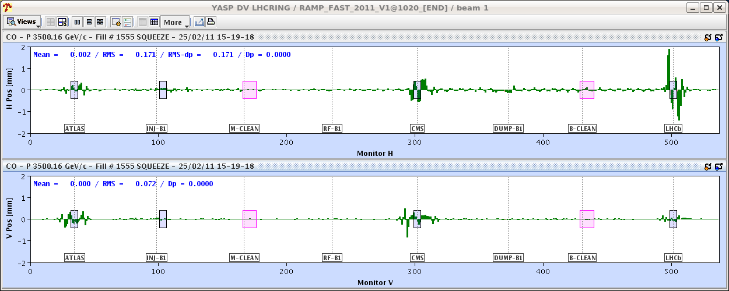
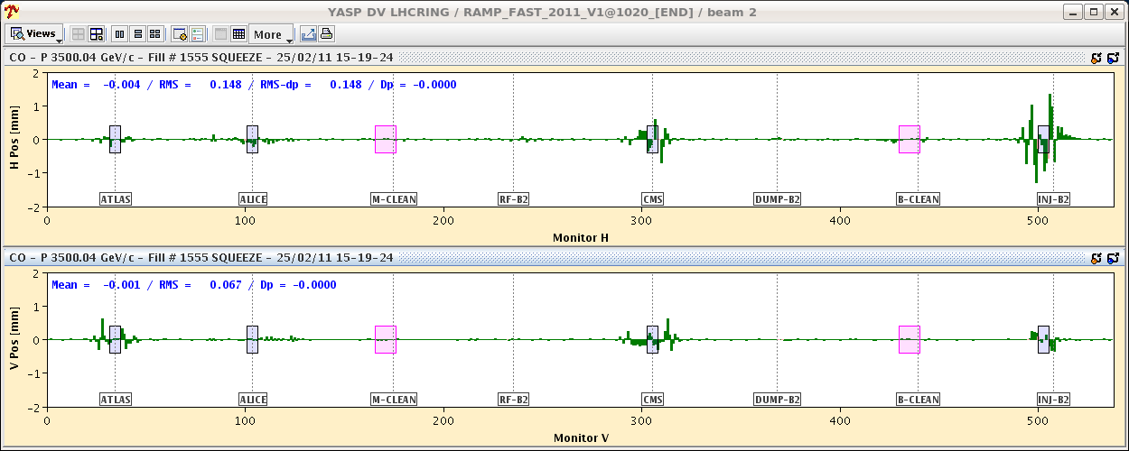
Orbit: squeeze start minus end

Slide 3
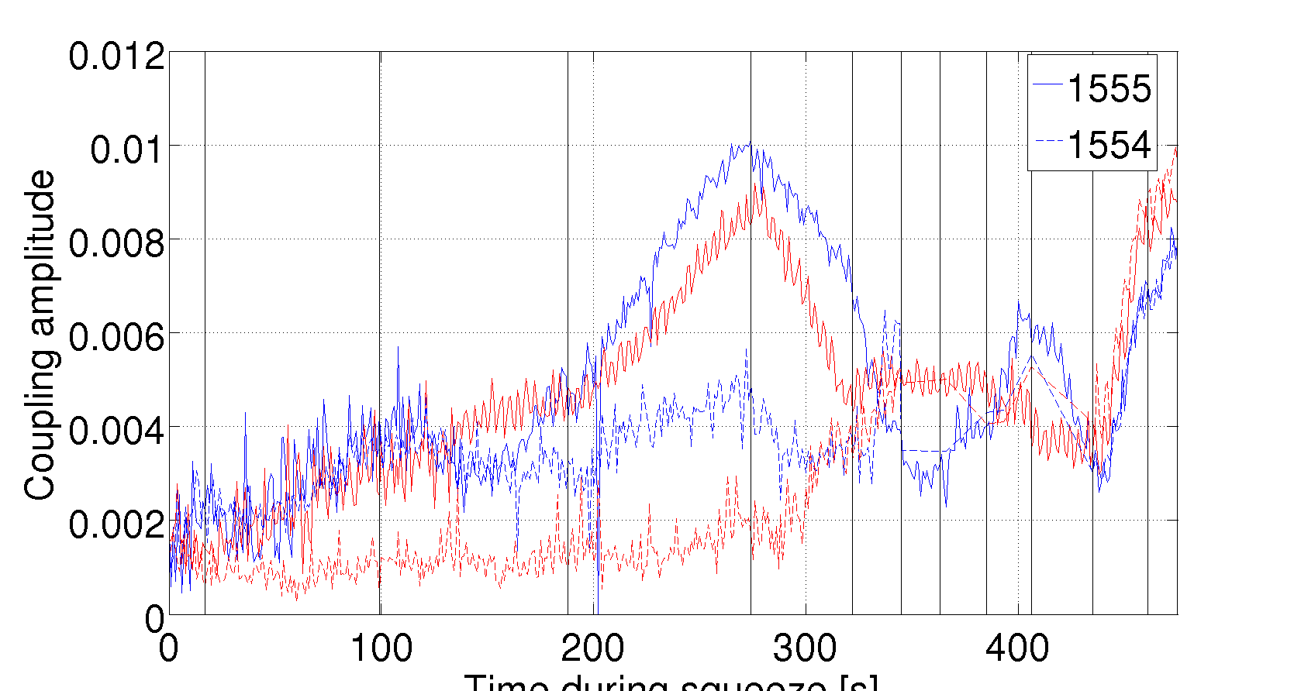
Coupling
Xavier Buffet

Slide 4
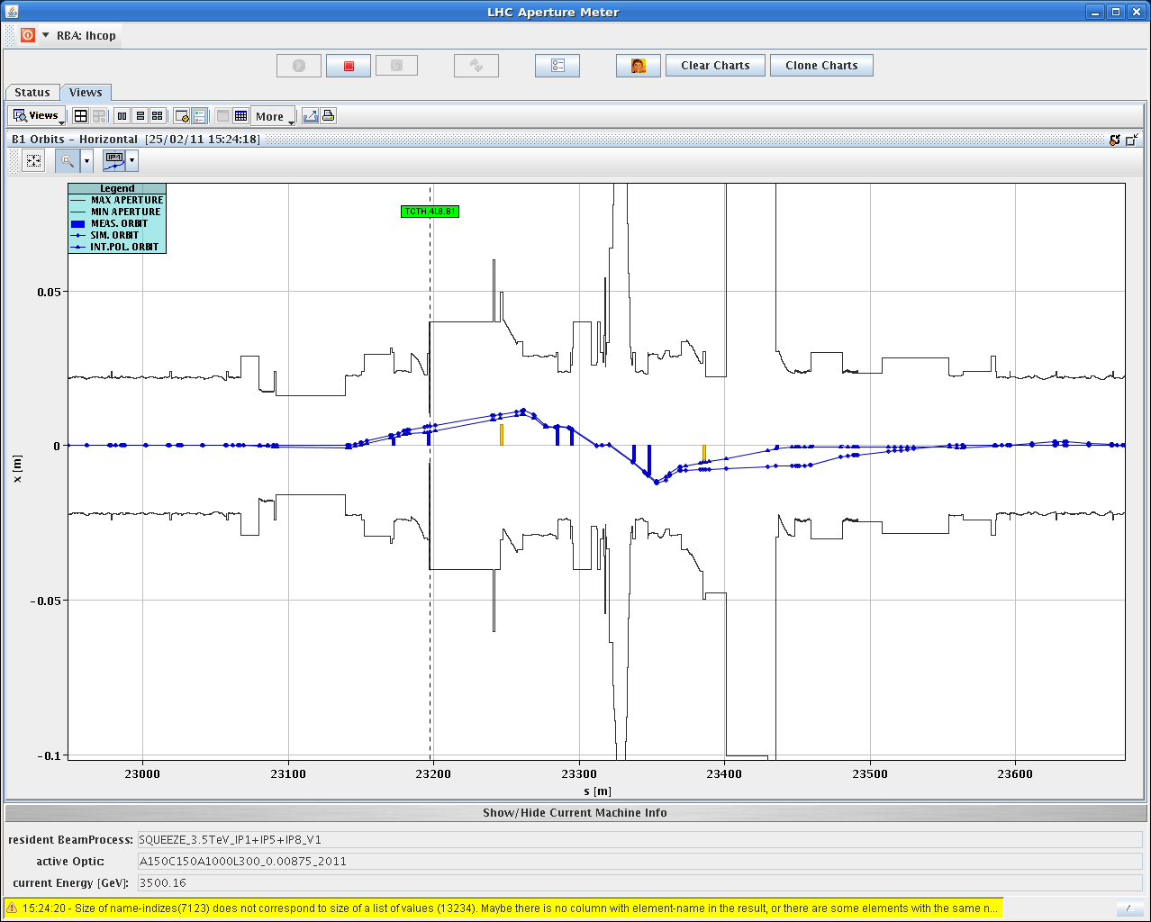
Aperture in IR8

Slide 5
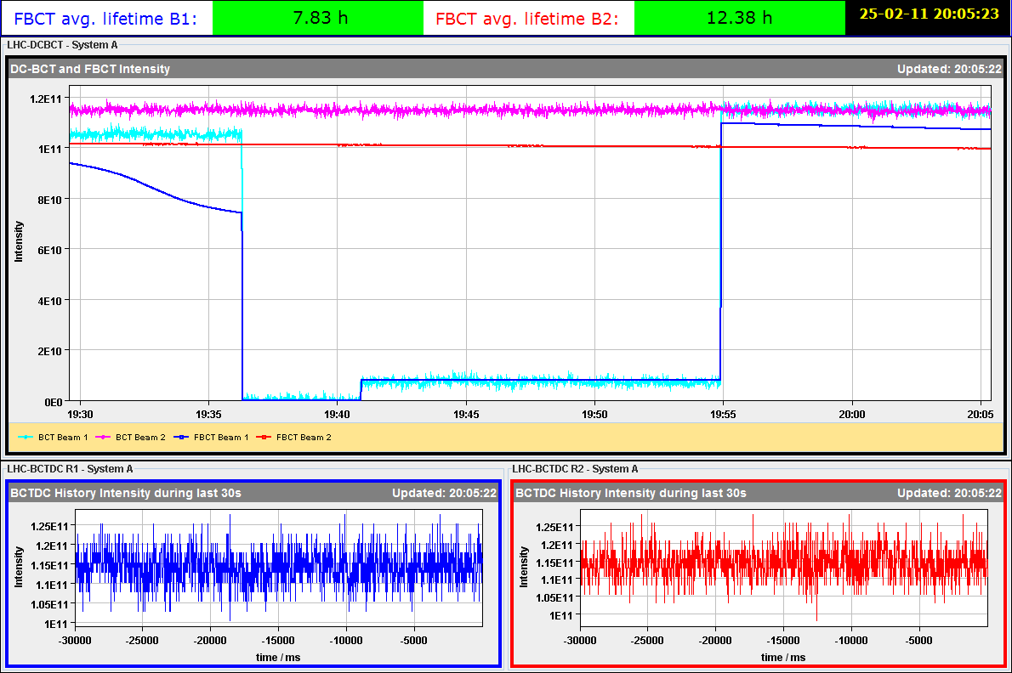
Collimation setup at injection
17:35 start, correct to reference orbit
Problem with de-bunching with beam
Called Philippe Baudrenghien

Slide 7
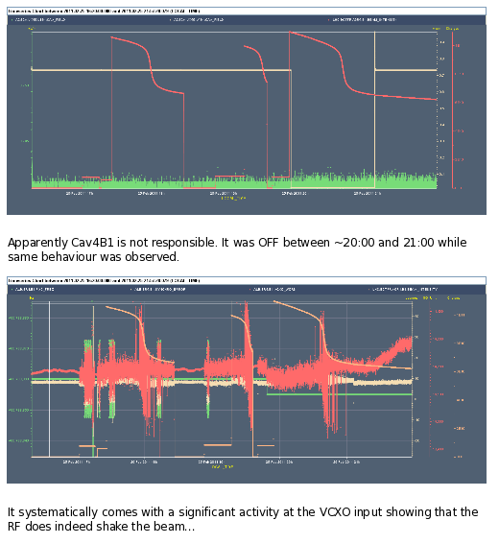

Slide 8
Collimation summary
Could only start at 19h18: roughly 4 hours.
Beam conditions need improvement. Setup strongly affected by de-bunched beam, especially for beam1. At the end, 45% of intensity was un-bunched for beam1 and 30% for beam2.
Large collimator setup errors at high dispersion points as a result.
Completed:
Beam1 => 6 collimators, several or all to be repeated
Beam2 => 11 collimators, a few to be repeated.
Before continuing tomorrow the problem of debunching should be addressed.

Slide 9
Overnight – aperture measurements
Stefano Redaelli, Gabriel Muller, Roderick Bruce
Global measurement…
First rough estimate of global aperture at injection (detailed analysis to follow): ----- 2011 ------- --------2010------ B1H Q6R2 ~12.0 sigma ~12.5 sigma Q6R2 B1V Q4L6 ~13.0 sigma ~13.5 sigma Q4L6 B2H Q5R6 ~12.5 sigma ~14.0 sigma Q5R6 B2V Q4R6 ~13.0 sigma ~13.0 sigma Q4R6 Must be reviewed by folding in beam loss per measurement. Seem to have higher BLM response (factor 1.5-3) at collimator compared to magnet (different result from last year) -> we can lose a sigma or so from this. .

Slide 10
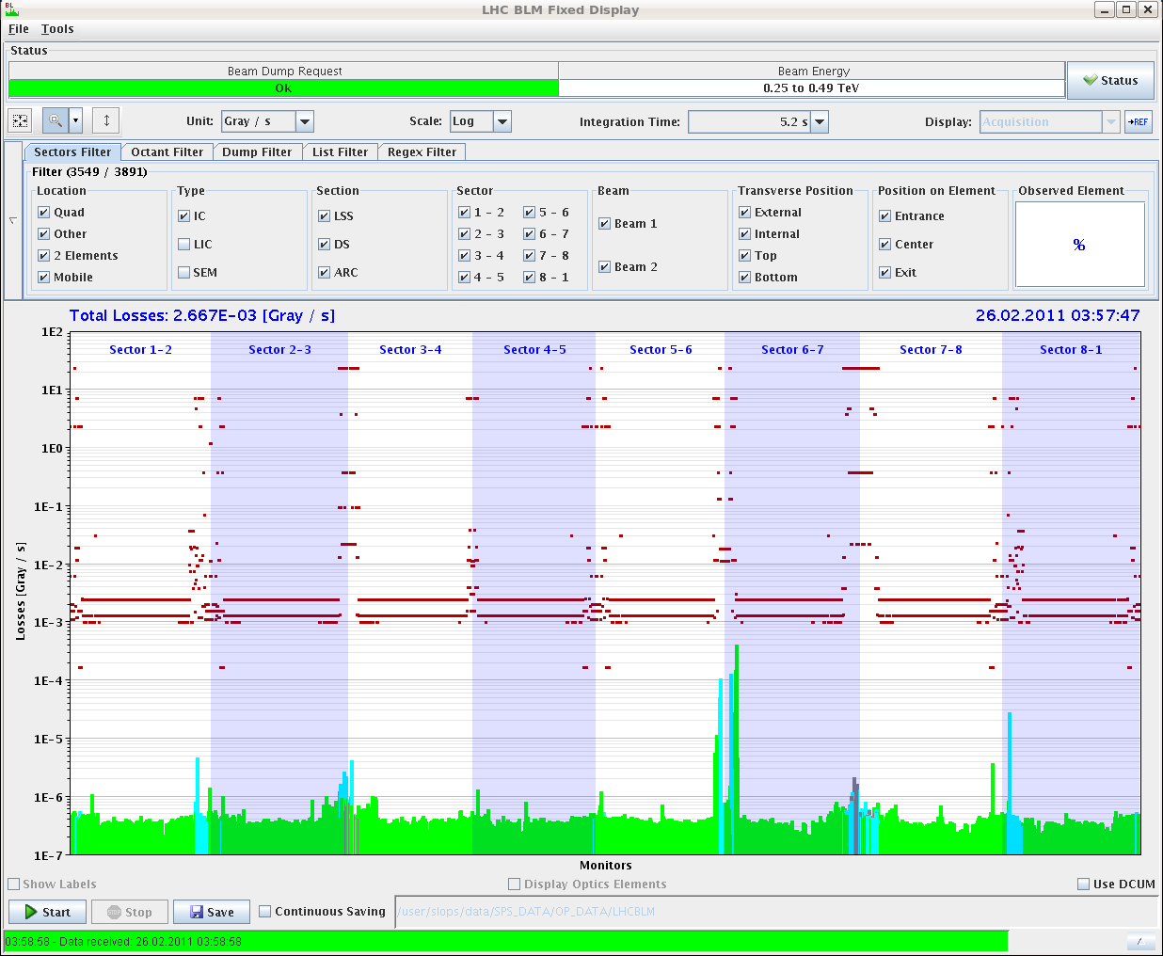
Consistent results compared to 2010. Same bottlenecks. Maybe some slight indication of aperture loss (0.5 - 2 sigma). To be analyzed in detail

Slide 11
B2H with collimators open Q5R6 3.93e-4 TCPH 0.0

Slide 12
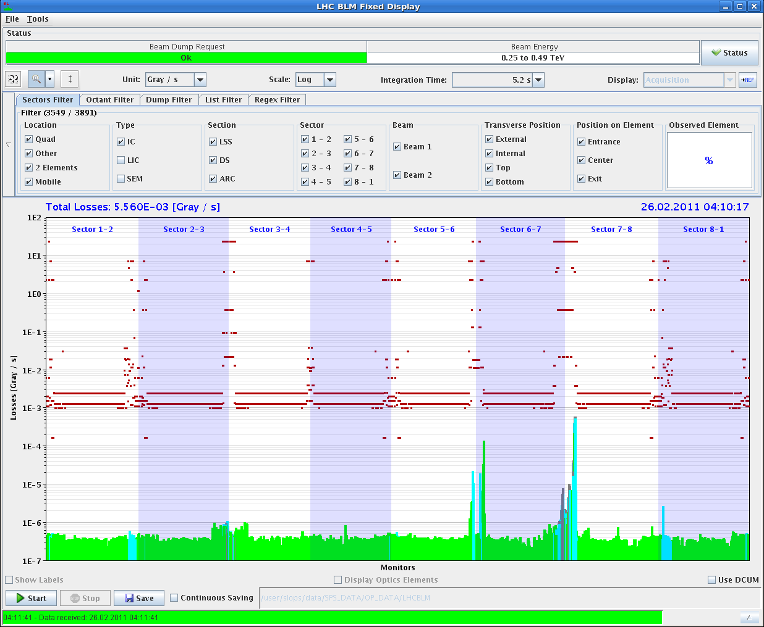
B2H with TCPH at 12 sigma Q5R6 1.35e-4 TCPH 5.16e-4

Slide 13
Local aperture
Preliminary estimate:
IR5 triplet L has aperture: 12 sigma + 4.4 mm
Taking the beam size (1.3mm) the aperture is: 15.4 sigma
Not bad.
IR5 triplet R has aperture: 12.5 sigma + 5.7 mm
Taking the beam size (1.3mm) the aperture is: 16.9 sigma
Not bad at all.
IR1 triplet R (B2-v) has aperture: 13.0 sigma + 2.5 mm
Taking the beam size (1.25mm) the aperture is: 15.0 sigma
IR1 triplet R (B1-v) has aperture: 13.0 sigma + 3.9 mm
Taking the beam size (1.25mm) the aperture is: 16.1 sigma.

Slide 14
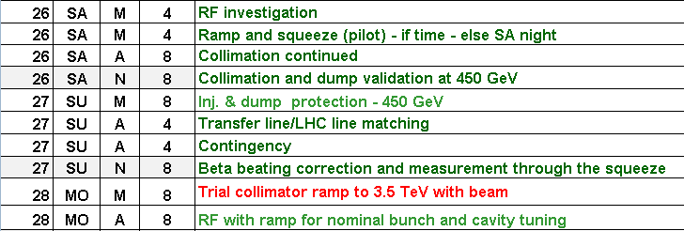
Incoming

