Slide 1
Summary of BPM tests:
1) orbit reponse measurements indicated no obvious BPM polarity errors (Kajetan)
2) confirmed consistency between synchronous and IIR-based orbit estimates (sync. being used for BPMS monitors in the IR
3) temperature compensation reduces effects by about a factor 3.
4) calibration sequencer task was verified and work as specified (Reyes et al.)
N.B. The residual temperature related orbit error is typically better than 100 um for an ambient temperature change of 3 degree Celsius. It's highly recommended to run the calibration sequencer task regularly to compensate for day-to-day temperature variations!

Slide 2
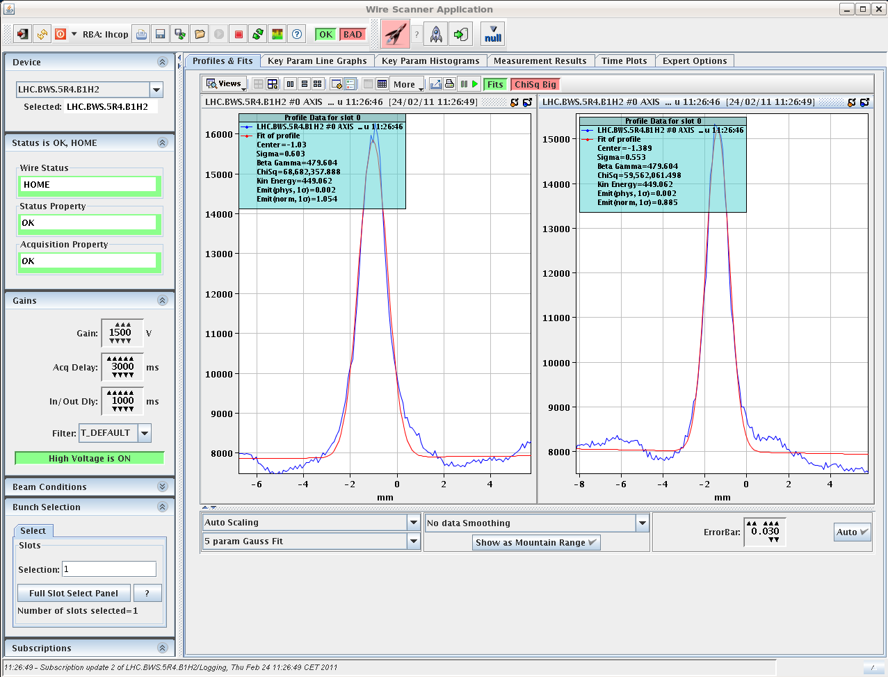
Wire scanner

Slide 3
Thursday afternoon - Orbit
Crossing angle on in IP2
all bumps now on
Separation, Xing angles and non-closure knobs trimmed into the ramp.
LHCb on with positive polarity
ALICE on with negative polarity.
First test of scaling bumps in ramp
Separation & Crossing-angle
hiccup with LHCb (250 demanded, 200 microrad limit)
New reference
LOW INT REF at 3.5 TeV from high int ref at injection, scaling of sep and Xing."
Bumps trimmed constant through the squeeze

Slide 4
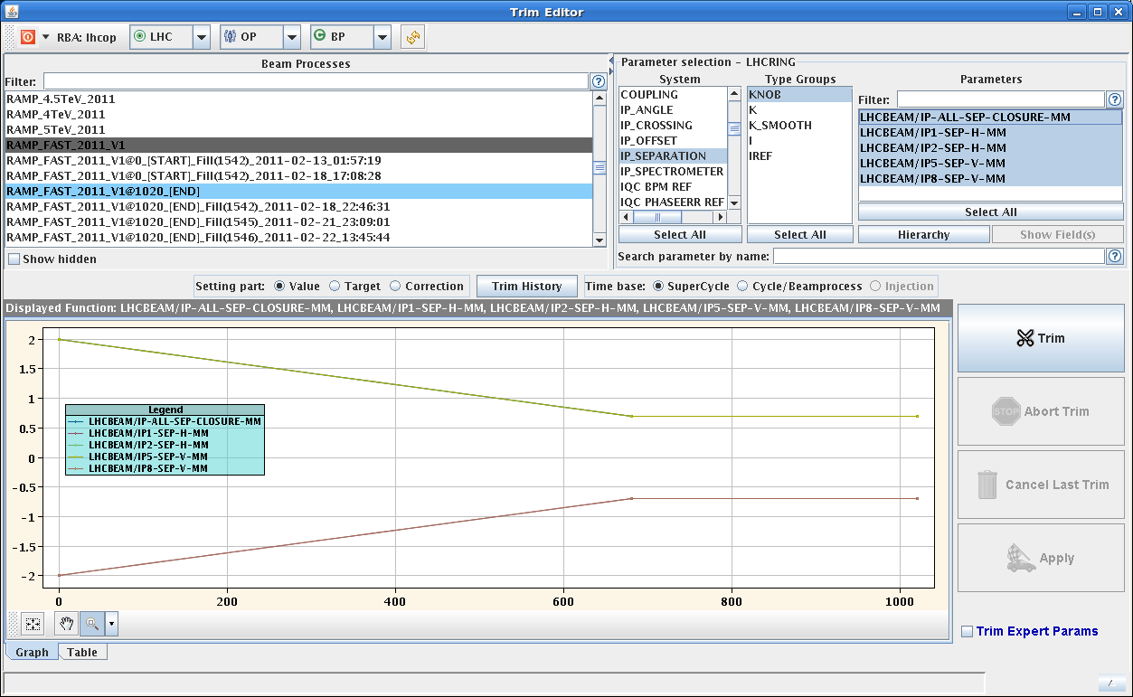
Separation bumps in ramp

Slide 5
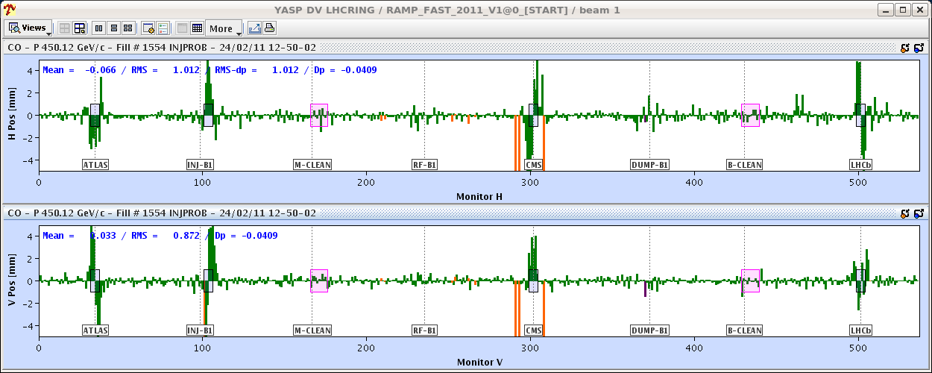
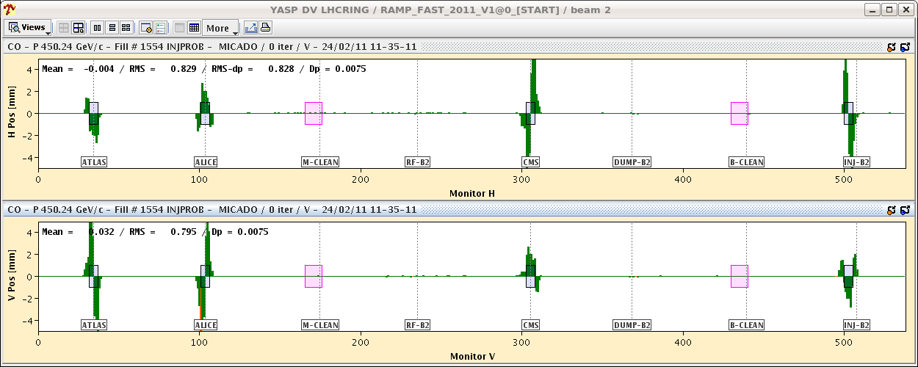

Slide 6
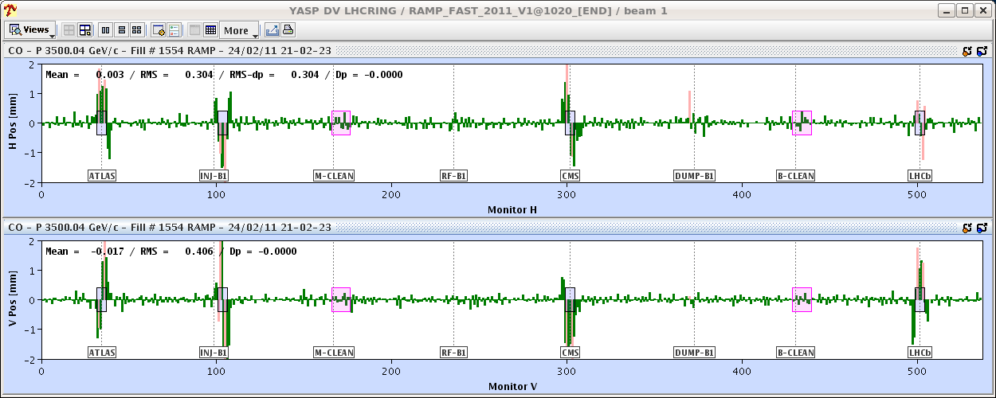
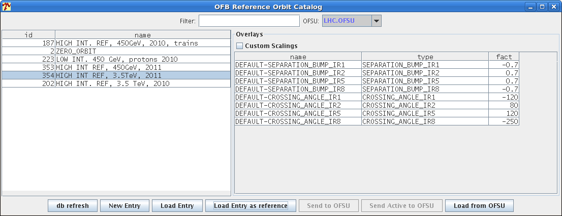
3.5 TeV

Slide 7
14:00
Beam dumped because of a glitch in IP6 but the FMCM RD1.LR5 opened the loop
plus problems in SPS

Slide 8
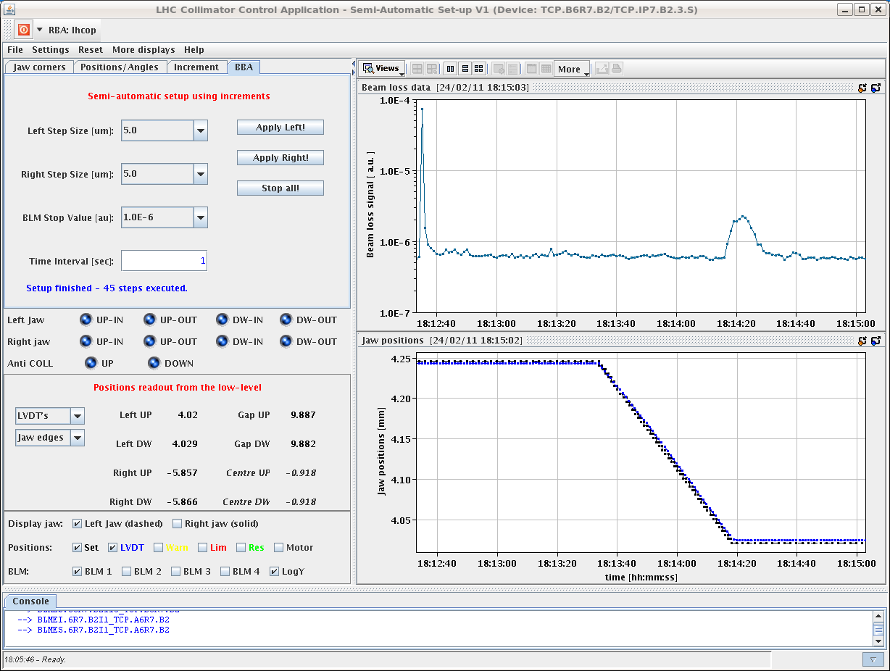
Test of semi-automatic collimator setup
Move in TCP in IR7 for B2
Speed of movement: 0.005 mm/s
BLM threshold value: 1e-6 Gy/s
Routine worked well. Movement of jaw stopped automatically after BLM threshold was reached. See plots in attachment.
Losses continue for a few seconds after jaw is stopped -> to be studied.

Slide 9
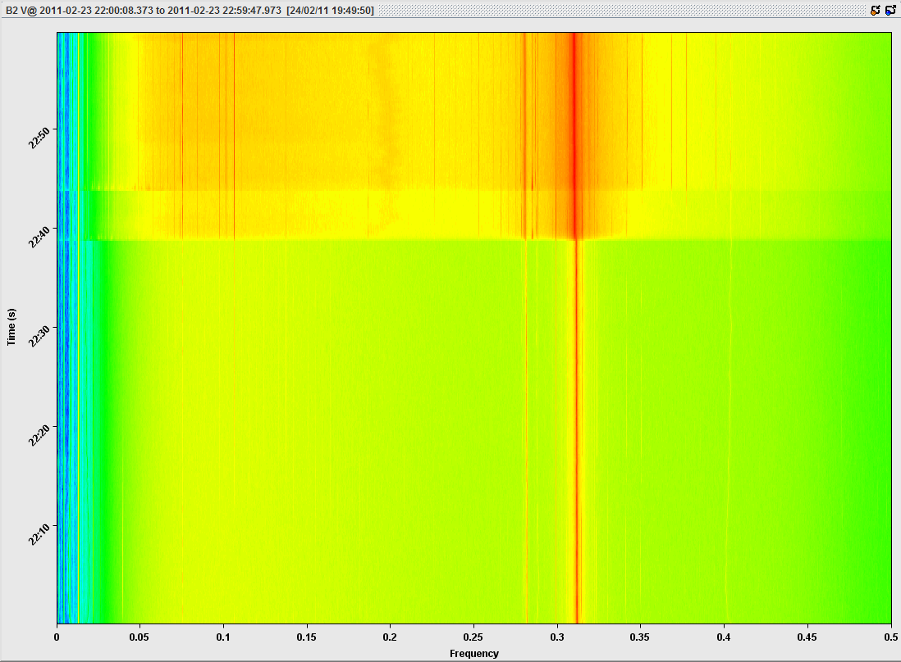
Premature rumours of hump’s disapperance

Slide 10
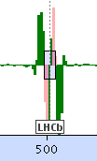
21:00 Thursday – into squeeze
Change of tune reference
We are at 7m. Stange structure built up in LHCb.
Structure could be corrected with (big) kicks taking into account the common correctors
3.5 m OK – orbit not perfect
coupling, chromaticity, beating correction
Orbits at 2 m. Structures growing in other points

Slide 11
Trouble at mill
The orbit feedback switched off, just after having introduced crazy corrections of the orbit. We apply corrections with SVD by hand.
Corrected orbit with SVD and switched feedback back on. Have to incorporate this unfortunately...
...at 1.5 m with both beams.
Investigations continue off-line

Slide 12
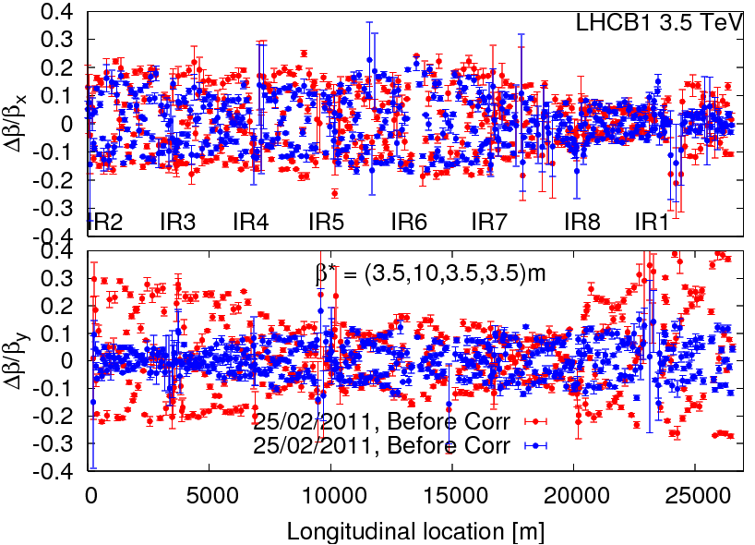
beating correction: beam 1 3.5 m

Slide 13
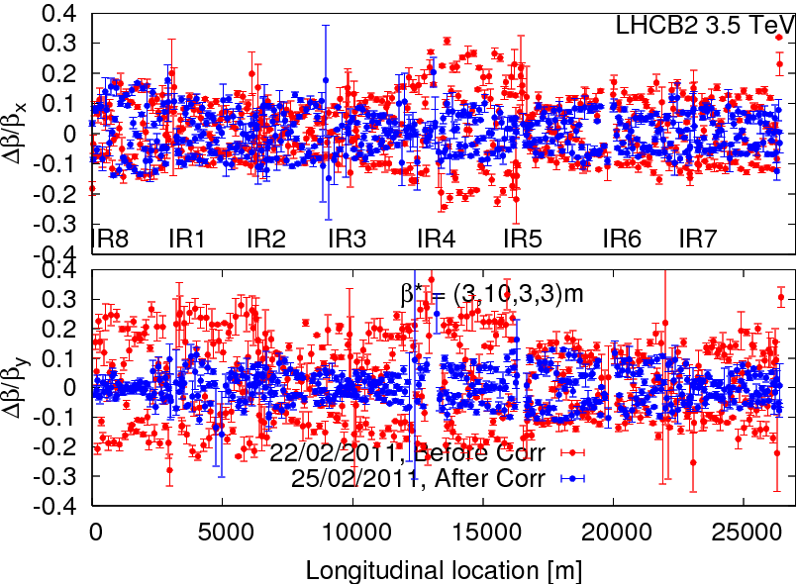
beating correction: beam 2 3.0 m

Slide 14
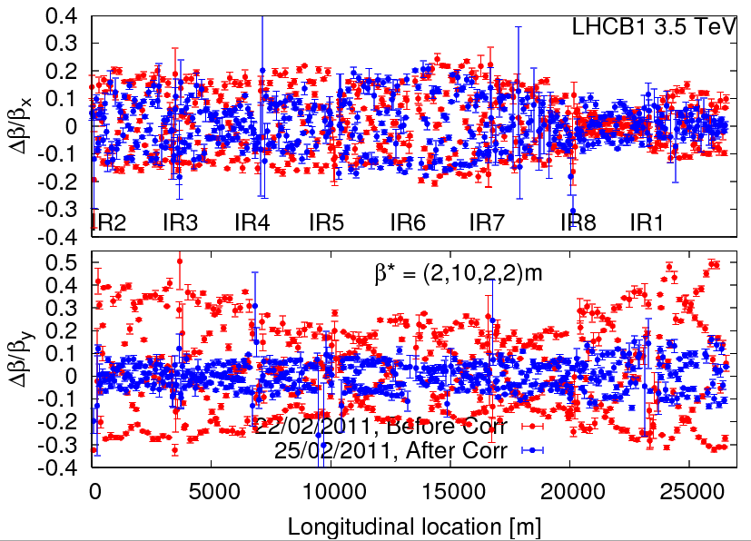
beating correction: beam 1 2.0 m

Slide 15
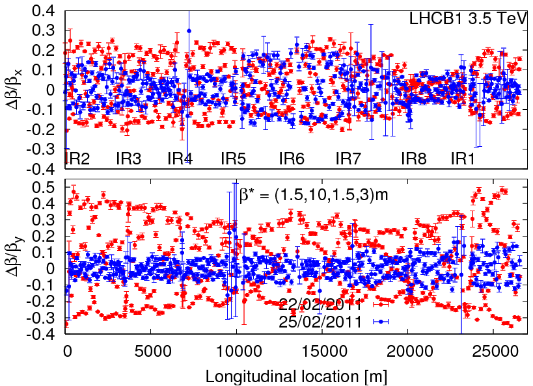
beating correction: beam 1 2.0 m
local corrections have made an excellent job all the way between 3.5m and 1.5m! All peak-beatings after correction are between 15% and 20% !

Slide 16
Night continued
Local coupling correction in IR1, IR5 and IR8 triplets was very successful for Beam1. For beam2 there is a clear new source of coupling in IR1 (compared to the 25th, when corrections where computed) that will require another iteration.
04:00 Lost beams during AC dipole kick. The BLMs had not been masked. The measurements of the beta beat team was fortunately essentially finished.
Damper studies – Daniel Valuch
Damper setup completed for both beams
Flooding alarm – LHCb cavern – fire brigade in
SPS: problem with MST in SPS/LSS6.

Slide 17
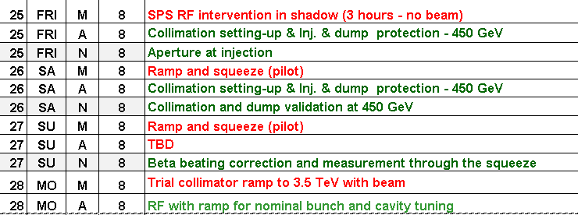
Incoming

