Slide 1
1v1

Slide 2
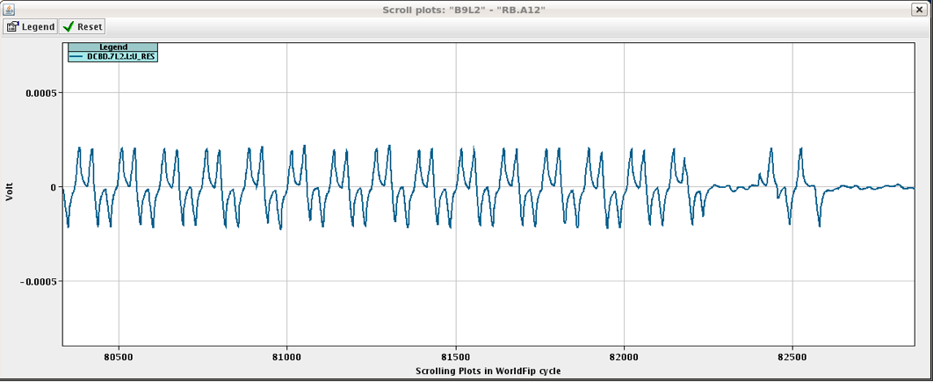
Machine check out status
17:00 LHC closed
RB 12 ramp to 6 kA ok now.
RCBXH2.R8 tripped at standby
powering failure
Inject and dump tested fine
Circulate and dump
LHC injection pulsing
RB 12
Qps board noise appear
MBIBH 2931 On

Slide 3
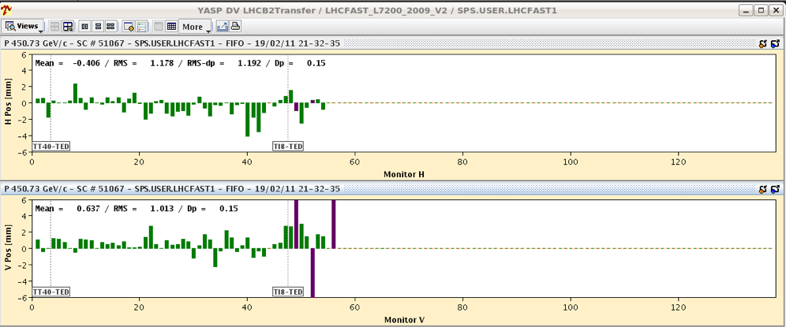
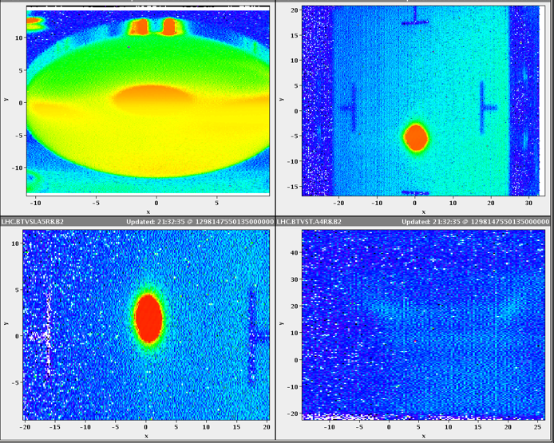
Machine check out status
Prepare for Injection
18:30
Precycle fine !!
Ramping down ALICE Dipole and Solenoid
Beam on the TED”s
Ready to inject B2
Beam on TDI,

Slide 4
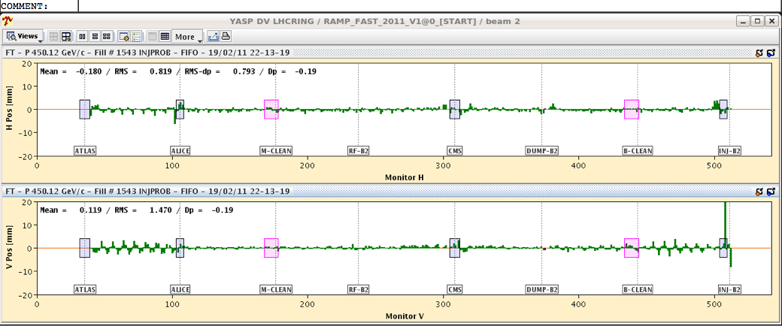
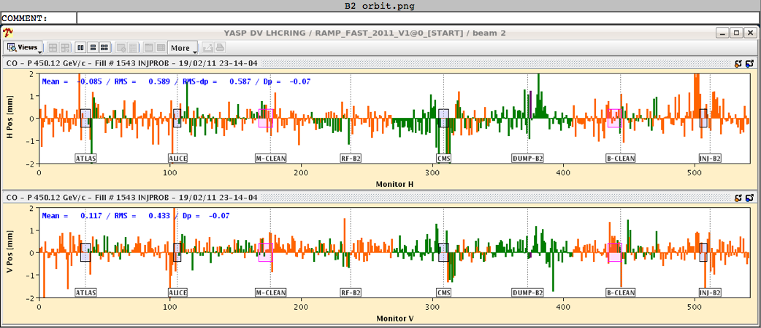
Machine check out status
Beam circulated
beam 2 was stepwise threaded around the ring, using TCTs, TCLAs and TCSGs to stop the beam. Splash events were given to CMS and ATLAS.
Beam 2 circulating
Beam 2 was stepwise threaded around the ring,
TCTs, TCLAs and TCSGs were used to stop the beam.
Splash events to CMS and ATLAS.
First orbit

Slide 5
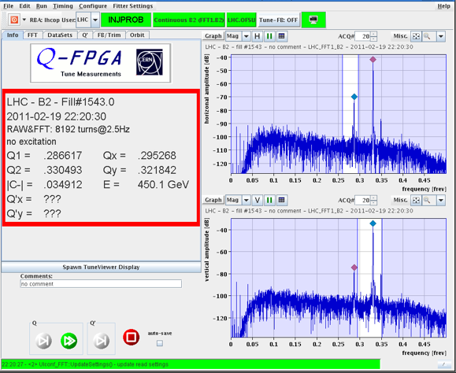
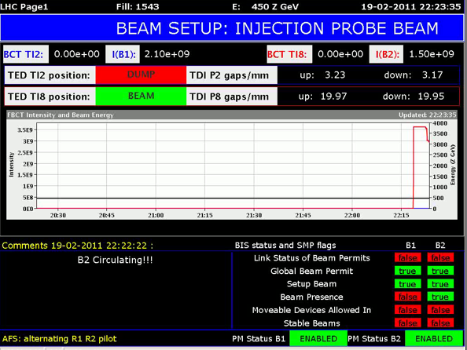
Machine check out status
B2 is Back!!
22:17
B2: >100 turns !!!
Tune measurement

Slide 6
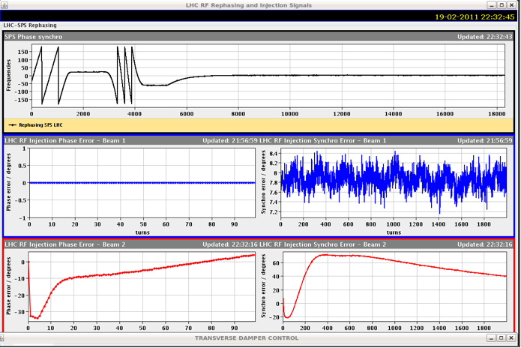
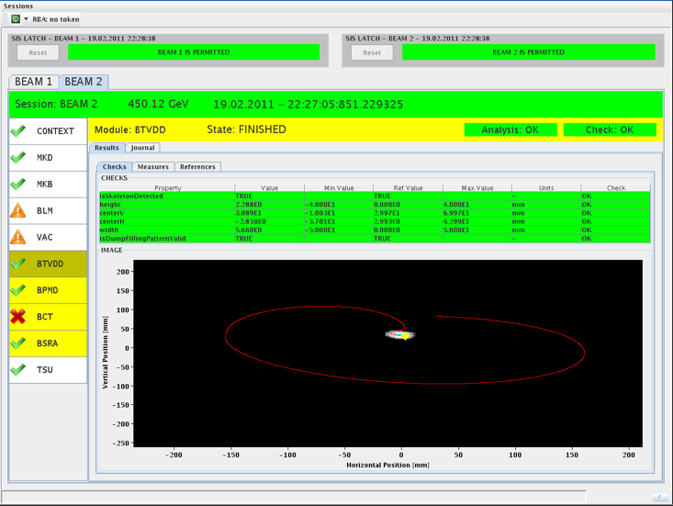
Machine check out status
B2
22:30
Once the beam was threaded around, it circulated without problems.
B2 dumped
Re-injected and trimmed the phase
It was decided that RF capture will be done today

Slide 7
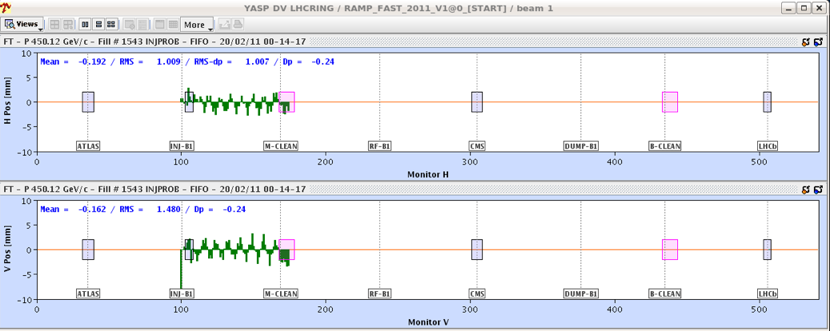
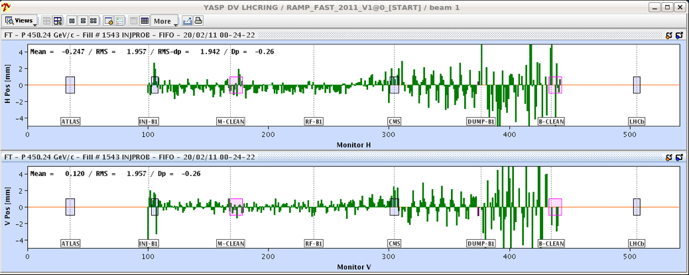
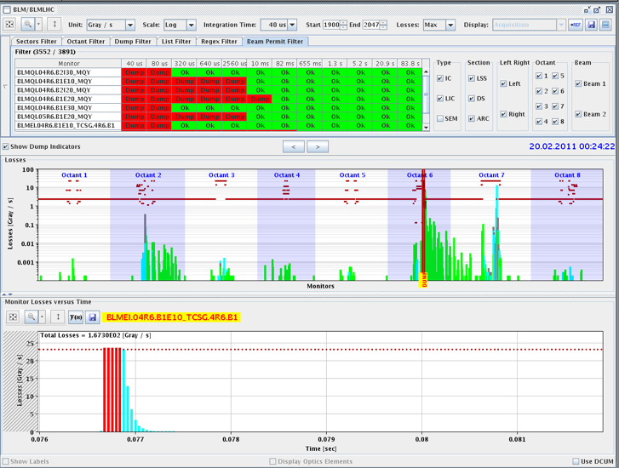
Machine check out status
B2
23:30
Switch to B1
beam 1 in point 2 trough 6, beam dumped

Slide 8
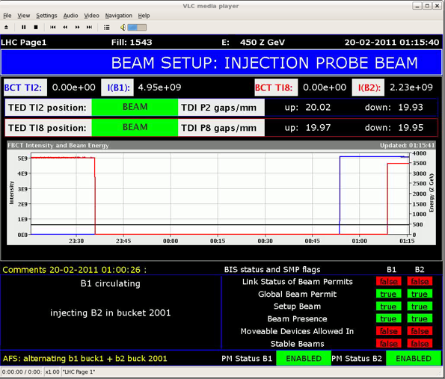
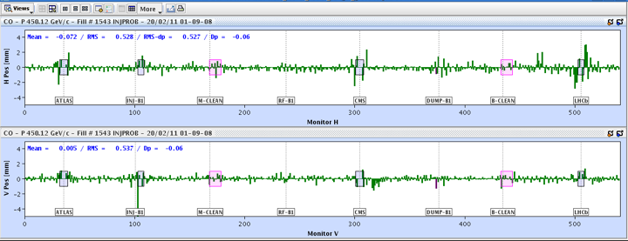
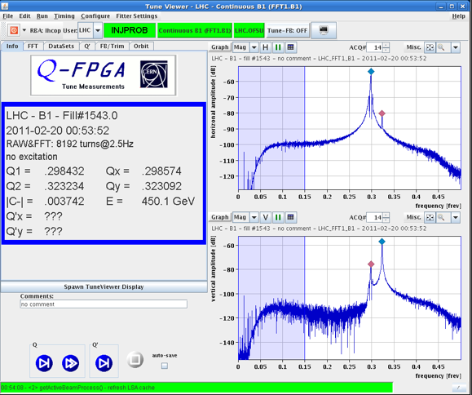
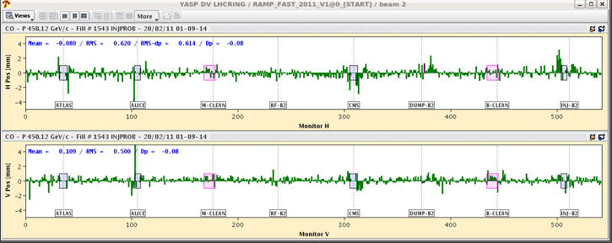
Machine check out status
B1 back as well!!
00:50
Both beams Circulating

Slide 9
Machine check out
Later in the night
measure/correct tune, chroma, coupling, dispersion measurement - -
Separation bumps IN but got an error when trying to put the crossing angle, to be looked at this morning
RF working this morning

Slide 10
Open issues & Access
RQS.A67B1 Auxiliary power supply fault
Access needed
RQT13.L7B1 high resistance failure
Current limited to 50 Amps.
BPM TI 2 BPM not triggering
Few self trigger of the LBDS beam 2
RF LDBS frequency link check ongoing
RF power & frequency interlock ongoing
BTVDD B1 no image
LBDS <> Access to be completed

Slide 11
Planning

Slide 12
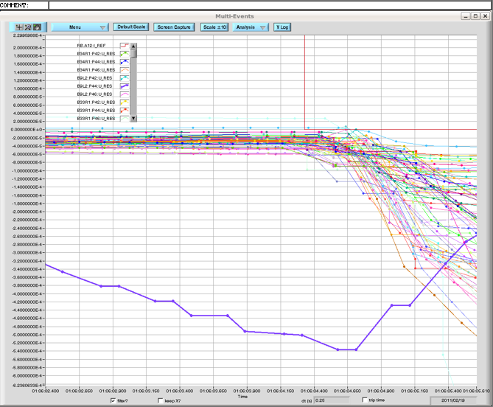
RB 12

