Slide 1
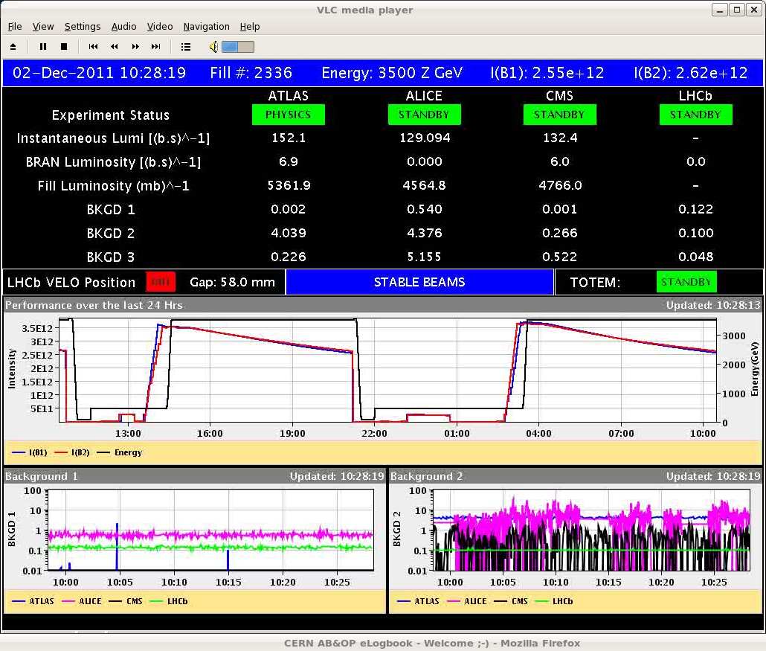
Fri 2/12
10:32 OP dump (Kept a bit longer because of LINAC3 problems) . End of physics fill #2336 – 5.4 μb⁻¹ in 6:15 h

Slide 2
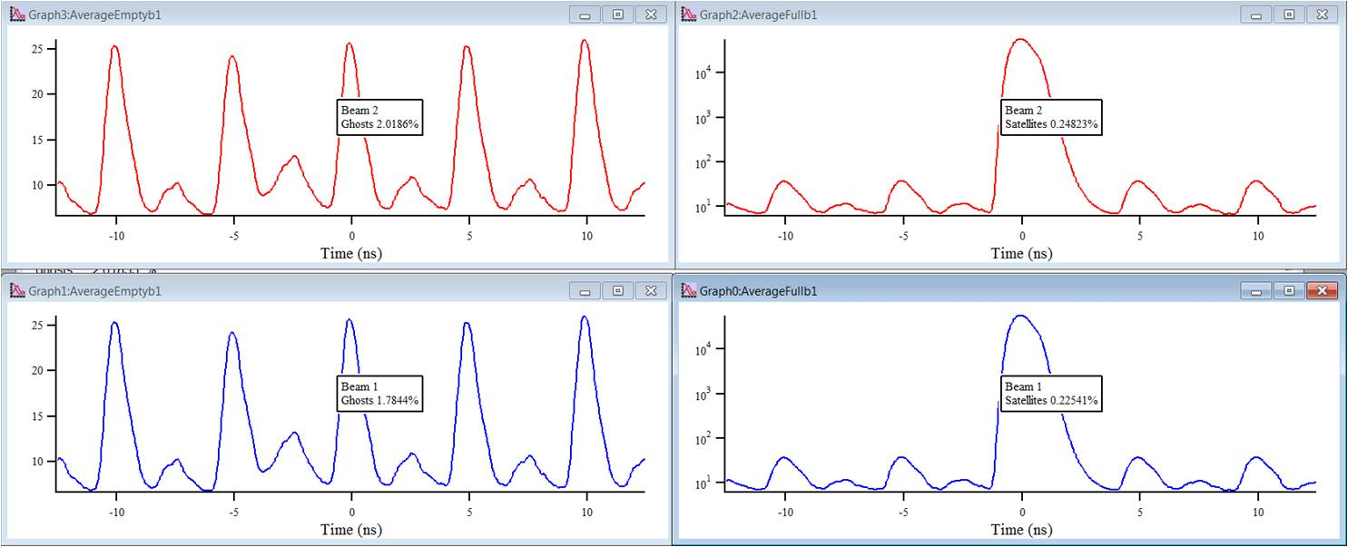
Fri 2/12
Filling for Van der Meer scan.
13:18 Stable beams #2337. (352 bunches/beam – 344/324 colliding pairs). Initial luminosity 4x10²⁶ cm⁻²s⁻¹
Initial emittances ~1.5 um but lower bunch intensity (~10 %) – Emittances at injection (1.1-1.5 um). Blow-up occurring at injection already

Slide 3
Fri 2/12 – Sat 3/12
17:29 Trip of Sector 12 (QPS B10.L2- communication lost – SEU?). End of STABLE BEAMS #2337 – 3.2 μb in 4:15 hours.
access required for QPS (card replacement)
RF tests for new longitudinal blow-up without beam ➔ OK
20:45 End of access and Pre-cycle
00:30 STABLE BEAMS #2338. Initial luminosity 3.7x10²⁶ cm⁻²s⁻¹ (still lower intensity from injectors)
No communication with nQPS RQF.B10L2
Try to contact QPS piquet to see whether an access is required. Delayed beam dump. Found re-placement.
08:09 OP dump. End of physics #2338. 5.6 μb in 7:40 hours.
Power cycle required, then precycle

Slide 4
Plan
10:00 Fill for Physics
Length scale calibration for ATLAS
Continue with physics

Slide 5
Incoming
ADT: physics fill with gated damping (24 bunches not damped) to assess possible coexistence damper/BBQ measurement
Use bunch mask to inhibit damping for a normal Physics fill. Do not change any other parameters. The only risk here is that the first bunch train with no damping will suffer more blow-up
Ion Quench test MD (> 8 hours). Proposed for Mon 5/12. tbc

Slide 6
Fill # | Start Stable beams | Duration [h] | Initial lumi (Atlas) | Int. lumi (Atlas) | Reason Dump
 |  | [hh:mm] | [10²⁶ cm-2s-1] | [ub-1]
2317 | Wed 13:15 | 4:57 | 4.1 | 4.5 | Programmed dump
2318 | Wed 21:53 | 5:36 | 4.6 | 5.5 | Programmed dump
2319 | Thu 9:04 | 9:02 | 4.7 | 5.7 | Programmed dump
2320 | Thu 22:45 | 5:23 | 5.0 | 5.7 | Programmed dump
2325 | Sat 8:04 | 5:43 | 4.8 | 5.6 | QPS, trip of RQF/RQD.A45
2327 | Sat 19:58 | 0:34 | 5.2 | 0.9 | LBDS Self-trigger
2328 | Sun 0:03 | 6:08 | 5.3 | 6.4 | Programmed dump
2329 | Sun12:29 | 6:18 | 4.9 | 6.2 | Programmed dump
2330 | Sun 22:03 | 7:09 | 5.2 | 6.9 | Programmed dump
2332 | Mon 19:11 | 1:12 | 5.5 | 1.9 | RF trip, PLC
2334 | Thu 04:58 | 5:45 | 5.1 | 5.7 | Programmed dump
2335 | Thu 15:27 | 5:46 | 3.9 | 3.7 | Programmed dump
2336 | Fri 04:19 | 6:14 | 4.5 | 5.4 | Programmed dump
2337 | Fri 13:18 | 4:15 | 4.4 | 3.2 | QPS (Sector 12) - SEU?

