Slide 1
Sat 19.11.11
08:10 Stable beams Fill #2305.
11:08 Lost QPS ok in B11.L1 (location of ion losses).
14:24 Beam dump.
XPOC Beam1 blocked due to BLM: BLM on TCDSA over threshold.
MB11.L1 QPS power cycle.
16:33 Injection.
Missing batch/low intensity batch when injecting. Dump and re-inject.
19:56 Adjust.
20:04 Beams dumped. Klystron low filament current on RF line 2B1 caused module M1B1 to trip.
21:53 RF intervention finished: reset of regulator on klystron.
23:45 RF filament current error on cavity 2B1 at flat top
Keep cavity 2B1 off.
B1 RF voltage reduced from 14MV to 12.2MV

Slide 2
Sun 20.11.11
02:43 Stable beams Fill #2308.
Higher intensities from the injectors. Django et al optimizing efficiency through the chain (on cost of time for NA experiments: ~2h).
New peak luminosity.
6h40 lost with problems on cavity 2B1. What is the issue with this cavity? Nothing found in access!?

Slide 3
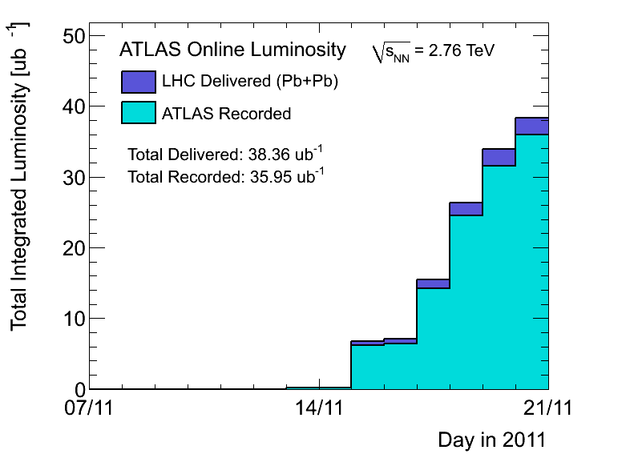
Integrated Pb-Pb 2011 (ATLAS)
… still nicely accumulating…

Slide 4
Ahead
Pb-Pb physics.
Any lesson from cavity 2B1 which we should take into account?
Scraping test for CMS delayed by 1.5 weeks.
Access (when opportunity arises)
Installation of four BLMs for IP2 Aperture checks (4hours)
CMS !
EPC 60A corrector (RCBCV10.R3B1)
Some ADT work
RF 7B1 klystron
12 hours for beam dump switch / generator replacement
Tuesday 08:00, if switch stable till then

