Slide 1
Thu 17.11.11
09:00 Dumped beams, refill for Pb-Pb physics. No more protons in 2011…
Some changes:
Increase of flat top total voltage to 14 MV. Feed-forward on the H orbit CODs in the ramp and squeeze. New version of the FBCT.
Release of SIS. The only change concerns the injection bucket check. The logic now allows injection if there is a lone single bunch in the machine beyond the point of the incoming injection.
11:00 Problem on dump kicker B1, one switch is dying and may need to be exchanged. It has been masked for the time being to allow to go in physics.
12:56 Stable beams. Fill #2301.

Slide 2
Decision on p-beam (Mike Lamont)
To avoid the risking a serious impact to the SPS and LHC's ion program, the decision has been taken to stop pulsing the faulty PS proton injection septum. This means the end of the 2011 physics run for all non-LHC protons users (except ISOLDE).
The LHC would have only needed protons for a continuation of the proton-lead study. The possibility of moving further tests to the week of 5th December when the bulk of the ion run was over has been considered. This would mean restarting the proton source, LINAC2, and booster, which are due to start their test and maintenance programs on Monday 21st November.
A restart would be decidedly non trivial and would have an impact on the restart in 2012. It has therefore been decided not to pursue this possibility.

Slide 3
Problem dump kicker (E. Carlier)
problem on dump kicker B1, one switch is dying and may need to be exchanged.
It has been masked for the time being to allow to go in physics
Missing re-trigger signals from switch A: RTB1 Principal A & RTB2 Principal A.
These 2 signals are coming from PUs located at the bottom of the capacitive part of the Switch A bleeding circuit (same signal measured by the 2 different PUs and sent to the 2 re-trigger lines). Detection system checks that the amplitude of the signal and the duration of the signal are above predefined limits. If one of the 2 conditions is not fulfilled the result of the analysis is false.
Both signals have been missing simultaneously for the first dump at 450GeV after a 3500GeV coast. Signals were correct for the dump at 3500GeV. Clear indication that the switch A is not anymore within nominal operation conditions (Higher leakage current noticed since 12/11).
In agreement with CCC, interlocks S708 and S724 have been masked for the time being. An issue has been created in the MPP tracking system.
Indepth analysis ongoing and possibility to replace the switch or the generator is under consideration.

Slide 4
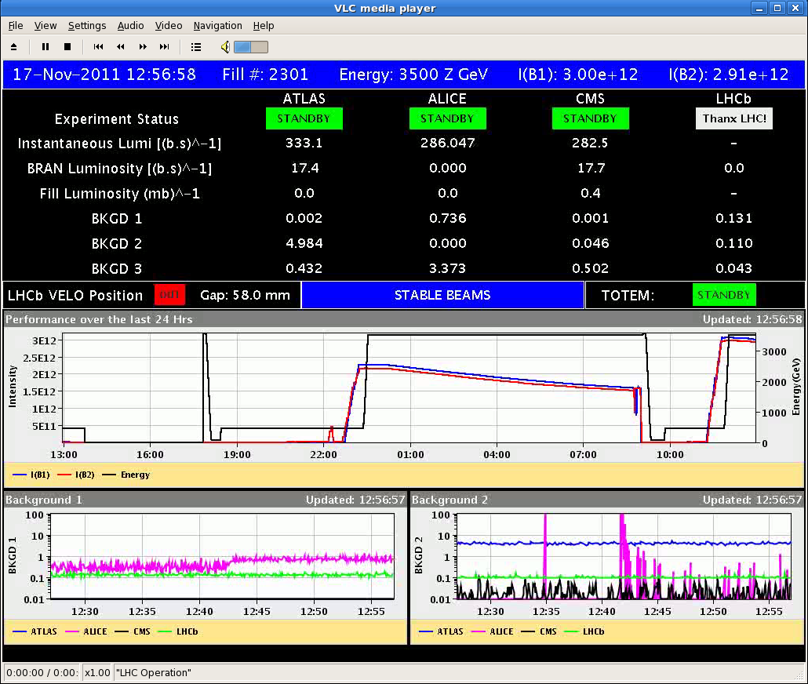
Fill #2301

Slide 5
Thu 17.11.11
12:56 Stable beams. Fill #2301.
13:47 Changed the settings on the acquisitions for the BQMLHC so that the pattern for ring 2 is not detected incorrectly at the flat top (so far at times the last batch was detected 1 bucket aside). The acquisition was always ok at the flat bottom, where it is vital...
18:46 change the target length for the blow up from 1.05E-9 to 1.25e-9 for both beams. We will have longer bunches for the next ramp.
19:22 Ramp down undulators for BSRT tests.
19:59 Adjust mode: end of stable beams. 4.2-4.8ub-1 delivered per experiment. Test of lumi scan software changes for 25min. Some bug found -> not yet deployed.
20:30 Beam dump. CMS access during ramp down and cycle.
21:08 Undulator is back on.
23:41 Ramp.

Slide 6
Fri 18.11.11
00:35 Stable beams. Fill #2302.
06:07 Beam dump by RF temperature interlock (HOM 4B2).
Total delivered Pb-Pb lumi in 2011 reached 19.6 μb⁻¹ in ATLAS.

Slide 7
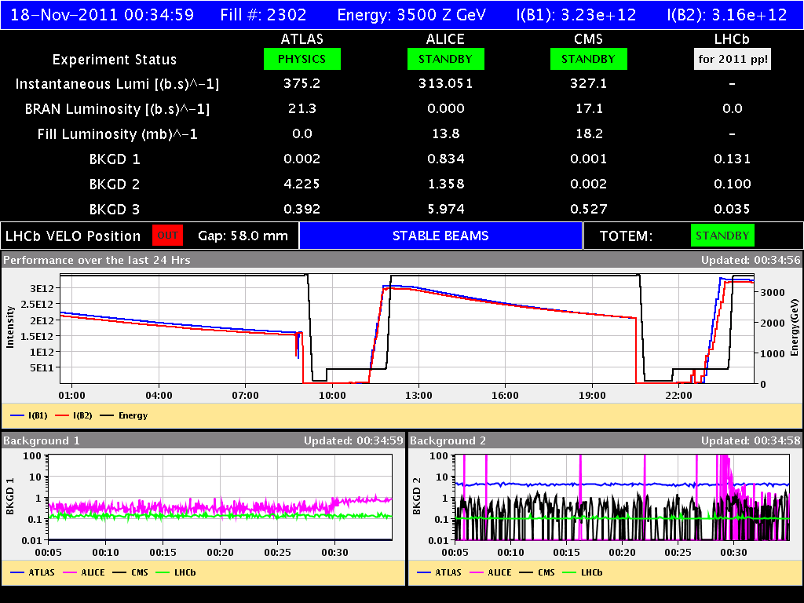
Successfully in ion lumi production…

Slide 8
Turn-around

Slide 9
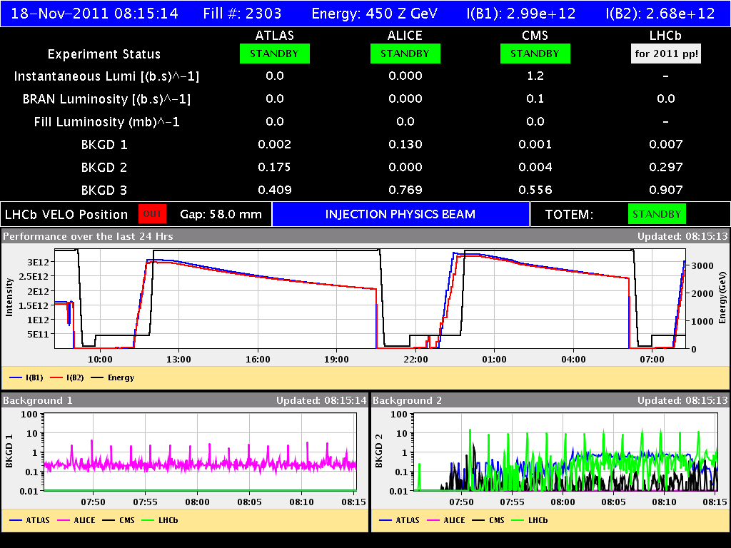
Successfully in ion lumi production…

Slide 10
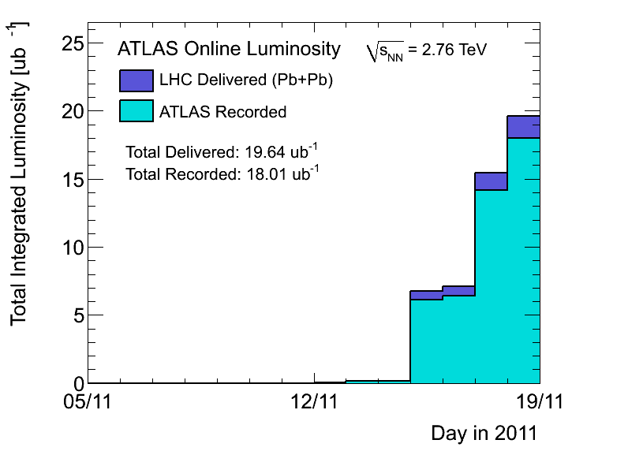
Integrated Pb-Pb 2011 (ATLAS)

Slide 11
Ahead
Pb-Pb physics.
Pending:
Some optional transverse damper work: see list from Wolfgang.
Access:
Installation of four BLMs for IP2 Aperture checks (4hours)
CMS !
EPC 60A corrector (RCBCV10.R3B1)
Some ADT work
RF 7B1 klystron

