Slide 1
Wednesday 16th November
09:15 Cryo conditions sector 34 recovered
Preparing machine for p-Pb
11:50 Injected 1 pilot B1
12:20 No beam from PS due to suspected vacuum leak on PS Proton injection Septum
Prepare access in PS to investigate
Try to do combined ramp and squeeze test with the proton beam but lost beam due to TDI not at relaxed settings when collapse of crossing angle
17:15 Decide to go back to ion physics for the night
20:45 Injecting Pb pilots
21:30 Problems with RF cavity 7B1 klystron current measurement causing interlocks – interlock levels changed
00:21 Stable beams
Reduced beam intensities, PS vacuum due to septum intervention & losses PS – SPS transfer, giving reduced lumi’s

Slide 2
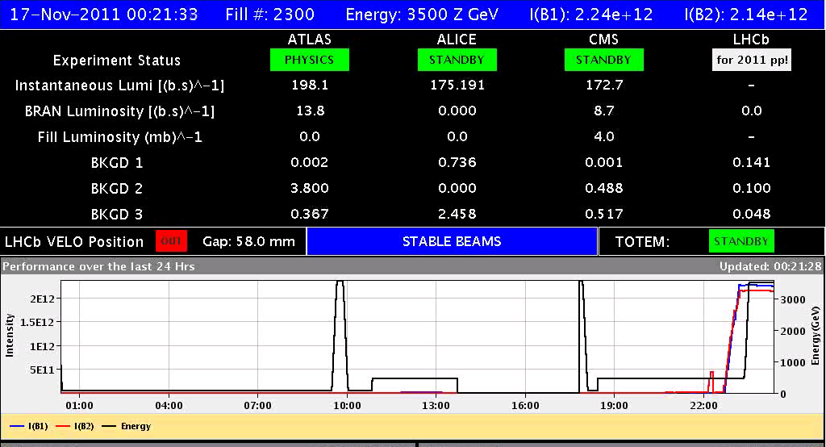
Fill #2300

Slide 3
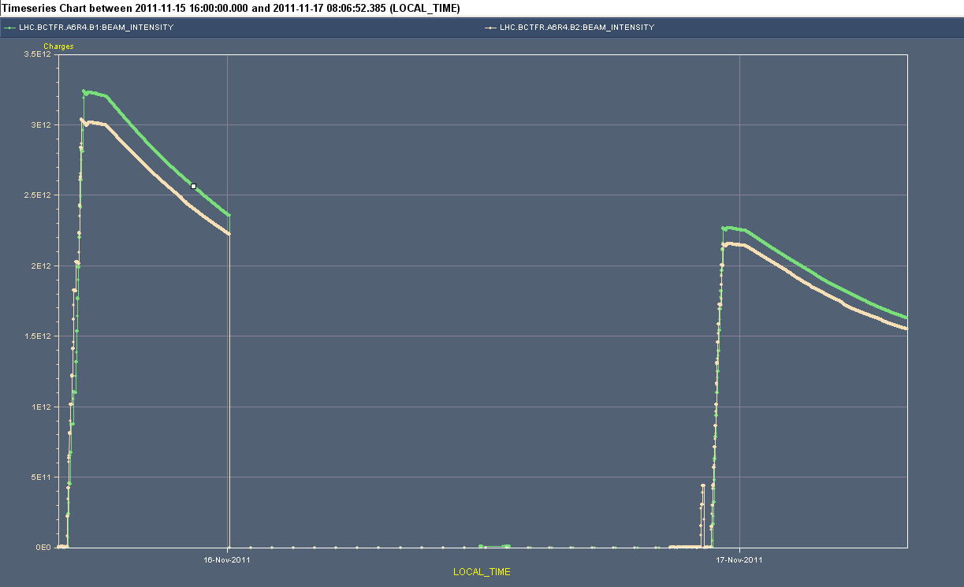
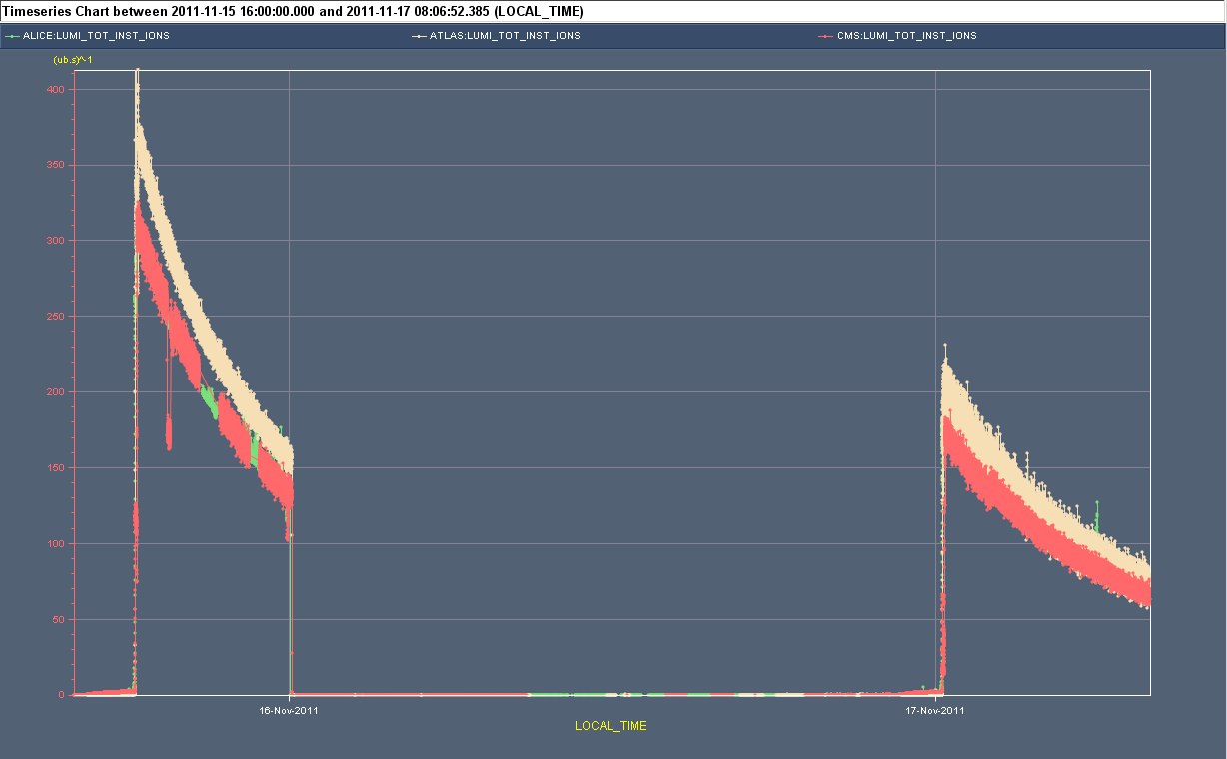
Bct and lumi’s – comparison two fills

Slide 4
PS Proton Injection Septum
Yesterday evening:
We suspect that an electrical fault under vacuum degrades significantly the vacuum in the ring when used. The septum is condemned until a next meeting tomorrow morning.
Most likely no water leak.
This morning:
Discussion with the equipment experts and vacuum for possible additional diagnostics. Any test pulsing would again degrade the vacuum for ion operation.
Pulsing the septum has a certain risk to create a vacuum leak to air, resulting in several days of interruption to operation.
Jan Borburgh Volker Mertens

Slide 5
Plan
Today Pb-Pb physics. Refill ‘now’.
Small chance of p-Pb tests tomorrow.
Access
Installation of four BLMs for IP2 Aperture checks (4hours)
CMS !
EPC 60A corrector (RCBCV10.R3B1)
Some ADT work
RF 7B1 klystron

