Slide 1
Friday 28 October 2011

Slide 2
8:32 cryo conditions S56 and S67 back but QPS problem on MB.B9R1
10:39 Start test of IP2 squeezed optics to 1 m and optics measurements, in preparation of the ion run.
one pilot per ring
Keeping the tune feedback with pilot beams was not obvious: Needed to chirp (and therefore impact the damper controls upgrade)
Coupling correction at several steps of beta*
19:38 on momentum beta-beat measurements completed
19:53 Electrical glitch. Cryogenics lost in sector 12. ATLAS Torroid and Solenoid tripped.
Short power cut on the Meyrin site. Automatic switch to Swiss electrical network to recover power.
The 66->18kV transformer (EHT102-LHC1) suffered from a problem on the control system: the voltage regulation got crazy and several alarms were generated, which produced a cut of the transformer. The Meyrin site was immediately taken over by the MP7 line, but the swap was not without effects: LHC sector 12 went down, together with the cryogenics and ATLAS magnets; PS was as well affected. At about 1:30, the network was put back in its original configuration, after replacement of the control system of the transformer.

Slide 3
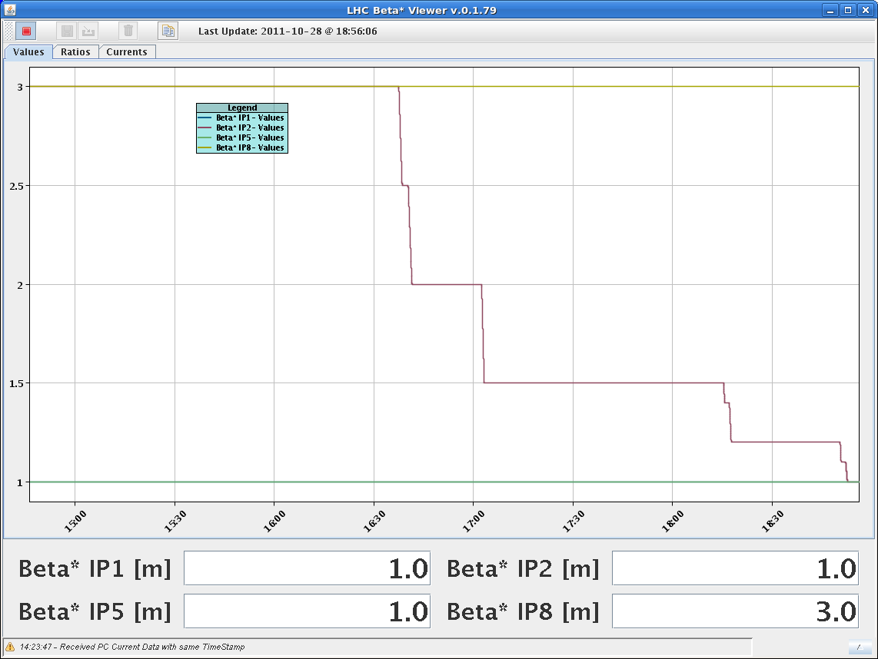
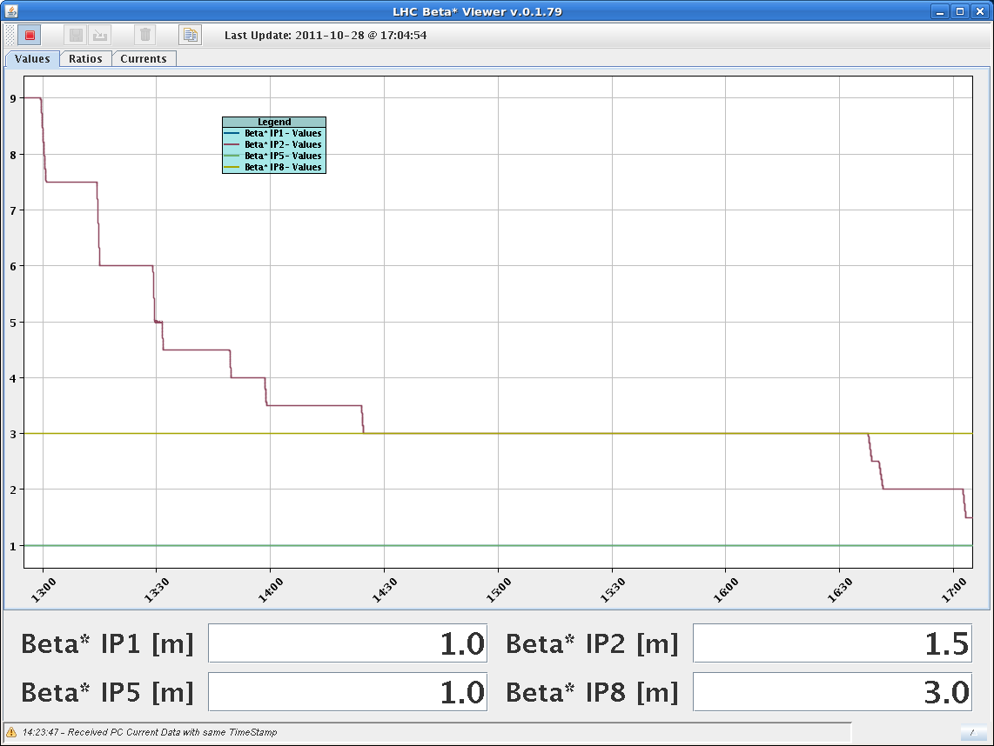
18:55 IP2 at 1m beta*
for the first time

Slide 4
Summary Coupling and Beat-beat
Coupling: Coupling correction has been put in place at IP 2 beta* = 3m, this reduced the global coupling knob. Knob name: Coupling_correction_IP2_ions. At lower beta* this coupling correction was not sufficient, so an additional know will be calculated.
Beta-beat: The beta-beat was measured at beta* IP2 = 3, 1.5 and 1m. The beta-beat at 1m is around 20% in the vertical plane and around 10-15% in the horizontal plane for both beams.
Detailed analysis will be conducted.

Slide 5
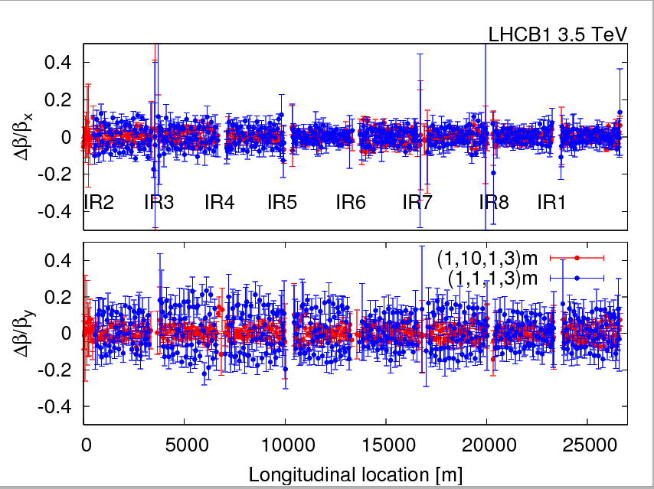
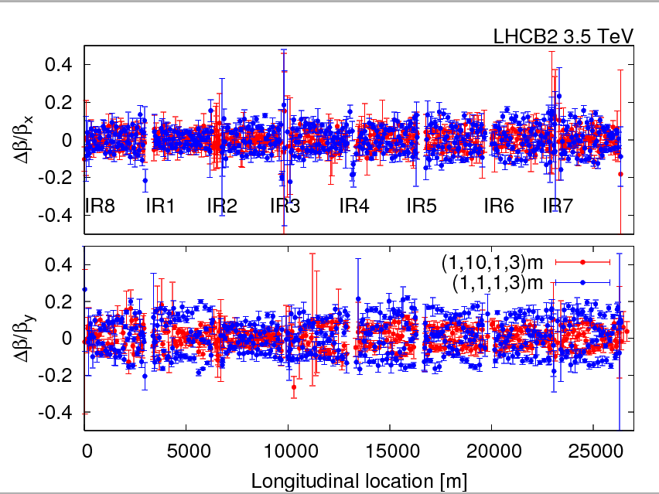
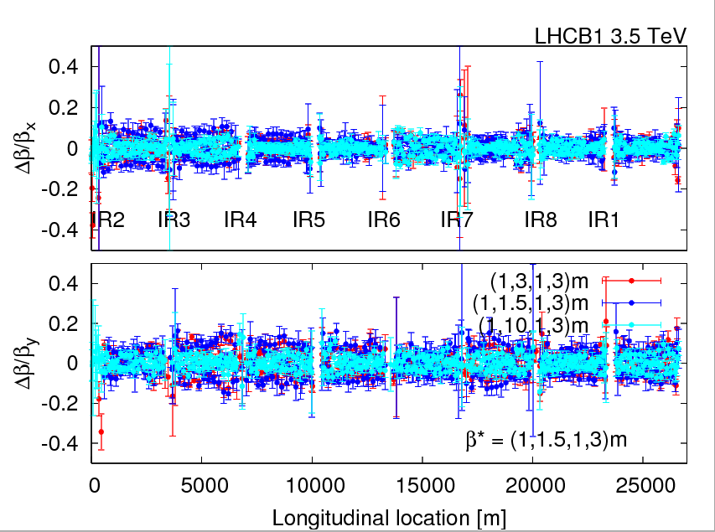
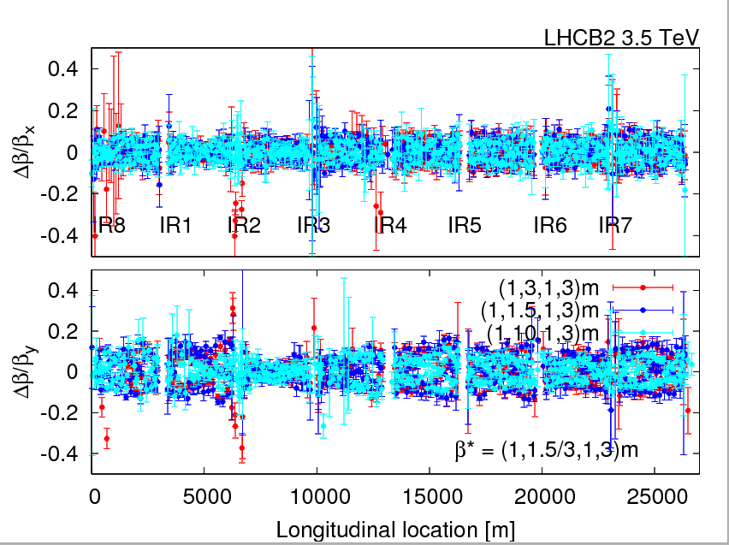

Slide 6
Others
TCTH.4R1.B2 motor steps lost
8:30 – 16:30 update of ADT: D. Valuch, F. Dubouchet, W. Hofle : We have installed new front end computers, new drivers, new fesa classes and upgraded firmware in the signal processing units. We could profit from the circulating pilot bunches and preliminarily checked all internal signals using the observation memories. One preamplifier was found broken, it is fixed now (saved time for ions). New critical settings for blowup were set from the CCC. The blowup is installed on all beams and planes, still needs to be checked during the validation with beam (~2 hours).
21:45 Since the vacuum in IP8 was rather bad in the last physics fill, we opened further the TDI.4R8 gap. For the last couple of fills, it had been closed back to +/-20mm positions instead of +/-55mm. We now set it to the intermediate position of +/-37.5mm.
22:31 access for ATLAS

Slide 7
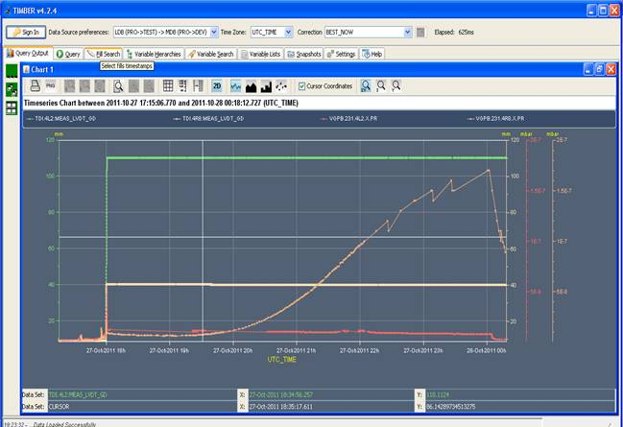
Vacuum at TDI: IP8 at +/-20mm, IP2 at +/-55mm

Slide 8
Satellites Fill #2261 (Enrico Bravin)
Satellite distribution for fill 2261. The satellite near the bunches range between 1.5% and 6% with an average of 3%.

Slide 9
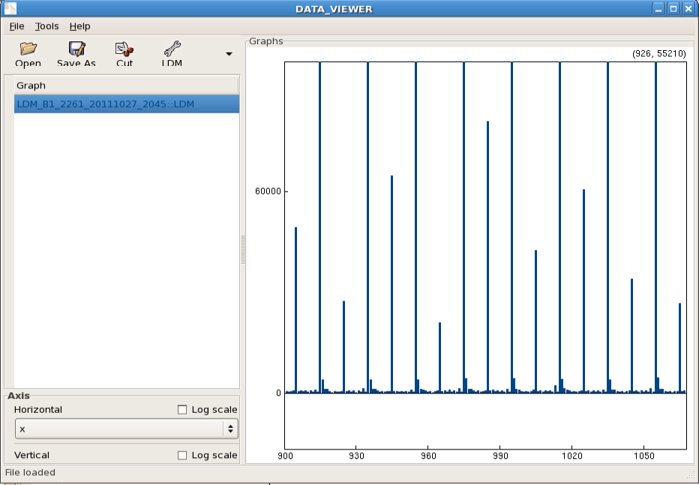
Satellites Fill #2261 (Enrico Bravin)
Satellites not at 25ns seem to be similar to previous fills. See screen capture: zoom of the buckets histogram: the lines going out of the plot are the main bunches (1E6), then you see the 25ns satellites and very small the other satellites.

Slide 10
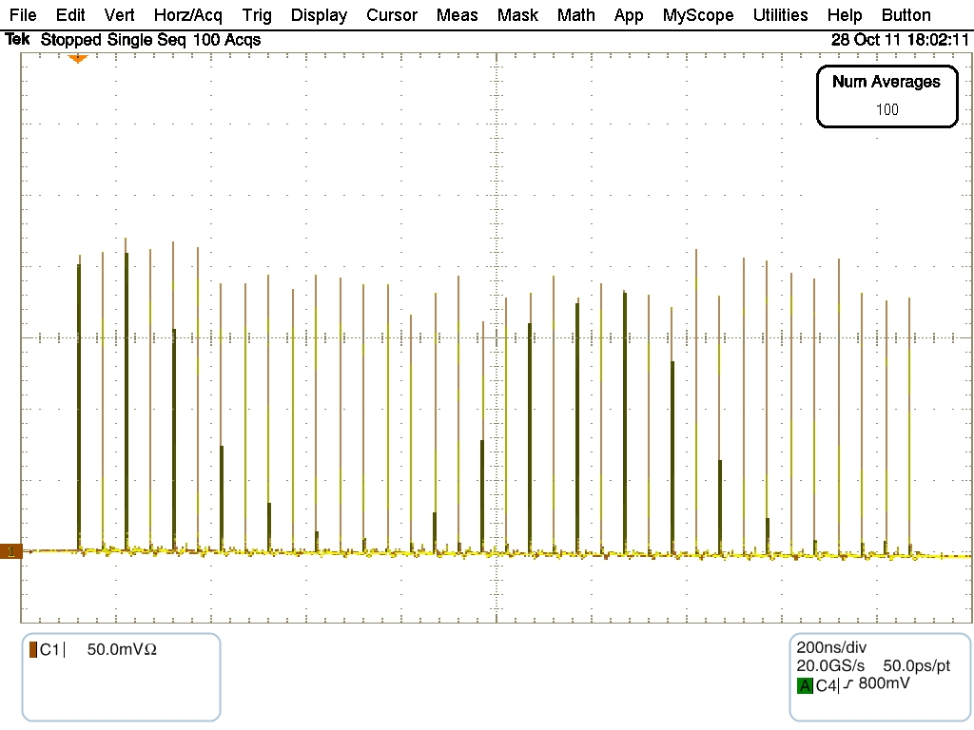
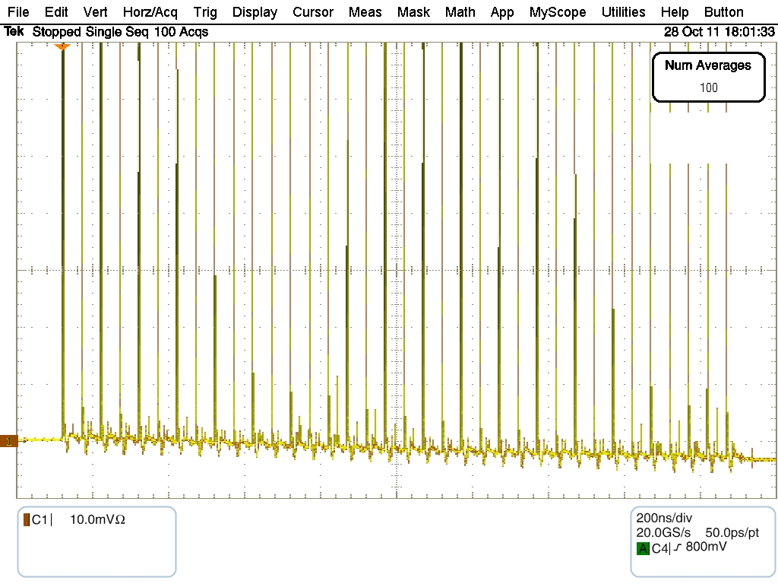
Preparation for reduced ‘enhanced’ satellites for next physics fill: aim is 1-2% of main bunches
From Steven Hancock and Thomas Bohl

Slide 11
Outlook
Cryo back estimated 10:00-11:00
Saturday continuation of: preparations for ion run using proton pilot beams
Second ramp for ALICE squeeze to 1.0 m
Aperture measurement
Checking/setting injection orbit
Afterwards approximately 2 hours of ADT validation
Then till Sunday 16:00 (End of proton physics 2011) : Luminosity production
18:00 Sunday – 6:00 Saturday 5 November: MD block 4
Others:
Maybe end of fill study reducing the ADT gain (check beam lifetime, emittance growth, luminosity lifetime)
ATLAS requested ~10 minutes at end of fill of beam separation by
+-3 sigma separation in the vertical plane
+-1 sigma separation in the horizontal plane

