Slide 1
Monday 24 October 2011
24 hours of 25ns MD
Fill with 72 bunches, scrub and study e-cloud effects

Slide 2
Overview
Till 16:30 set-up of injection B2
Issues:
Losses injection B2
Vacuum interlock MKI
16:30 – 20:28 Fill 2249: 1020 bunches each beam
Dumped by BPM interlock
20:30 – 1:00 Fill 2250: B1 2096 bunches; B2 804 bunches
Dumped by BPM interlock
3:30 – now Fill 2251: B1 2100 bunches; B2 1020 bunches

Slide 3
Preparations:
07:40 loaded 25 ns settings for ADT
08:24 Increased vacuum threshold for the injection of B2 from 2x10⁻⁹ mbar to 2.5 x10⁻⁹ mbar
9:00 LHC and injectors ready for 25ns beam
Correcting injection oscillations and injection phase
9:57 All e-cloud solenoids in the experimental areas have been switched off
Typical beam parameters:
Emittances measured in LHC: 2.5 – 3.5um
Intensity: 1.25x10¹¹ p/bunch → lowered to 1x10¹¹ in the afternoon

Slide 4
High losses when injecting
10:50 Dump by Beam Losses during injection of B1 (12b in, 72 were not extracted from SPS, but losses above threshold were seen at ALICE and at 4R2)
suspect that dump was due to satellites after the 12b (PS reduced the kicker length for the 12 bunches injection)
11:57 Dump by Beam Losses during injection of B2 (12b in, we were injecting the 72b)
TI8 line needs further steering
12:34 Dump, losses injection B2.
Line trajectory, losses and injection oscillations are fine with 12 bunches, we cannot do better but losses increase by a factor 100 when injecting 72 bunches and trajectory gets much worse
13:02 Vacuum interlocks changed from 4E-7mbar to 2E-6mbar: 3 gauges in IP3 and 9 gauges in IP7.
13:27 dump on losses injection B2.

Slide 5
Summary Injection of 72 bunches with 25 ns (Chiara, Wolfgang)
Beam 1: corrected injection oscillations in the horizontal plane then OK ==> losses at 15% of dump threshold at MSIB for 72 bunches
Beam 2: injection with 12 bunches looked fine but beam was dumped when injecting 72 bunches (losses at MQ6 at ~200%). We steered the line in both planes but situation did not improve:
Losses at MQ6 increased by a factor 100 and trajectory at the last collimators got worse by a factor 3, when passing from 12 to 72 bunches.
We injected 36 bunches to check injection oscillations and we saw horizontal oscillations increasing along the train starting from the 20th bunch ==> problem with MKE4 SPS extraction kicker.
We tried to add the second CNGS cycle in the SPS but this did not solve the problem
Correction for steering in the horizontal plane calculated on the injection of 36 bunches ==> check injection with 12 bunches and found optimum tradeoff between trajectory and injection oscillations (lengthy procedure since it requires continuous cycle change in the SPS 12-36 bunches: beam setup in the injectors)
We managed to inject 72 bunches with losses at 40% from dump thresholds at MQ6.
We still see a pattern in the injection oscillations along the train
IMPORTANT: scan with beam of MKE4 flattop to be performed Xmas stop!

Slide 6
25ns MD continues Fill 2249
16:30 injection set-up finished.
Managed to inject the 72 bunches with a trajectory correction based on 36 bunches. This was necessary because the horizontal trajectory of the bunches is changing along the train because of the shape of the SPS extraction kicker MKE4.
Switching solenoids at MKI to 3A for injection and OFF for scraping
20:20 1020 bunches in each beam: cryogenics measurements
20:28 Dump by BPM in IR6: intensity of some bunches was too low.
Joerg increased the SIS threshold on MKI2 (B1) vacuum to 2.5 10-9 mbar in agreement with M. Barnes

Slide 7
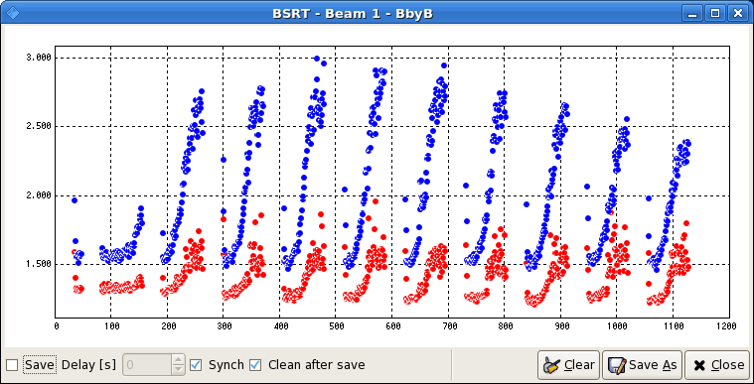
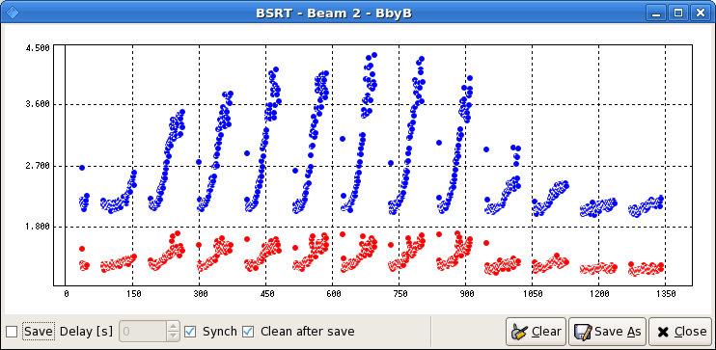
BSRT bunch by bunch transverse beam size (Fill 2249)
Horizontal
Vertical

Slide 8
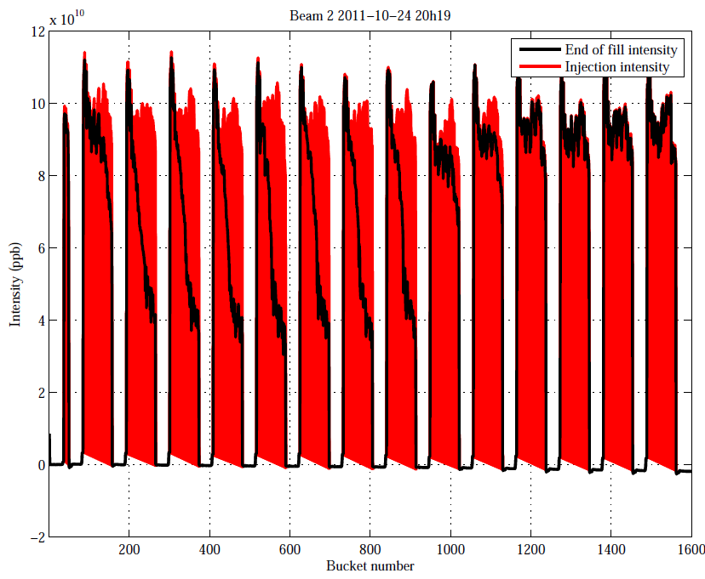
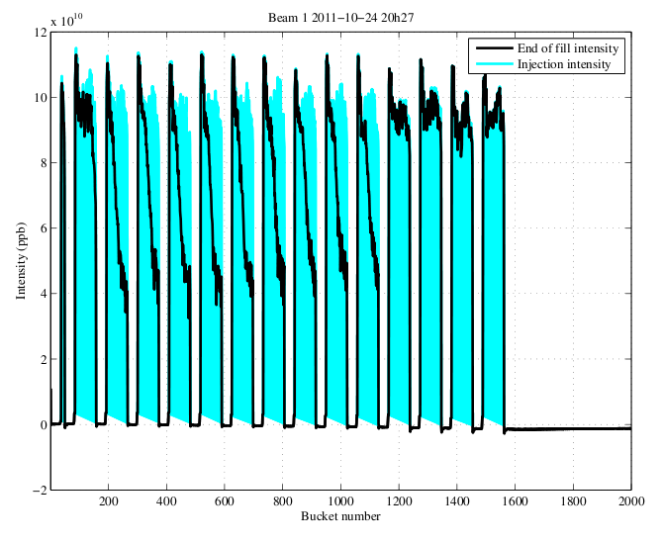
FBCT Measurements (Fill 2249)

Slide 9
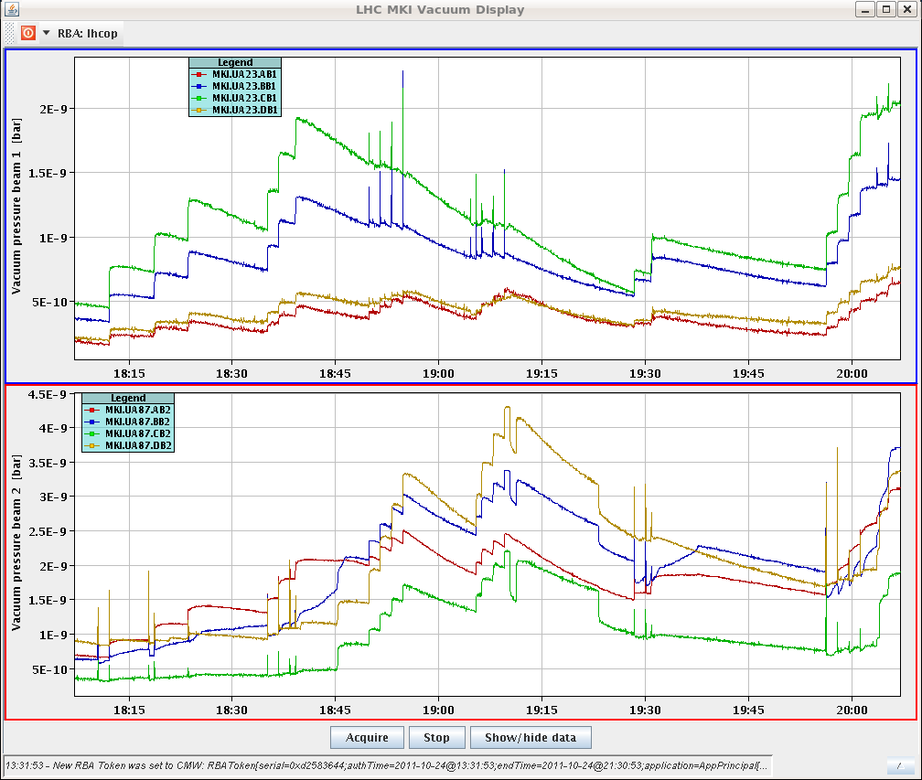
Vacuum at MKI – injection limit at 2.5 x10-9 mbar

Slide 10
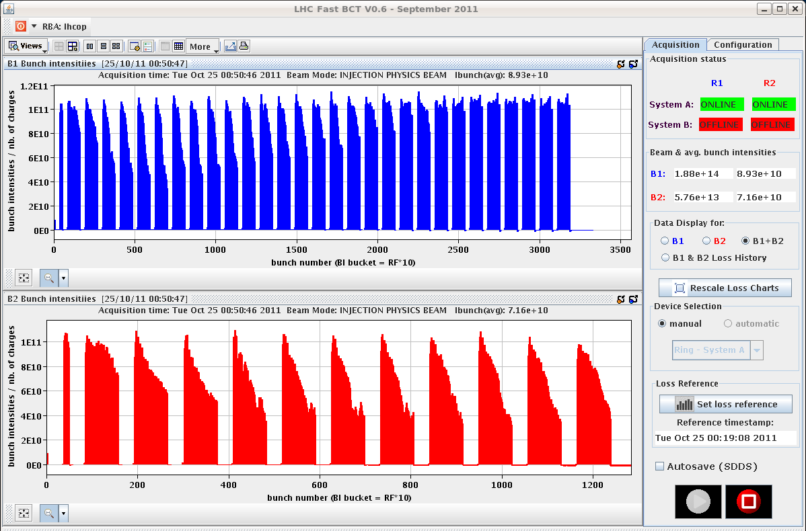
Continue with New Fill (#2250)
00:50 B1 2096 bunches; B2 804 bunches
00:59 Dump: some bunches below BPM detection level

Slide 11
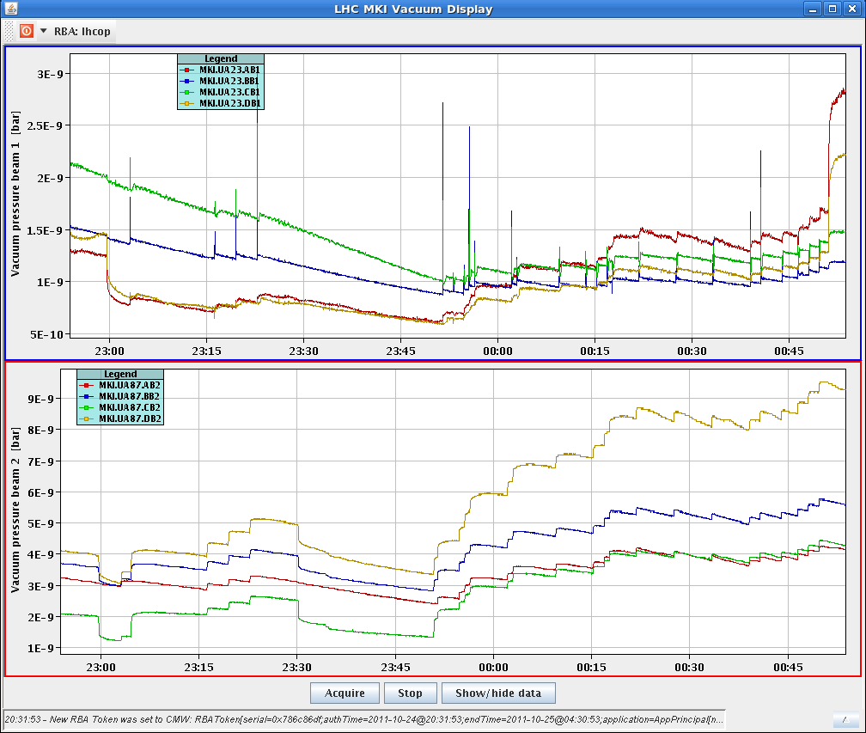
00:50 vacuum at MKIs
Solenoid switched off

Slide 12
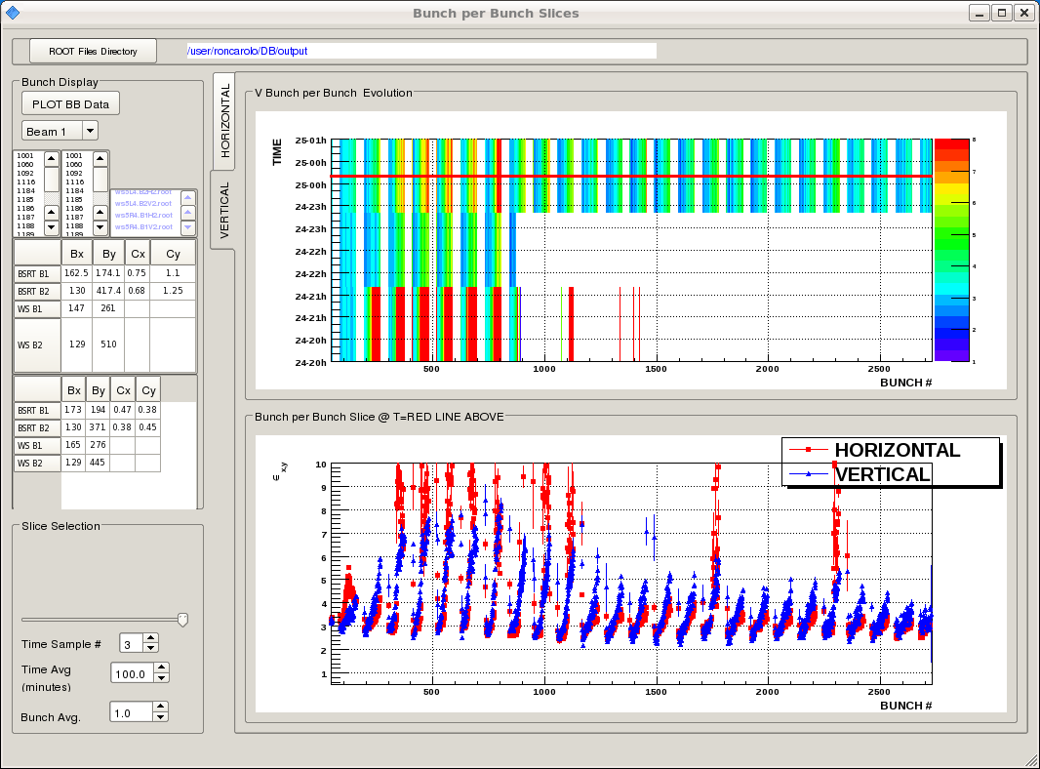
B1 emittance from BSRT

Slide 13
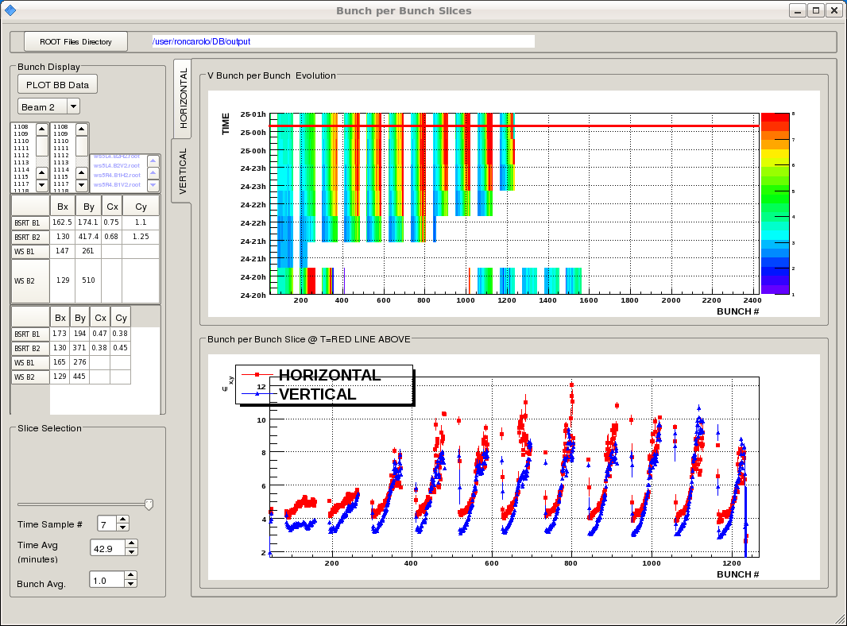
B2 emittance from BSRT

Slide 14
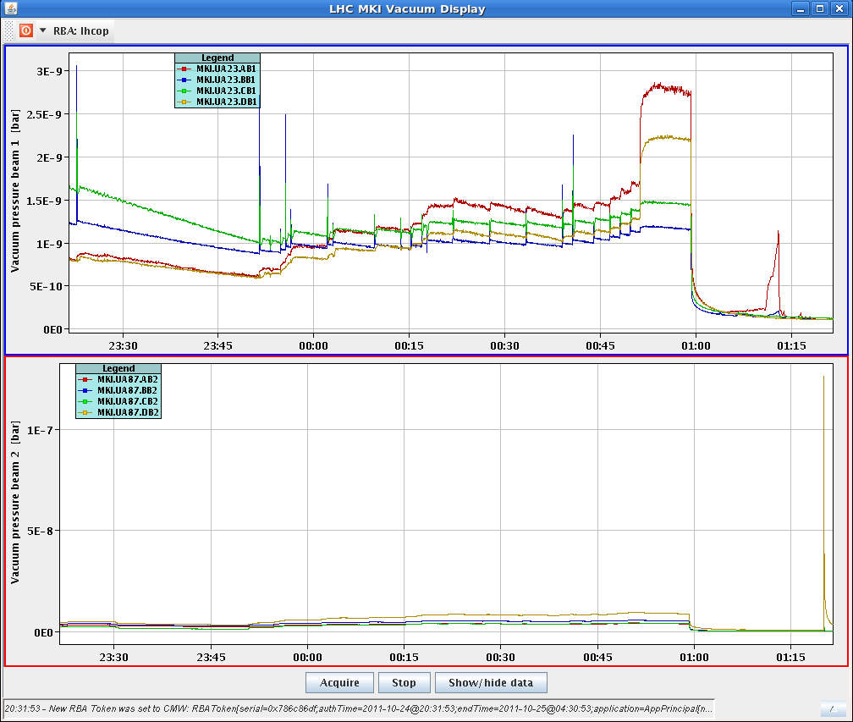
1:06 MKI B2 in faulty state during soft start... suddenly back in ON state
Vacuum spike after soft-start
Vacuum interlock: called Mike Barnes, he needs to do an extended soft start (finished at 3:30)
Continuing with B1 pilot in the meantime

Slide 15
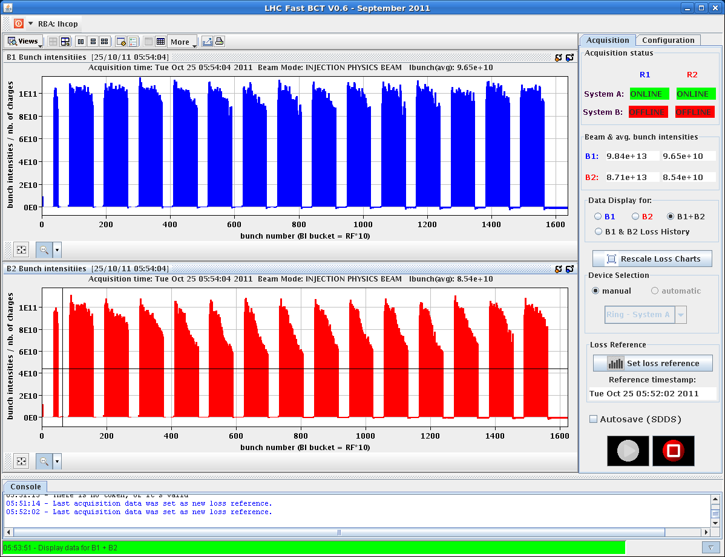
4:00 back to injection 72 bunches: Still very high injection losses for B2
5:50 1020 bunches for both beams in the LHC

Slide 16
7:09 2100 bunches B1 and 1020 bunches B2
Continue scrubbing

Slide 17
Outlook
Tuesday: 10:30 high pile-up for 8 hours (max.); 2-3 hours in stable beams
Then Luminosity production till Friday morning
Friday (24 hours) preparations for ion run (proton pilot beams)
Luminosity production till Sunday evening (End of proton physics 2011)
Sunday 18:00 start of MD block

