Slide 1
Friday
06:30 Stable beams
Van der Meer, length scale calibrations and beam gas imaging
14:29 RQXL2 tripped
In shadow
Landau octupoles trimmed up to 200 A at end of ramp, and through squeeze. Chromaticity trimmed down by 0.5 both beams, both planes at 1 m.
LHCb polarity switched
Test of RF ramp with hypercycle p-Pb with unlocked frequencies.

Slide 2
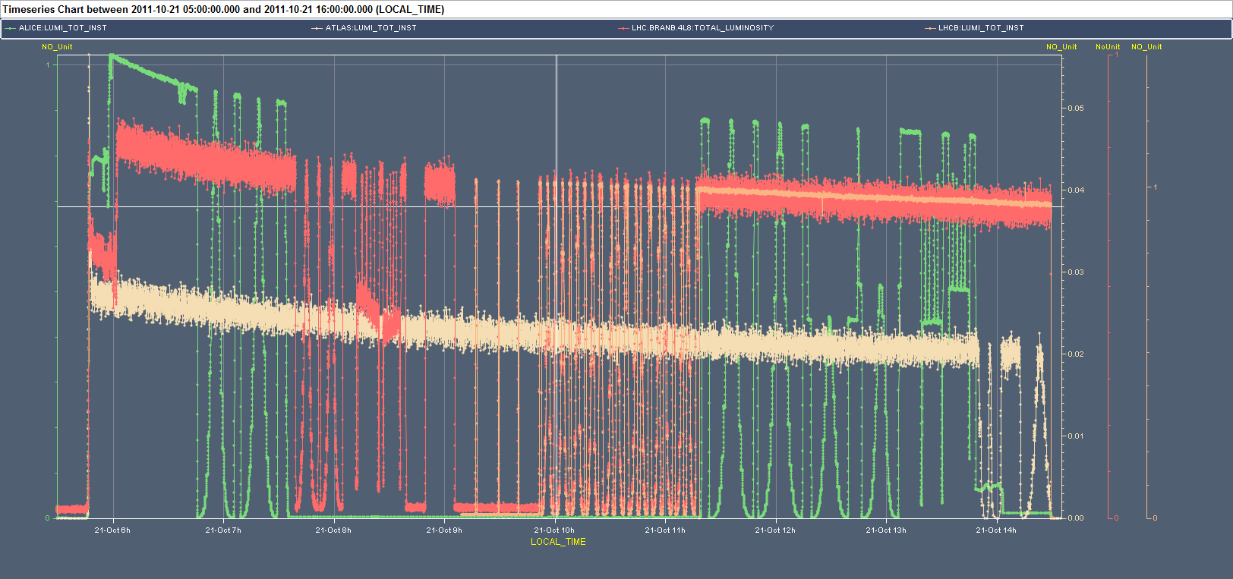
Luminosity scans etc
Massi Ferro-Luzzi

Slide 3
Proton lead RF ramp
We have tested without beam an RF ramp with p (ring1) and Pb (ring2) using the hypercycle 3.5TeV_10Aps_PPb_1m.
The RF loops and cavities tracked without problem.
The frequency ramped from 400.788860 to 400.789717 MHz (p) and from 400.784216 to 400.789645 MHz (Pb). See attached. PB will check if the 70 Hz difference at flat top is normal (probably too large for rephasing. To be followed).
Issues found:
The ‘Relative cogging’ SIS intlk has to be masked. This will not be possible with nominal beam but IT IS REQUIRED for asymmetric LHC. To be followed (Jorg, Andy).
The Master Frev B2 intlk is a REAL fault. It can be cured by modification to the RF tasks in the sequencer.
There were several problems with the functions B2 (mixture of 2011 situation at Z.450 GeV/c and copies from 2010 Pb in ramp). Solved for the next ramp.
Reyes and Philippe

Slide 4
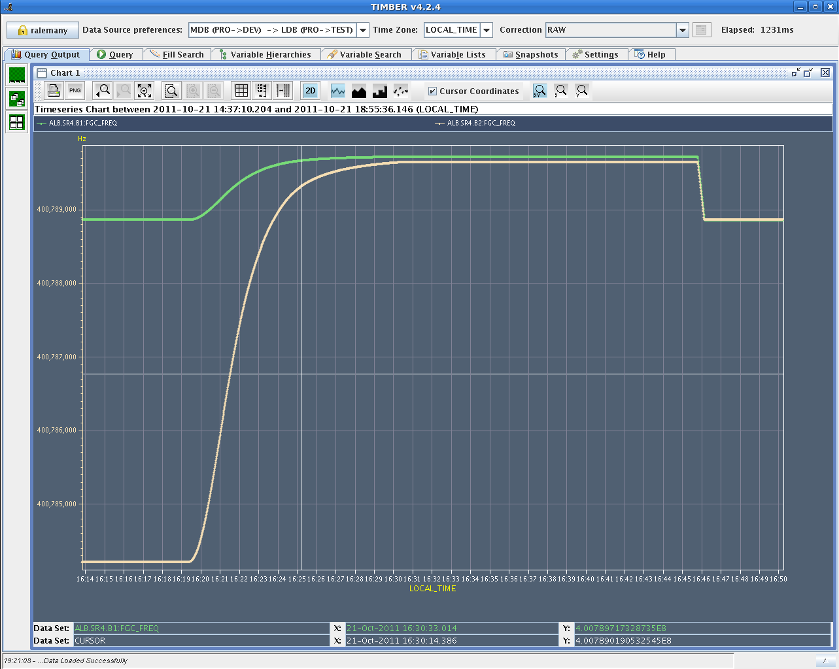
Proton Lead frequencies in ramp

Slide 5
17:36 Electrical glitch - Description
16h50 TI averti le LHC et M Lamont de la manipulation sur le réseau
17h30 SIG et EDF previennent TI de la manipulation
17h40 Nombreux UPS LHC sur batterie + filtres ME9, SE2, SE4, SE6, SE8 déclenchés.
Alarme sur les aimants ATLAS, ALICE, LHC
( Access for ATLAS, ODH monitoring and Vacuum in shadow.)

Slide 6
Glitch - Action
TI prévient les piquets TE/EPC pour LHC et SPS ainsi que Karsten Kahle
TI prévient OPs LHC, ATLAS, ALICE, CMS, LHCB, CAST, Ops PS PSB du ré-enclenchement prochain
18:45 le piquet TE/EPC PS va devoir mesurer les capacités car il y a un deséquilibre (estimation de 2 heures supplémentaires)
19:10 TE/EPC au point 2 pour enclencher
19:10 Alice OK pour enclencher, mais TI attend un mail de confirmation
19:20 Alice appelle le LHC car en fait ils ne savent pas quoi faire

Slide 7
Glitch - Action
le LHC ramp down le solenoide de ALICE; en attendant les piquets vont enclencher le point 4
19:40 Filtre SEF4 ré-enclenché
19:45 Filtre SEF6 ré-enclenché
19:49 Filtre SEF2 ré-enclenché
20:19 Filtre SEF8 ré-enclenché
20:35 EN-EL baisse les gradins de l'EHT102/1E
20:40 Filtre ME9 ré-enclenché
Remarks:
Au total 3 équipes TE/EPC déployées pour une intervention rapide
Rapport demandé à EDF
Aucun TCR de touché pendant la perturbation
SVC SPS et Filtres stables LHC insensibles à la perturbation
21:40 ATLAS Torroid on standby. V.Montabonnet clearing warnings, so the long ramp up can begin.

Slide 8
Friday evening
22:00 Injecting for loss maps
23:51 Ramp
wire scans, wire scans, wire scans
00:52 Optimized collisions
01:25 All TOTEM RPs arrived at target position.
Loss maps
betatron
+500 Hz off momentum
01:40 Programmed dump after loss maps at collision settings with roman pots at physics settings

Slide 9
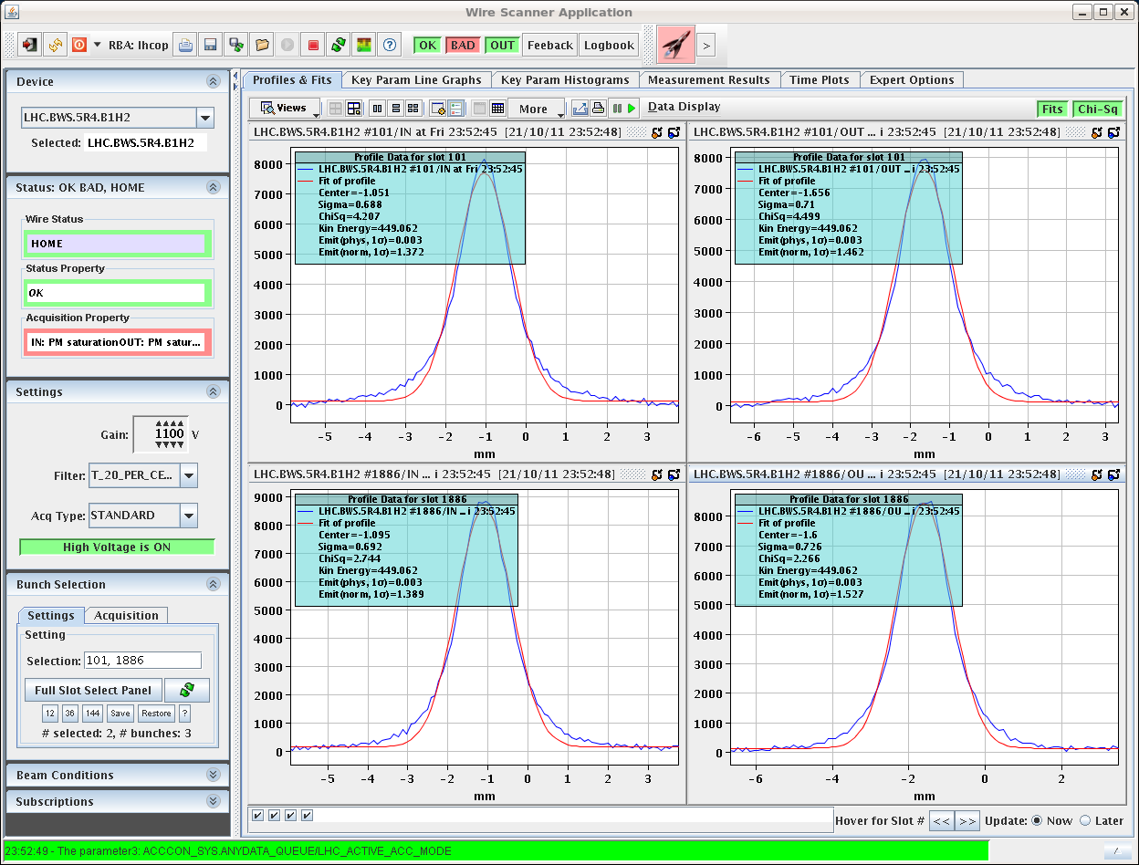
Wire scans – start and end ramp

Slide 10
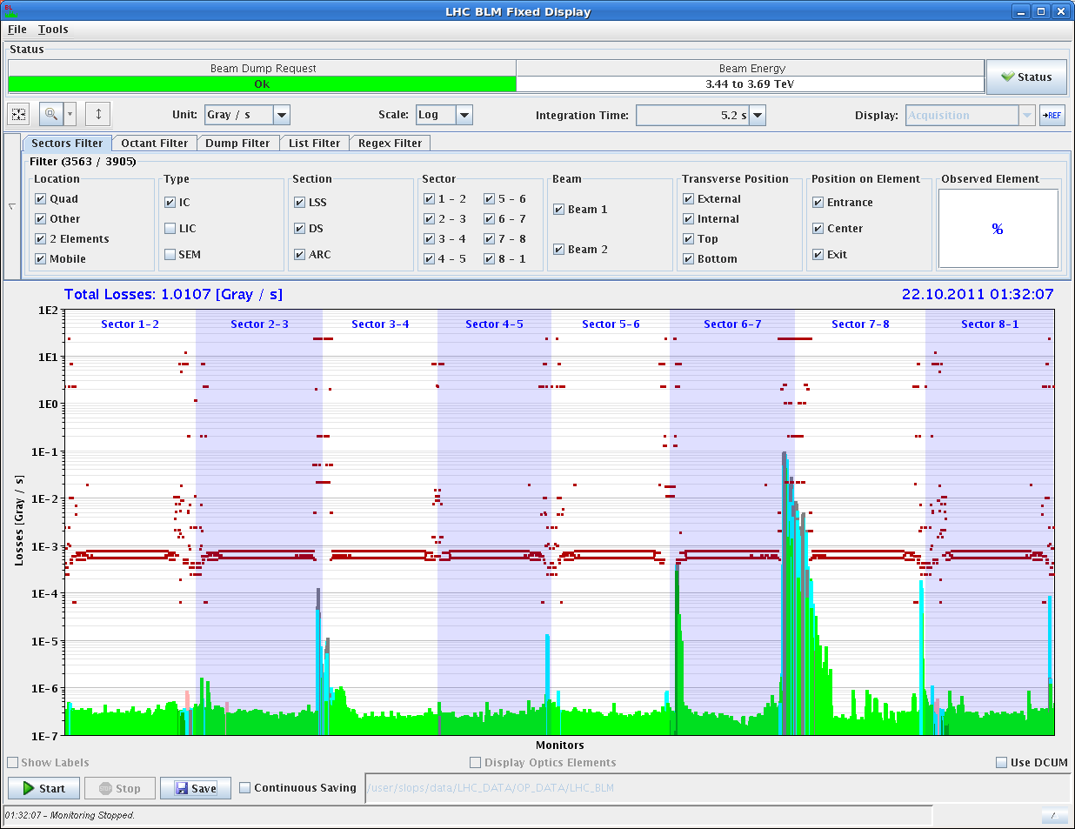
Loss map – B1H

Slide 11
Saturday morning
02:30 Injection
Filling not straight forward
High losses on the TCDIs (50 % of dump threshold for beam 2)... SPS was only scraping about 2 %. Asked them to increase it on the fly.
Also, large losses for uncaptured beam. Much more than usual, see attached pic.
Many BQM latches - latches on "stability
Dump & re-fill
It was the phase... The measurement was not set up for injection so we had not seen it before. The phase is wrong by -70 degrees....(?!? what has changed?)
06:45 Stable beams 3e33 cm-2s-1
low bunch intensity (1.23e11) for first run after MD

Slide 12
Saturday morning
07:45 Beams dumped
LHCb triggered
In logging timber we see a glitch of the stable beam flag and movable devices allowed flag - investigating
Go again – increased bunch intensity

