Slide 1
Saturday 8 October 2011

Slide 2
8:45 precycle started after access for QPS problem (circuit breaker opend); Alice finishing access.
10:00 injecting probe beam
10:48 Very clean injection, average bunch intensity: 1.3E11
11:41 stable beams Fill #2195. Luminosities:
Atlas and CMS peak luminosity: 3.3E33 cm-2s-1
Alice: went to 1.14e30, manually steered down to target 0.5e30 cm-2s-1
LHCb went above target with auto-leveling

Slide 3
LHCb lumi Leveling

Slide 4
14:24 gateway problem RB.A56 nQPS: There is no logging coming from the crate, the protection is still guaranteed.
→ solved by MPE piquet in the shadow during the next turn-around
23:48 TCL.5R1.B1 collimator give an error of lost steps on one axis. This error of the motor controller blocks the motor drivers but does not cause interlocks as long as the jaws remain within safe limits. No movement was requested, but the LVDT_LU shows a step of 50um.
→ problem solved by piquet in the shadow of the next ramp-down.

Slide 5
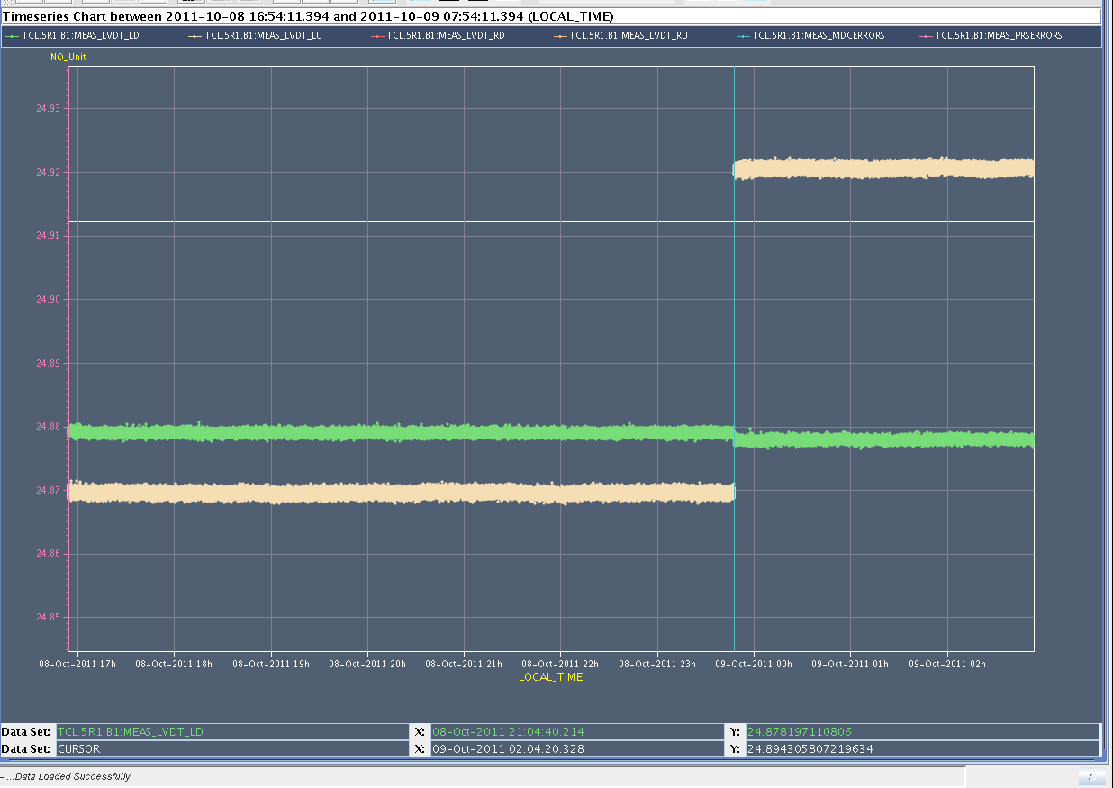
50 um step in the TCL.5R1.B1:MEAS_LVDT_LU

Slide 6
4:58 programmed Dump Fill #2195 after 17:17 hours in stable beams: integrated luminosity Atlas/CMS/LHCb: 115/120/21.3 pb-1; Alice: 58.5 nb-1
5:22 cannot execute BLM sanity check in IP1 (stuck in ‘beam mode’) → solved by C. Zamantzas
6:20 injecting physics beams
6:27 Extraction kicker problem for B1 in the SPS.
6:54 beams dumped (B2 already fully injected) as the SPS cannot deliver beams before 9:00
Plan for today:
Physics
ALICE test: solenoid to 0.2T (40% of nominal) at the end of a fill; stable beams for ½ - 1 hour

Slide 7
Ahead
Monday day: High pile-up MD.
Tue – Thu: Physics
Friday: Floating MD 25ns
To be scheduled: Loss map qualification for injection & physics (status is red since a week)
Abort gap cleaning at 3.5TeV to be tried out with a physics fill

