Slide 1
Thursday 6 October 2011

Slide 2
Thursday Morning - Problems
Status in the morning:
Vacuum recovery in TI2 after the repair of the vacuum leak at the TED
7:00 power glitch 400kV EDF; affected:
Injectors
LHC sectors 81 and 12, RF and collimators
Alice and LHCb dipoles
7:43 accidental switch off of LHC magnets including experiments; undulators took down cryo in MSL/R4.
Short summary by Valerie Montabonnet
Presentation on actions by Stephen Page
11:41 water leak in CMS

Slide 3
Thursday Morning Recovery
Till 14:00 recovery from the events above and various accesses in the shadow:
9:26 collimators and RF ok
11:55 RF tested new tuner firmware for 25ns MD
12:02 patrol at point 2 started (necessary because of vacuum intervention in TI2)
12:24 The whole machine is on standby. Ramping up of:
Undulators
Alice's dipole and solenoid
LHCb dipole after polarity change (now positive).
13:25 LHC is closed
13:56 CMS starts ramping up the solenoid. All other experimental magnets are already at nominal currents.
14:30 injection probe beam
Start of 25ns MD

Slide 4
Accesses
Pt 1: EN - EL
Pt 2: EN - CV
Pt 4: RF and ADT
Pt 5: vacuum and optical fibers
Pt 6: TE - EPC
Pt 7: BLM
Pt 8: vacuum, CNGS and QPS

Slide 5
Summary of 25 ns floating MD (Brennan, Gianluigi, …)
14:00 – 02:30
things went very well.
intensities around 1.05e11/b after scraping, emittances 2.5-2.7um
- RF setup (2h) and damper setup (4h) all OK
- increased chromas to about +17 units to keep beam stable
- clear signs of ecloud along batches
- vacuum and cryo activity apparent
- vacuum pressure rise seen in injection kickers to about 4.5e-9 in P8, 3e-9 in P2;
- reached nominal (!) length trains of 288b injected and stored for B2
- reached trains of 144b injected and stored for B1; 288b train was injected but lost after less than 1 s (losses at TCTH.4R2.B2)
- injection good; losses 30% of dump thresholds for 288b
- had 732b at 25ns circulating in B2 for some time with 5h lifetime.

Slide 6
Summary of ADT set-up for 25 ns
Wolfgang Hofle, Daniel Valuch, Tom Levens:
Completed this iteration of setting-up for 25 ns. Used beam transfer function done by network analyser with one train of 12 bunches spaced 25 ns and increased Landau octupoles to broaden response (|k|=12).
All 8 delays were set-up, changes were between 6.7 ns and 11.4 ns
All phase shifts for the pick-ups signals were checked and corrected where necessary: The maximum change necessary was 18 degrees (horizontal B2)
Settings will be incorporated for 450 GeV for Physics beams, too.
The settings for 3.5 TeV, should also be adapted to the new values.
Switching between 25 ns settings and 50 ns settings must be done by experts (for the time being), but can be quickly done.

Slide 7
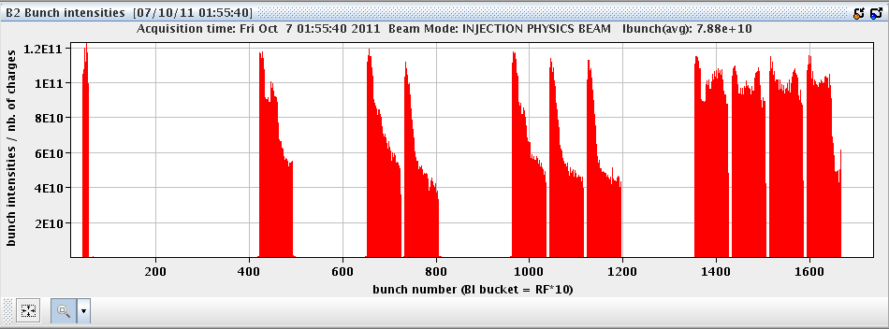
B2 bunch intensities – 732 bunches, 25ns

Slide 8
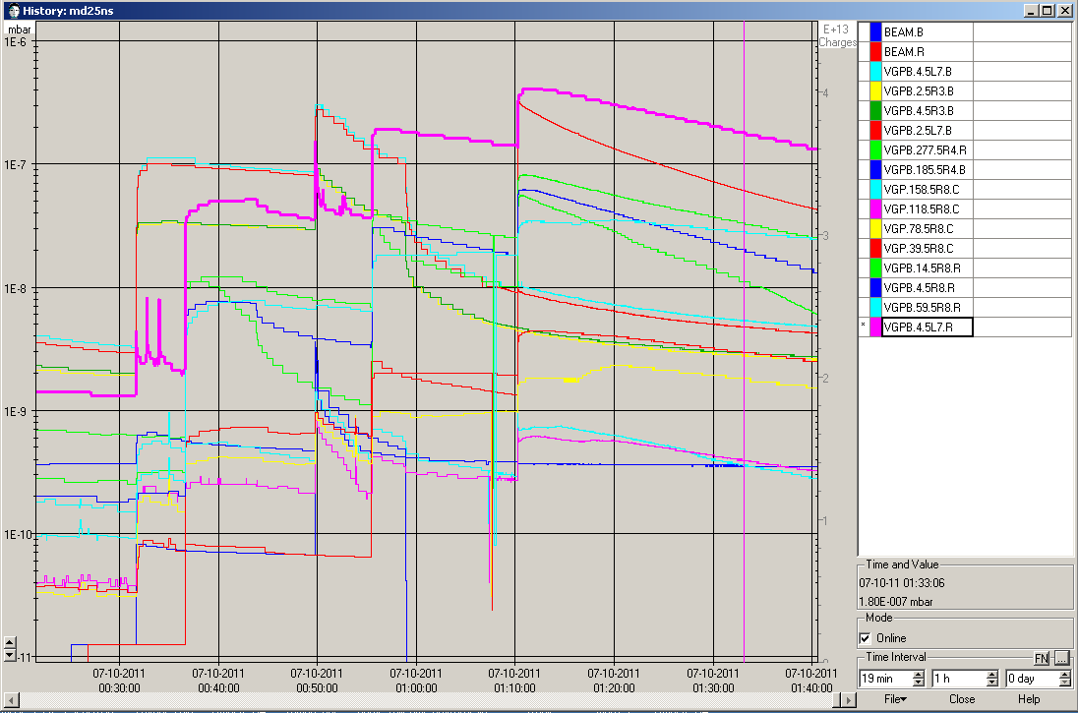

Slide 9
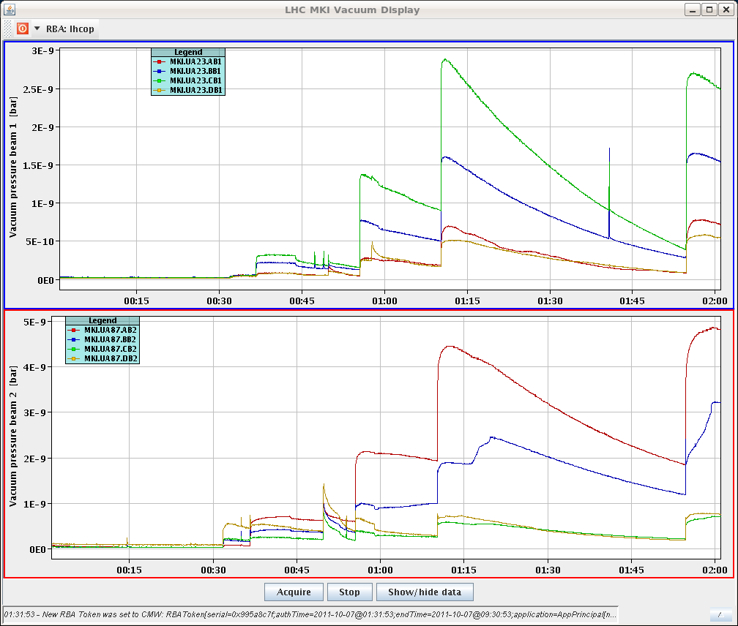

Slide 10
Physics with 25ns
02:30 prepare for physics with 25ns and 60 bunches
5:23 stable beams
Emittances in collisions calculated from luminosity: 3.2 – 3.3um
Bunch length: 1.32/1.38 ns (1.2 ns with 50 ns spacing)
Lifetimes: 125 hours

Slide 11
