Slide 1
Wednesday
Validation campaign finished Wednesday morning.
Analysis of collision loss maps with RPs pending. Small losses seen at RP BLMs – checks ongoing,
Condition | Betatron H | Betatron V | Dp/p + | Dp/p - | Dump
Injection | OK | OK | OK | OK | OK
Flat top | OK | OK | --- | --- | OK
Squeezed | OK | OK | --- | --- | OK
Collisions | OK | OK | OK | OK | OK

Slide 2
Injection of beam1
Since we inverted the ALICE polarity we have observed abnormal losses at and behind the TCLIA.R2.
Dump trigger from losses collected by the beam2 TCTH.
ALICE
TDI
TCLIA
TCTH.B2
triplet
triplet
Q4

Slide 3
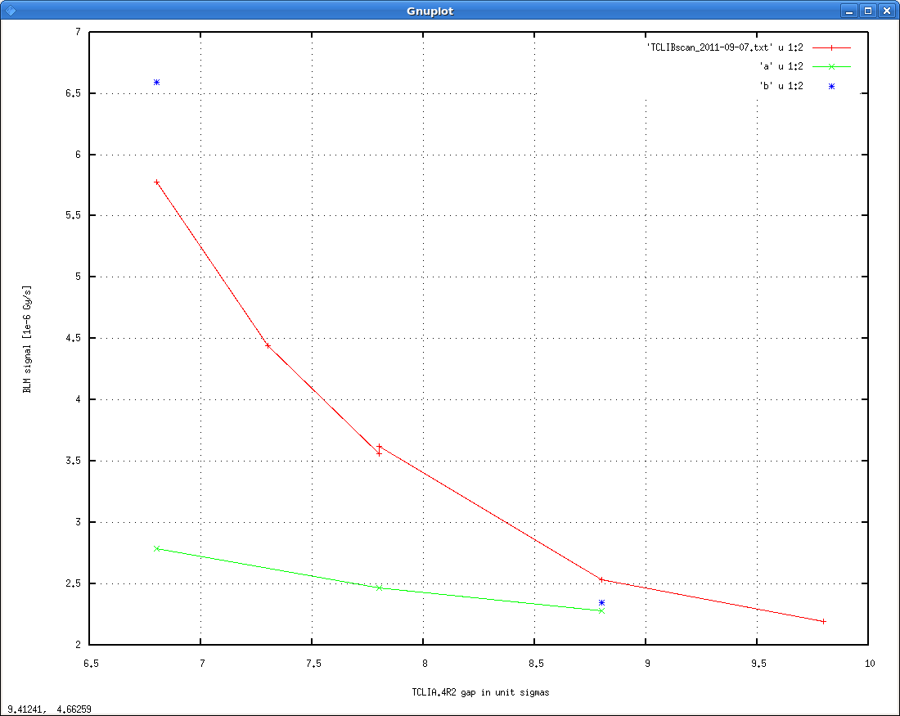
TCLIA issue
Scan of the gap – losses go down when opened.
Most sensitive to the lower jaw.
Lower jaw
Upper jaw

Slide 4
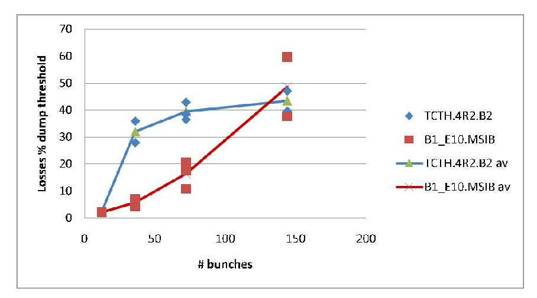
TCLIA issue
Scanned the aperture around TCLIA.
No apparent obstacle found in front of TCLIA.
Opened lower jaw by 1 sigma, then scan of number of bunches.
Similar losses were found during August, they were just a factor 2 or so lower.

Slide 5
Wednesday
Filled with 264 bunches for first stable beams.
Lower jaw of TCLIA opened by 1 sigma.
14:30 Fill #2083 L = 5.8E32 cm-2s-1.
Luminosity consistent with beta* of 1m and emittance of 2.1 um.
20:30 Dumped #2083, 10 pb-1.
Access for ALICE during ramp-down.
Refill for 480 bunches.
Some small steering done – generally OK for injection.

Slide 6
Night
00:00 Fill#2084 L = 9.4E32 cm-2s-1.
02:30 Ventilation door UL44 opens !
Similar event before TS (twice within 2 hours).
We can carry on but cannot give access to UX45 before this door is closed.
06:00 Dump 15 pb-1.
Refill for 912b – long fill.
ATLAS scan for event rate (tbc).
Followed by fill with 1380 bunches.

