Slide 1
Week 36 plan
Todo’s:
12+b injection.
Special fill 84b for LR BB.
Loss maps ‘a gogo’.
Intensity ramp up.
And also:
Define ALFA and TOTEM RP settings, prepare them in LSA.

Slide 2
Part1: work with 50 ns
Injection of 50 ns.
Injection of 12b, steering if needed.
Injection of 36,72,144 to checkout injection.
Special fill for LR beam-beam.
12 + 2x36 bunches, Scheme 50ns_84b_36_36_36_BBMD3.
Ramp, squeeze, collide: stability, lifetime.
In collisions for ~1 hour.
Done
Done – to be checked

Slide 3
Part 2: validation / loss maps
Loss maps injection.
Betatron H + V, off-momentum +/-, asynch dump.
Fresh beams for each test.
Swap H and V tunes for H loss map.
Loss maps at flat top (unsqueezed) – 1 fill.
Betatron H + V, asynch dump.
Loss maps end of squeeze to 1m (separated !) – 1 fill.
Betatron H + V, asynch dump.
Loss maps with collisions – 1 fill.
ALFA and TOTEM RPs in beam.
Betatron H + V, asynch dump.
Loss maps with collisions – 1 fill.
ALFA and TOTEM RPs in beam –1-2 hours (data taking test)
Off-momentum test dp/p + (RF frequency trim -500 Hz).
Almost done
½ Done
Done

Slide 4
Part 3: intensity ramp up
Ramp up for stable beams:
264 – few hours
480 – short fill
912 – long fill
1380 – finally !!

Slide 5
Monday
10:30 Fill for loss map with TCTs @ 14 sigma (end of squeeze, separated) lost just before starting the loss maps.
Sector 56 tripped – network communication was cut by accident during an intervention…
Retry…
14:30 Loss map and asynch. dump test with TCTs @ 14 sigma (end of squeeze, separated).
Good results – confirm that triplet in shadow with 14 sigma.

Slide 6
Validations with TCTs at 14 sigma
Asynch. dump test OK (C. Bracco).
Collimation - preliminary analysis (D. Wollmann):
All loss maps look ok:
Leakage into the TCTs below 1e-3.
Leakage into cold magnets in IR1/IR5 ~ 1 order of magnitude below the corresponding TCT.
No un-expected losses into cold magnets.
Couldn't reproduce the leakage into the Q10R1 (as reported Saturday night).
Highest leakage into cold magnets found in Q8 of IR7: - B1-H: ~3.5e-4 - B1-V: ~2.5e-4 - B2-H: ~5e-4 - B2-V: ~2.5e-4

Slide 7
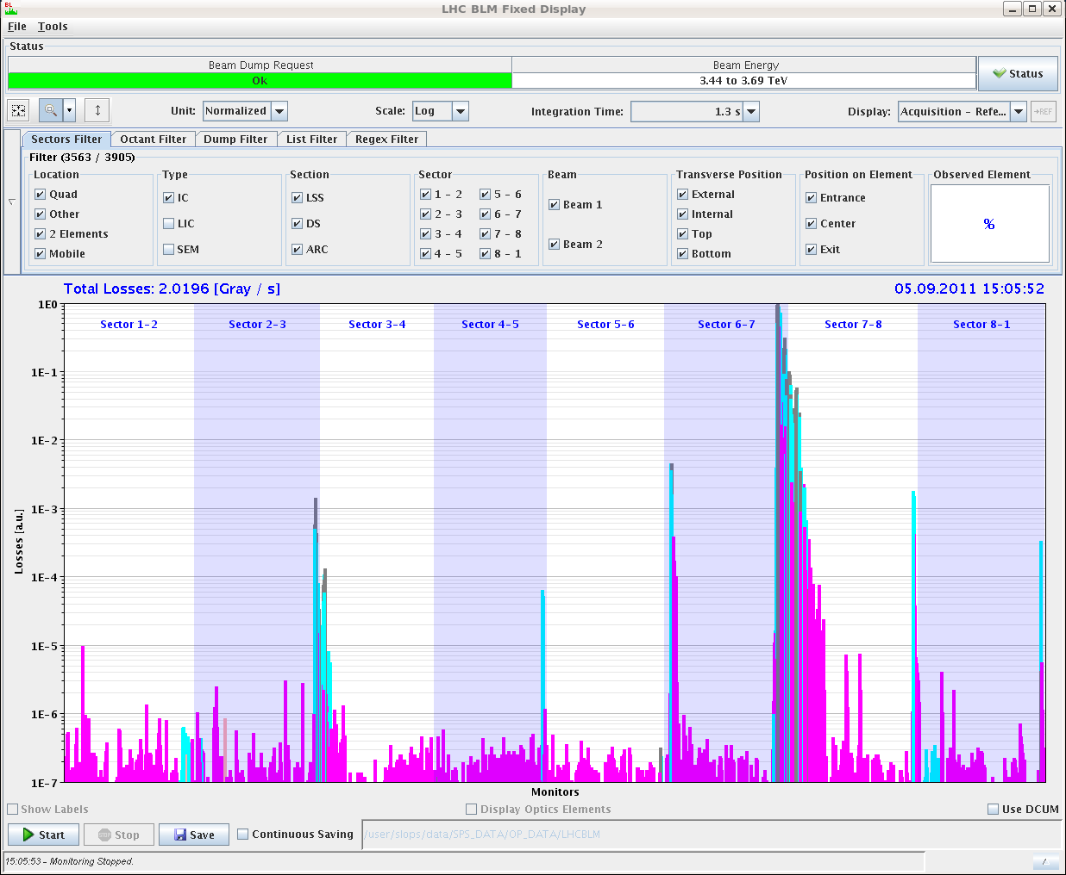
B1 H

Slide 8
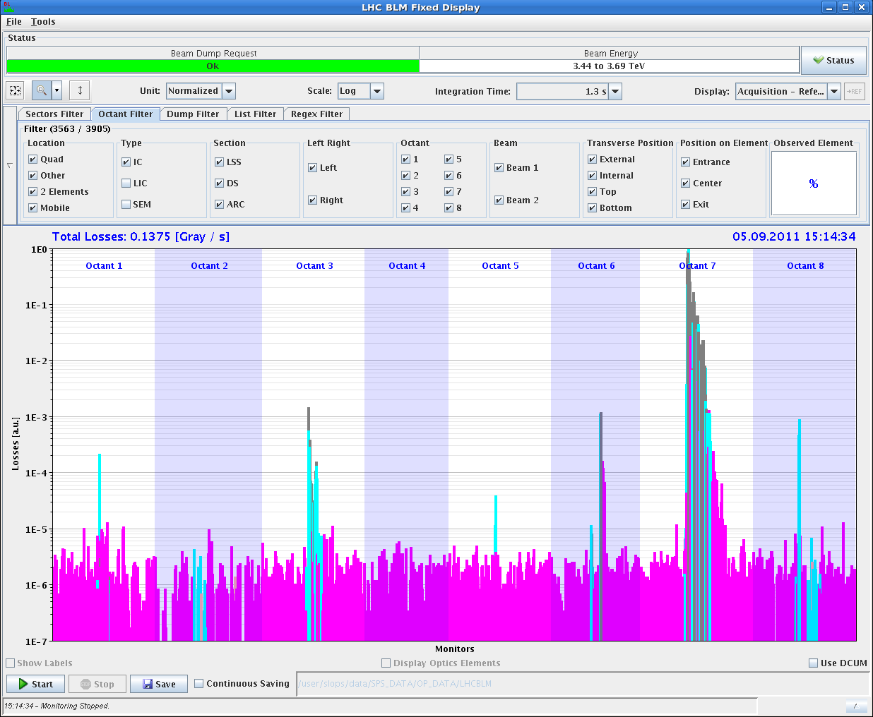
B1 V

Slide 9
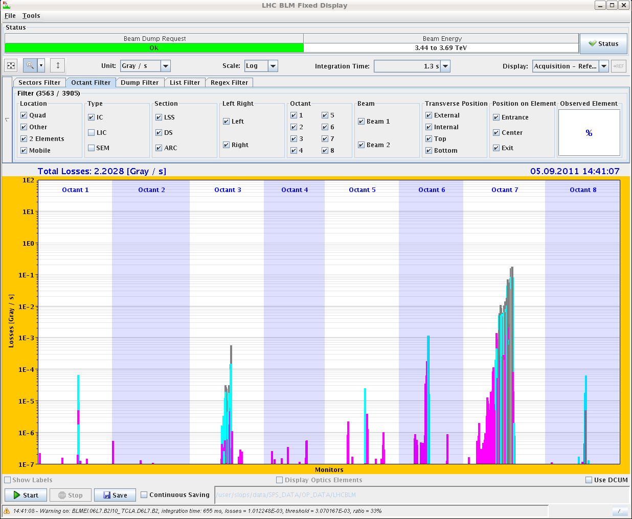
B2 H

Slide 10
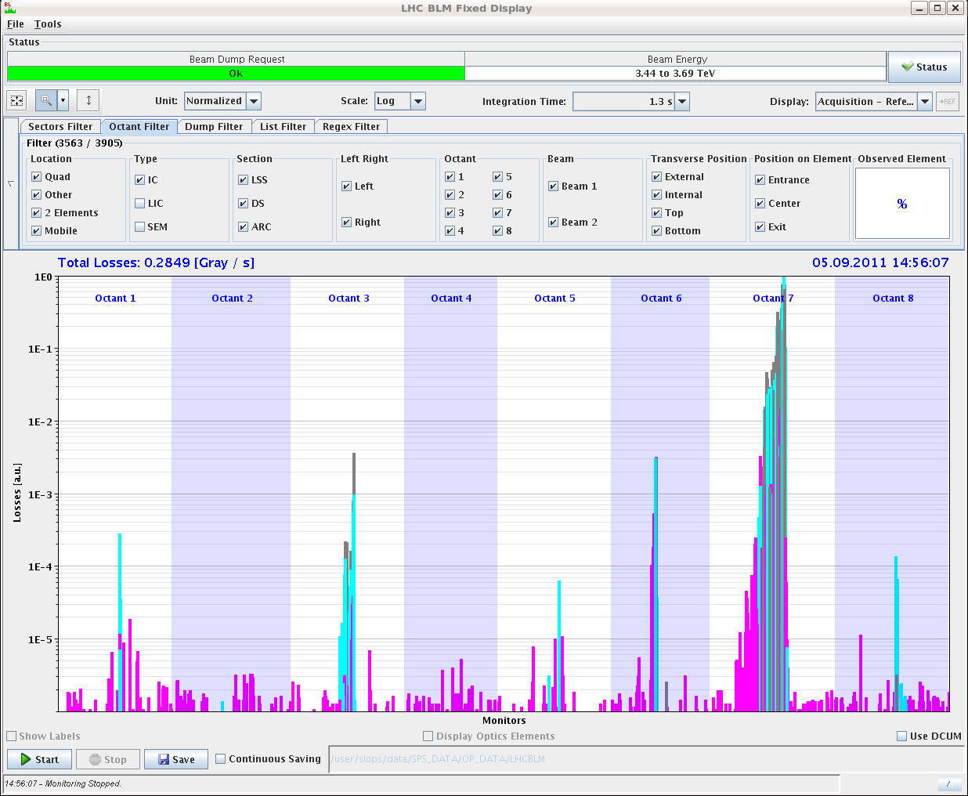
B2 V

Slide 11
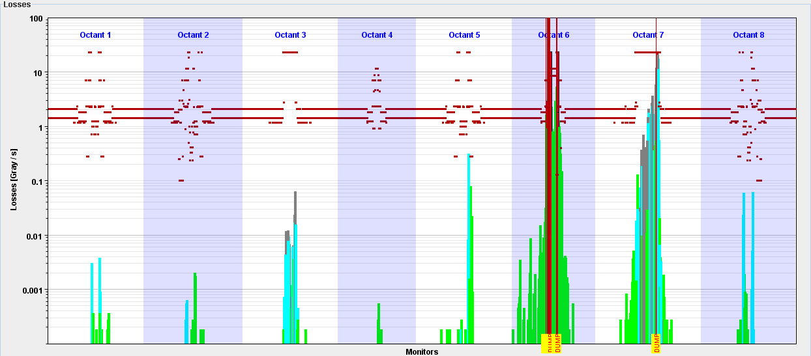
Asynch dump, TCTs @ 14 sigma.
No losses visible in triplets.

Slide 12
Monday continued
16:00 Injection setup.
Verification of the magnet synchronization of B1 (E. Carlier)
Kick delay - MAIN-D : no change (reference magnet for synchronisation) - MAIN-C : -75ns (old delay: 1100ns - new delay: 1025ns) - MAIN-B : +10ns (old delay: 1140ns - new delay: 1150ns) - MAIN-A : no change
Kick length - DUMP-D : no change - DUMP-C : +95ns (old delay: 1000ns - new delay: 1095ns) - DUMP-B : +50ns (old delay: 1090ns - new delay: 1140ns) - DUMP-A : +100ns (old delay: 1000ns - new delay: 1100ns)
17:00 Injection check 12b.
OK – no problems.

Slide 13
Monday continued
18:15 Lost the cryogenics conditions for MSL2 and ITL2.
Worldfip communication problem.
18:50 Vacuum valves in LSS2.
Gauge switched off.
21:00 Back to injection.
Injection of up to 144b – worked but not at its best.
Losses from circulating beam (tbc), and some injection oscillations.
00:00 Loss maps at injection.
Injection protection out.
H and V were not done with separate beams → repeat.

Slide 14
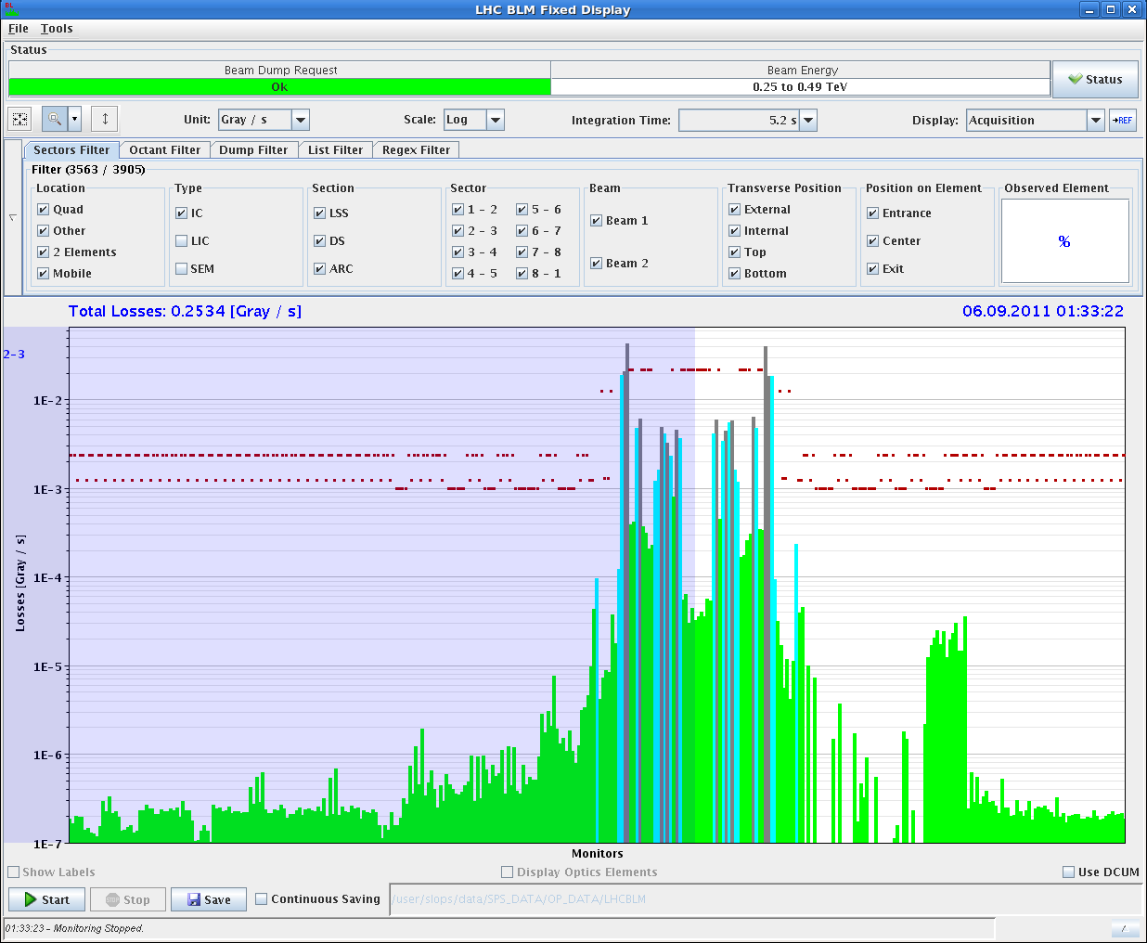
Off-momentum loss map at injection.
HV problem? Re-cabled BLM?

Slide 15
Night
00:20 Loss maps at flat top.
Betatron H + V.
B1 lost before asynch. dump test by spurious SIS interlock.
Asynch. dump to be repeated.
Lot’s of CMW errors… including SIS interlock.
05:30 Loss maps at end of squeeze.
Betatron H+V ansd asynch dump test.

Slide 16
Validation matrix
Injection to be done also with injection protection (betatron)
Condition | Betatron H | Betatron V | Dp/p + | Dp/p - | Dump
Injection | DONE | REPEAT | DONE | DONE | DONE
Flat top | DONE | DONE | --- | --- | REPEAT
Squeezed | DONE | DONE | --- | --- | DONE
Collisions | OK | X | X | OK | X

Slide 17
Today
Finishing injection loss maps now.
Long range BB test with 84b.
Injection checkout to 144b.
Continue loss maps / repeat if not good.
IR3 R-side BLMs.
Collision maps with RPs.

Slide 18
Accelerator Mode
Name in the database & over DIP ➔
PROTON-NUCLEUS PHYSICS
Name in the timing telegram = AMODE ➔
Line = PAPHYS, value=16
Particle Type
New groups! With name in the timing telegram ➔
PARTY1 (= particle type for B1)
PARTY2 (= particle type for B2)
PARTY1(2) is group number=23(24)
Lines ➔
Over DIP you see them under RunControl/RunConfiguration:
PARTICLE_TYPE_B1 & PARTICLE_TYPE_B2
Proton (Proton), value=1
Pb82 (Lead 82+), value=2
Ar18 (Argon 18+), value=3
D (Deuteron), value=4
Xe54 (Xenon 54+), value=5
The bold names are used in the database
(what you see over DIP)

Slide 19
The following telegram groups have been suppressed
23 | C1BNCH | Circulating number of bunches - Ring 1
24 | C1BSP | Circulating bunch spacing - Ring 1
25 | C1BIN | Circulating bunch intensity - Ring 1
26 | CPTY | Circulating particle type - Ring 1 and 2
27 | C2BNCH | Circulating number of bunches - Ring 2
28 | C2BSP | Circulating bunch spacing - Ring 2
29 | C2BIN | Circulating bunch intensity - Ring 2

