Slide 1
Plan for 1 m b*
J. Uythoven & J. Wenninger
With input from rMPP, W. Herr, R. Bruce, M. Giovannozzi, S. Redaelli

Slide 2
Startup with beam
This evening between 19-20 if all goes well.
In the SPS a quadrupole was exchanged (H foc.). There is a slight orbit perturbation (too small for the surveyors to correct, < 0.1 mm) that we will have to steer back some time over the WE.

Slide 3
Aperture @ 1 m
Simple scaling – just to check if it even makes sense…
Just about right for 18σ, σ = nom. Emittance.
Aperture @ 1.5 m (sigma) | 18 | 20
Beam size ratio 1.5/1 m | 0.80 | 0.80
Raw scaling to 1 m by beam size (sigma) | 14.4 | 16
Xing angle change (mm) for 120 urad* | 0.25 | 0.25
Aperture @ 1 m, 120 urad (sigma) | 14.2 | 15.8
Peak σ @ triplet = 1.42 mm (3.5 μm emit)
* @ the BPMs

Slide 4
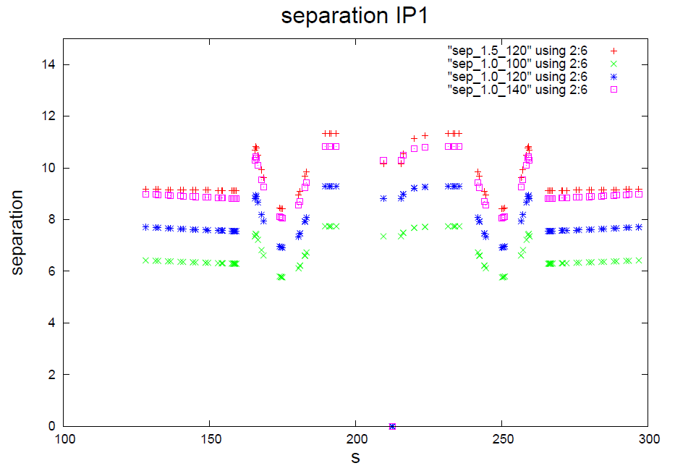
Beam-beam separation
Beam-beam separation down below 6σ for 100 μrad
With 120 μrad ~ equivalent to nominal (β* 0.55 m)
Triplet
Triplet
W. Herr

Slide 5
The commissioning blocks
Configuration:
β* 1m, 120 μrad Xing angles.
IR6+7 collimators at standard settings, TCTs 11.8σ (IR1+5+8)
Block A: aperture at 1m and 120 μrad
This block may change depending on the results !
Block B: ALICE polarity reversal
Block C: Validation
Block D: Intensity ramp up

Slide 6
Block A : aperture check
Fill 1: 1 probe/beam, checkout cycle.
b* 1 m and Xing angle 120 μrad.
Standard collimator settings IR6+7.
TCTs IR1/5 to be adapted to 120 μrad (setup on 100 μrad).
Fill 2: 2 nominals/beam, TCT alignment, orbit.
TCTs IR1/5 alignment on 120 μrad, separated and in collision.
Collision (re-)optimization with 120 μrad, reference orbit.
End with loss map (H+V) and asynch dump. TCTs are 11.8σ.
Fill 3: 1 probe/beam, aperture check @ 1 m.
Repeat aperture measurement at 1 m.
End with a loss map H, TCTs at 14σ.
Fill 4: 1 probe/beam, aperture check with loss map.
Loss map with TCTs at Xσ, X = 13…14.
4h
6h
8h
5h

Slide 7
Block A: long range BB check
Fill 5: 84b with highly asymmetric BB filling pattern (also used for 1 m with 100 μrad).
Bring the beam up to collisions.
Verify stability and beam-beam effects.
6h

Slide 8
Block B : ALICE polarity
Step 1: adjust injection, reference.
ALICE on ‘old’ polarity.
Injection steering with 12b, then copy to probe and check it.
Step 2: revert ALICE polarity.
Check/correct orbit.
Check/steer injection oscillations with probe, repeat with nominal.
Step 2’: re-steer TI2 if necessary.
TDI coarse
TL setup, TCDI alignment and verification.
Step 3: TDI/TCLI alignment.
TDI/TCLI alignment with 1 nominal b.
Check TDI,TCLI setup.
Check injection 12b.
2h
4h
12h
If required, ‘alternate’ with TCT alignment (steps 4-6)
8h

Slide 9
Block B : ALICE polarity continued
Step 4: TCTs IR2 at injection.
Setup TCTs in IR2 at injection.
Step 5: Checkout cycle, 2 probes/beam.
Check Xing angle IR2 along the cycle.
Correct orbit if necessary.
TCTs IR2 ‘open’.
Step 6: TCT IR2 alignment cycle, 2 nominal b/beam.
TCT alignment on flat top and in collision.
Collision orbit, reference.
Loss map H+V and asynch. dump.
(Step 7: TCT IR2 functions, positions and interlocks )
2h
4h
6h

Slide 10
Block C
Validations (loss maps, asynch dump checks) – to be confirmed with collimation team (Dp/p)
Condition | Betatron H | Betatron V | Dp/p + | Dp/p - | Dump
Injection | X | X | X | X | X
Flat top | X | X | X | X | X
Squeezed | X | X | X | X | X
Collisions | X | X | X | X | X

Slide 11
Block D: Intensity ramp up
Proposed ramp up for stable beams:
48b – short fill
264 – short fill
480 – short fill
912 – long fill
1380 – finally !!

