Slide 1
Technical Stop #4 29th August - 2nd September 2011
Day 3
Julie Coupard
Schedule and Coordination

Slide 2
Summary after Day 3
Cryogenics
Done Intervention on oil pipes @Pt6 on surface
Cabling
Ongoing BLM @Pt3
Ongoing NG18 replacement @Pt3
Ongoing Thermo-switch @Pt1&2
Ongoing Monitoring cryo @Pt4
Beam Instrumentation
Ongoing BLM: Direct beam dump connection to dump system
BPM: New firmware and SW to increase IIR filter order
Kickers
Done Change of generator pos K @Pt6 – revalidation tests ongoing
Done Change of generator HV switch @Pt2 – revalidation tests ongoing
Machine Protection
Done Adjustment of 600 A Energy Extraction Switches
DQEMC.UA63.RQTD.A56B1 – test to perform
DQEMC.UA43.RCS.A34B1 – test to perform

Slide 3
Powering Tests
Circuit | Test | Current | Length | Constraints | UPS | DFB concerned | Patrol | CRYO OK | Lock | When
RCBCV9.R3B2 | R meas (MP3) |  |  | These tests will be done during the day with very low current and presence of people | P3 P4 |  | NO | A34 | NO | Mon
RCBCH7.R3B1 | R meas (MP3) |  |  |  | P3 P4 |  | NO | A34 | NO | Mon
RD3.R4 | ISRM meas (MP3) | ~3000 A | 2h | ElQA after PXI inst | P4 | DFBMK | P 4 5 6 | MR4 | NO | Wed
RD4.R4, RQ5.R4 | ISRM meas (MP3) | ~3000 A | 2h | ElQA after PXI inst | P4 | DFBML | P 4 5 6 | MR4 | NO | Wed
RQ6.R4 | ISRM meas (MP3) | ~3000 A | 2h | ElQA after PXI inst | P6 | DFBMG | P 6 7 8 | MR4 | NO | Thu
RQD/F.A56 | Quench propagation test | I_nom | tbd | Powering phase II | P5 P6 | DFBAJ DFBAK | P4 P5 P6 | A56 | NO | Wed (& Thu ???)
RQD/F.A45 | Multiple FPA | see below | 6h | Powering phase II | P4 P5 | DFBAH DFBAI | P4 P5 P6 | A45 | NO | Thu
RU.L4 | Test on zero-offset reset | 400 A | 2h |  | P4 | DFBME | NO | ML4 | NO | Thu

Slide 4
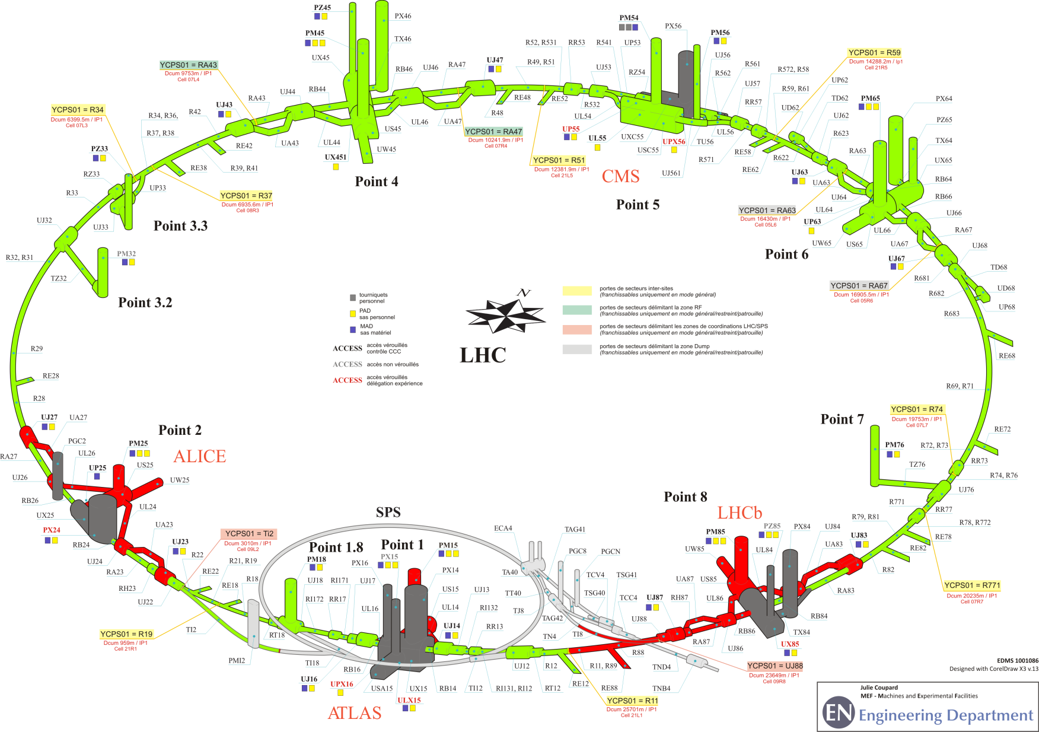
Status of patrol
Pt8
Thursday 17h
Pt1
Friday 17h
Pt2
Friday 7h30

Slide 5
Program for Friday
Deconsignation of injection lines (Ti2, Ti8) on Friday afternoon
Steve Hutchins will take the SPS keys for LHC extraction so the LHC will remain safe during the Patrols on Friday evening
Last patrols at 17h
Point 1
End of the Technical Stop around 18h30 (if no more patrols)
People in CCC to give the green light for beam : S.Hutchins
EIC : L.Ponce

